Slide 1
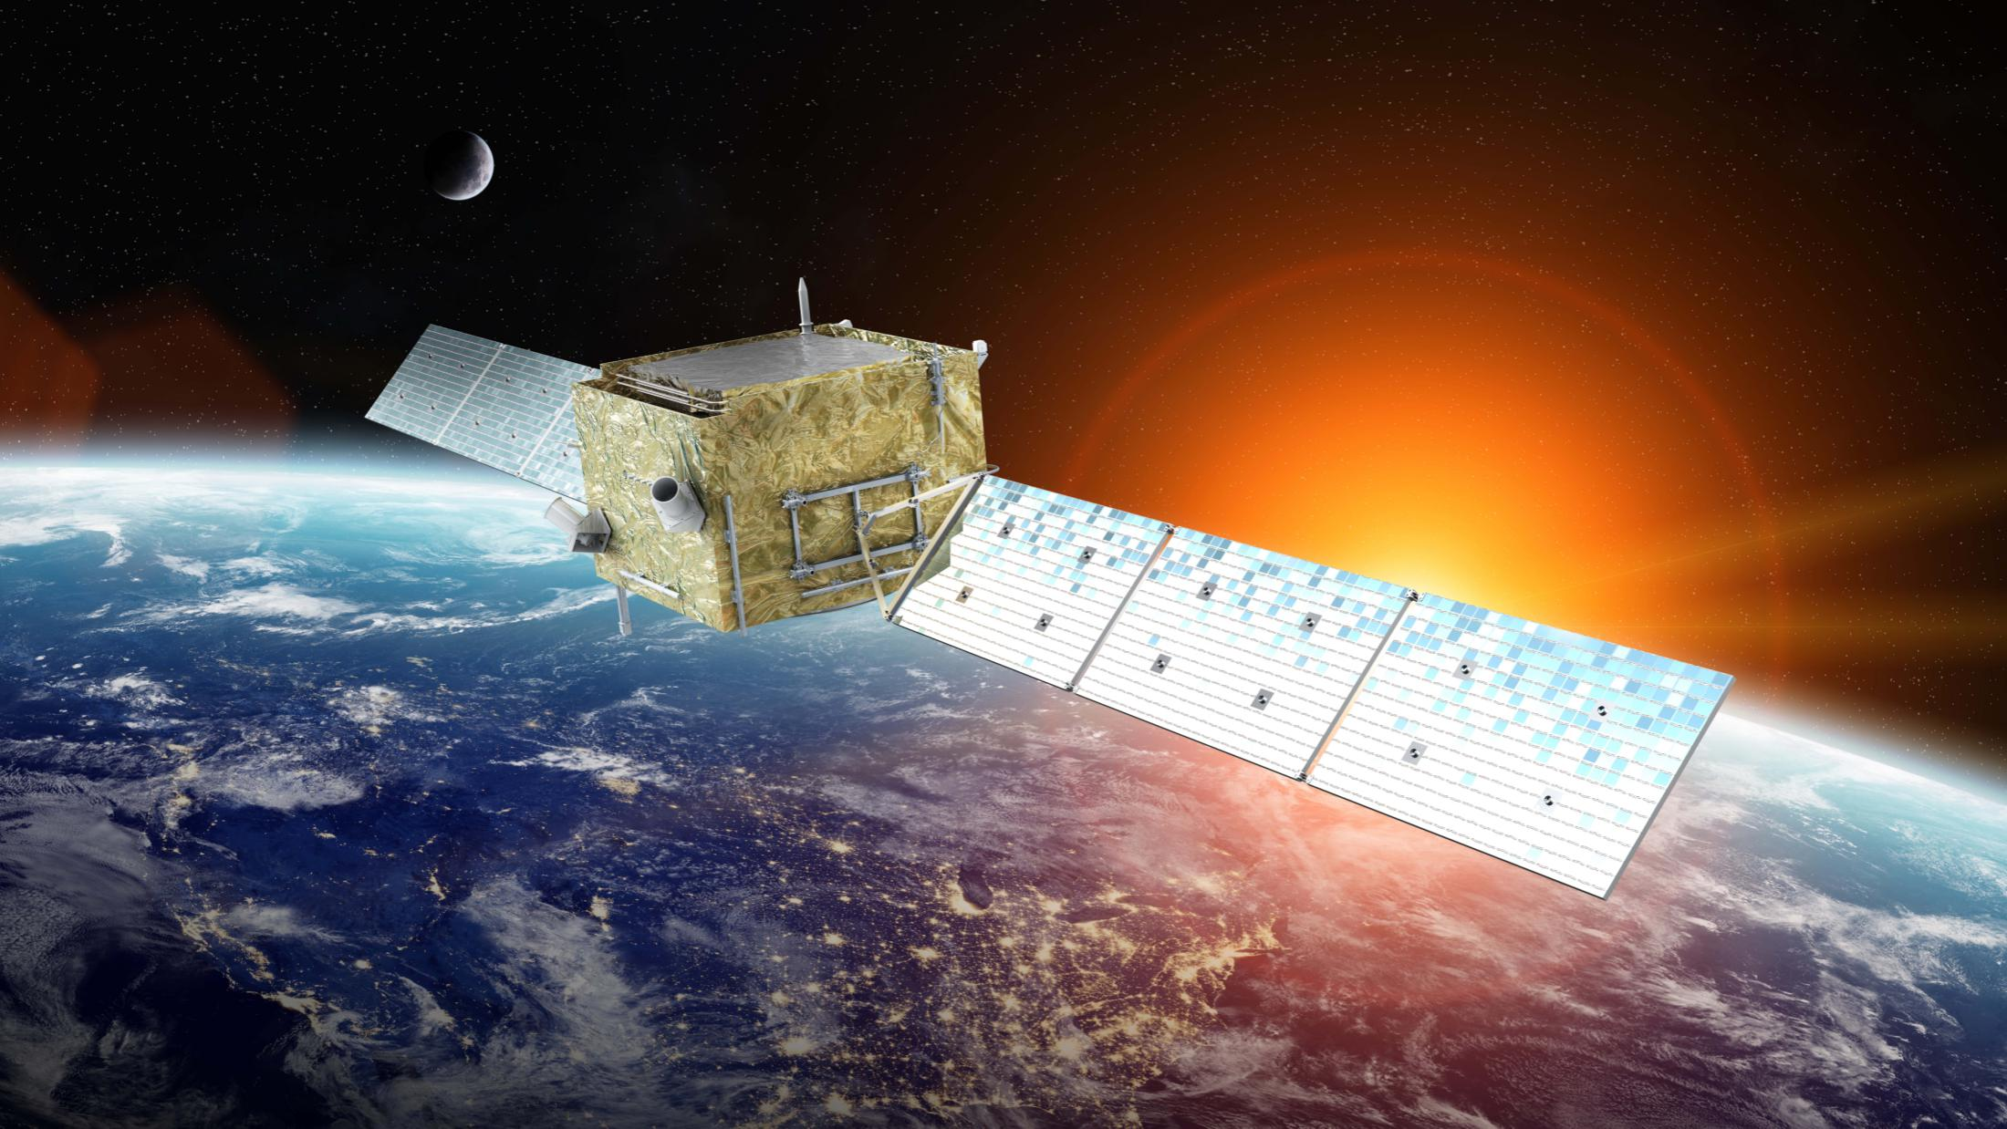
DAMPE and VLAST
Yi-Zhong Fan (范一中)
（Purple Mountain Observatory）
2025.12.17

Slide 2
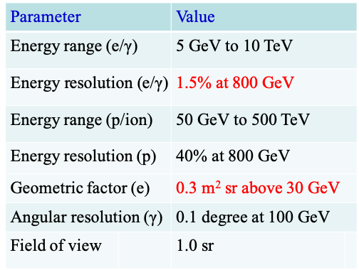
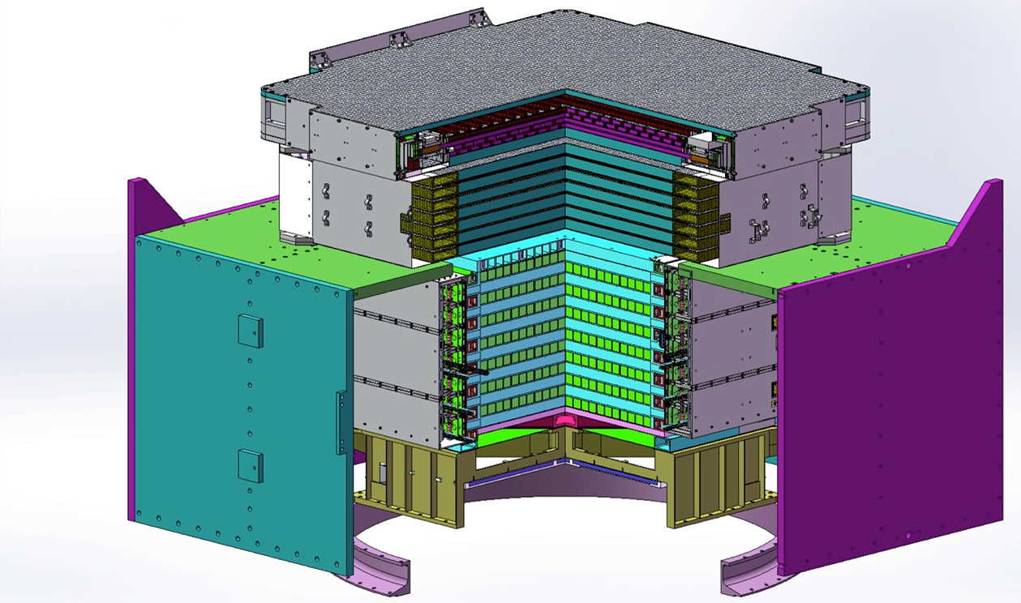
Dark Matter Particle Explorer (DAMPE)
Plastic Scintillator Detector
Silicon-Tungsten Tracker
BGO Calorimeter
Neutron Detector
Weight: 1.4 tons in total
Power: ~400 W
Launched on 2015.12.17，design life ~3 yrs，on-orbit 10 yrs
DAMPE, the first Chinese astronomical satellite, is a GeV-sub PeV cosmic ray and GeV-TeV gamma-ray detector

Slide 3
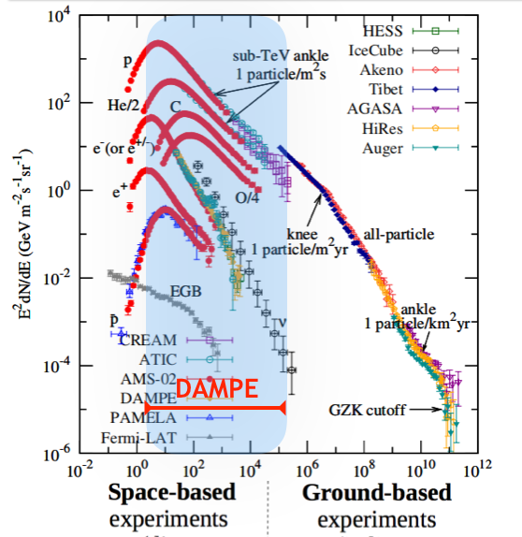
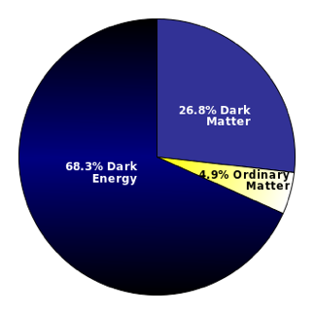
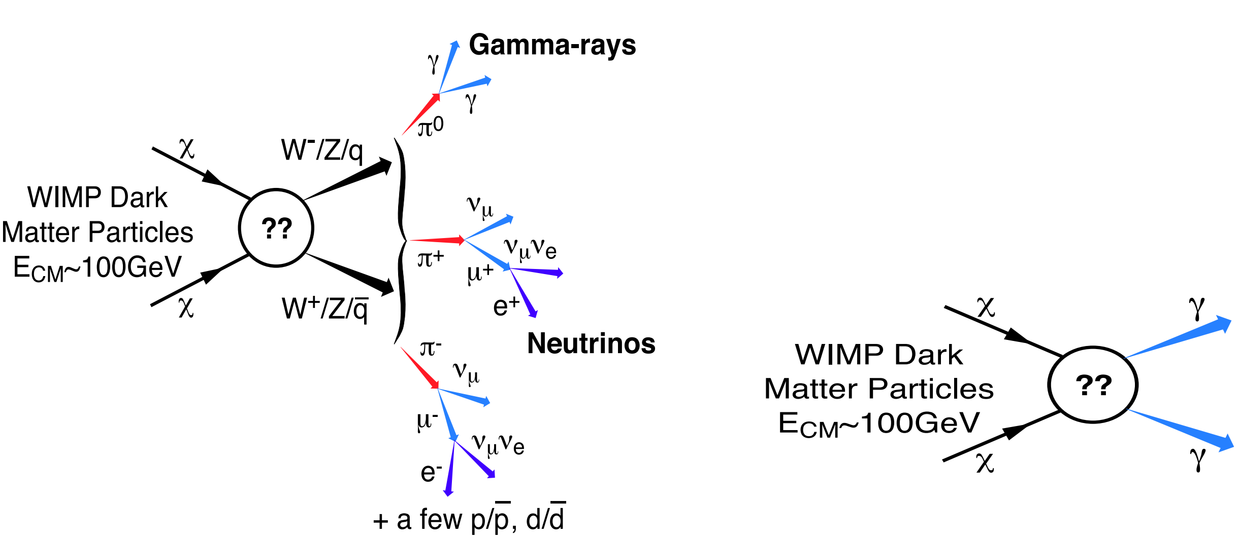
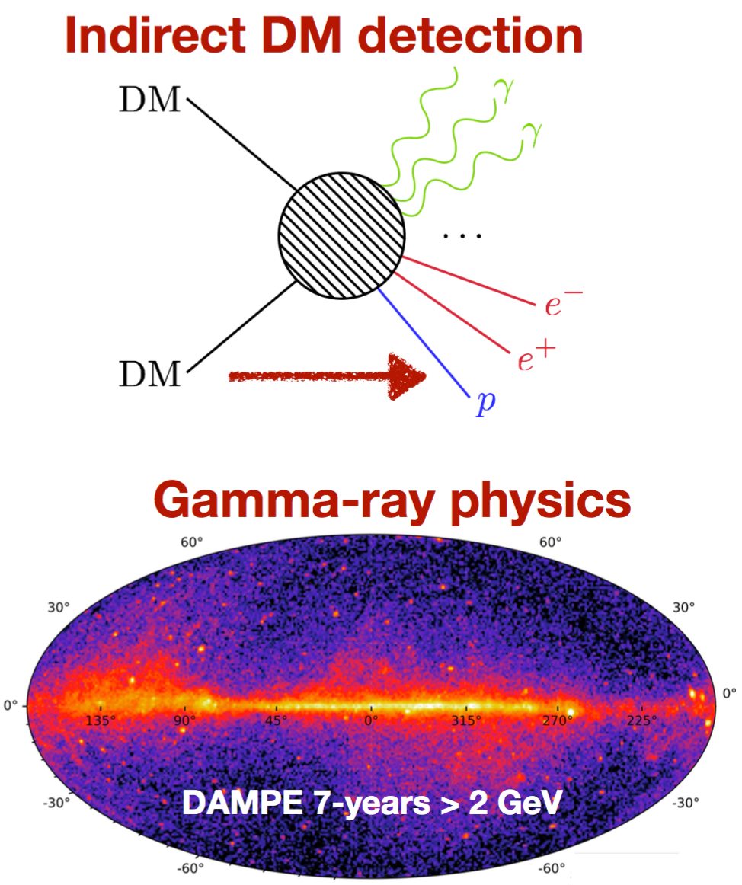
Scientific objectives of DAMPE
Cosmic-ray detection
Indirect DM detection
Gamma-ray astronomy

Slide 4
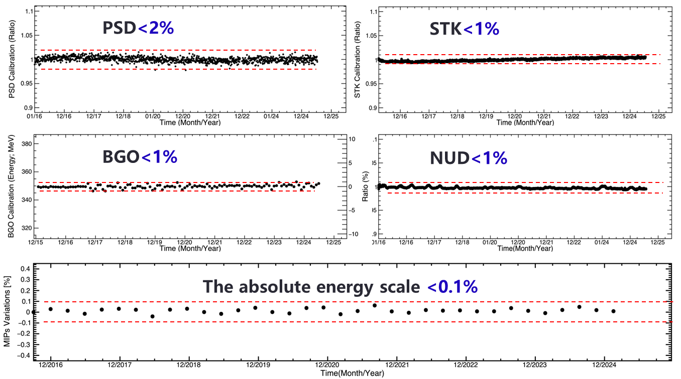
DAMPE works very stably

Slide 5
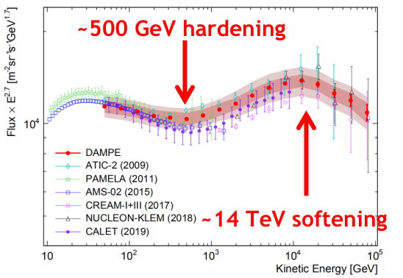
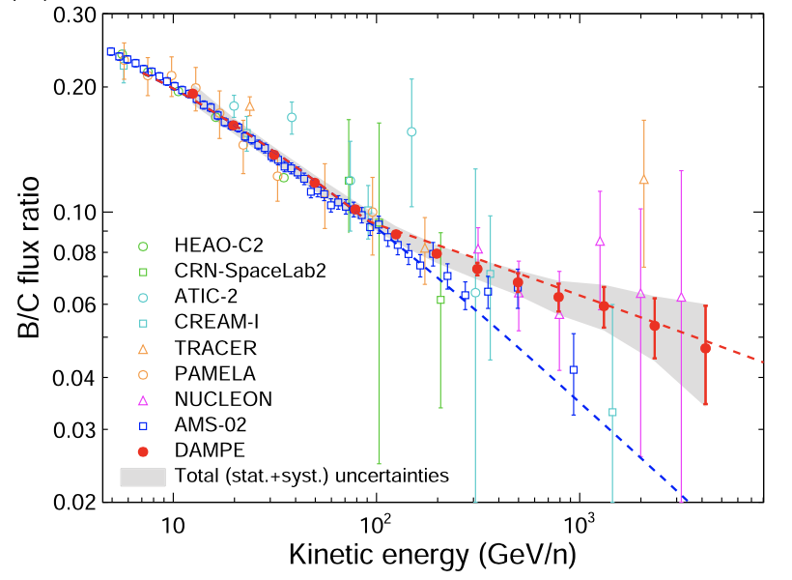
DAMPE: cosmic ray measurement results (1/2)
Electron spectrum Proton spectrum Boron-to-Carbon ratio
2015年12月17日发射
已平稳运行8年时间
excess
Canonical model
Left: the measurement of total electron spectrum up to ~5 TeV，resolving a sharp break (2017)
Middle: detection of the spectral softening of proton cosmic rays (2019)
Right: detecting the hardening of B/C ratio，which challenges the canonical CR propagation model proposed by Kolmogorov in 1941 (2022)

Slide 6
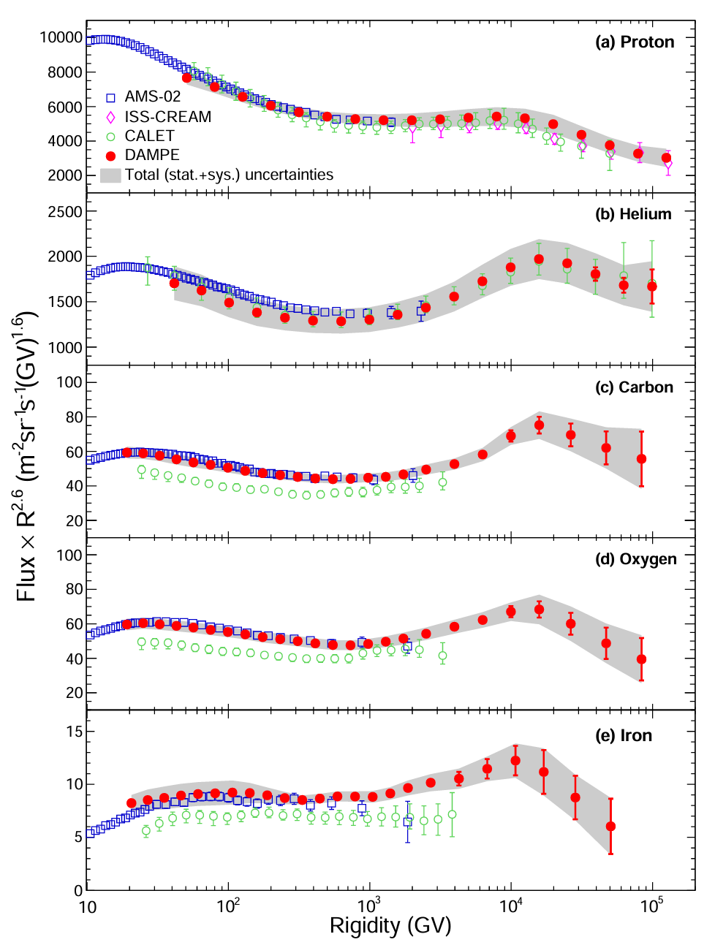
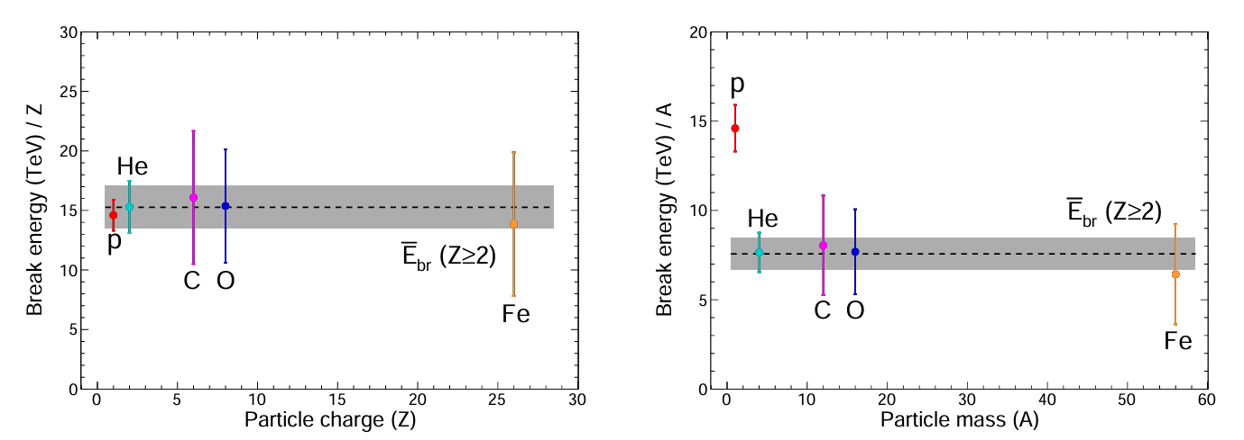
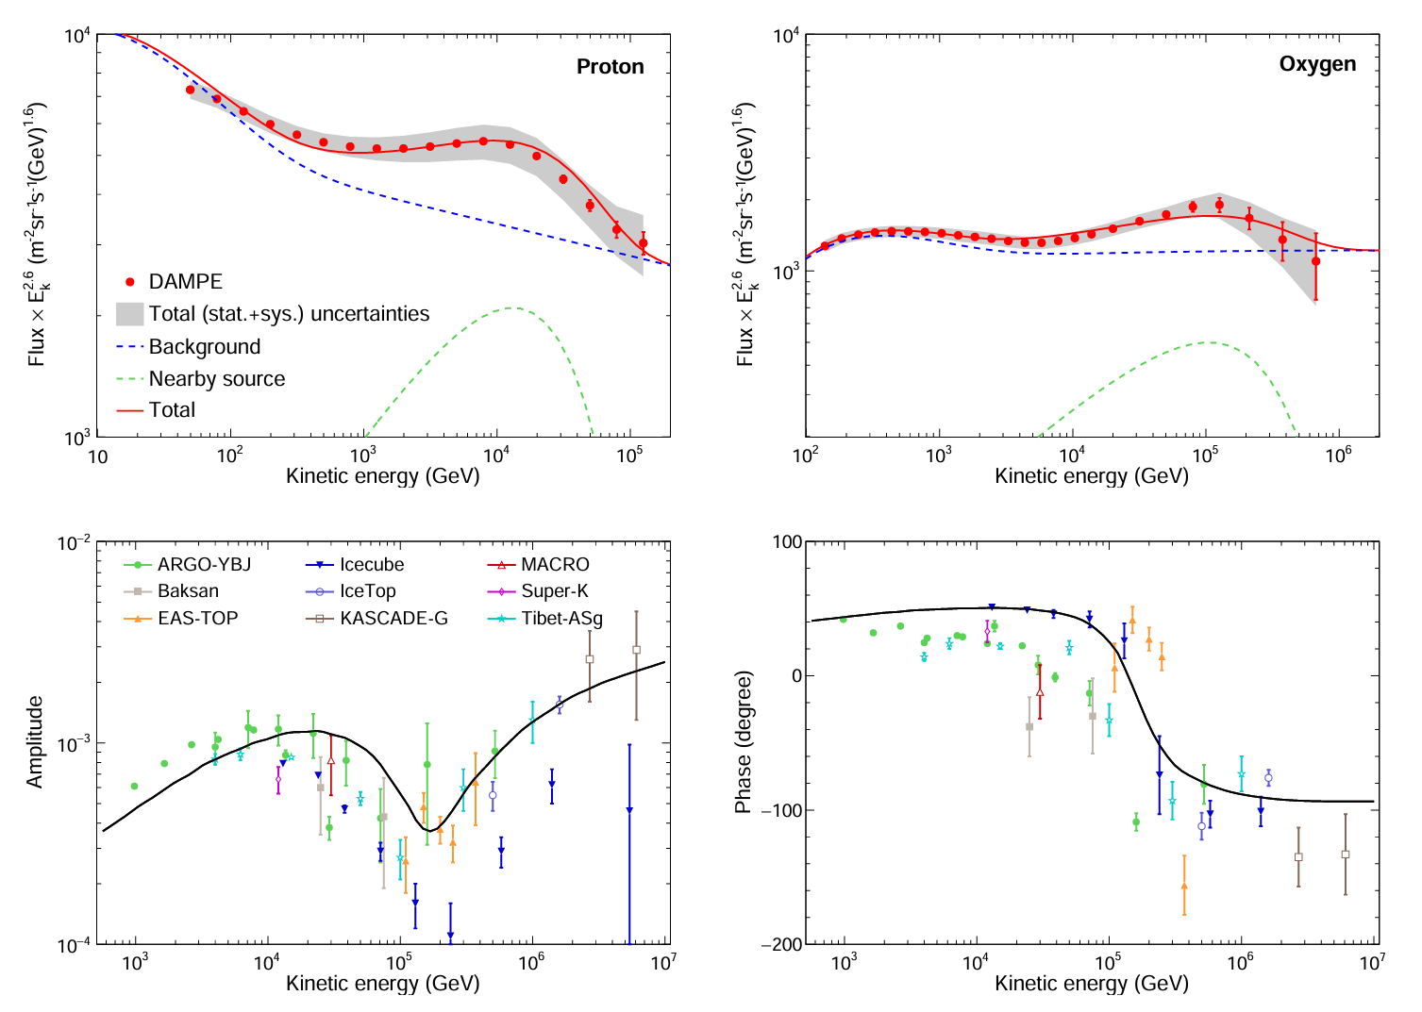
DAMPE: cosmic ray measurement results (2/2)
2015年12月17日发射
已平稳运行8年时间
Spectra: algebraic sum
DAMPE provides observational verification of the charge-dependent energy limit of the cosmic ray acceleration, a long-standing theoretical prediction since 1962 (DAMPE Coll. arXiv:2511.05409)
Anisotropy: vector sum

Slide 7
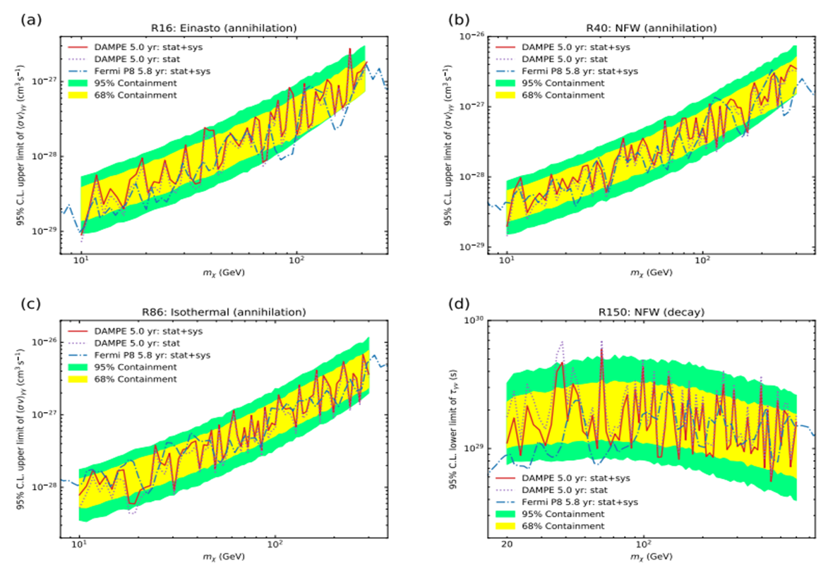
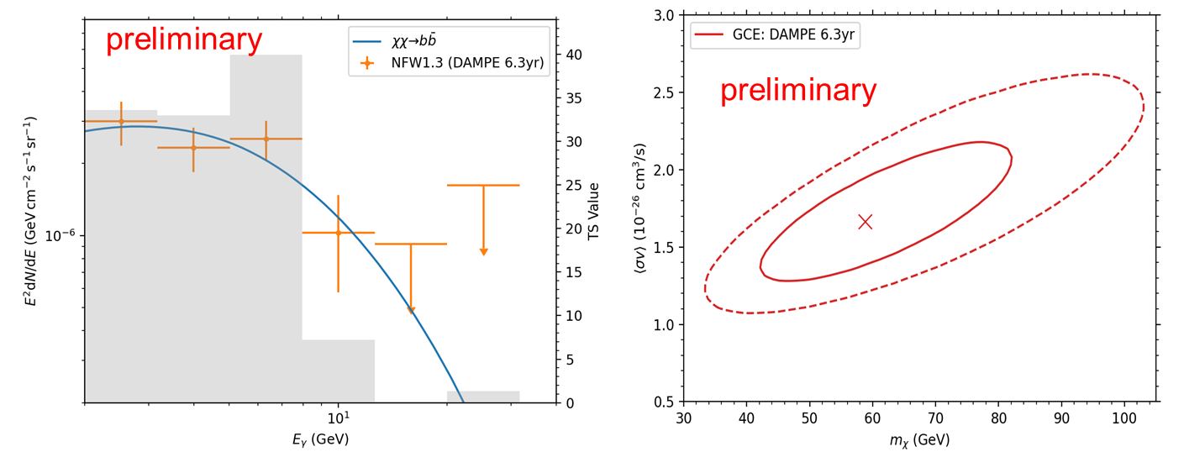
DAMPE: gamma ray measurement results
GeV line search GeV excess in the Galactic center
2015年12月17日发射
已平稳运行8年时间
Left: benefited from a very high energy resolution，it can achieve a better constraint on the dark matter annihilation/decay line emission than Fermi-LAT (DAMPE Coll. 2022 Sci. Bull.)
Right: We confirm the presence of a GeV excess in the Galactic center, which may be generated by the annihilation of ~50 GeV dark matter particles (2025 in prep.)

Slide 8
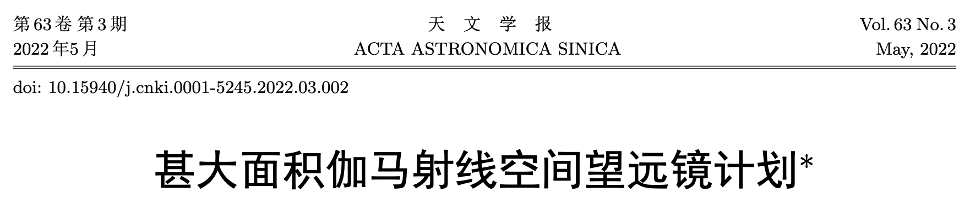
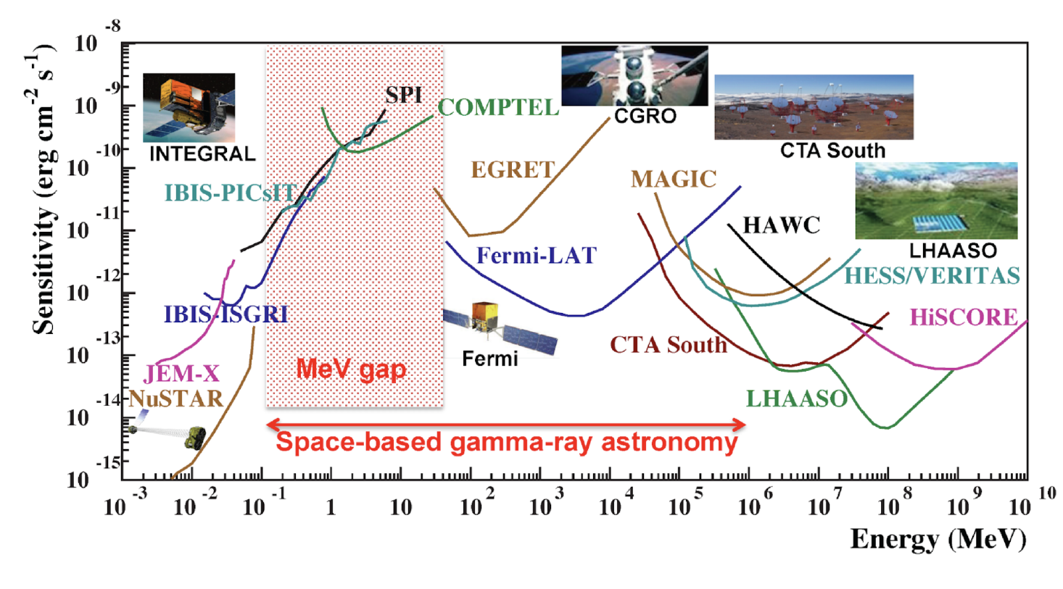
Very Large Area gamma-ray Space Telescope
Different from the CRs losing almost all information of initial direction, the γ-ray observation can resolve spatial distribution of the signal. The spectral + spatial information offer a much more robust clarification on the possible dark matter origin.
A very broad energy range: ~1MeV-10TeV

Slide 9
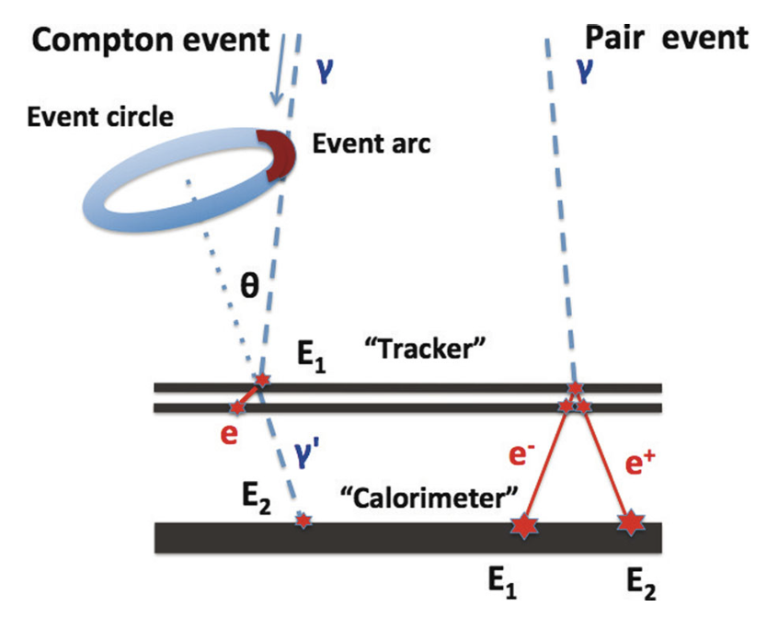
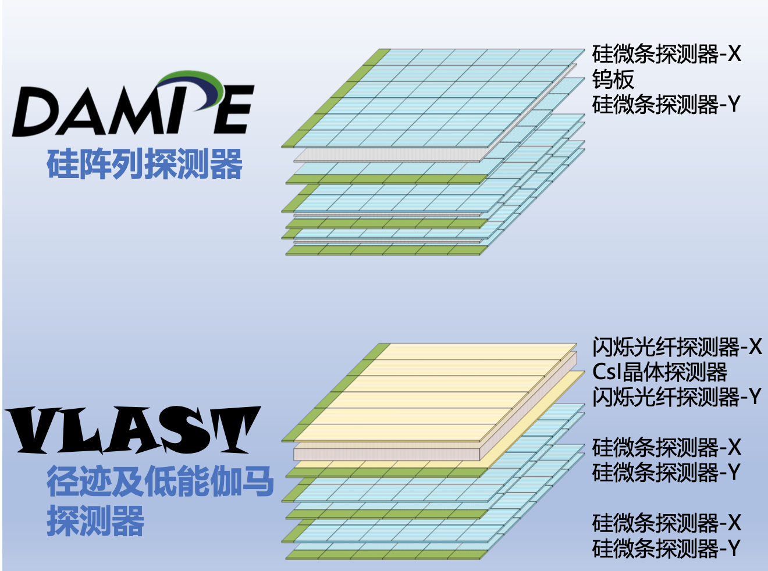
Very Large Area gamma-ray Space Telescope
Key design: replacing the tungsten layer in the silicon-strip detector by CsI, with which the MeV γ-rays can be measured via the Compton scattering

Slide 10
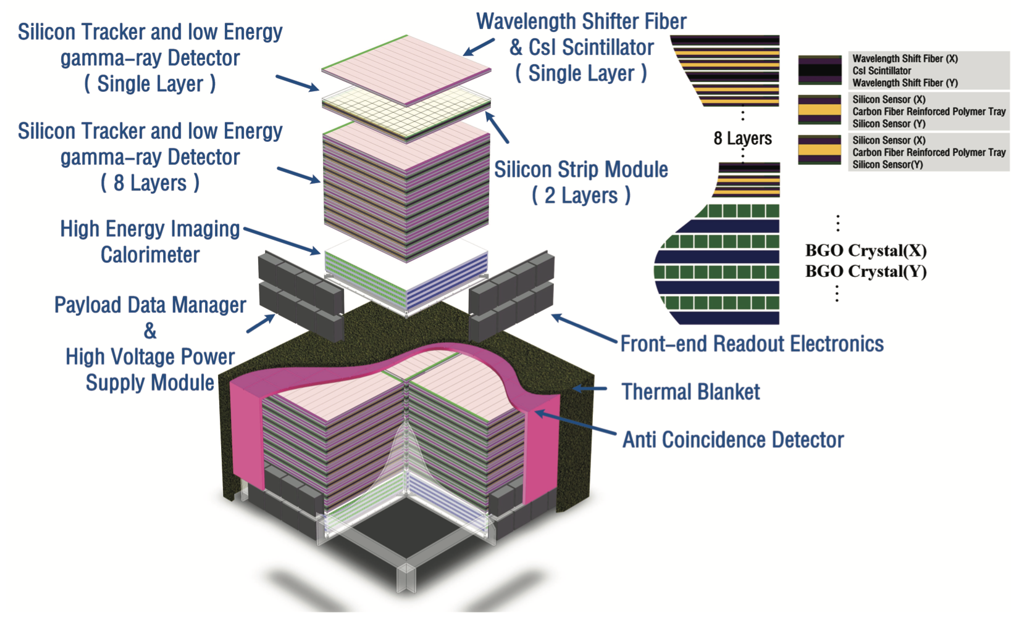
Very Large Area gamma-ray Space Telescope
Each sub-detector contains four units, each >1.2m×1.2m; Total weight~17 tons

Slide 11
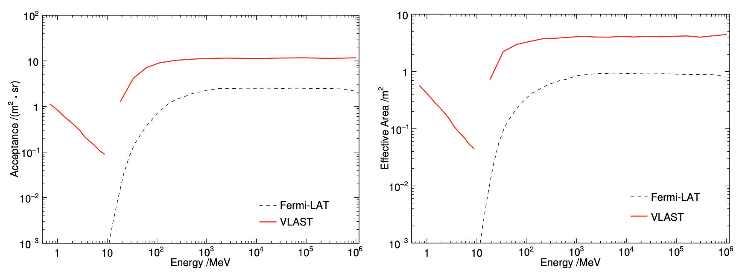
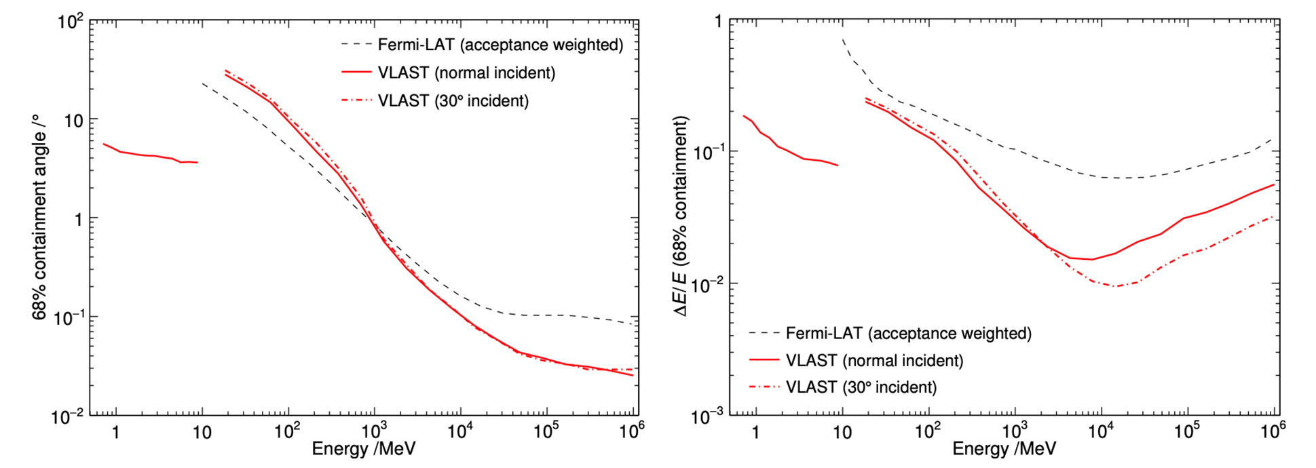
Very Large Area gamma-ray space telescope
Acceptance Energy resolution
In comparison with Fermi-LAT, VLAST has larger acceptance and higher energy resolution (Fan et al. 2022)
Notes:
We have carried out the simulations for the performance of VLAST. The left panel shows the acceptance. From GeV to TeV, the acceptance is about five times that of Fermi-LAT, while in the sub-GeV band, the enhancement is even larger. The right panel is for the energy resolution. VLAST has a thick calorimeter, so its energy resolution is better than Fermi-LAT. This is in particular the case in the high energy band.

Slide 12
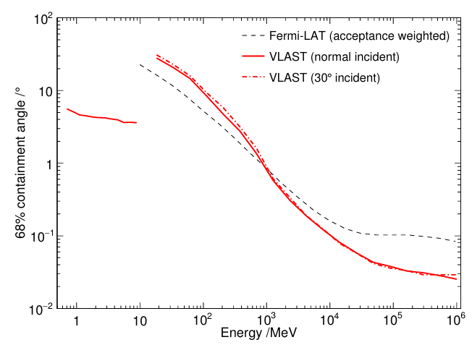
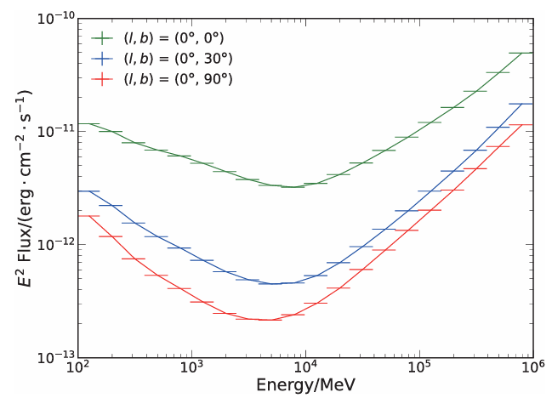
Very Large Area gamma-ray space telescope
Angular resolution Sensitivity
VLAST has a good angular resolution and a high sensitivity (Fan et al. 2022)

Slide 13
Expected performance of VLAST
Some space-based gamma-ray missions
facility | acceptance (m² sr) | energy range | energy resolution (@10GeV) | angular resolution (@50GeV)
Fermi-LAT | ～2 | 20 MeV-300 GeV | ~6.0% | ~ 0.10 deg
DAMPE | ～0.2 | 5 GeV-10 TeV | ~1.5% | ~ 0.10 deg
AMS-100 (concept) | ~30 | 0.1 GeV-10 TeV |  | ~ 0.03 deg
APT (in proposal) | ~20 | 1 MeV-10 TeV | ～20% | ~ 0.10 deg
HERD | ~2 | 0.5 GeV-10 TeV | ~1.5%
VLAST (in proposal) | ~12 | 1 MeV-10 TeV | ~1.5% | ～0.10 deg

Slide 14
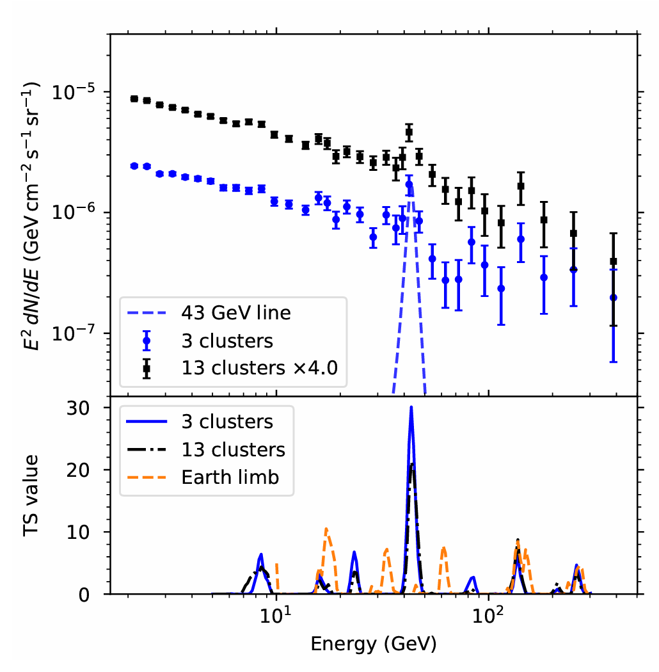
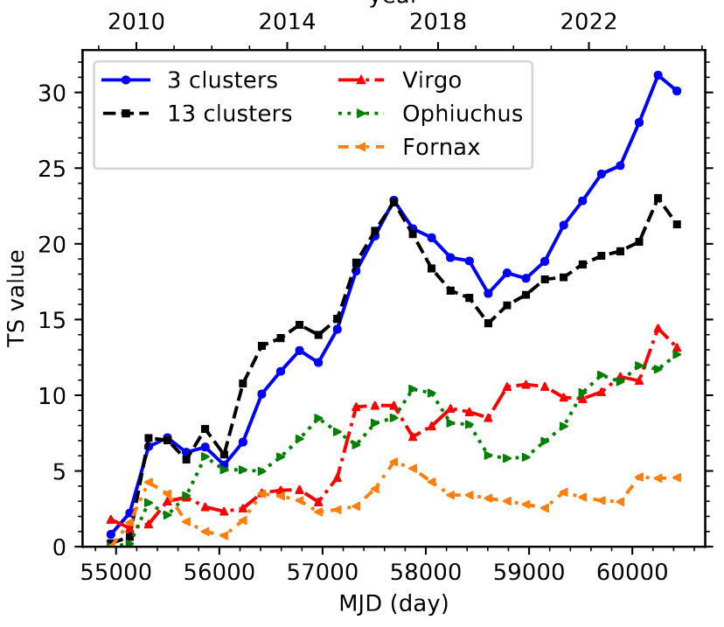
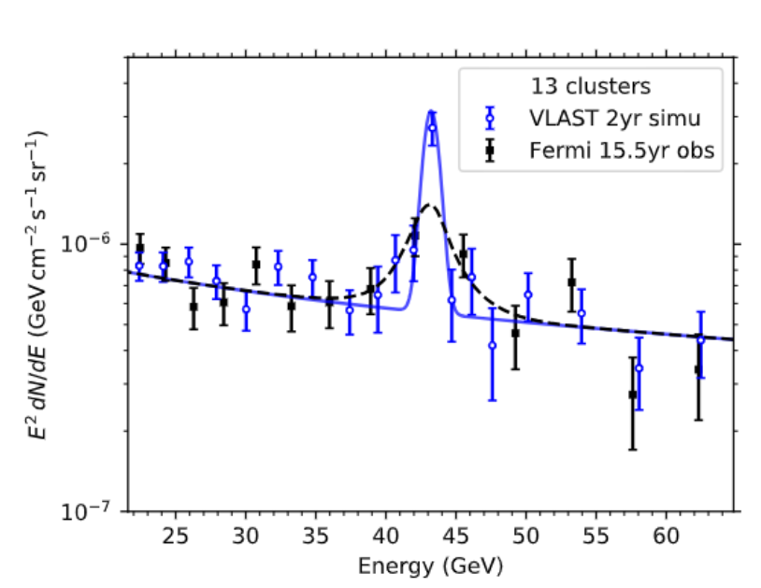
Very Large Area gamma-ray space telescope
GeV line signal of Fermi-LAT Expected VLAST check
There is tentative evidence for a 43GeV line in some nearby galaxy clusters， which can be clarified with VLAST in 2 yrs (Fan et al. arXiv:2407.11737)
Notes:
Such a powerful instrument will contribute greatly to gamma-ray astronomy. Thousands of GeV sources will be detected and many exciting discoveries are anticipated. Here I just show one example on dark matter indirect detection. In the directions of some nearby galaxy clusters, we have found tentative evidence for a 43 GeV line in the Fermi-LAT data. Look, there is a hard spike in the spectrum. No astrophysical process can yield such a peculiar signal. If confirmed, it would point towards the new physics. VLSAT can robustly detect this signal, if intrinsic, in two years.

Slide 15
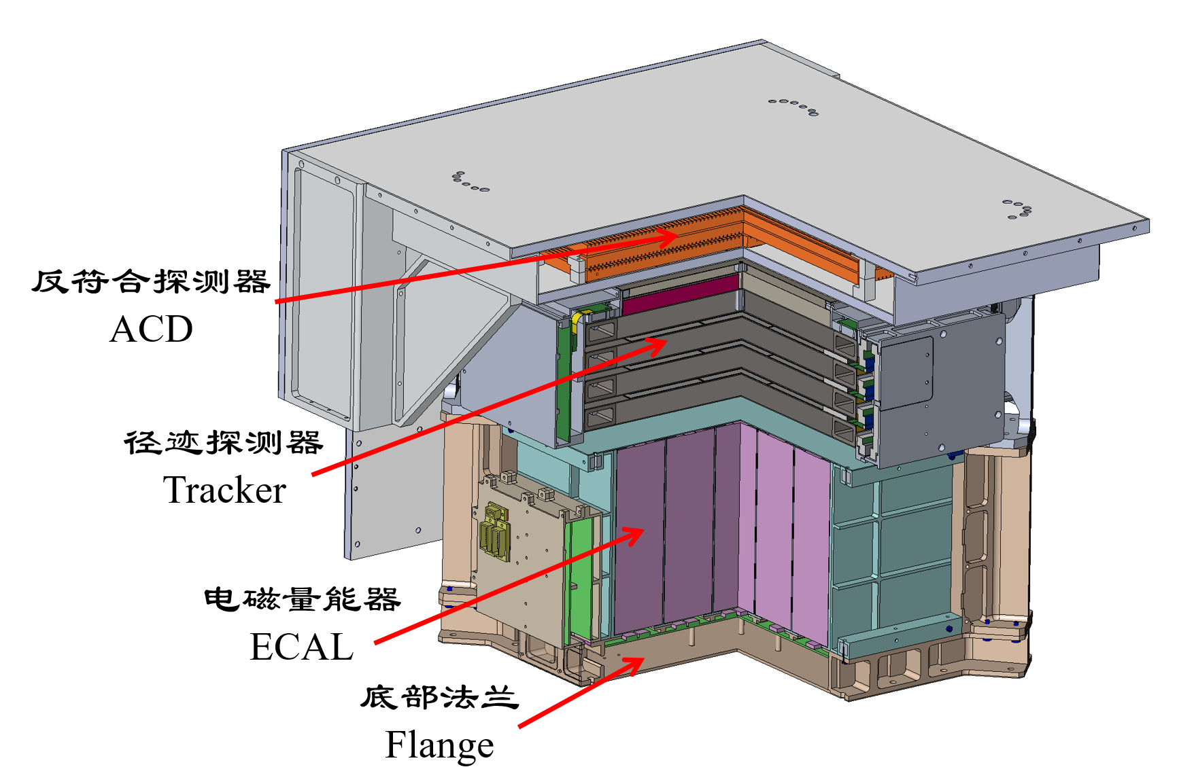
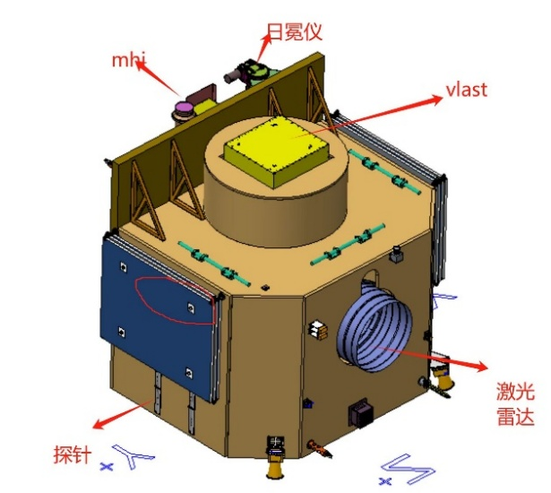
Very Large Area gamma-ray space telescope
VLAST pathfinder: 50MeV-5GeV （To launch in 2026）

Slide 16
Summary
DAMPE works well in the orbit and has discovered some new intriguing features in the cosmic ray spectra. However, as a gamma-ray detector, the effective aera is too small
A much more sensitive gamma-ray space detector is needed to advance the knowledge of dark matter as well as high energy astronomy
VLAST is distinguished by an acceptance of ～12 m² sr and an extremely wide energy range (1MeV-10TeV). R&D is ongoing

