Slide 1


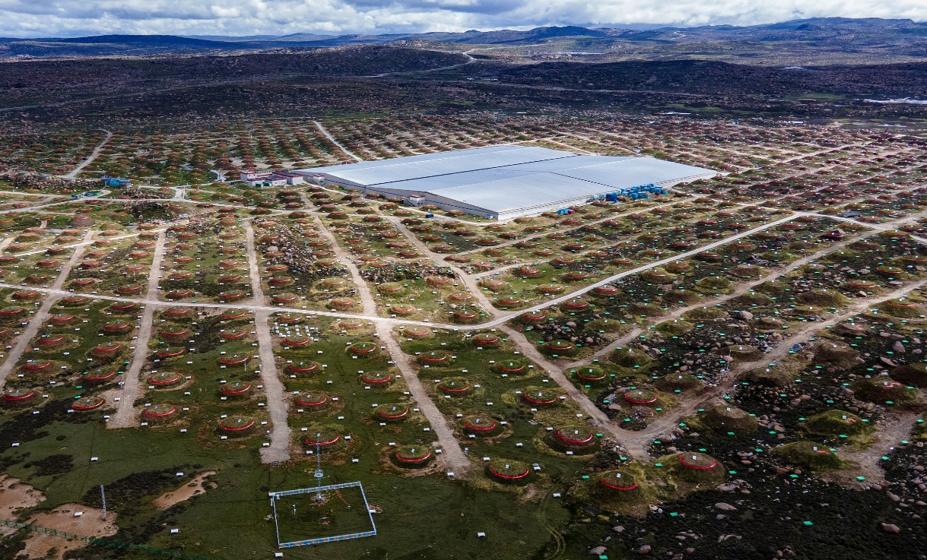
Measurement of diffuse gamma-ray emission from Galactic plane with LHAASO
Yi Zhang （张毅）
Purple Mountain Observatory (PMO), CAS
on behalf of the LHAASO Collaboration
(2023, PRL, 131, 151001; 2025, PRL, 134, 081002)
International Workshop on Cosmic Ray Direct Detection and Physics, Nanjing, China, Dec. 17-20, 2025

Slide 2
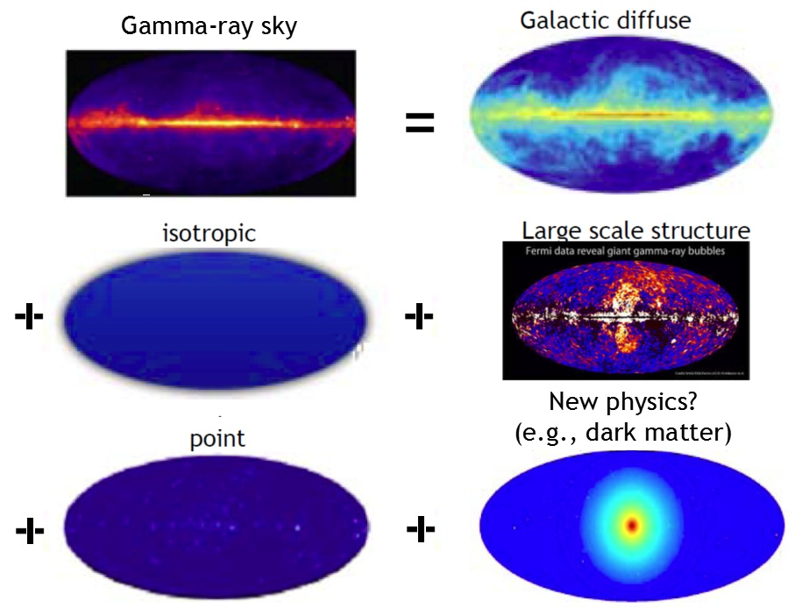
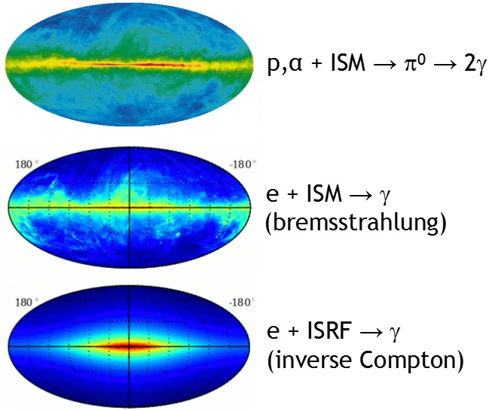
The gamma-ray sky
scattering
2
Notes:
Focusing on the Galactic Diffuse Emission, it mainly comes from three mechanisms
interstellar radiation field (ISRF) via Inverse Compton scattering.

Slide 3
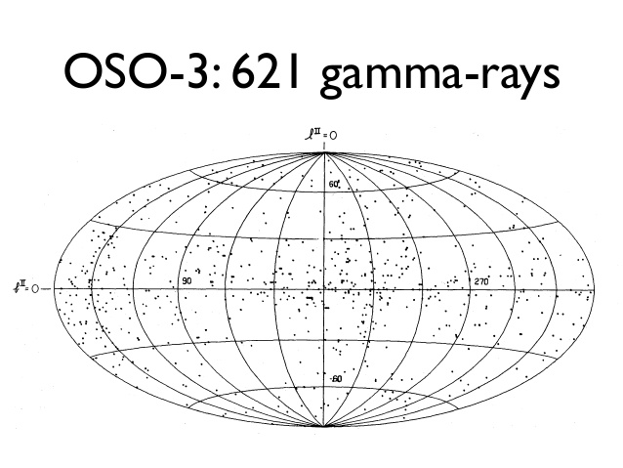
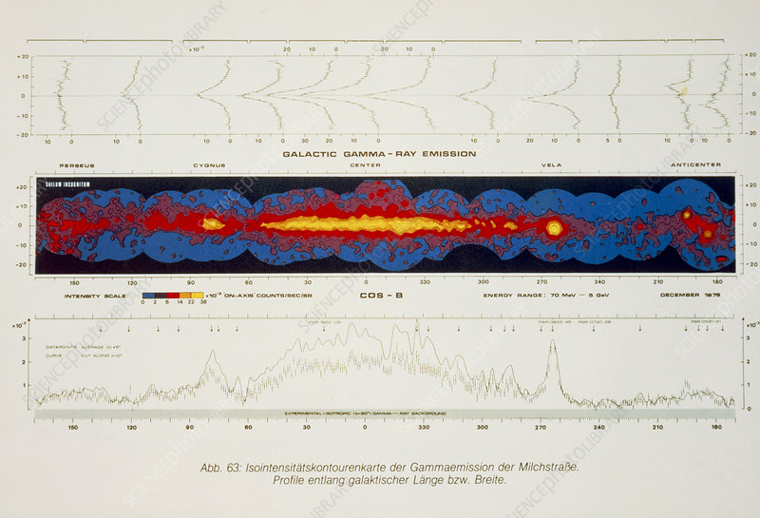
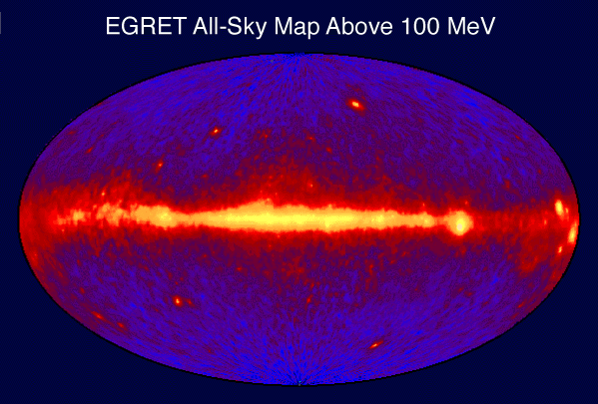
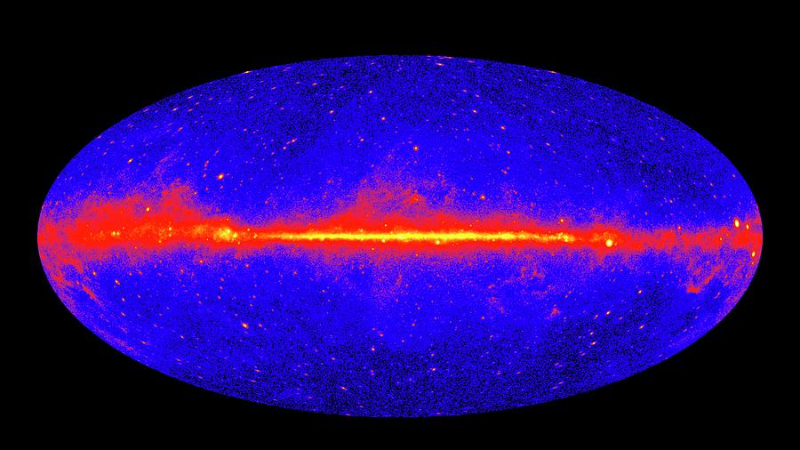
Diffuse γ-ray observations from space (<TeV)
COS-B
OSO-3​ made the first detection of Galactic gamma-ray emission, revealing signal from the inner Galaxy
COS-B, through its survey of the Galactic plane above 100 MeV, provided the breakthrough data, allowing us to test early diffuse models
EGRET​ followed, delivering high-quality all-sky data up to 10GeV, stimulating more detailed and advanced modeling
Fermi-LAT improved sensitivity by an order of magnitude, giving us an unprecedented view from 30 MeV to several hundred GeV.
Fermi
3
Notes:
Orbiting Solar Observatory-3

Slide 4
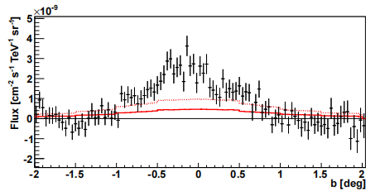
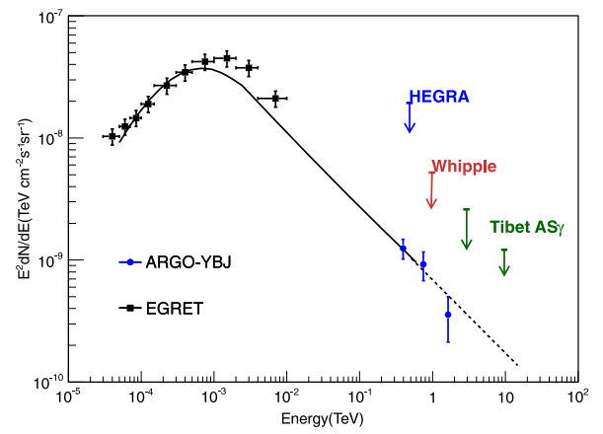
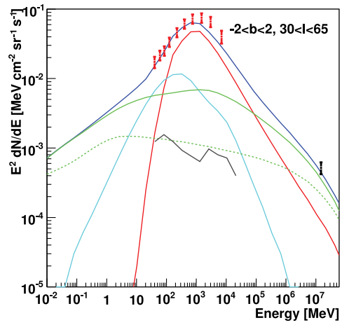
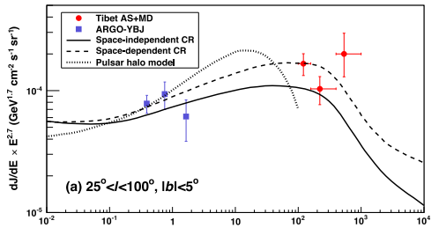
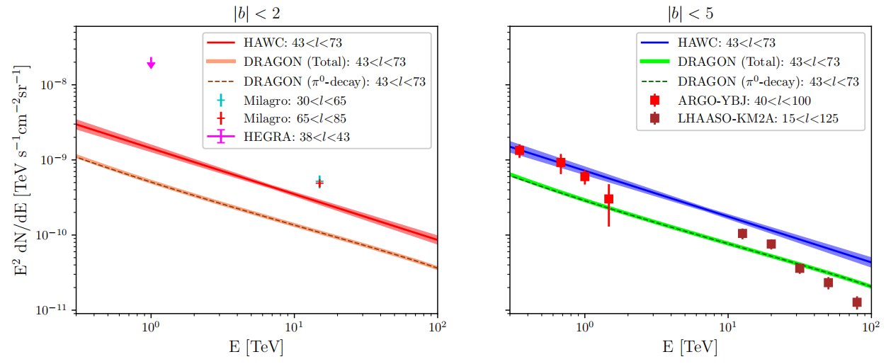
VHE diffuse measurement on ground （key role >TeV)
ARGO-YBJ (2015)
Milagro (2008)
HESS (2014)
HAWC (2024)
Tibet-ASγ (2021)
Ground-based experiments measured gamma-ray emission in the inner Galactic direction, covering energies from sub-TeV to sub-PeV.
4
Notes:
d

Slide 5
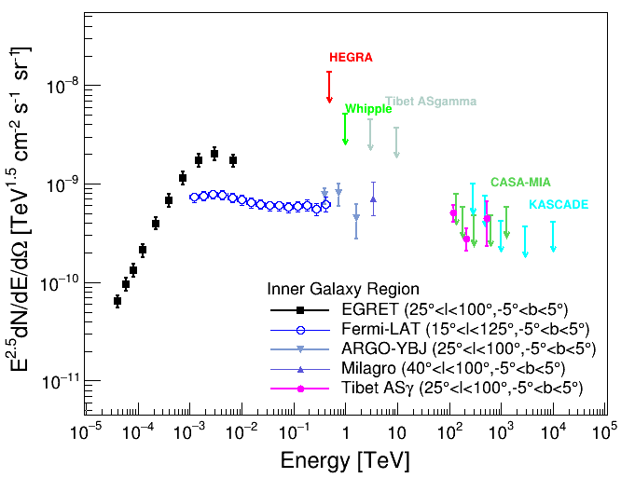
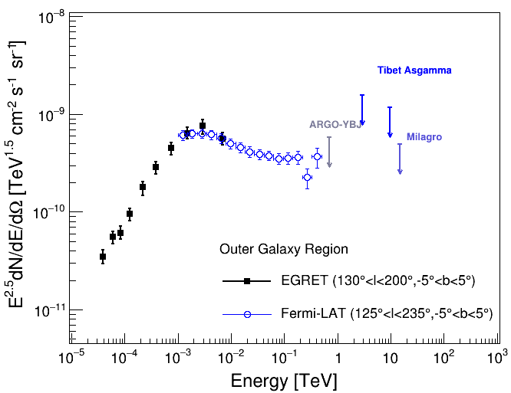
Wide-energy-band diffuse emission measurements
Before LHAASO
Inner Galactic plane
Outer Galactic region
Combining these space and ground experiments gives us wide-energy-band diffuse measurements, which allow for combined fitting of multiple mechanisms.
Above the TeV range, however, both the energy and sky coverage are quite limited, especially in the outer Galactic plane, where we only have upper limits.
5

Slide 6
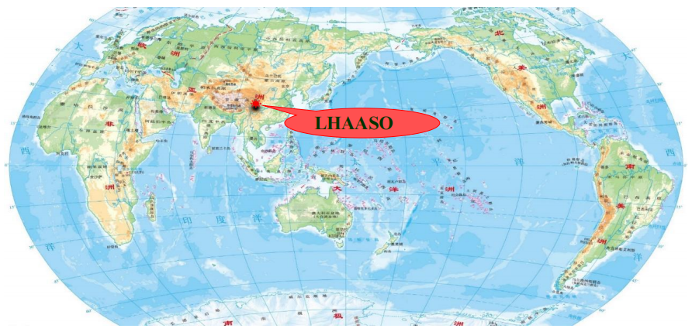
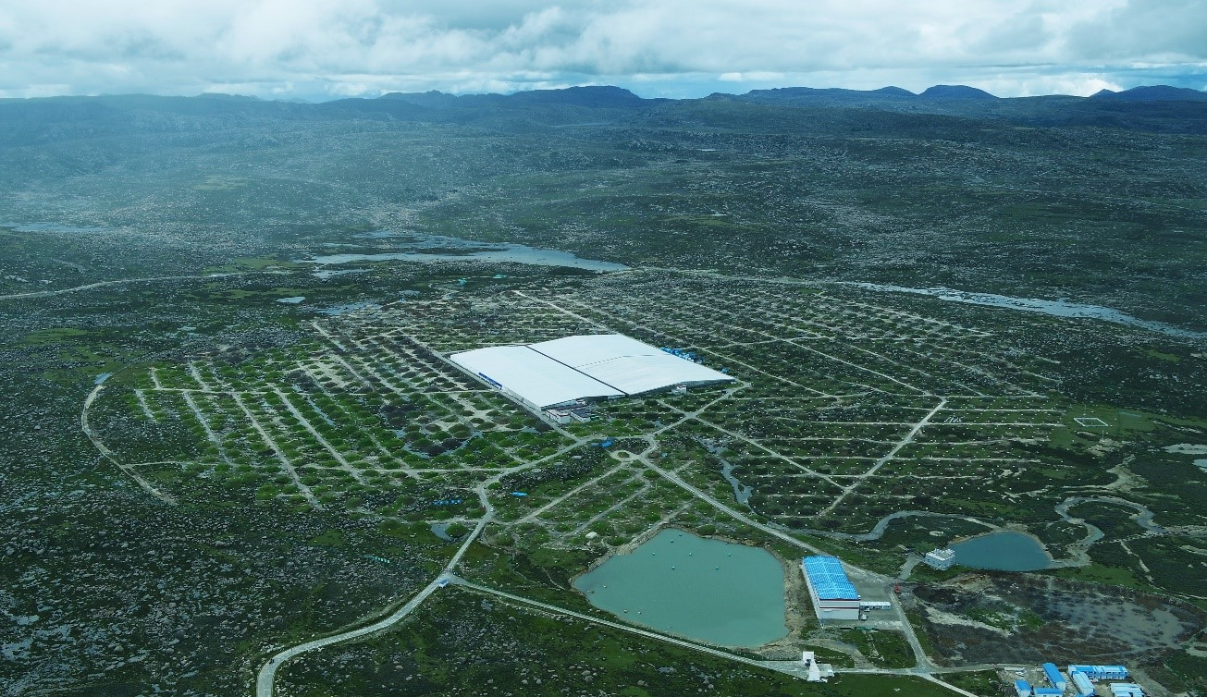
Large High Altitude Air Shower Observatory——LHAASO
Haizi mountain, Sichuan, China, 4410 m above the sea level
LHAASO uses hybrid detector arrays: the square kilometer array (KM2A), the water Cherenkov detector array (WCDA), and the wide field-of-view Cherenkov telescope array (WFCTA)
We have been in full operation since July 2021.
6

Slide 7
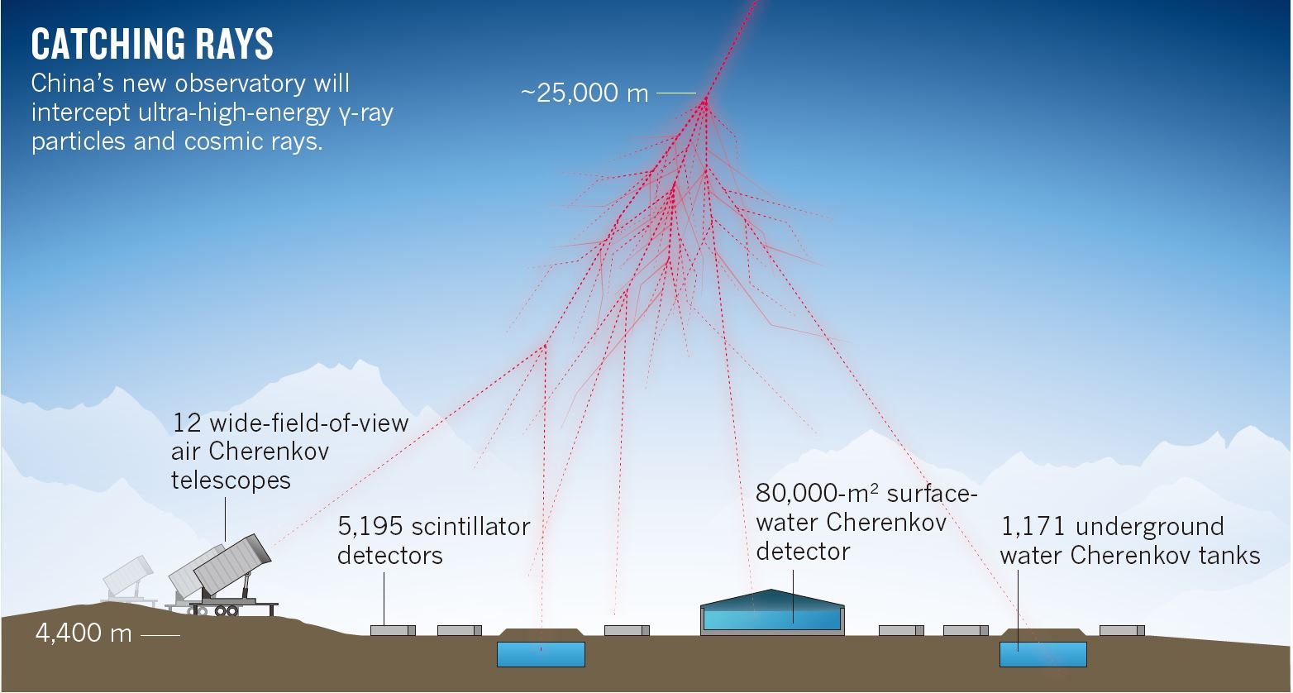
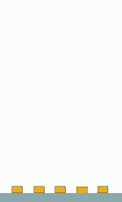
Detection principle of CR Air showers
18
7

Slide 8
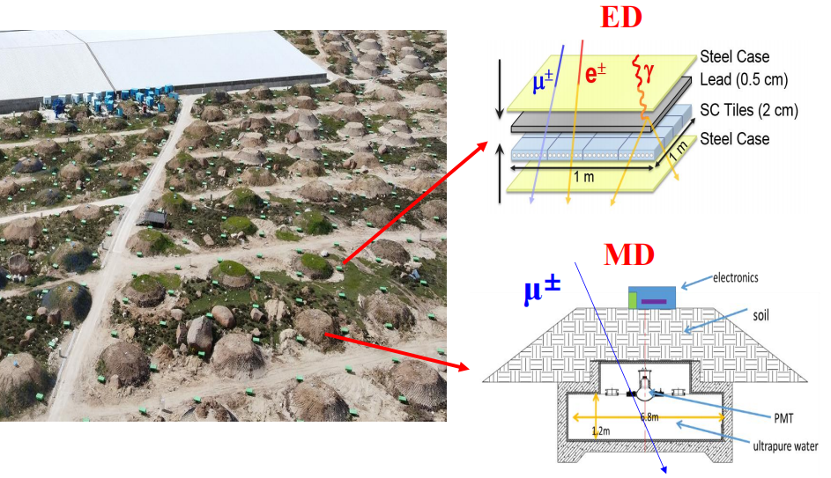
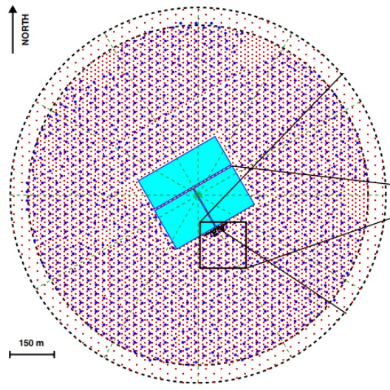
KM2A: Square Kilometer Array
5216 EDs
1188 MDs
It covers 1.3 square kilometers with ~5,216 electromagnetic detectors for energy and direction reconstruction
1,188 muon detectors for gamma/hadron discrimination; largest of its kind; high rejection power for CRs
Energy coverage: 10 TeV - 100 PeV
8

Slide 9
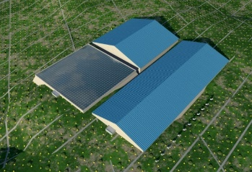
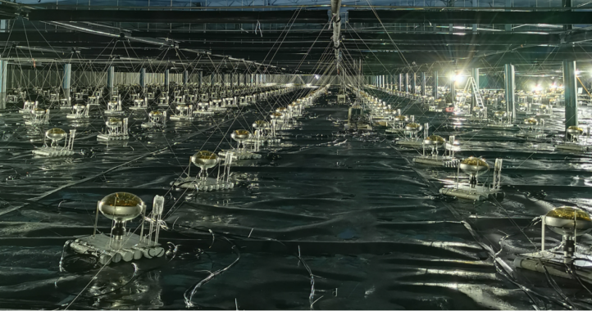
WCDA: Water Cherenkov Detector Array
78000 m² water pool to detect Cherenkov light produced by air shower secdary particles in water
Energy coverage: 0.3 TeV - PeV
9

Slide 10
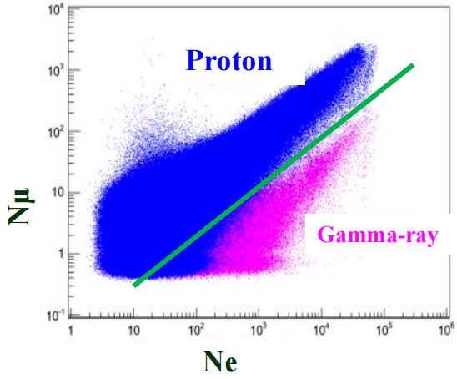
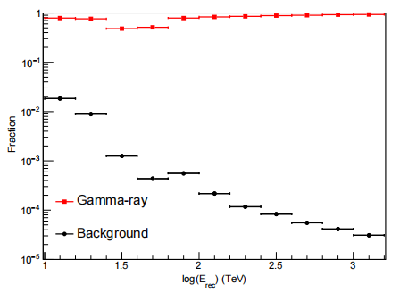
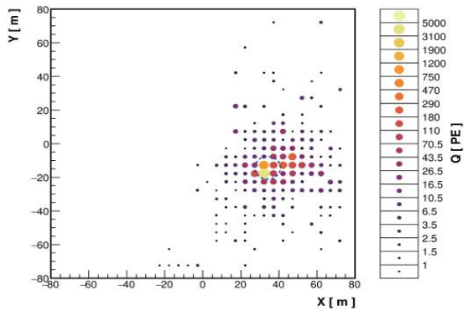
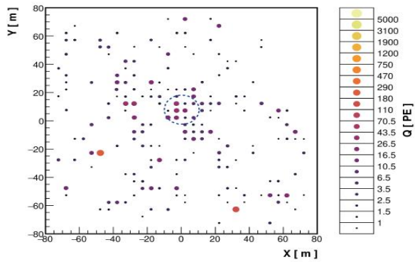
Gamma-CR discrimination
Chin. Phys. C, 45, 025002 (2021)
KM2A
Muon Contents
Chin. Phys. C, 45, 085002 (2021)
WCDA
Morphology
γ：a concentrated lateral distribution；CR： more dispersed
10

Slide 11
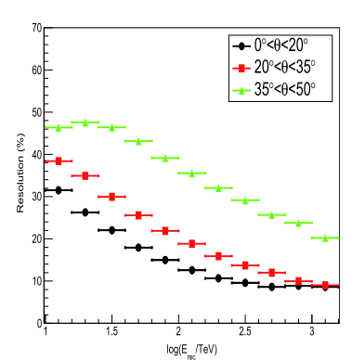
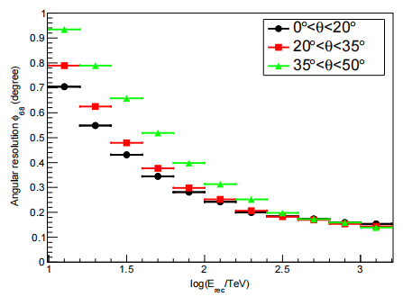
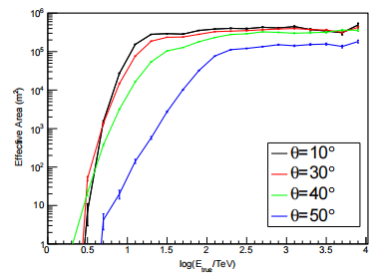
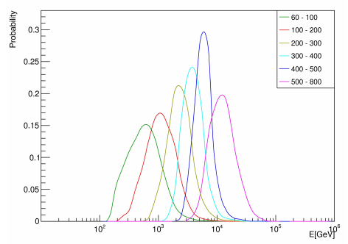
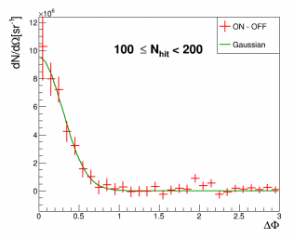
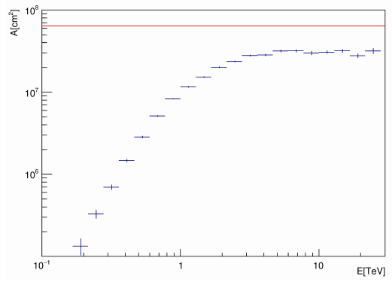
Gamma-ray performance for KM2A and WCDA
Energy resolution
Angular resolution
Effective area
KM2A
WCDA
11

Slide 12
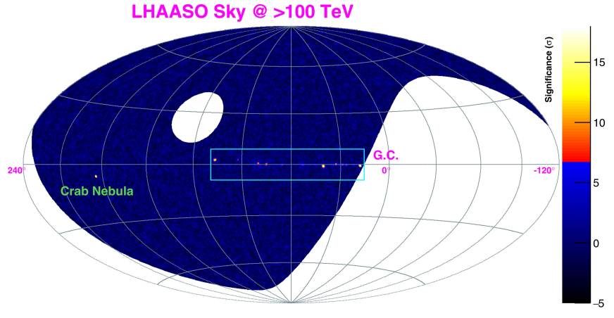
LHAASO sky coverage
15°< l < 235°
LHAASO cover the Galactic plane from a Galactic longitude of 15° to 235°
12

Slide 13
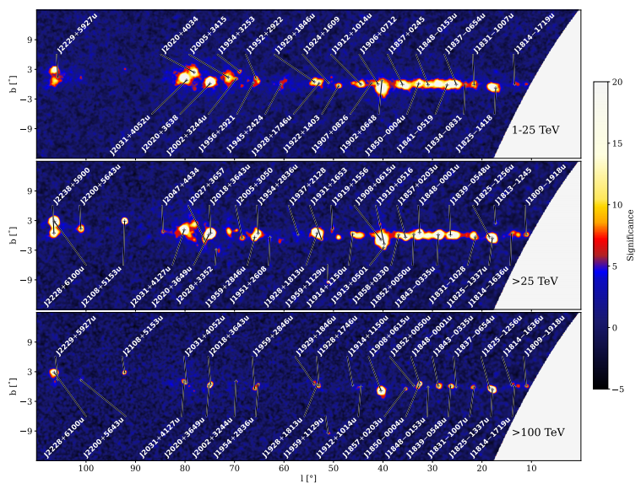

Method：Resolved source masks
Assumption: source morphology is Gaussian
n=2.5 is chosen
Source catalogs: LHAASO catalog + TeVCat
For overlapping sources, LHAASO parameters are used
LHAASO first catalog (2024, ApJS)
13

Slide 14
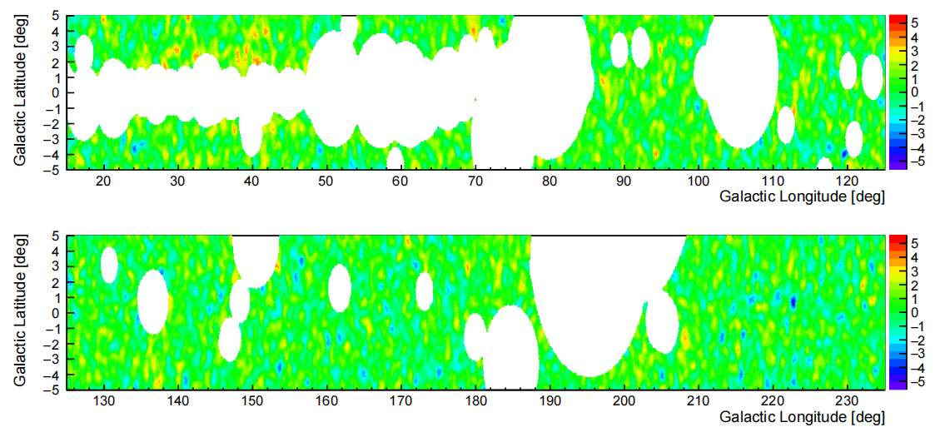
LHAASO diffuse results
KM2A: 29.1σ; WCDA: 24.6σ
Inner Galactic direction
KM2A: 12.7σ; WCDA: 9.1σ
Outer Galactic direction
LHAASO (2025, PRL)
Covering Galactic latitudes between ±5°.
14

Slide 15
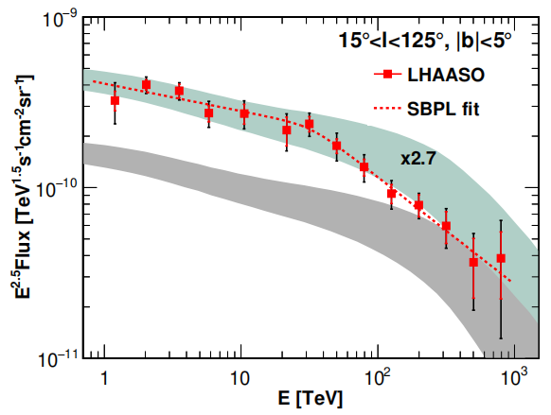
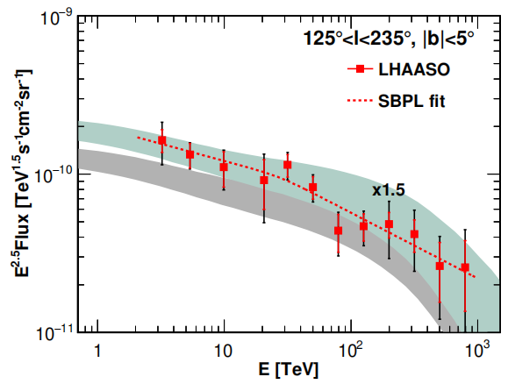
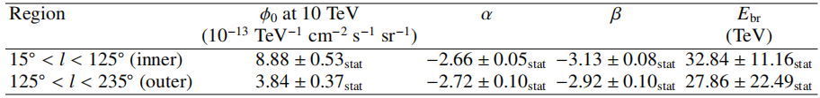
LHAASO diffuse results
Inner Galactic plane
Outer Galactic plane
LHAASO measures diffuse emission from 1 TeV to 1 PeV with high significance, and gives the first detection from the outer Galactic plane
Fitting the data with a spectral break power-law, a spectral break around 30 TeV is revealed in the inner Galactic plane
15

Slide 16
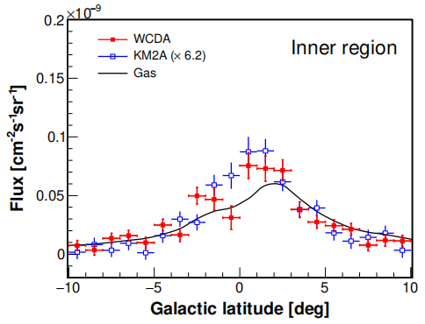
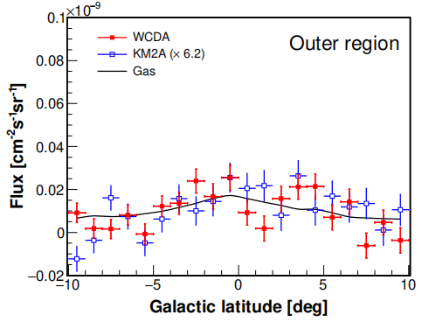
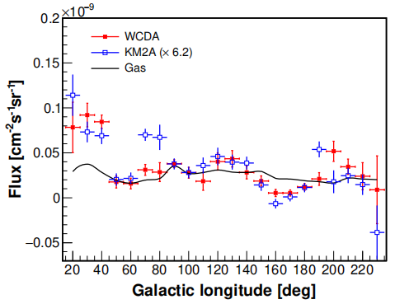
Longitude and latitude profiles
The outer region distribution is flatter that the inner region
Roughly consistent with gas distributions for b, but show significant deviation for l
16

Slide 17
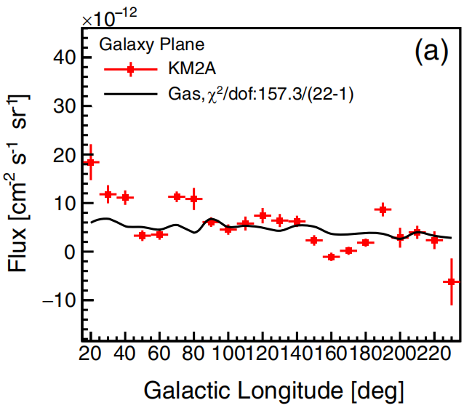
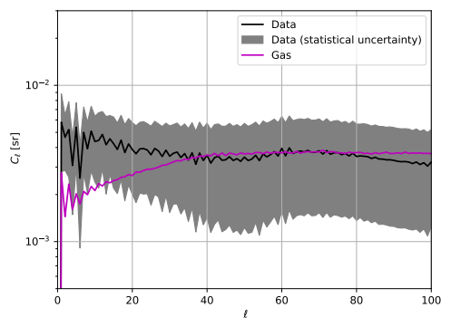
Spatial distribution
E>10 TeV
Expected spectrum based on the gas distribution
Analyzed the spatial distribution using angular power spectra analysis.
Difference between data and gas is also shown in the angular power spectra at low-l
17

Slide 18
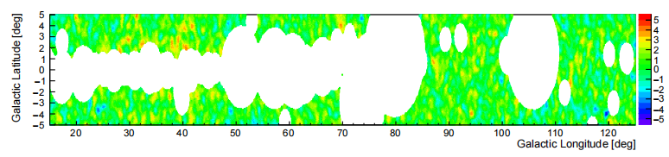
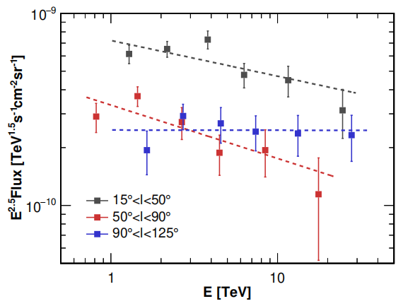
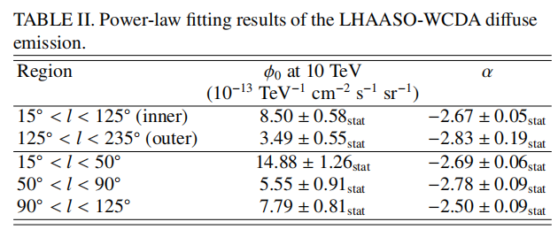
Possible spatial variation of spectra
Inner Galactic region divided into three sub-regions
Hints of spectral variations aross the Galactic plane (~2σ)
Need more data for a higher significance comparison.
18

Slide 19
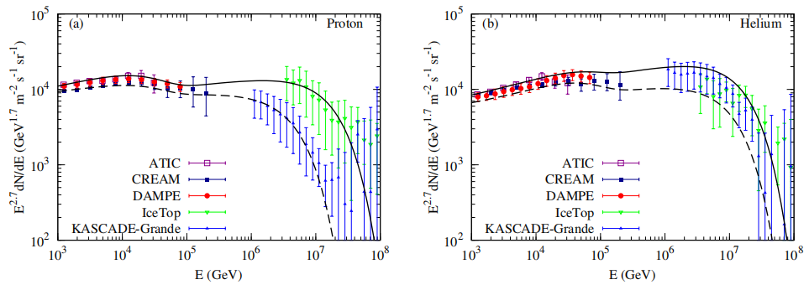
Confront LHAASO data with a toy model
Toy model prediction: local CR × gas column density
Measured fluxes are higher by a factor of 1.5~2.7 than predictions
Spectra are slightly different from the prediction
One uncertainty in the model is the input CR spectrum; significant discrepancies between ICETOP and KASCADE Grande at high energies.
Expectation could be improved significantly with LHAASO CR measurement!
19

Slide 20
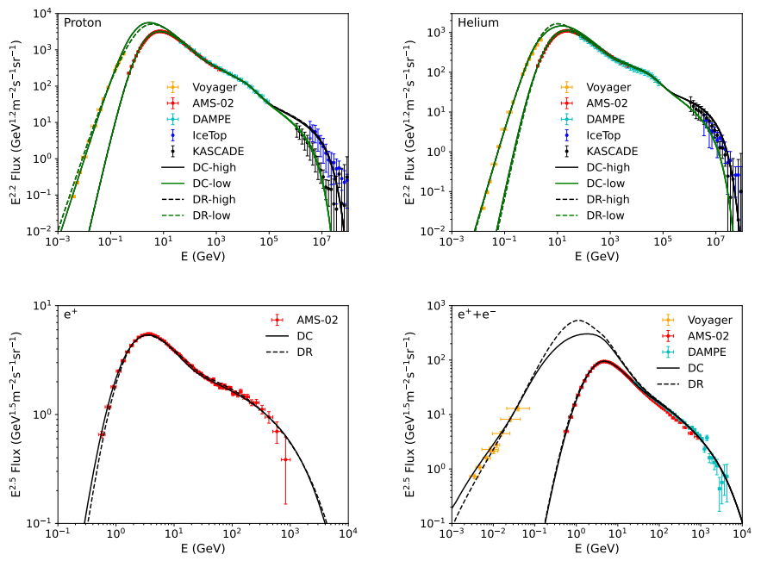
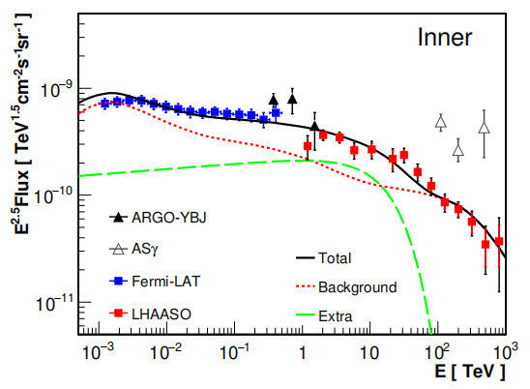
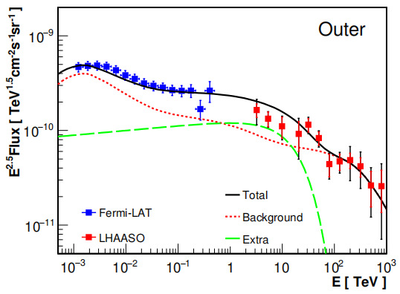

Confront LHAASO data with a GALPROP model
DC Model (Diffusion + Convection)
DR Model (Diffusion + Reacceleration)
Zhang et al. (2023, ApJ, 957, 43)
Excess?
Excess?
Model-predicted spectra Vs the measurements.
Wide-band spectra of diffuse γ-ray emission for the DC propagation model, assuming an extra component with an ECPL spectrum
Use diffusion-based models (Galprop DC/DR) calibrated with up-to-date local cosmic-ray data to predict wide-band emissions.
Shows good agreement with data for measured particles, successfully reproducing key spectral structures.
Requires an extra exponential cutoff power-law component to account for the significant GeV-to-TeV excess observed in the diffuse emission.
20

Slide 21


Unresolved source contribution?
Inner Galaxy
Number
Intrinsic flux distribution
Observed flux distribution
Outer Galaxy
Flux
Derived the intrinsic flux distribution by applying the Lynden-Bell C⁻method (a non-parametric technique)
The contribution of unresolved sources is able to describe the exta component for Outer Galaxy region, while it is insufficient for Inner Galaxy region.
Additional contributions from unknown mechanisms
He + (2025, ApJ); Kaci + (2024, ApJ)
21

Slide 22
Other interpretations
Various types of unresolved sources: pulsar halo/PWN (Pagliaroli + 2023 Universe; Yan + 2024 Nat. Astron.; Dekker + 2024 PRD; Chen + 2024 CPC), X-ray binaries (Yue + 2024; Kuze + 2025), massive star clusters (Menchiari + 2024) ...
Cosmic ray sea interaction with alternative propagation setup (Giacinti + 2023; Vecchiotti + 2024; De La Torre Luque + 2025)
Time-dependent model of discrete sources (Marinos + 2024)
22

Slide 23

Summary
The diffuse emission from 1 TeV to 1 PeV from the Galactic plane was observed with high significance; Firstly detected in the outer Galaxy region!
A spectral break around 30 TeV is found in the inner region, with a change of indices by ~0.5
The longitude distribution deviates from gas distribution; there is possible spectral variation of the spectra across the Galactic plane
Together with Fermi-LAT, the wide-band data show excesses from several GeV to 10s TeV compared with a traditional CR propagation model, which could be explained by a population of unresolved sources (pulsar halos or secondary interaction at source)
Thank you!
23

Slide 25


Caveat: no distinct definition between sources and diffuse
Truly diffuse large extended source pointlike sources
(adequate prop.) (non-adequate prop.) (freshly accelerated)
Chen + (2024, CPC)
VS.
25

Slide 26




Confinement and interaction around sources
Cygnus bubble: super accelerator as extended as 10 degrees (LHAASO 2024, Sci. Bull.)
Nie + ApJ (2024); He + ApJ (2024);
Yang & Aharonian (2024); Ambrosone + (2025)
26

Slide 27


Improved measurement is important
source subtraction
Preliminary!
Preliminary!
27

Slide 28


Background estimate
Direct integral method: assuming the spatial distribution in detector coordinate is stable in a reasonably short time bin
Efficiencies do vary slightly with time, and thus a sliding window method is adopted (1_10 is used as benchmark, 1 hr step and +/-5 hr window)

Slide 29



Residual source contamination

Slide 30


At 100 GeV, the data is about 4e-3, when subtracting sources (yellow) and IGRB (brown), the result is about 3e-4, which is about 2 times of the GDE model (blue) of 1.5e-3
This analysis
25<l<100, -5<b<5, no mask
Fig. 17 of Ackermann et al. (2012)

