Slide 1
Cosmic ray sea and islands: a new picture about Galactic cosmic ray distribution and propagation
Qiang Yuan
Purple Mountain Observatory, Chinese Academy of Sciences
International Workshop on Cosmic Ray Direct Detection and Physics, Nanjing, 2025.12.17-18

Slide 2
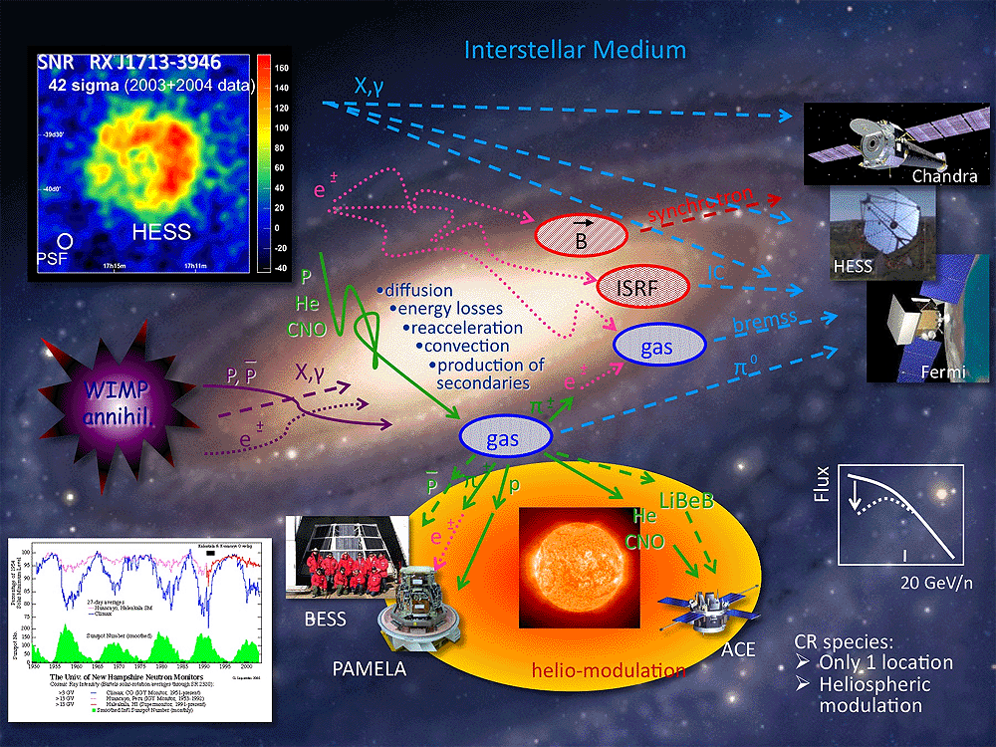
General picture of Galactic cosmic rays
CRs are mainly produced by astrophysical sources like supernova remnants
They propagate diffusively in the Galactic magnetic field, and interact with medium and radiation, producing secondary particles and diffuse emission

Slide 3
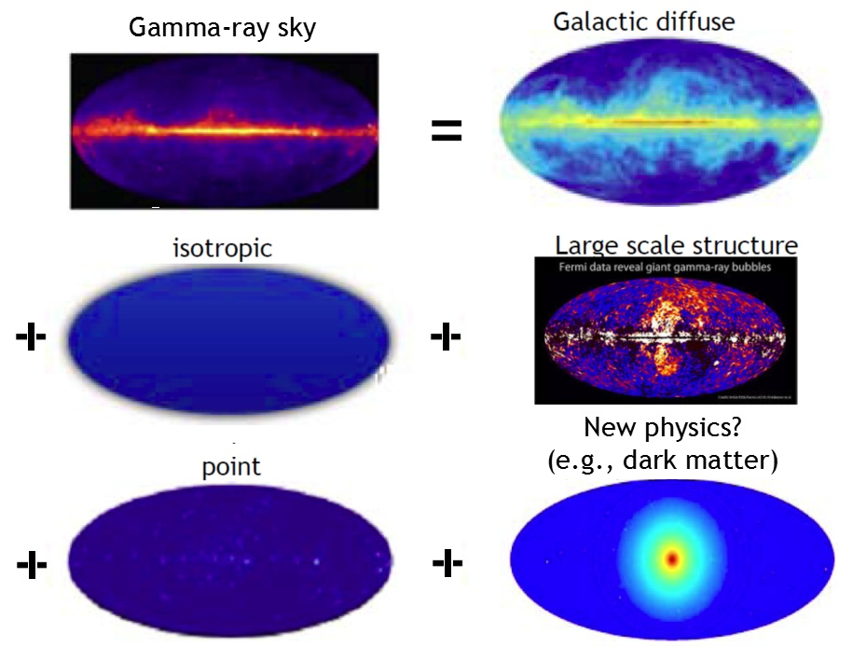
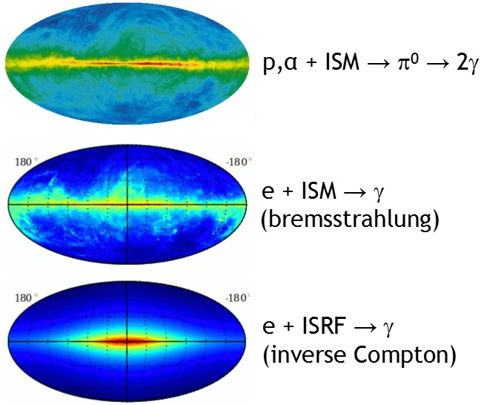
The gamma-ray sky

Slide 4
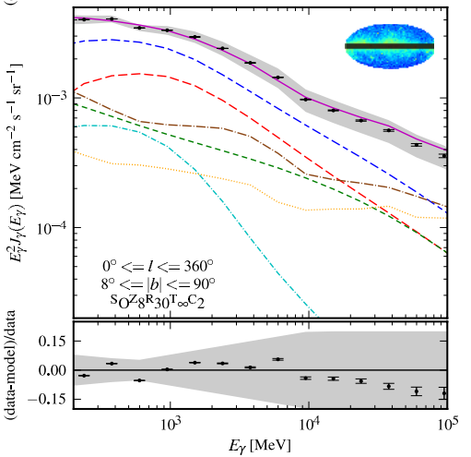
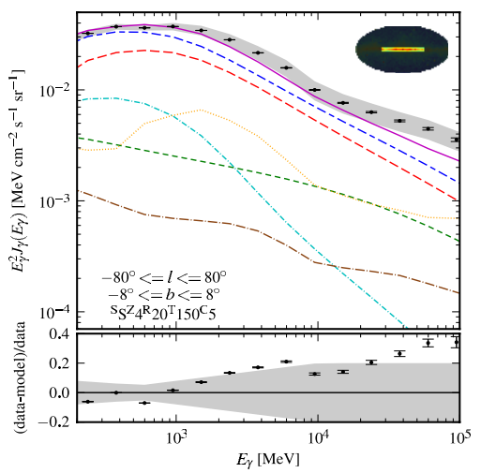
Fermi-LAT measurement of all-sky diffuse γ-ray
低能
Excess in the Galactic plane
Fermi-LAT (2012, ApJ)
高能
The Fermi all-sky data can be largely reproduced by the conventional propagation model except in some region of the Galactic plane

Slide 5
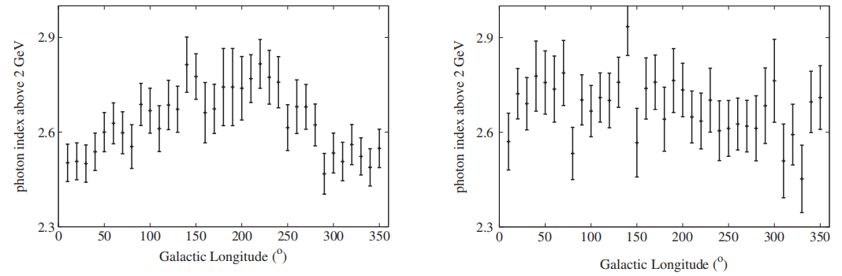
Spatial variation of gamma-ray spectra
Yang et al. (2016, PRD)
Spectral index shows variations along Galactic longitude in the Galactic disk, but is uniform away from the disk

Slide 6
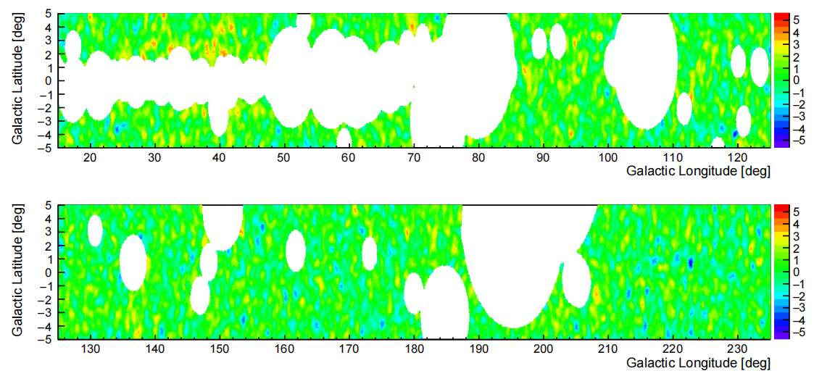
LHAASO diffuse results
KM2A: 29.1σ; WCDA: 24.6σ
KM2A: 12.7σ; WCDA: 9.1σ
LHAASO (2025, PRL)
See talk by Y. Zhang

Slide 7
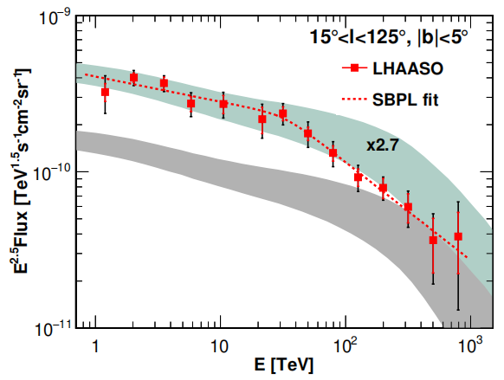
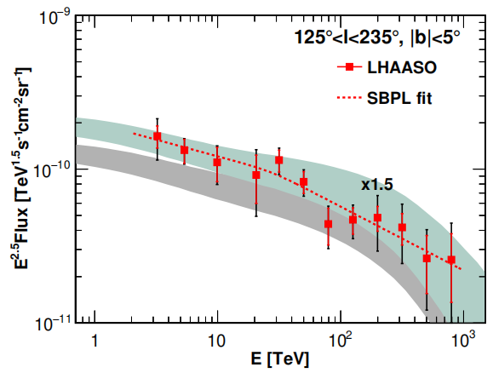
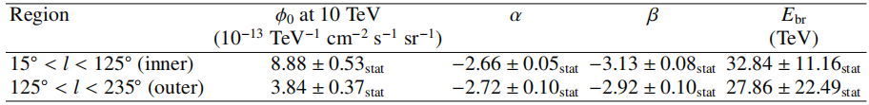
LHAASO diffuse results
LHAASO (2025, PRL)
LHAASO gives the first detection from the outer Galactic plane (125º<l<235º)
A spectral break around 30 TeV is revealed in the inner Galactic plane
Measured fluxes are higher than predictions (local CR×gas column×cross section)

Slide 8
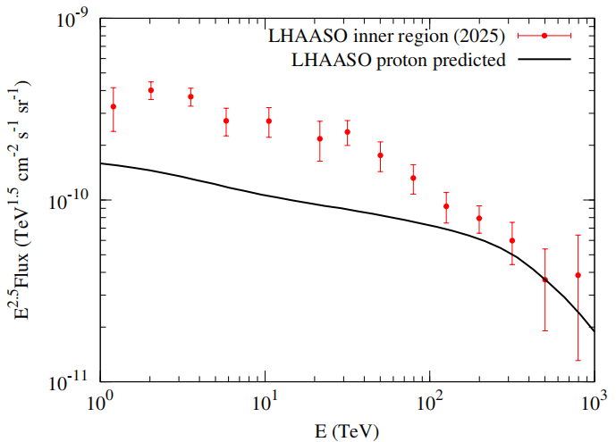
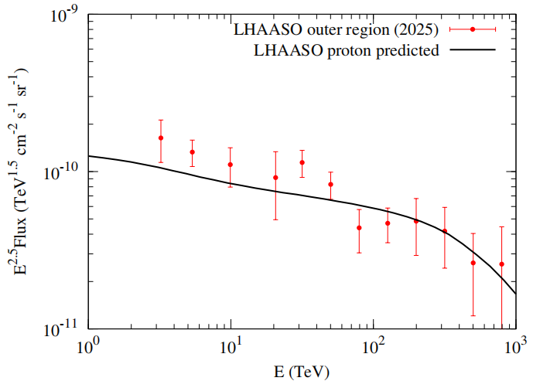
Confront LHAASO p, He spectra and DGE
LHAASO fluxes of diffuse emission in the Galactic plane is higher than the prediction of cormic ray interactions

Slide 9
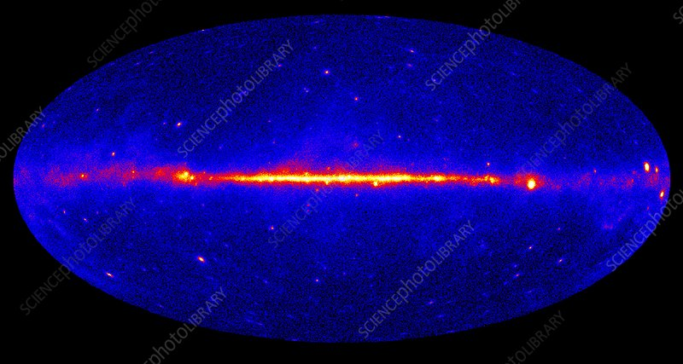
Re-analysis of the Fermi-LAT data
Divide the Galactic plane into 18 regions, each with 20⁰×20⁰ size

Slide 10
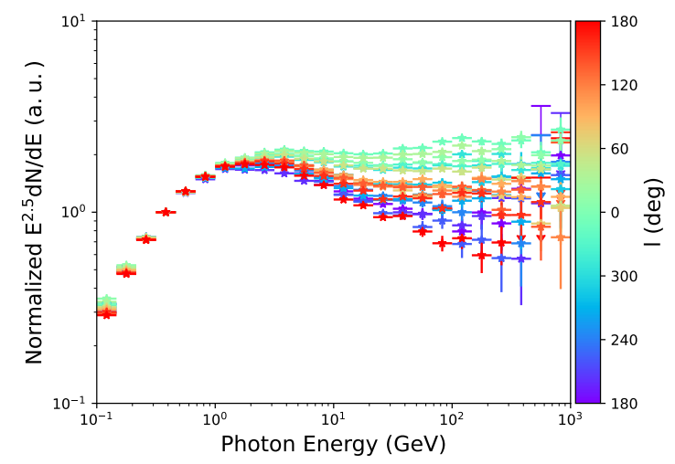
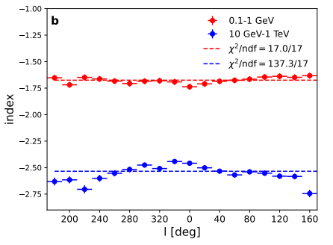
Re-analysis of the Fermi-LAT data
arXiv:2509.26290
Subtract detected sources (re-fit according to 4FGL) and isotropic bkg.
The low-energy spectra are uniform, and the high-energy spectra show variations

Slide 11
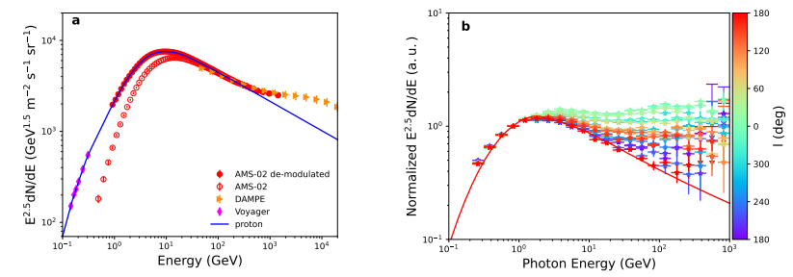
Re-analysis of the Fermi-LAT data
The low-energy spectra are consistent with prediction using locally observed proton spectrum

Slide 12
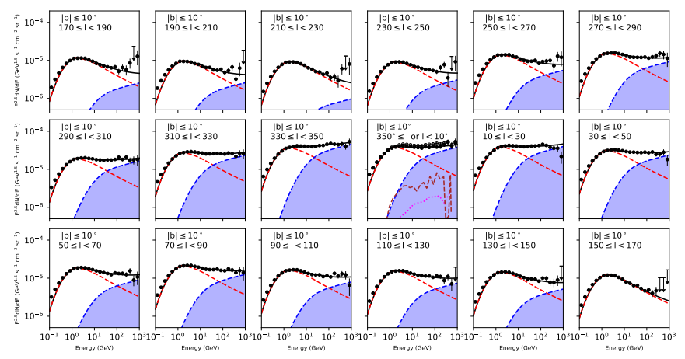
Two-component de-composition
arXiv:2509.26290
See also Liu & Yang (2022, A&A), Vecchiotti + (2022, Commun. Phys.)

Slide 13
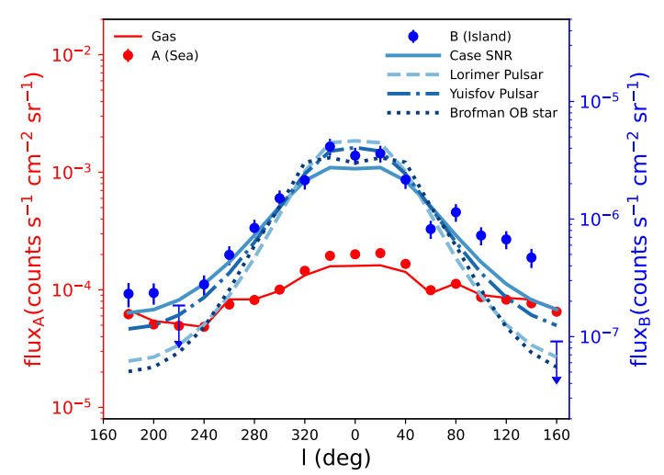
Two-component de-composition
The A component (dominates in low energy) is consistent with gas distribution
The B component (dominates at high energy) is correlated with potential source distribution
arXiv:2509.26290

Slide 14
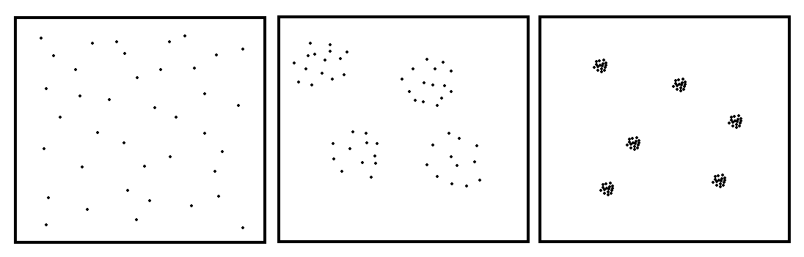
Implications on CR distribution and propagation
Truly diffuse large extended source pointlike sources
(adequate prop.) (inadequate prop.) (freshly accelerated)
CR sea CR islands

Slide 15
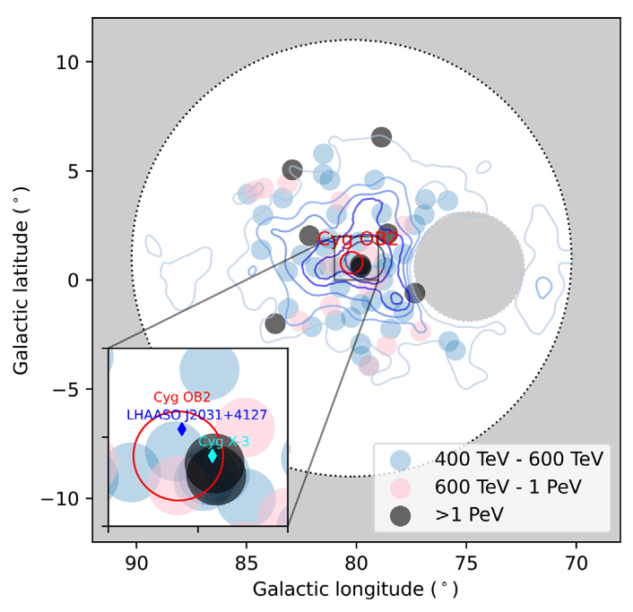
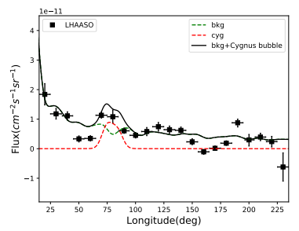
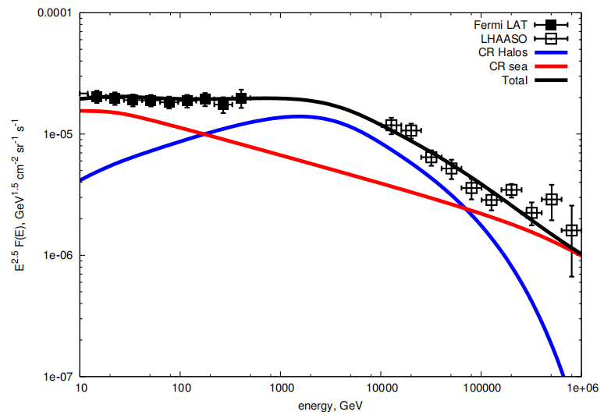
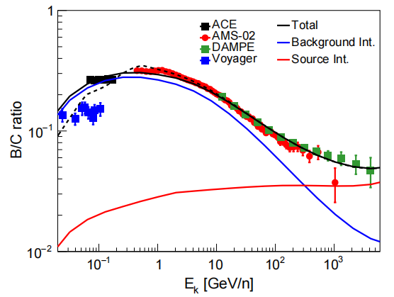
Confinement and interaction around sources
Cygnus bubble: super accelerator extends to 10 degrees (LHAASO 2024, Sci. Bull.)
Confinement for 0.2-0.5 Myr can explain the B/C, diffuse γ and ν results
Nie + ApJ (2024); Sun + PRD (2024);
Yang & Aharonian (2024); Ambrosone + (2025)
See talk by R. Yang

Slide 16
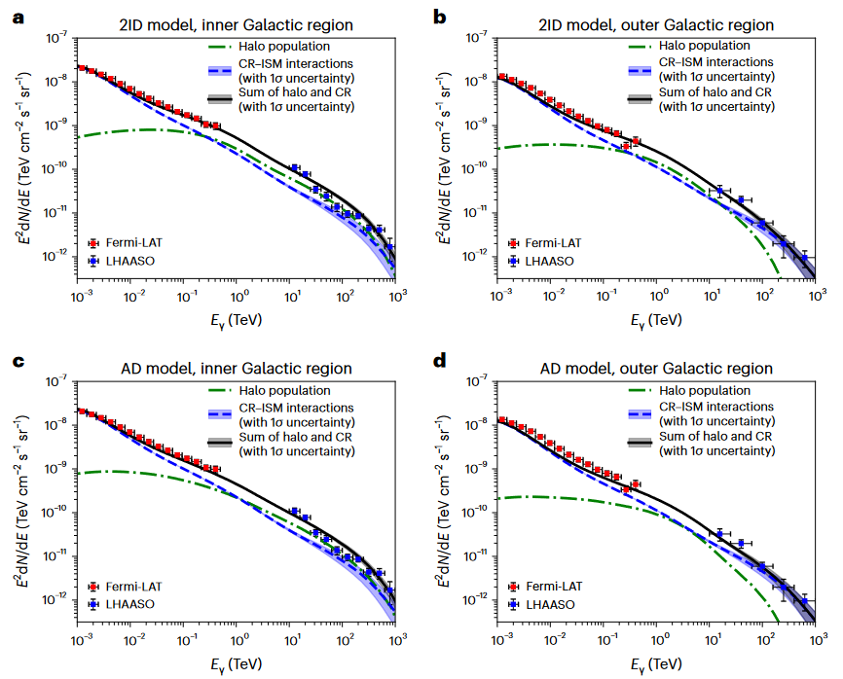
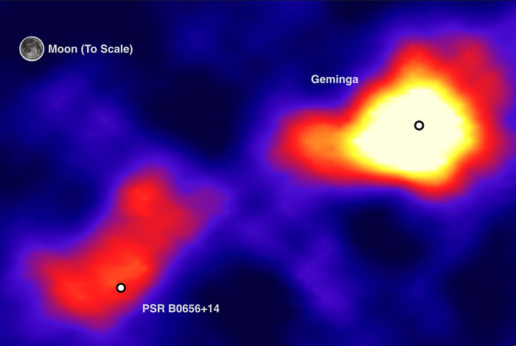
PWN/halo interpretation
HAWC (2017, Science)
Extended halos around middle-aged pulsars are expected to be common in Milky Way, which could form a diffuse component of gamma-ray background (e.g., Aharonian & Atoyan 2000; Linden & Buckman 2018).
K. Yan et al. (2024, Nat. Astron.); Dekker + (2024, PRD); Pagliaroli + (2023, Universe); Chen + (2024, CPC)

Slide 17
Summary
Galactic diffuse gamma-ray emission is important probe of GCR propagation
Precise measurements of the diffuse emission from GeV to PeV by Fermi and LHAASO show interesting excesses compared with the model prediction
The Fermi-LAT data further reveal that the Galactic diffuse emission has spectral variation, and can be decomposed as two components
The results indicate that the GCRs have a sea component from adequate propagated CRs and an island component from inadequate propagated CRs
Thank you!

