Slide 1
The Very Large Area gamma-ray Space Telescope (VLAST)
International Workshop on Cosmic Ray Direct Detection and Physics
Guo, Jianhua (郭建华)
(jhguo@pmo.ac.cn)
Purple Mountain Observatory, CAS
(on behalf the collaboration)
Dec 18th, 2025, Nanjing

Slide 2
Outline
Scientific Objectives
Detector design
R & D progress
Summary

Slide 3
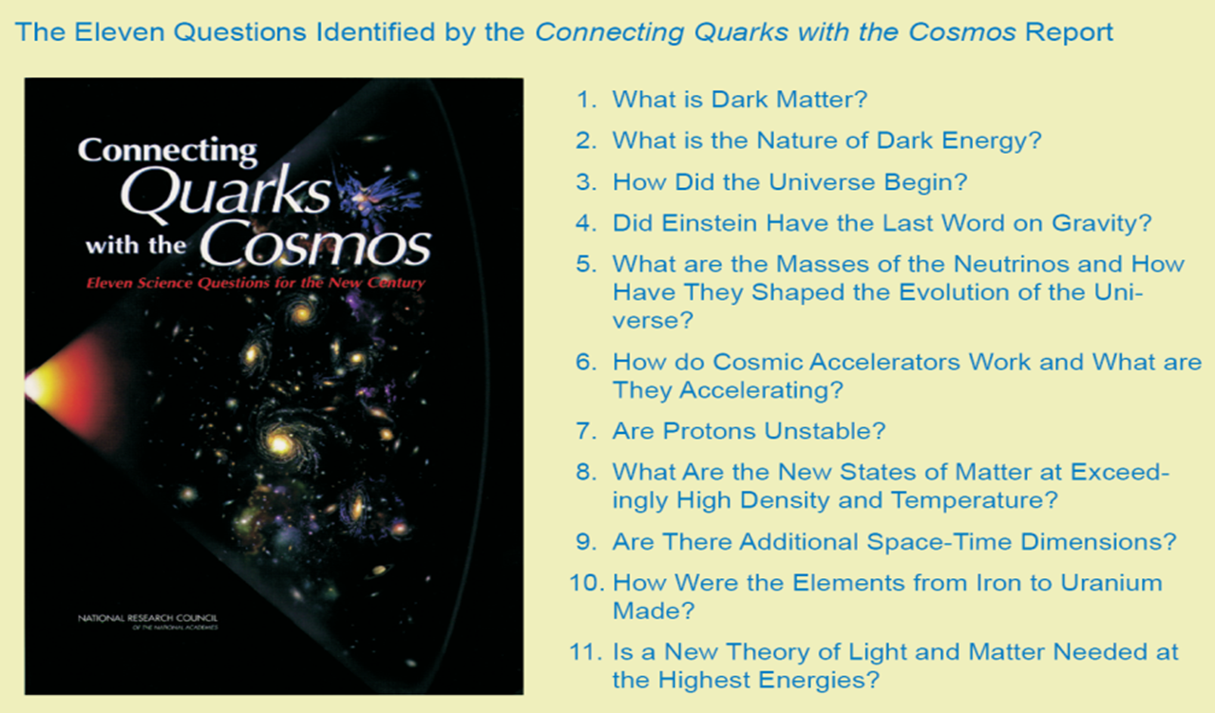
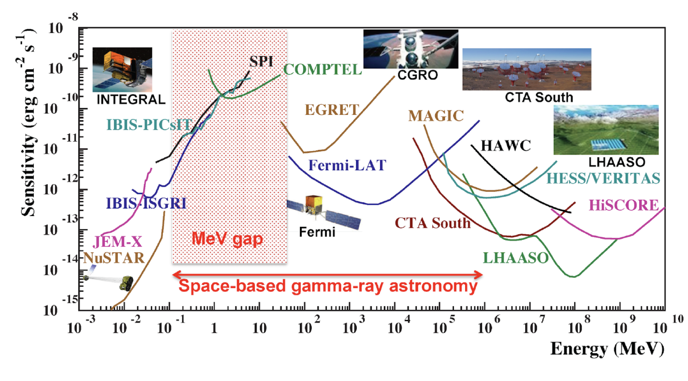
MeV – TeV gamma-ray detection
There are fantastic scientific opportunities on dark matter detection, cosmic ray physics, origination of elements above Iron and time-domain & multi-messenger astronomy, via precise gamma-ray observations in a wide energy range from MeV to TeV.

Slide 4
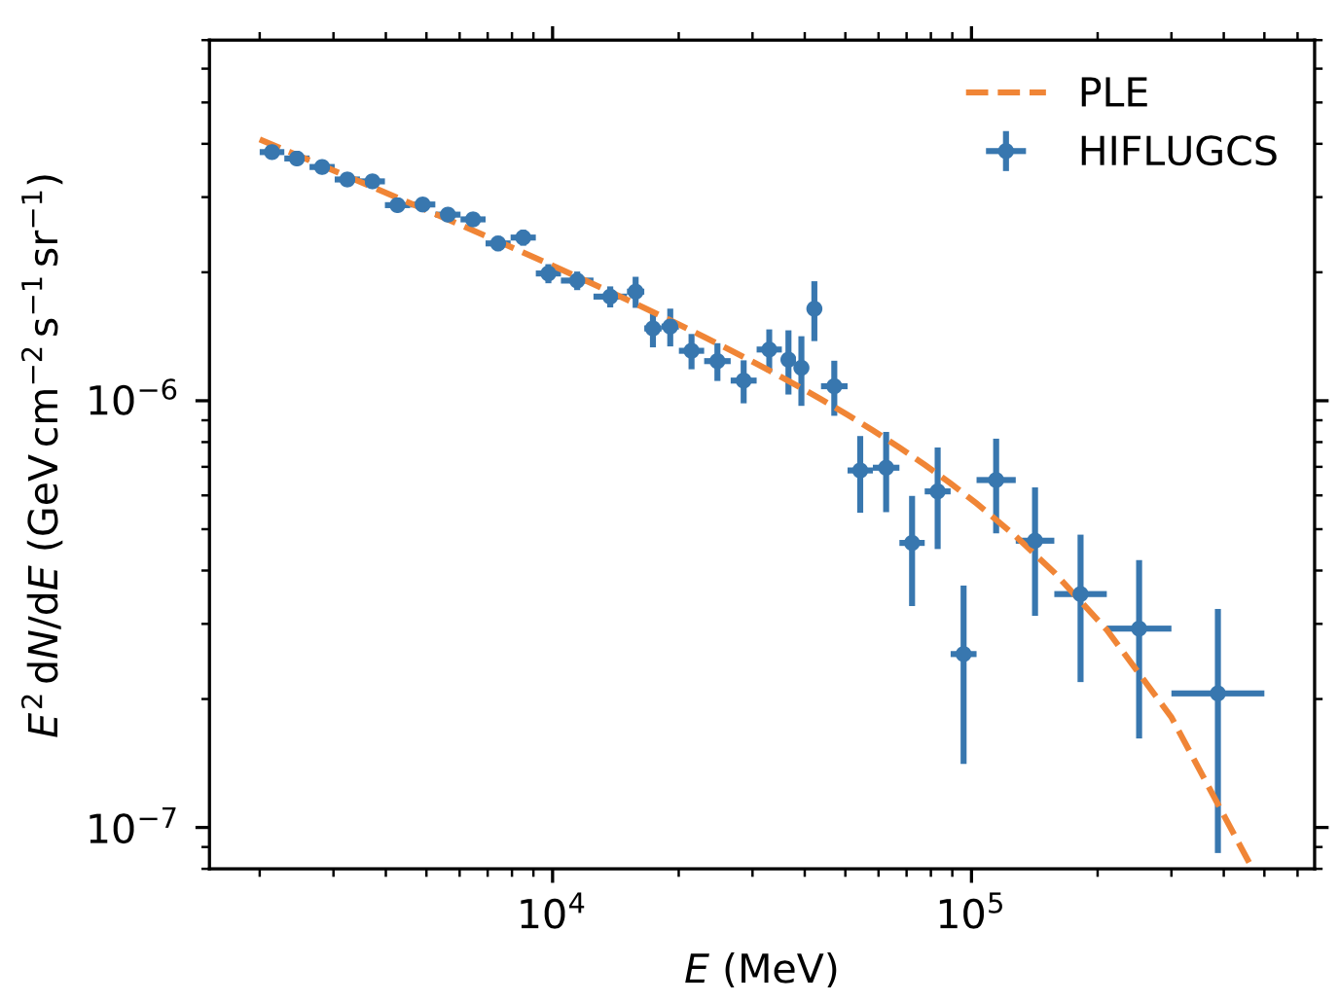
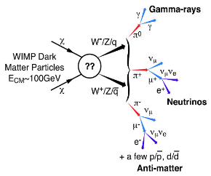
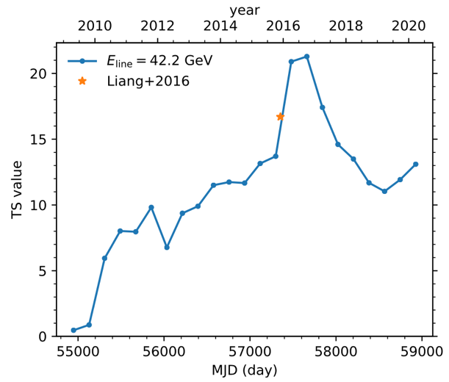
Dark matter indirect detection
Shen, Xia & Fan 2021
line-like?
Dark matter may annihilate or decay to gamma-ray lines. A new detector with sensitivity over 10 times more than current detectors could validate or discover line candidates, leading the research on gamma-ray-based dark matter indirect detection.

Slide 5
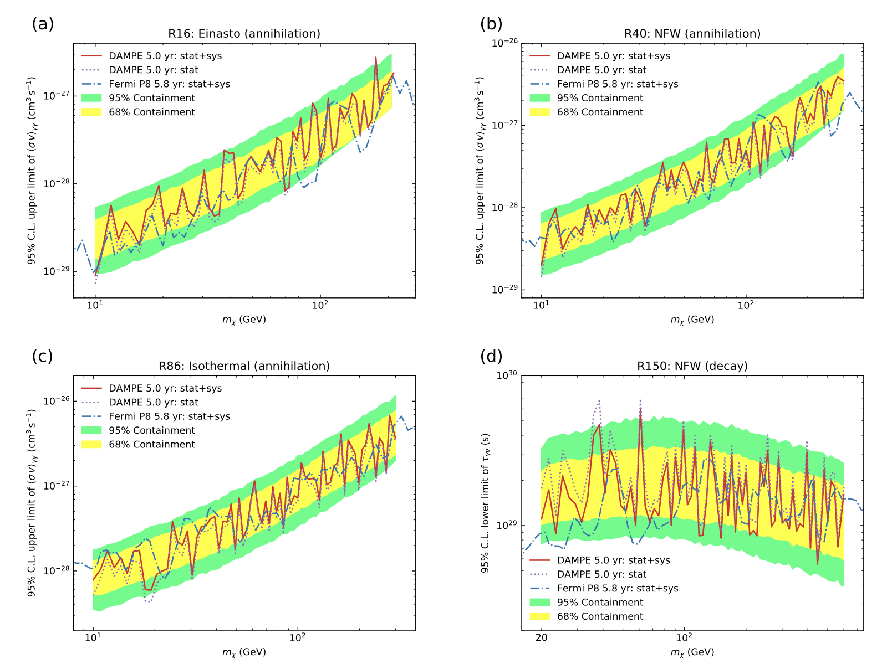
Implications from DAMPE
DAMPE 5yr vs Fermi-LAT 5.8yr
Sci. Bull. 67, 679 (2022)
The best potential signal of dark matter in space detection
DAMPE is much smaller than Fermi-LAT (1/10), but much better energy resolution
Similar sensitivity with Fermi-LAT, and even better in lower energies

Slide 6
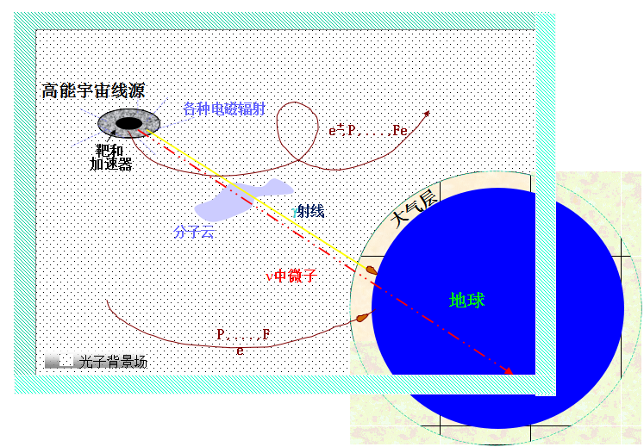
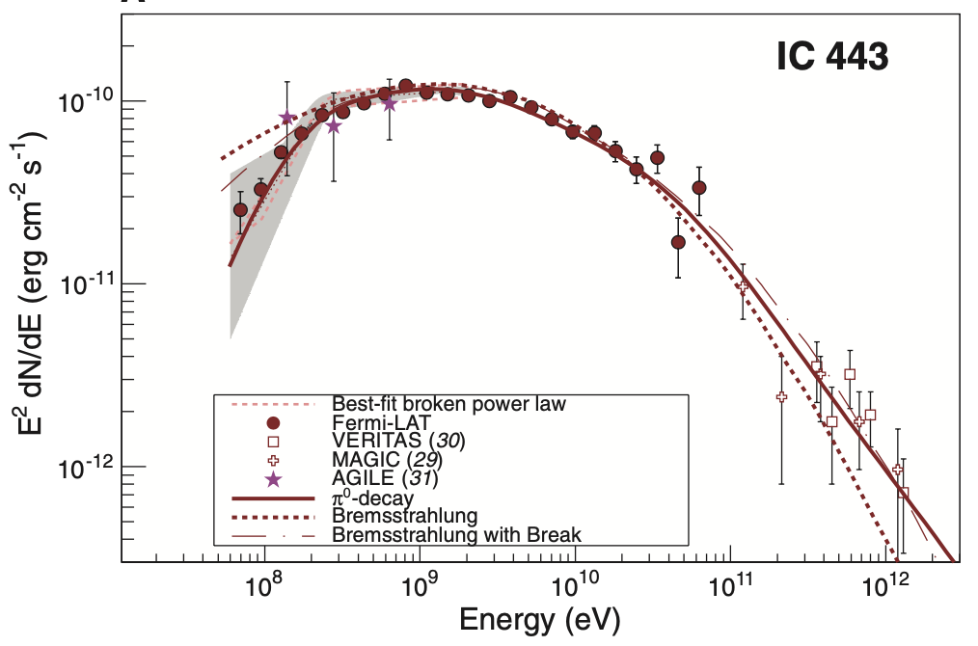
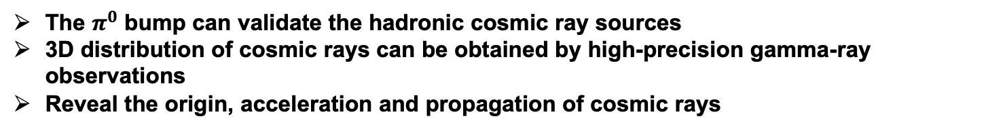

Cosmic ray origination
Fermi collaboration (2013 Science)
$π^{0}$bump
The $π^{0}$ bump can validate the hadronic cosmic ray sources
3D distribution of cosmic rays can be obtained by high-precision gamma-ray observations
Reveal the origin, acceleration and propagation of cosmic rays

Slide 7
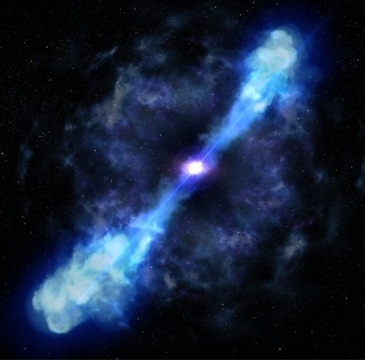
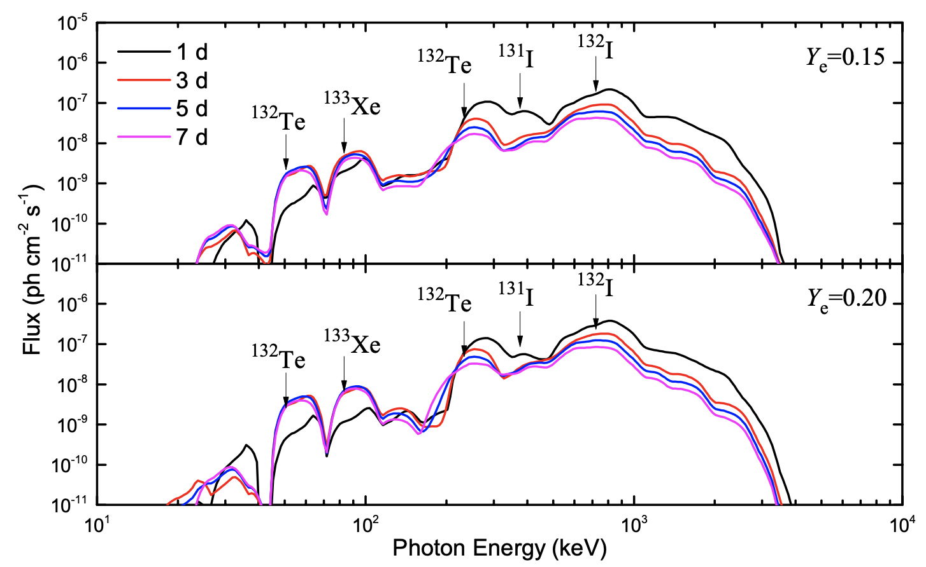
Elements above Iron
kilonova by NS mergers
MeV emission from neutron star merger / kilonova
Direct observation by a new high-sensitivity gamma-ray detector
Discovery of the source of elements above Iron in the Universe

Slide 8
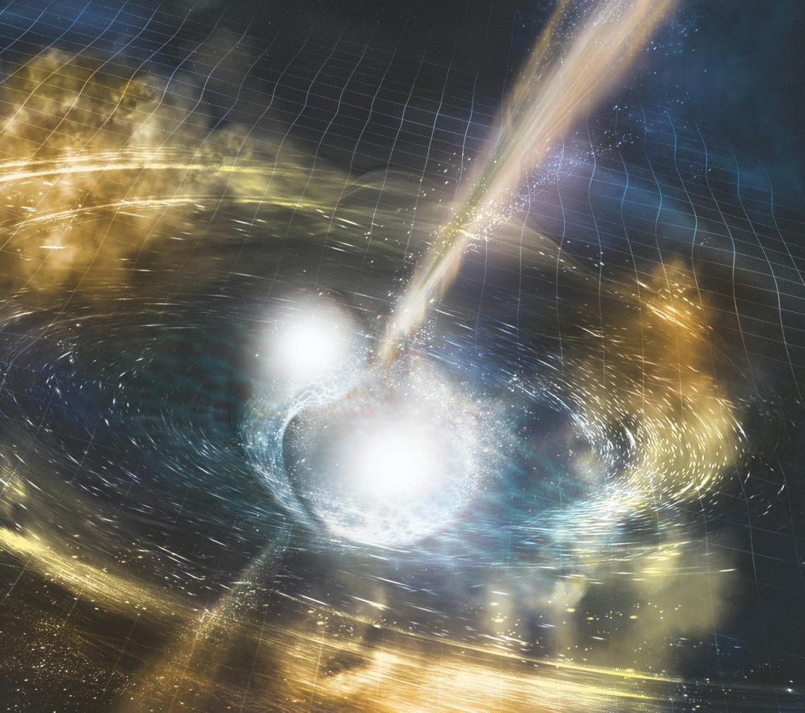
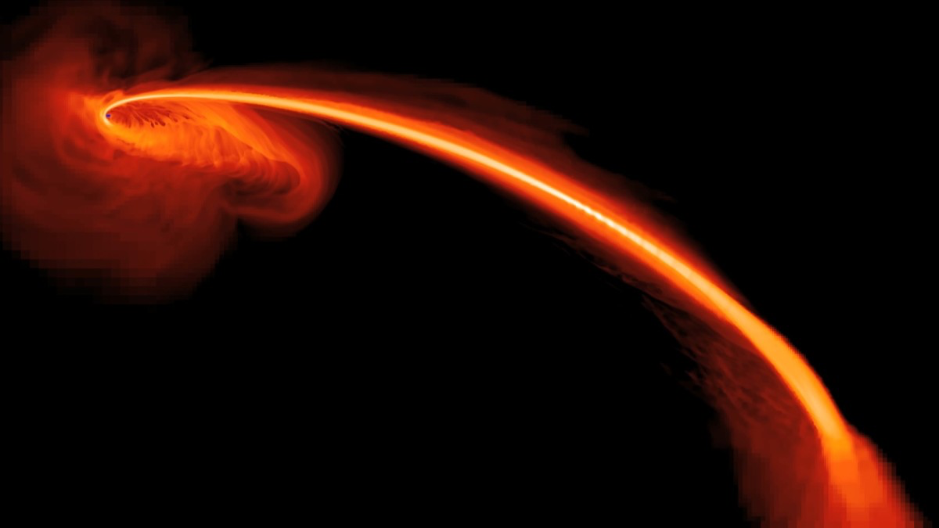
Time-domain astronomy
GeV emission from electromagnetic counterparts of GWs
GeV emission from TDE
Monitoring the GeV emissions/bursts
Revealing new mechanisms of NS merger, TDE, etc.

Slide 9
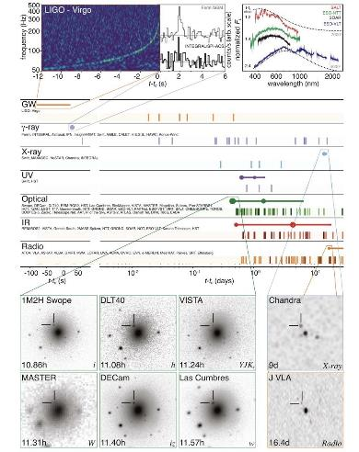
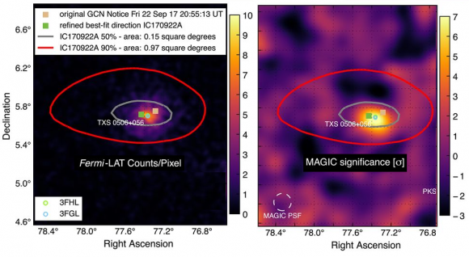
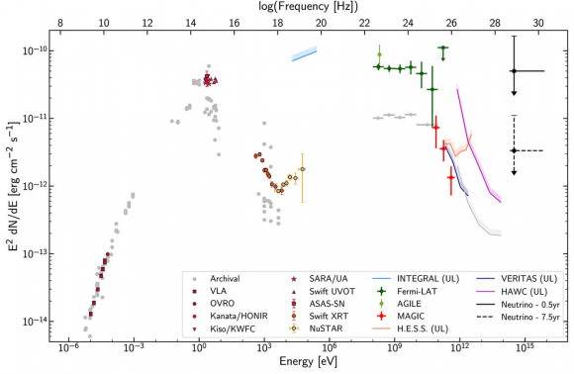
Multi-messenger astronomy
LIGO (2017)
IceCube et al. (2018)

Slide 10
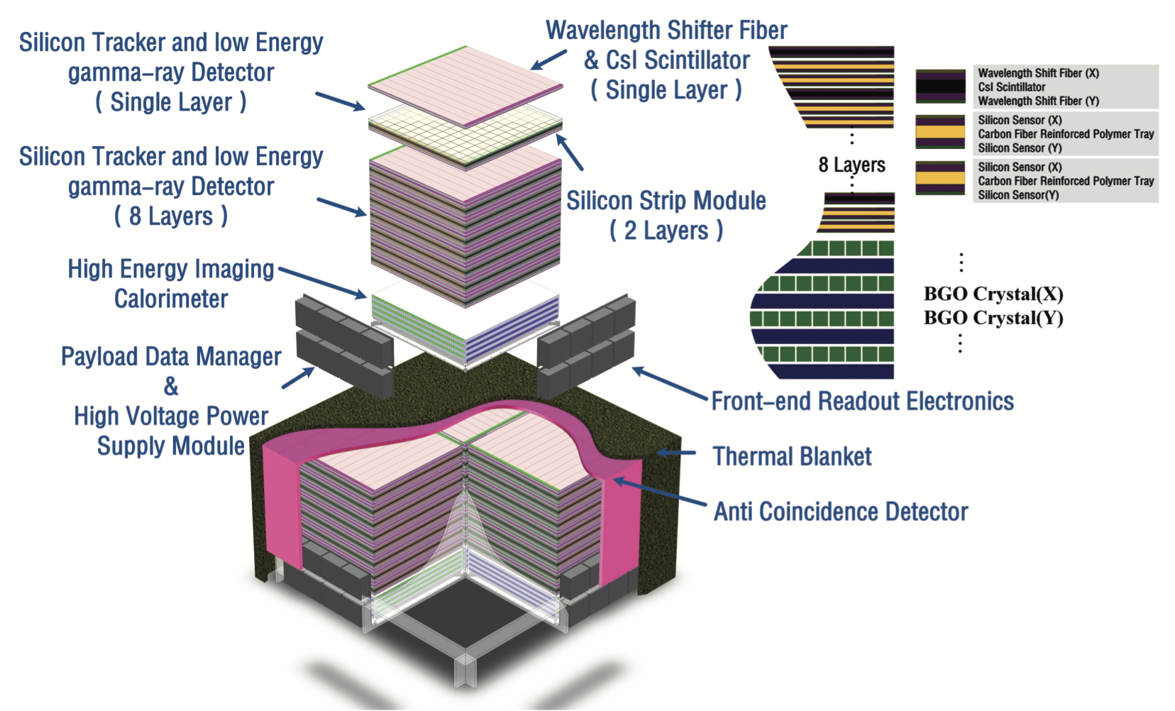
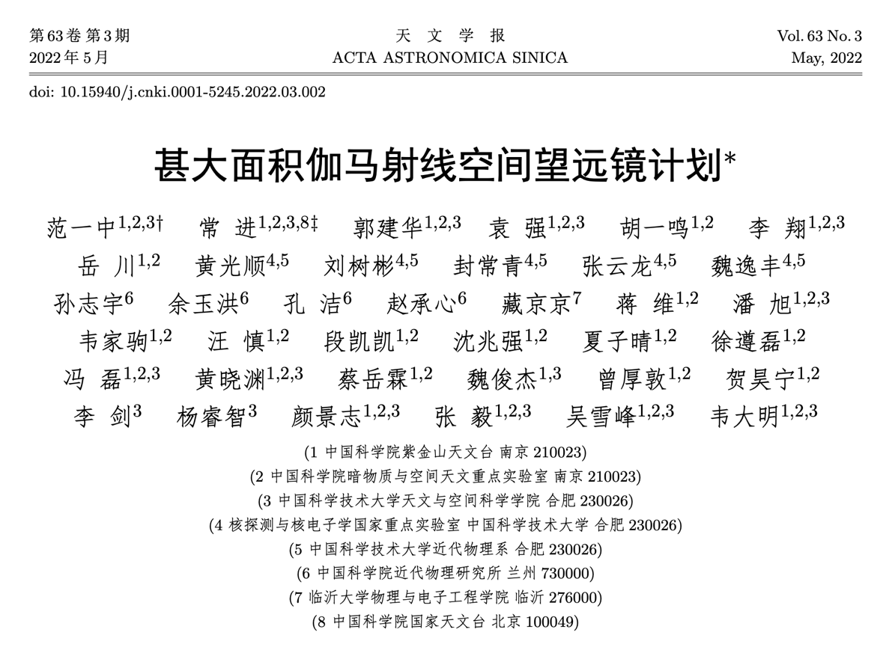
VLAST
Y.Z. Fan et al., Acta Astronomica Sinica 63(2022)27
Very Large Area gamma-ray Space Telescope (VLAST), the successor of DAMPE
The first 10 m² sr level gamma-ray satellite (~20 tons)
Leading the research on dark matter detection and time-domain astronomy based on MeV - TeV gamma-rays

Slide 11
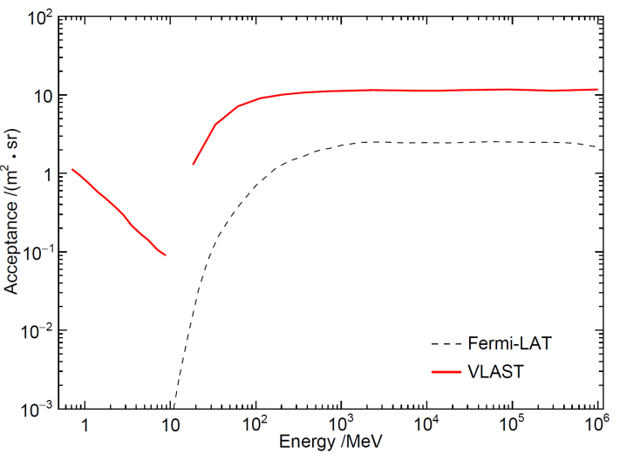
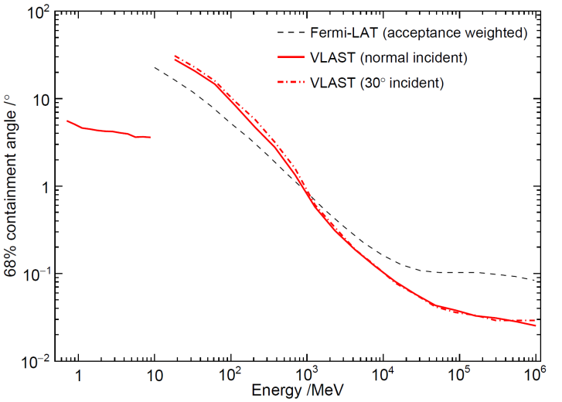
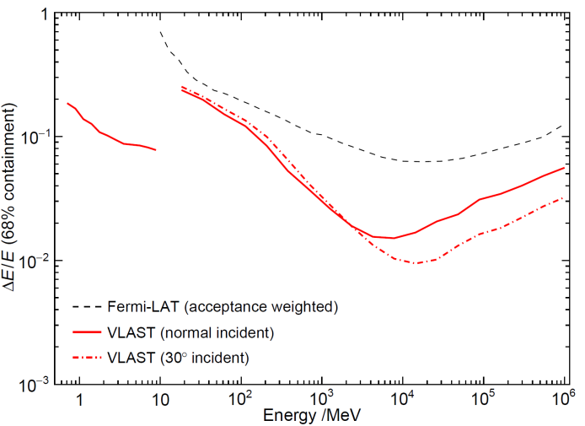
VLAST -- IRFs
VLAST
Fermi-LAT
Fermi-LAT
Fermi-LAT
VLAST
VLAST
large accepance
high angular resolution
high energy resolution
some space-based gamma-ray missions
facility | acceptance (m² sr) | energy range | energy resolution (@10GeV) | angular resolution (@50GeV)
Fermi-LAT | ～2 | 20 MeV-300 GeV | ~6.0% | ~ 0.10 deg
DAMPE | ～0.2 | 5 GeV-10 TeV | ~1.5% | ~ 0.10 deg
AMS-100 (concept) | ~30 | 0.1 GeV-10 TeV |  | ~ 0.03 deg
APT | ~20 | 1 MeV-10 TeV | ～20% | ~ 0.10 deg
HERD | ~2 | 0.5 GeV-10 TeV | ~1.5%
VLAST | ~10 | 1 MeV-10 TeV | ~1.5% | ～0.10 deg

Slide 12
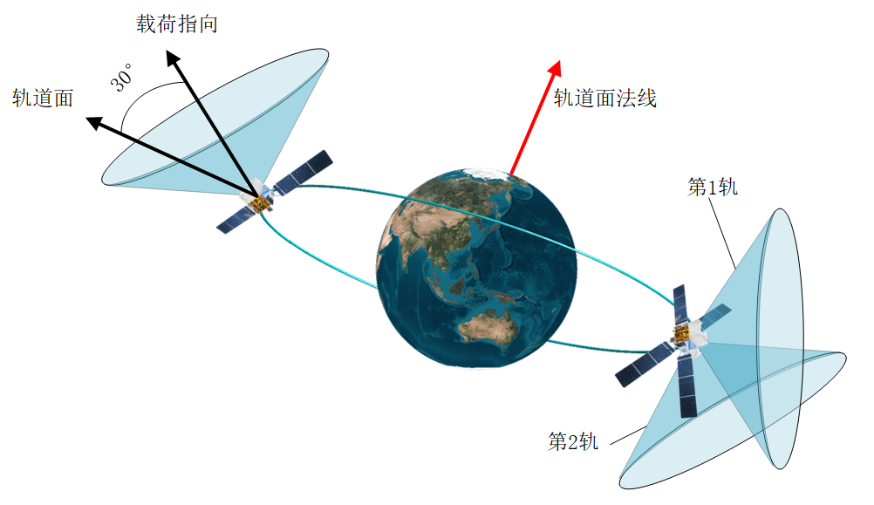
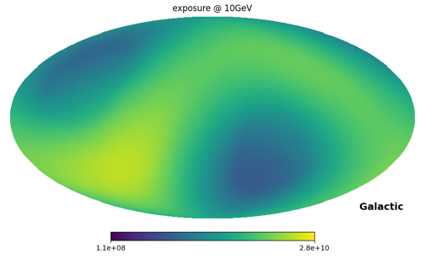
Observation mode
sky survey
Design of observation modes
sky survey：full sky survey in two orbits
pointing mode：specific points/regions
opportunity mode
Transient source：rely on Beidou communications within 120s
1 month exposure

Slide 13
Outline
Scientific Objectives
Detector design
R & D progress
Summary

Slide 14
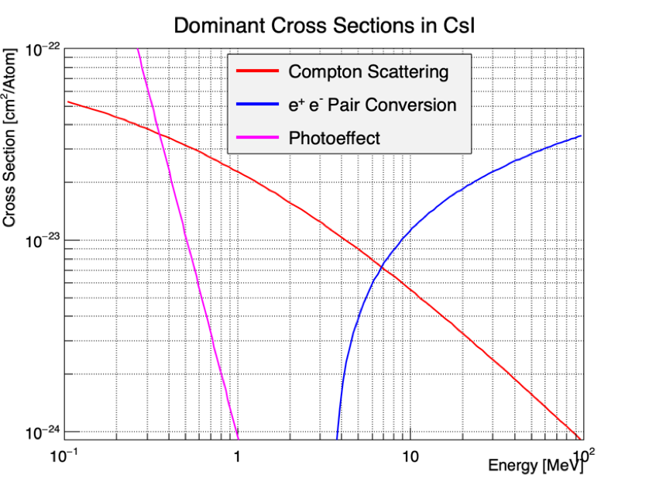
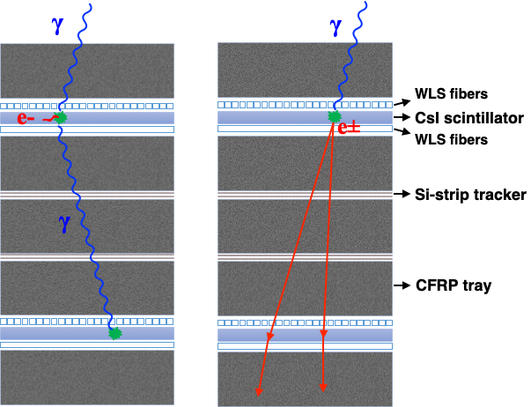
Design of VLAST
Y.Z. Fan et al., Acta Astronomica Sinica 63(2022)27
Compton
event
Pair
event
2×2 matrix
each unit: 1.2×1.2 m2
Weight: ~1.6 tons in total
Major payloads:
ACD (Anti Coincidence Detector)
STED (Silicon Tracker and low Energy gamma-ray Detector)
HEIC (High Energy Imaging Calorimeter)

Slide 15
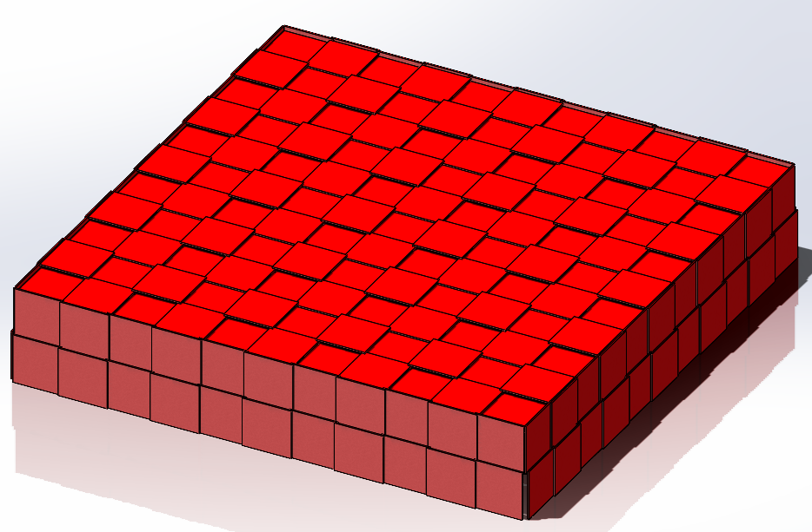
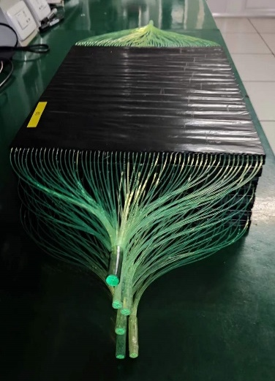
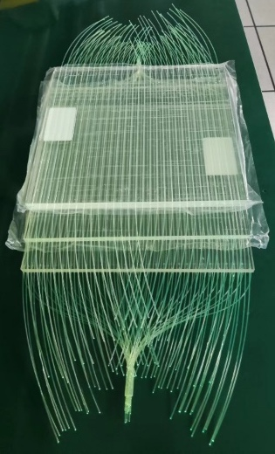
Anti-Coindicence Detector
Major functions
distinguish electron/gamma
measuring charge for light nuclei
Major technical indices
unit size：<1000cm²
charge range：electron, nuclei (Z=1~8)
efficiency：better than 99.97%
trigger signal for charged particles
10 kHz/m²
Detector
top: 3100mm×3100 mm
side:3100mm× 600 mm
unit size: 300mm×300 mm
readout: WLSF
electronics
PMT (or SiPM) +charge ASIC
structure
unit

Slide 16
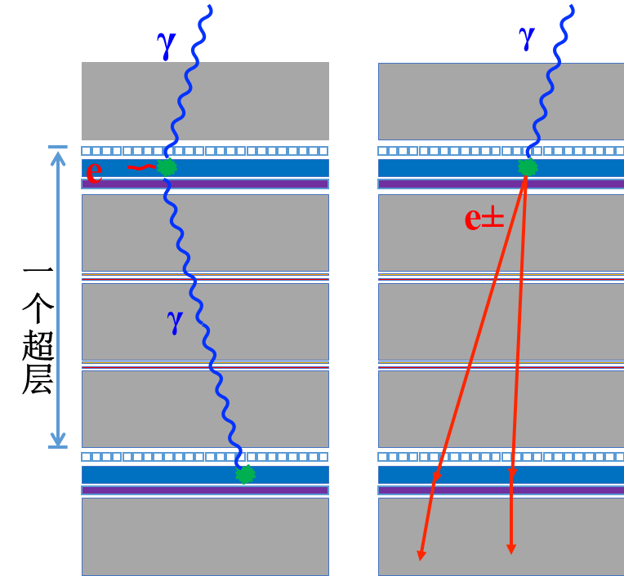
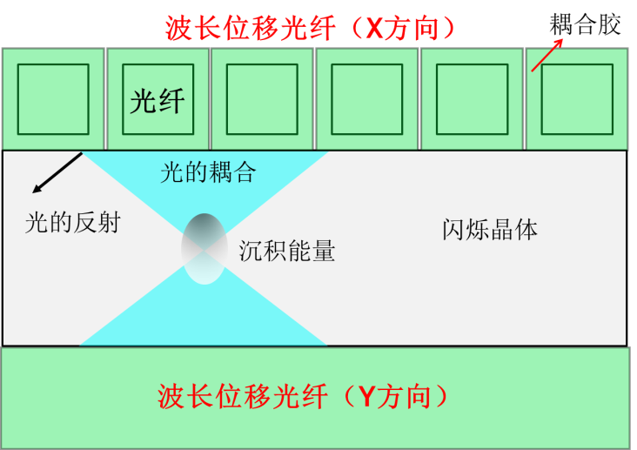
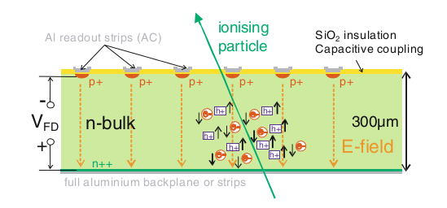
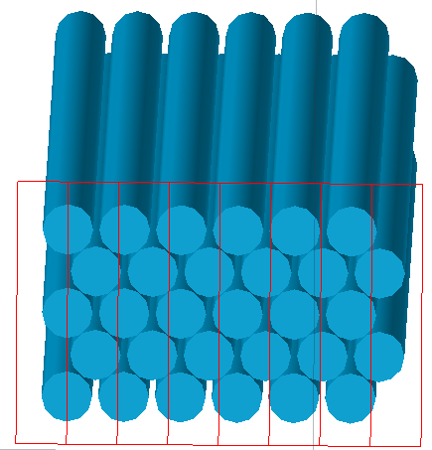
Silicon Tracker and low Energy gamma-ray Detector
Major functions
GeV- TeV: track measurement for pair converted electrons
MeV: direction and energy
Major technical indices
layers：8 superlayers (one CsI layer + two silicon layers)
area：>= 2800mm×2800 mm；
energy range：1-100 MeV
angular resolution <0.1°@50GeV
Detector + electronics
CsI+WLSF，SiPM+waveshape
inheriting current techniques of silicon microstrip tracker at DAMPE
exploring the fiber substitute for silicon microstrip
CsI layer + silicon tracker layer
scintillator fiber

Slide 17
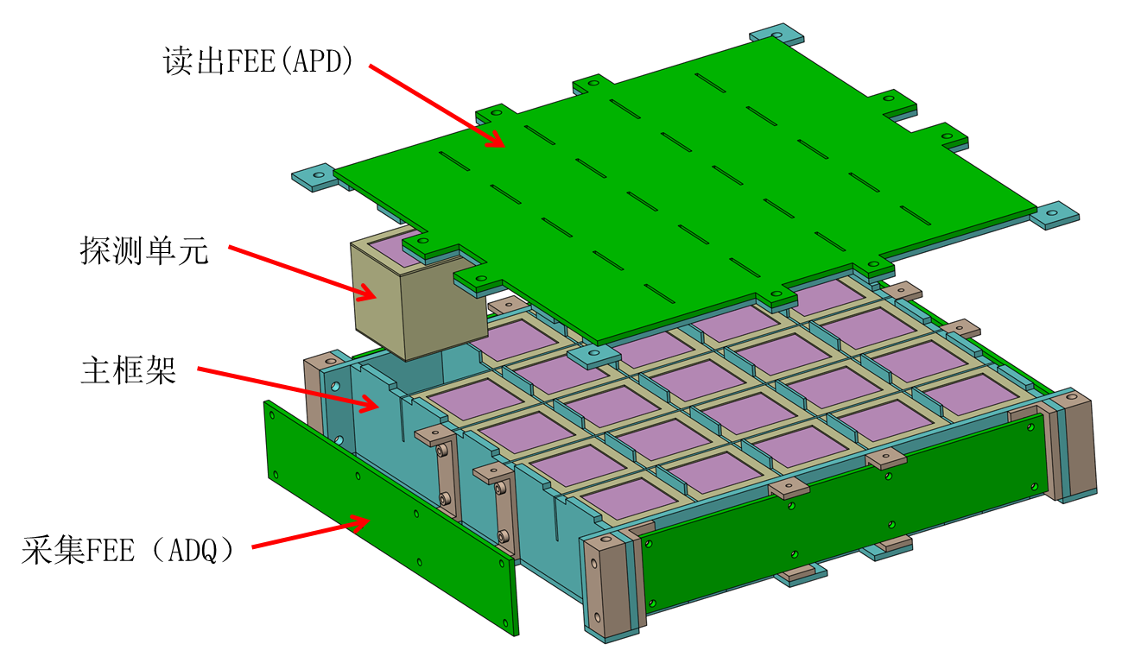
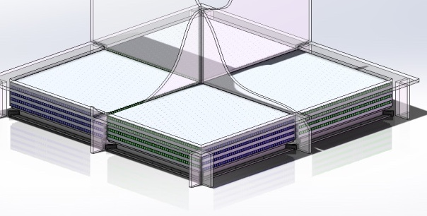
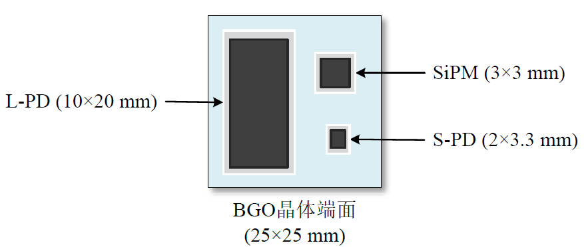
High Energy Imaging Calorimeter
Major functions
energy measurement
proton/electron discrimination
trigger
Major technical indices
area：~2400mm×2400 mm
energy range：0.1GeV~20TeV (gamma)
energy resolution: <2%@50GeV
proton rejection: >10⁴@50GeV
trigger threshold：<0.5MIPs
Detector + electronics
3D pixels：~3cm cubes, 1 layer
long bars：1200×25×25 mm³，4 layers (X+Y)， 2×2 matrix
multi-gain readouts
structure
bar readout

Slide 18
Payload Data Manager
Major functions
trigger and DAQ
on-orbit multi-level trigger algorithm, reducing the event rate
Major technical indices
event rate：2kHz on average
data storage：64GB per day？
Trigger approach
MeV gamma: CsI independent
GeV gamma: ACD + STED + HEIC
>5GeV: HEIC only

Slide 19
Outline
Scientific Objectives
Detector design
R & D progress
Summary

Slide 20
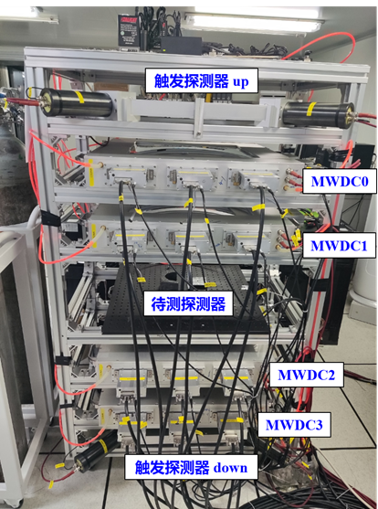
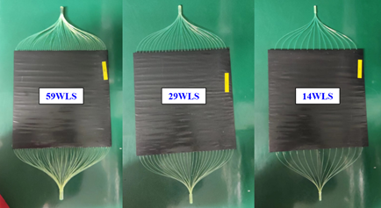
Anti-Coindicence Detector
ACD
unit product: done
unit test: efficiency >99.99%
first prototype: done

Slide 21

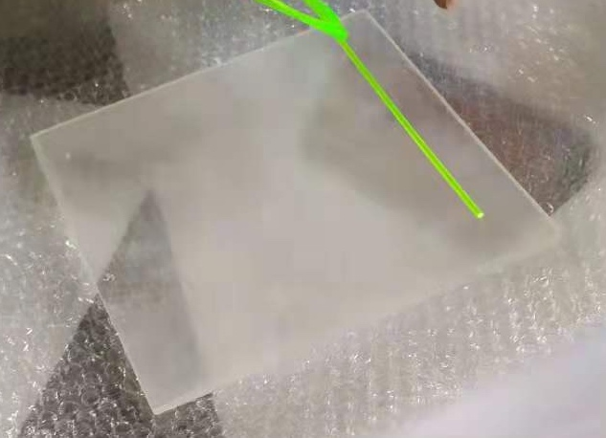
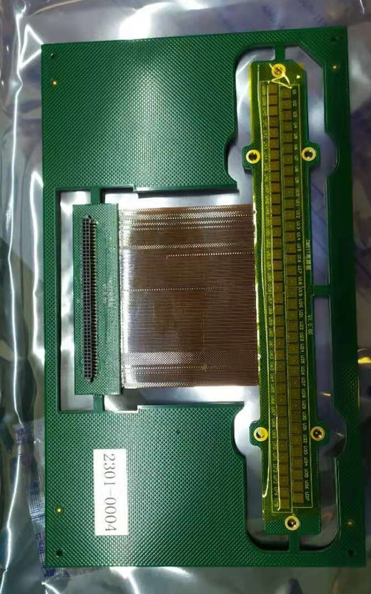
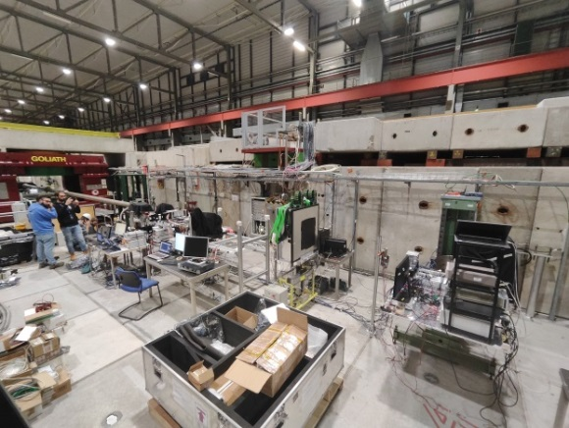
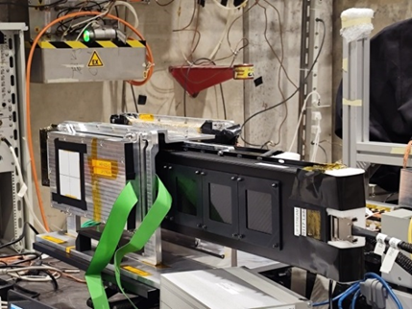
Silicon Tracker and low Energy gamma-ray Detector
CsI readout
crystal: done
fiber: cut and polish done
first module: done
silicon tracker
module: 40cm and 70cm
first prototype: 11 ladders, done

Slide 22
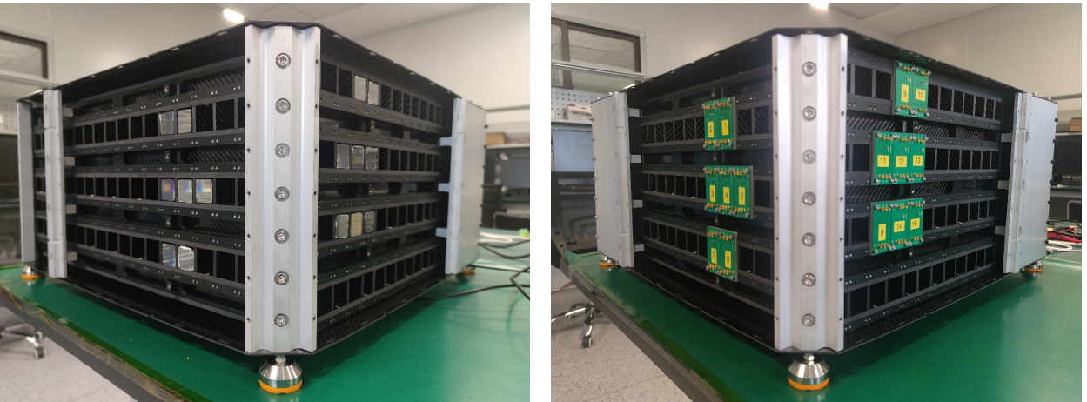
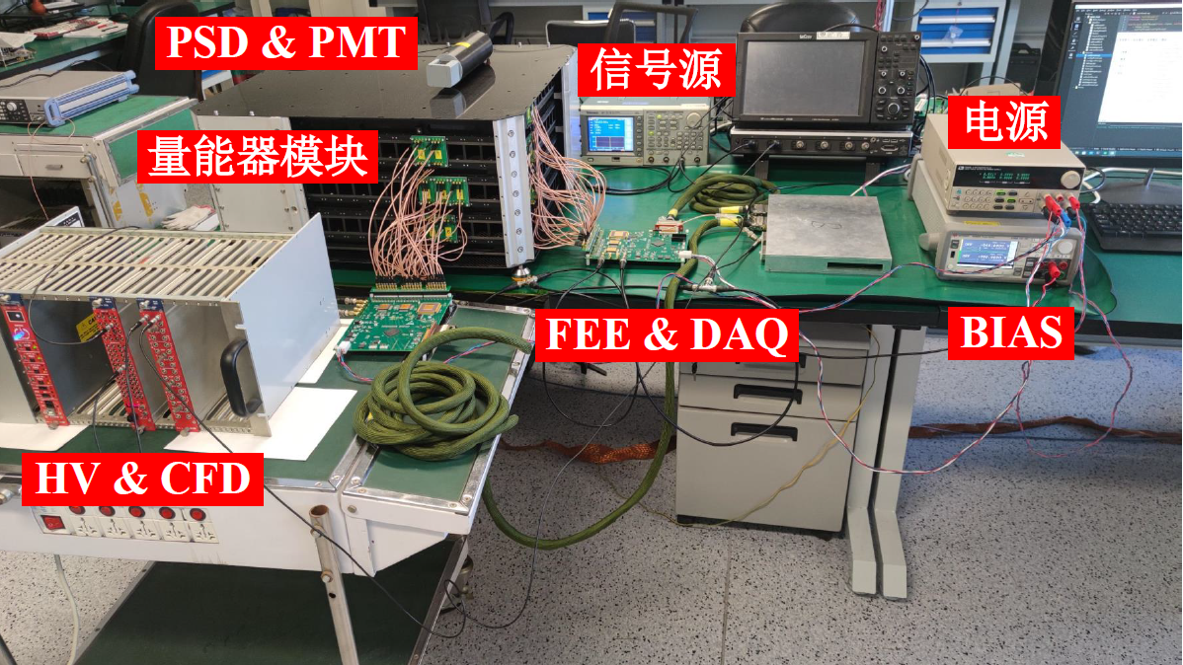
High Energy Imaging Calorimeter
long bar
electronics: done
first prototype：5 layers, done
3D pixels
design done
pixel: 30mm*30mm*30mm
first prototype: 4 layers, done

Slide 23
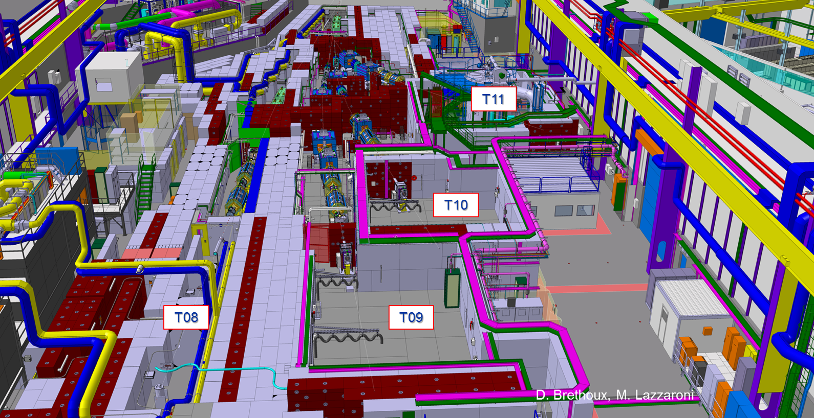
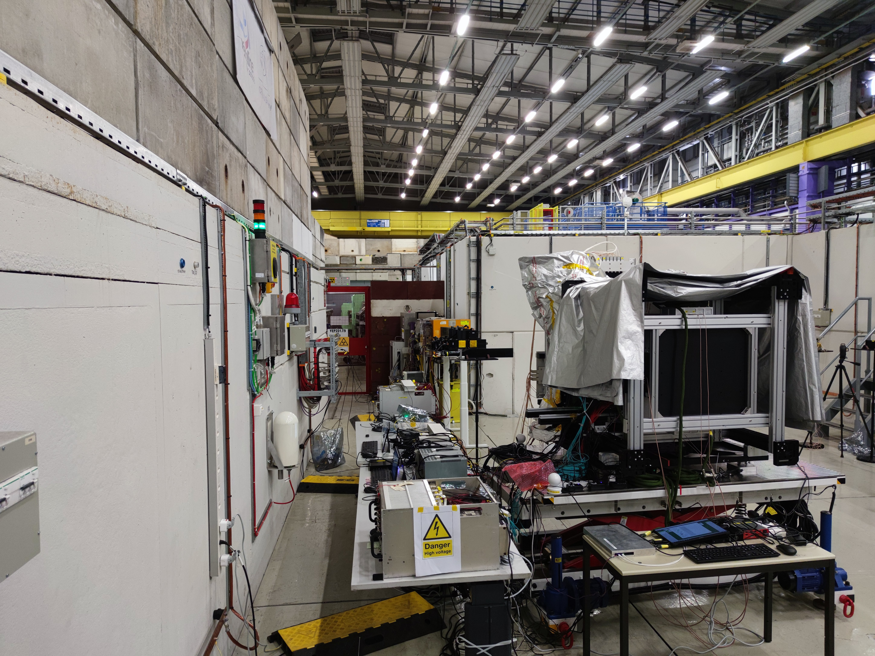
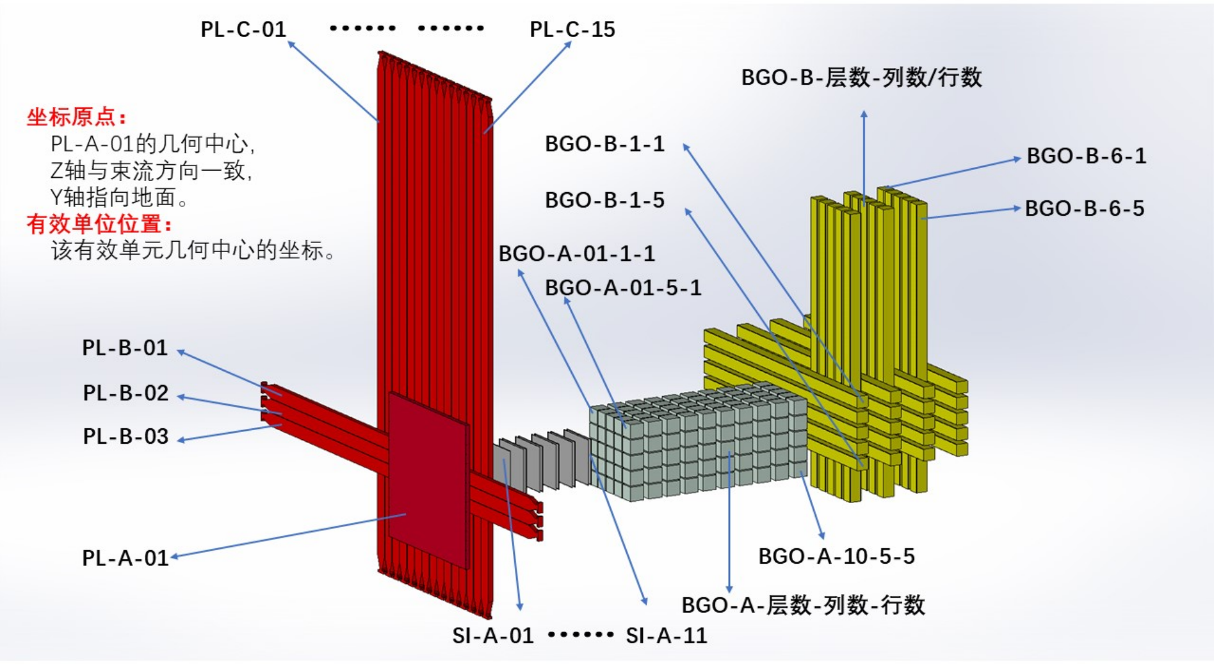
Beam Test in the past two years
BT@CERN-PS
Beam Test at CERN：
2023: Week37, PS-T9 (e-/p)
2023: Week40, SPS-H8 (ions)
2024: Week20, SPS-H2 (e-/pi-)
2024: Week21-22, PS-T9 (e-/p/γ)
2024: Week46, SPS-H4(ions)
status for prototype：
ACD (pile + long strip)
STED (Silicon + CsI)
HEIC (3D pixel + long bar)

Slide 24
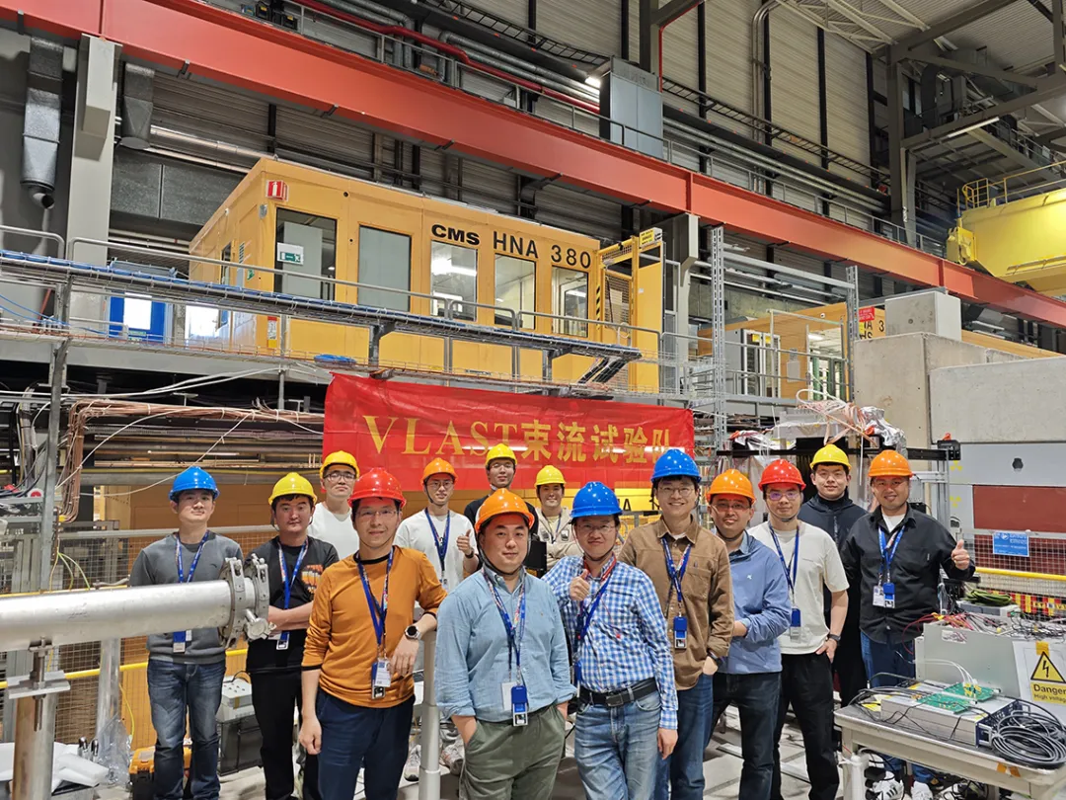
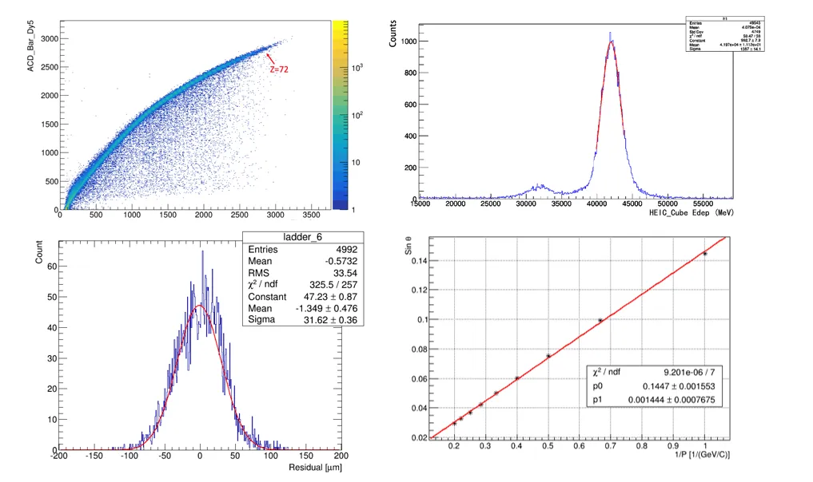
Beam Test in the past two years
BT@CERN-SPS
some preliminary results

Slide 25
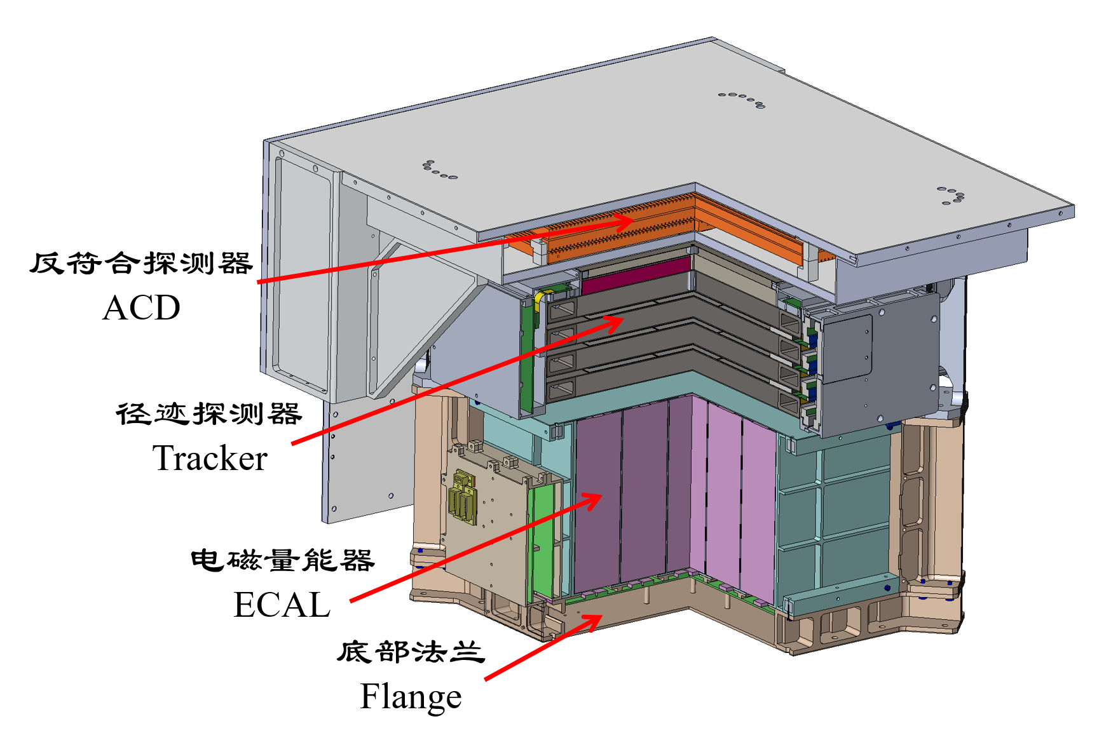
Pathfinder (VLAST-P)
Specification
Field of View | ±45°
Energy range | 50MeV~5GeV
Energy Resolution（Sigma） | <10%@(200MeV~1GeV)
Acceptance | > 100cm2 Sr @100MeV
ACD Efficiency for MIPs | > 99.9%
Spatial resolution (Sigma) | <50um
Mass | ~178Kg
Technical purpose：
ACD detector developed by IMP
Silicon-strip detector developed by PMO
ECAL developed by USTC
Scientific purpose:
Observing high-energy radiation processes during solar flares, studying the radiation mechanisms of solar flares
Observing other high-energy gamma-ray bursts beyond the Sun

Slide 26
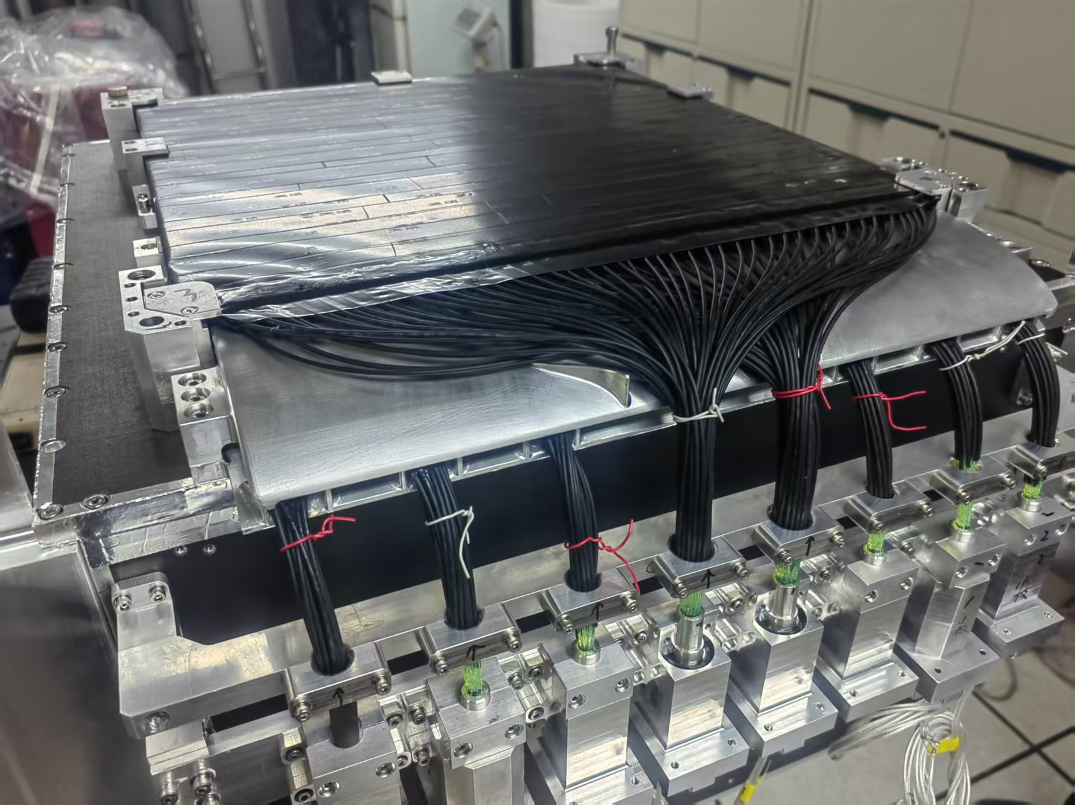



Pathfinder (VLAST-P)
ACD
Tracker
ECAL
Electronics Model：
Assembled in May
Thermal cycle test, mechanics test and thermal vacuum test by June
Flight Model：
Will finish assembly by the end of next Feb.
Plan to be launched by the end of 2026
VLAST-p

Slide 27


Summary/Overview
A flagship for space-based gamma-ray detection：Very Large Area gamma-ray Space Telescope（VLAST）
Leading the researches on gamma-ray-based dark matter indirect detection and time-domain astronomy
Major payloads:
ACD (Anti Coincidence Detector)
STED (Silicon Tracker and low Energy gamma-ray Detector)
HEIC (High Energy Imaging Calorimeter)
Scientific objectives：
Indirect detection of dark matter (DM) particles
1) GeV emission by DM annihilation/decay from regions like dwarf spheroidal galaxies
2) Line-like structure by DM annihilation/decay
3) Axions or axion-like particles
4) DM signals in cosmic ray electrons
Gamma-ray astronomy
1) Electromagnetic counterparts of gravitational waves, neutrinos and tidal disruption events
2) New GeV bursting or high-z sources
3) Measuring the GeV gamma-ray horizon of the Universe
Cosmic ray physics
1) Nearby electron sources
2) New spectral structures in high-energy range
An prototype has been sent to CERN for Beam Test in the past two years (2023-2034)
Handle the key techniques in a few years
A pathfinder project has been established and will be launched in 2026

Slide 28
Summary/Overview
A flagship for space-based gamma-ray detection：Very Large Area gamma-ray Space Telescope（VLAST）
Leading the researches on gamma-ray-based dark matter indirect detection and time-domain astronomy
Major payloads:
ACD (Anti Coincidence Detector)
STED (Silicon Tracker and low Energy gamma-ray Detector)
HEIC (High Energy Imaging Calorimeter)
Scientific objectives：
Indirect detection of dark matter (DM) particles
1) GeV emission by DM annihilation/decay from regions like dwarf spheroidal galaxies
2) Line-like structure by DM annihilation/decay
3) Axions or axion-like particles
4) DM signals in cosmic ray electrons
Gamma-ray astronomy
1) Electromagnetic counterparts of gravitational waves, neutrinos and tidal disruption events
2) New GeV bursting or high-z sources
3) Measuring the GeV gamma-ray horizon of the Universe
Cosmic ray physics
1) Nearby electron sources
2) New spectral structures in high-energy range
An prototype has been sent to CERN for Beam Test in the past two years (2023-2034)
Handle the key techniques in a few years
A pathfinder project has been established and will be launched in 2026
Thank you for your attention!

