Slide 1

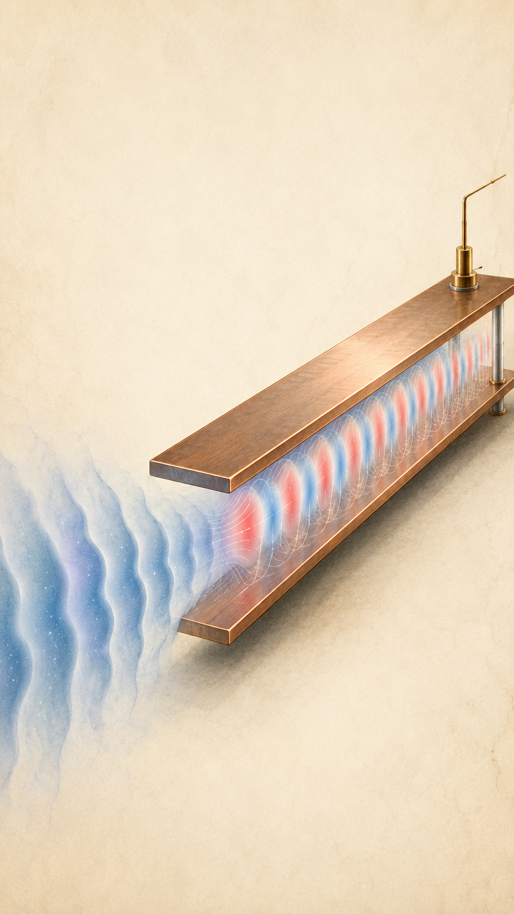

Waveguide Haloscope
for sub-meV dark matter
邢传阳 (Chuan-Yang Xing)
China University of Petroleum (East China)
arXiv: 2605.15820
Bin Zhu
2026.7 @ Urumqi

Slide 2
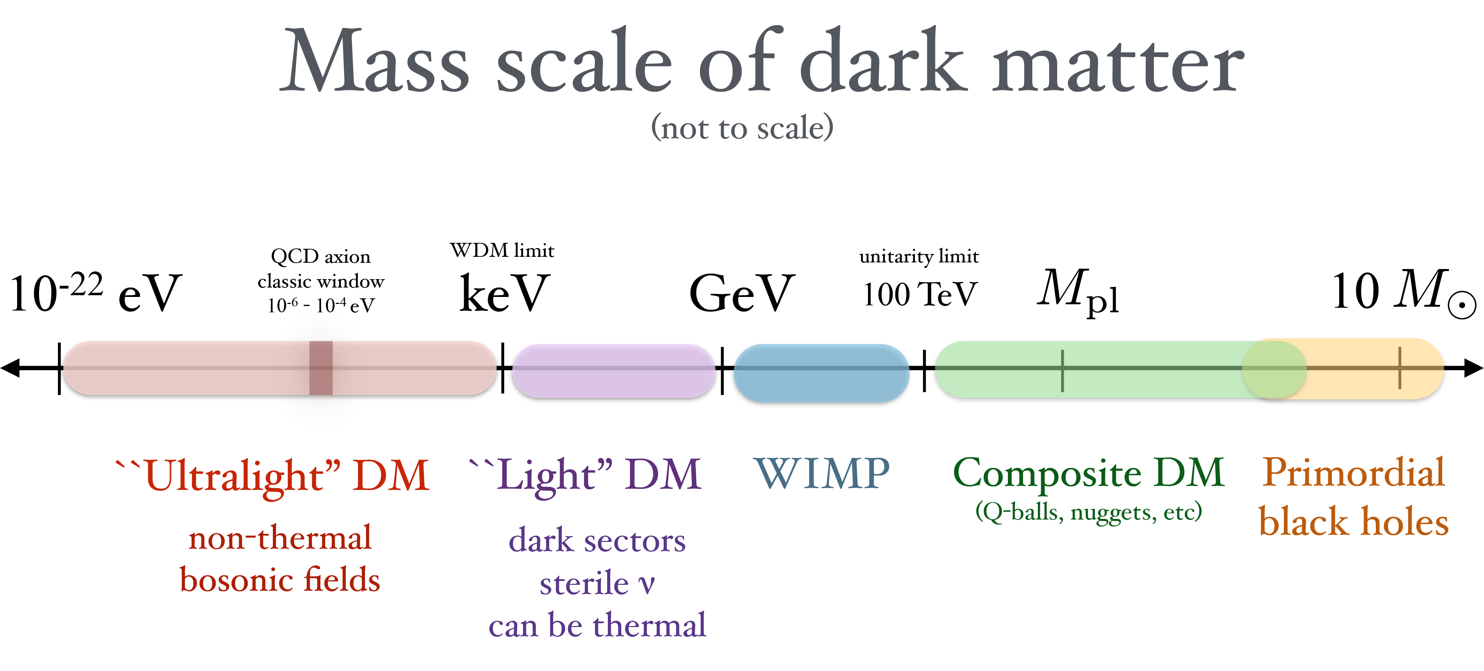
Dark Matter Spectrum
Lin, 1904.07915
Wave-like
Particle-like
Macroscopic

Slide 3
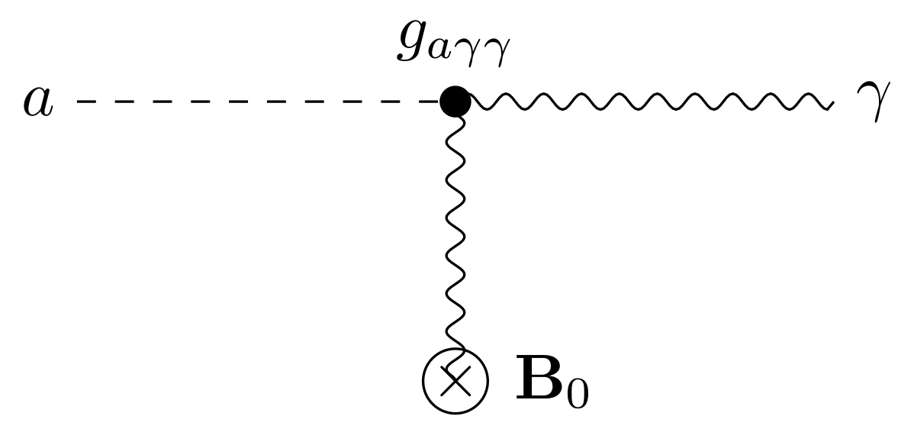
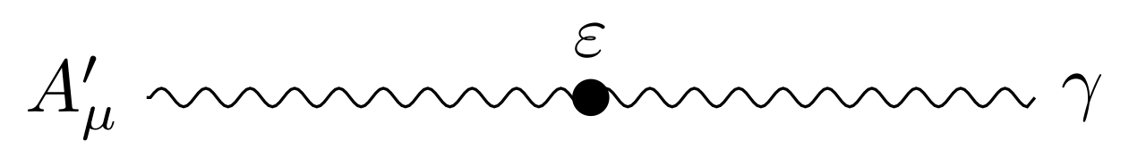
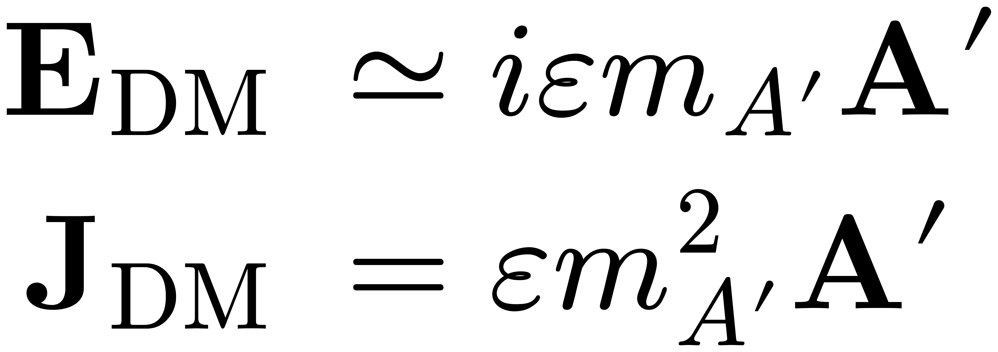
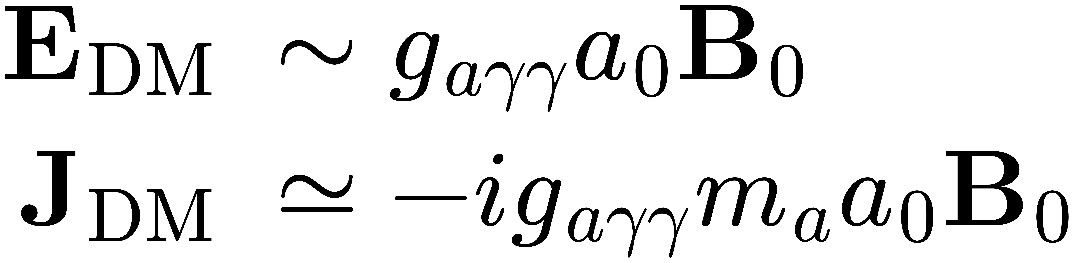
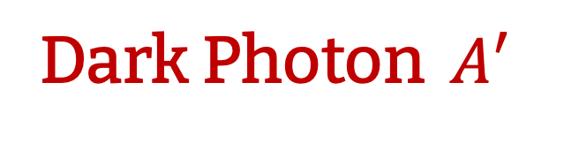
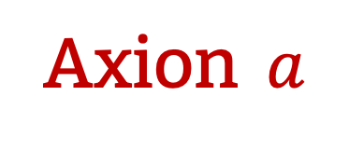
Benchmark Models
Dark Photon $A′$
Axion $a$

Slide 4
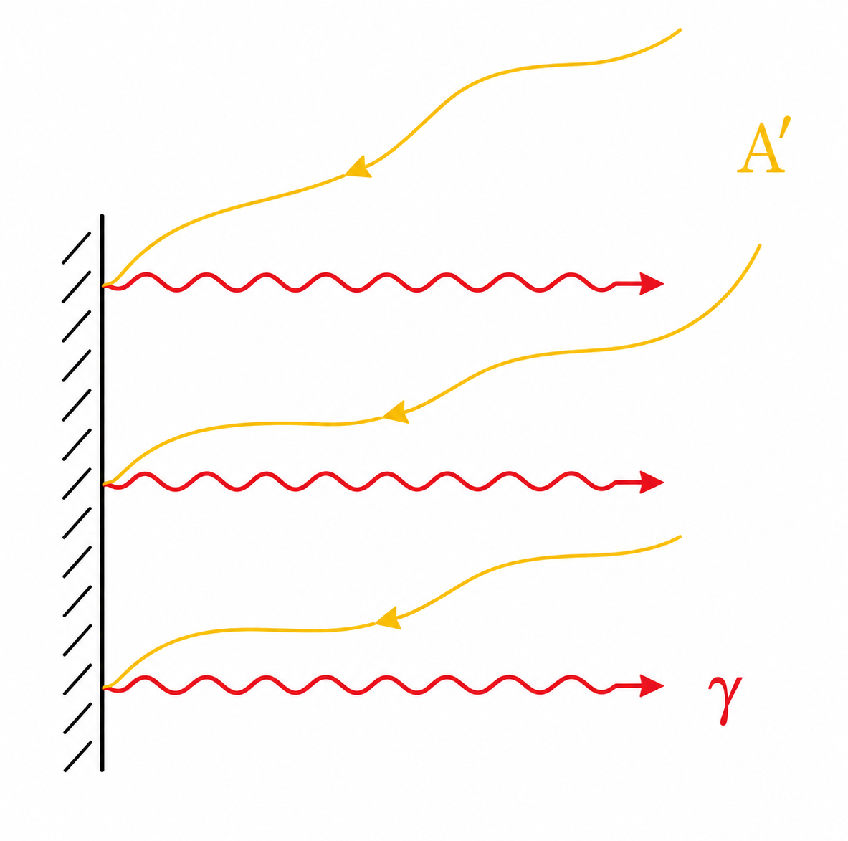
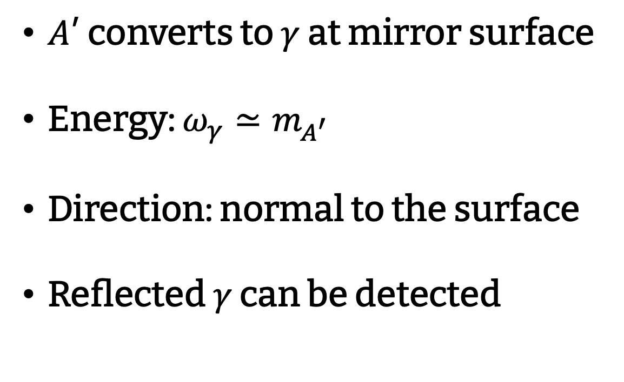
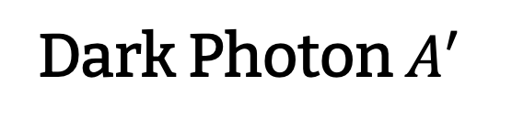
Detection: Dish Antenna
Dark Photon $A^{′}$
mirror
𝐴′ converts to $γ$ at mirror surface
Energy: $ω_{γ}≃m_{A^{′}}$
Direction: normal to the surface
Reflected $γ$ can be detected
see also in Guan’s talk.

Slide 5
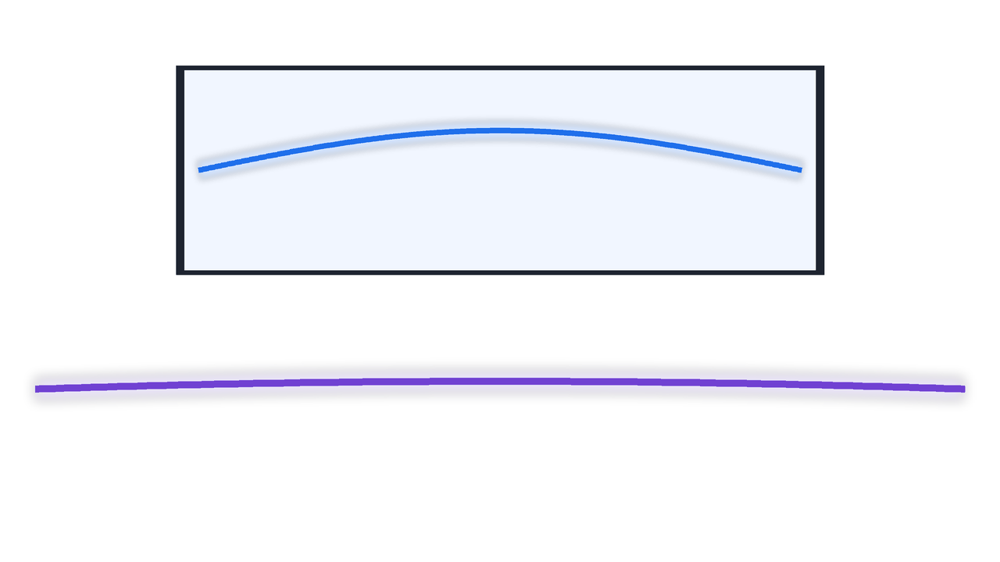

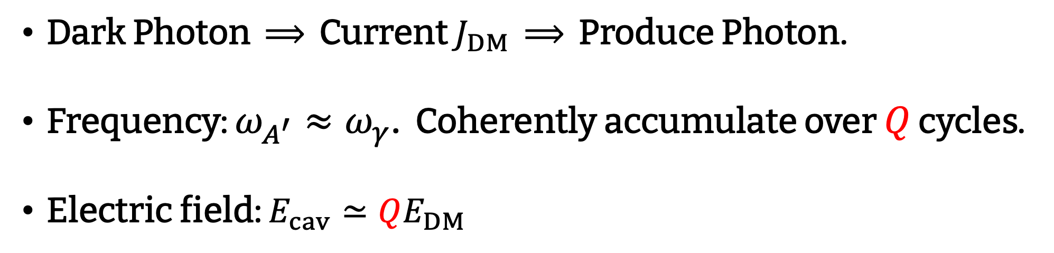
Detection: Cavity
Cavity
standing wave
Photon Field
Dark Photon Drive $J_{DM}$
Dark Photon $⟹$ Current $J_{DM}$ $⟹$ Produce Photon.
Frequency: $ω_{A^{′}}≈ω_{γ}$. Coherently accumulate over $Q$ cycles.
Electric field: $E_{cav}≃QE_{DM}$

Slide 6
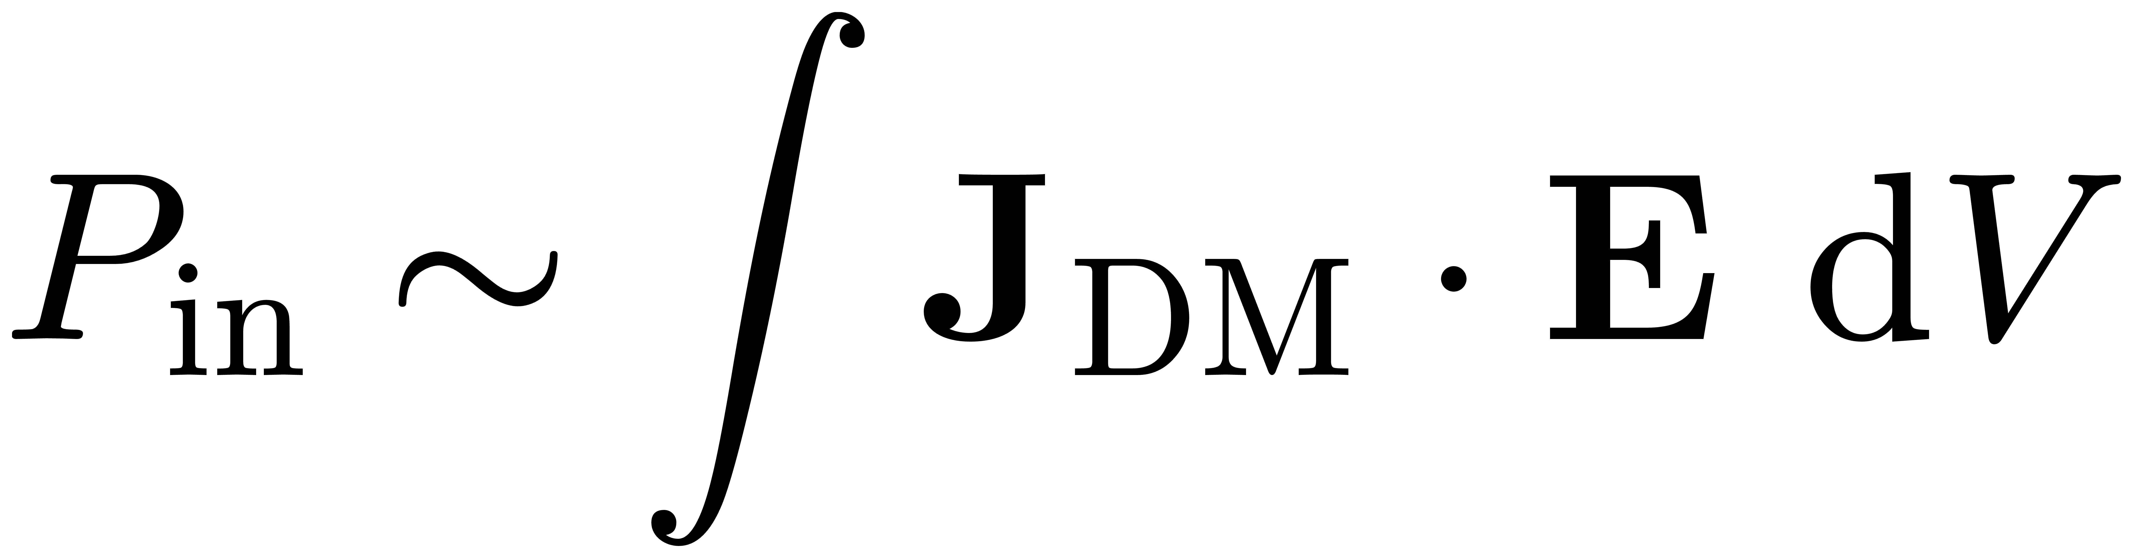
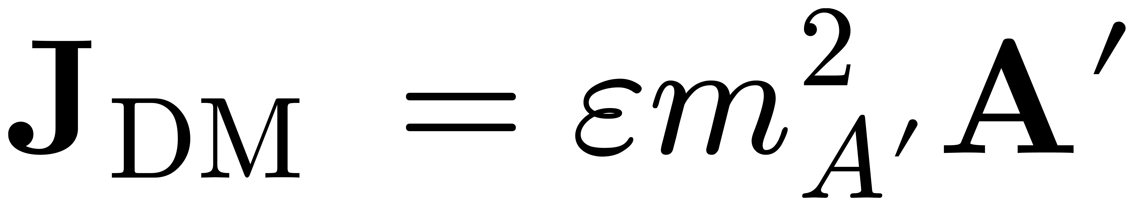
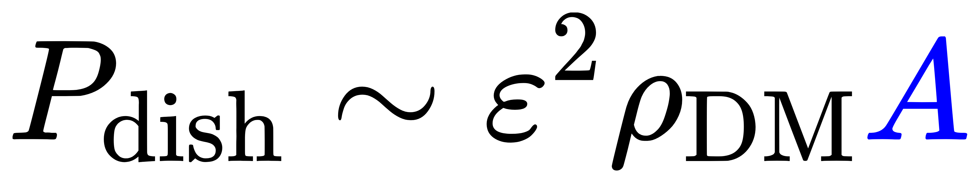
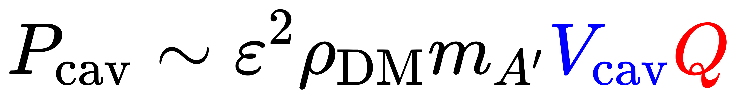
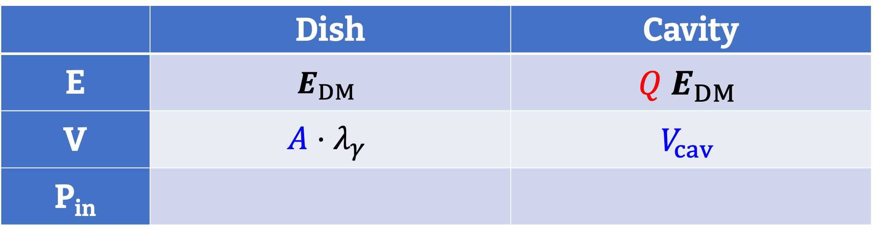

Detection Power
Output Power $≈$ Input Power:
is constant.
 | Dish | Cavity
E | $$E_{DM}$$ | $$Q E_{DM}$$
V | $$A⋅λ_{γ}$$ | $$V_{cav}$$
P_{in}
mirror

Slide 7

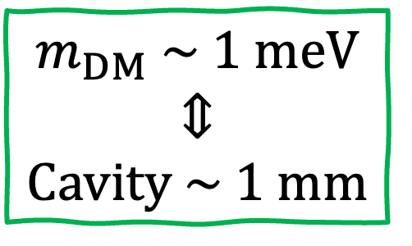
Detection
Dish Antenna:
  Open geometry, large area
  No field enhancement
Cavity:
  Strong resonant enhancement
  Small volume @ high frequency
    Hard engineering
    Reduced power
mirror
$$m_{DM} \sim 1 meV$$
$$⇕$$
$$Cavity \sim 1 mm$$

Slide 8
Detection
New Method?
Large Volume
&
Field Enhancement
Waveguide Haloscope

Slide 9
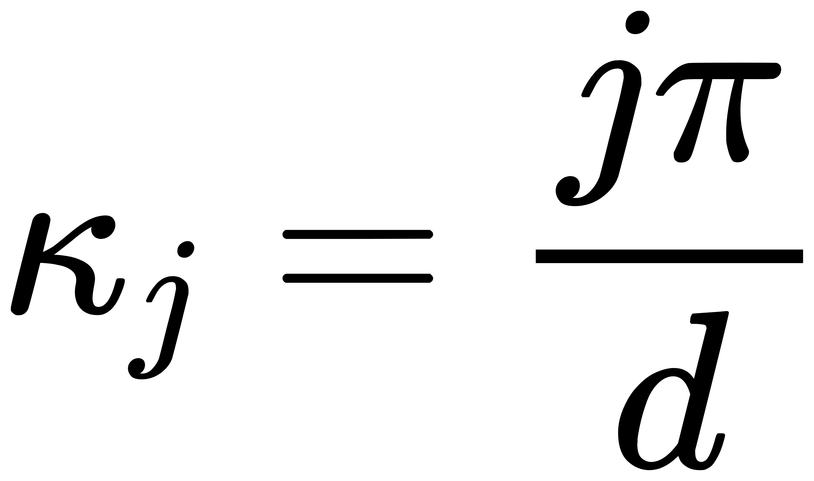
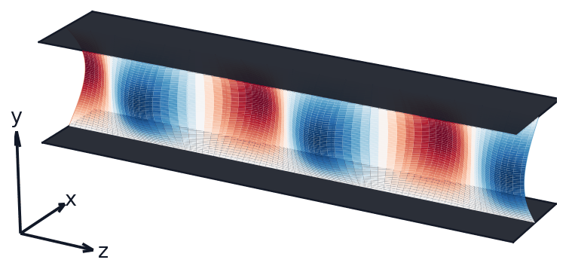
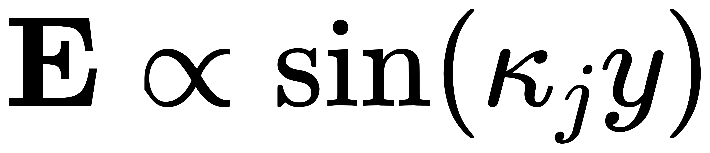
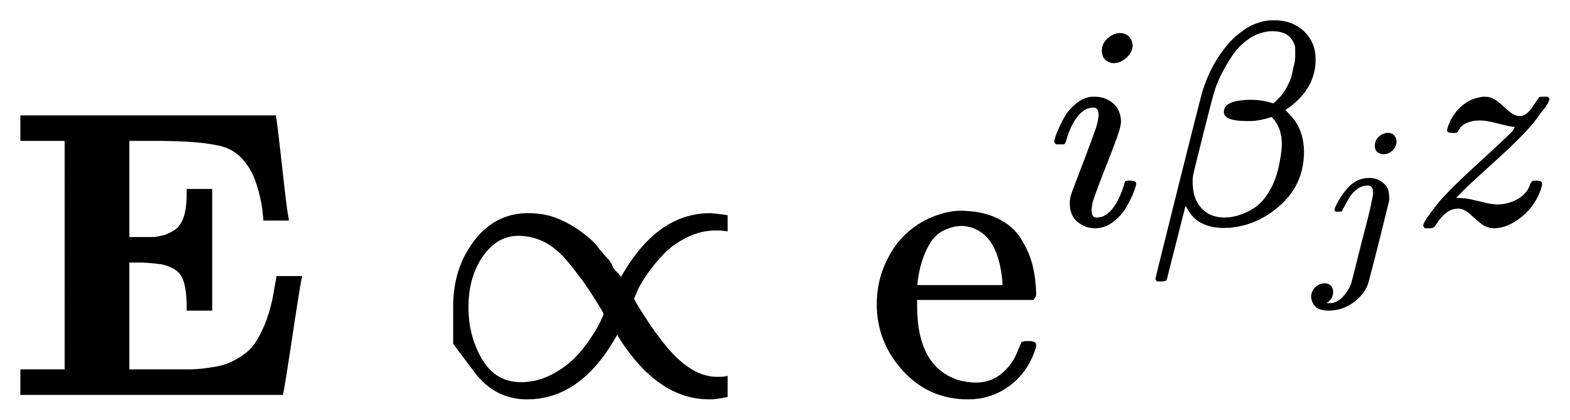
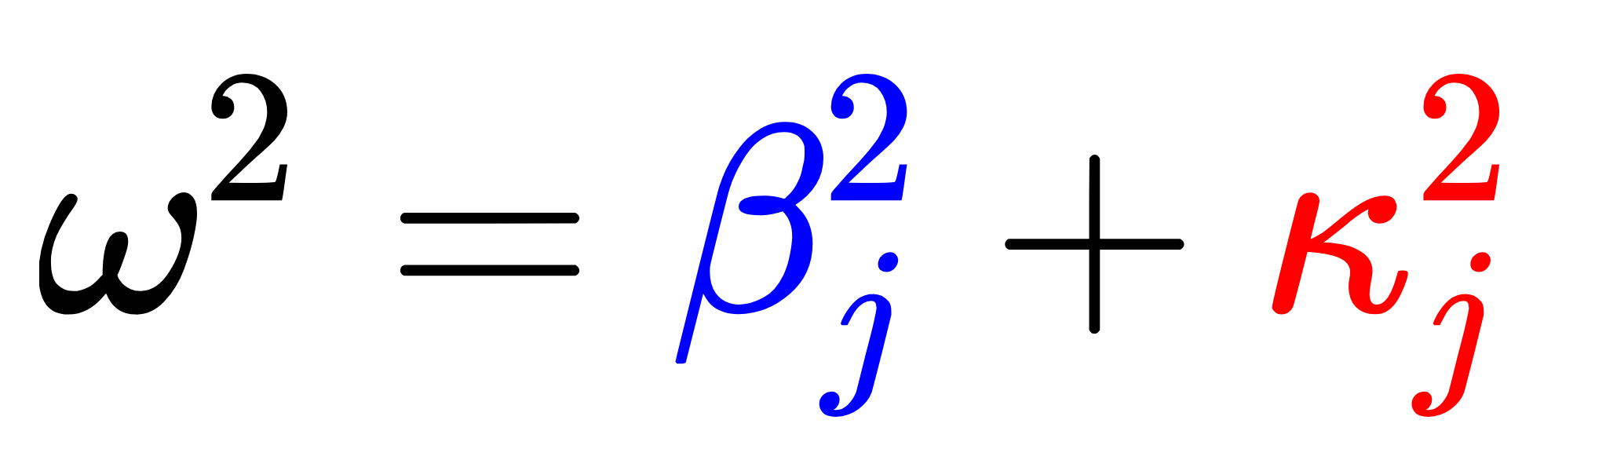
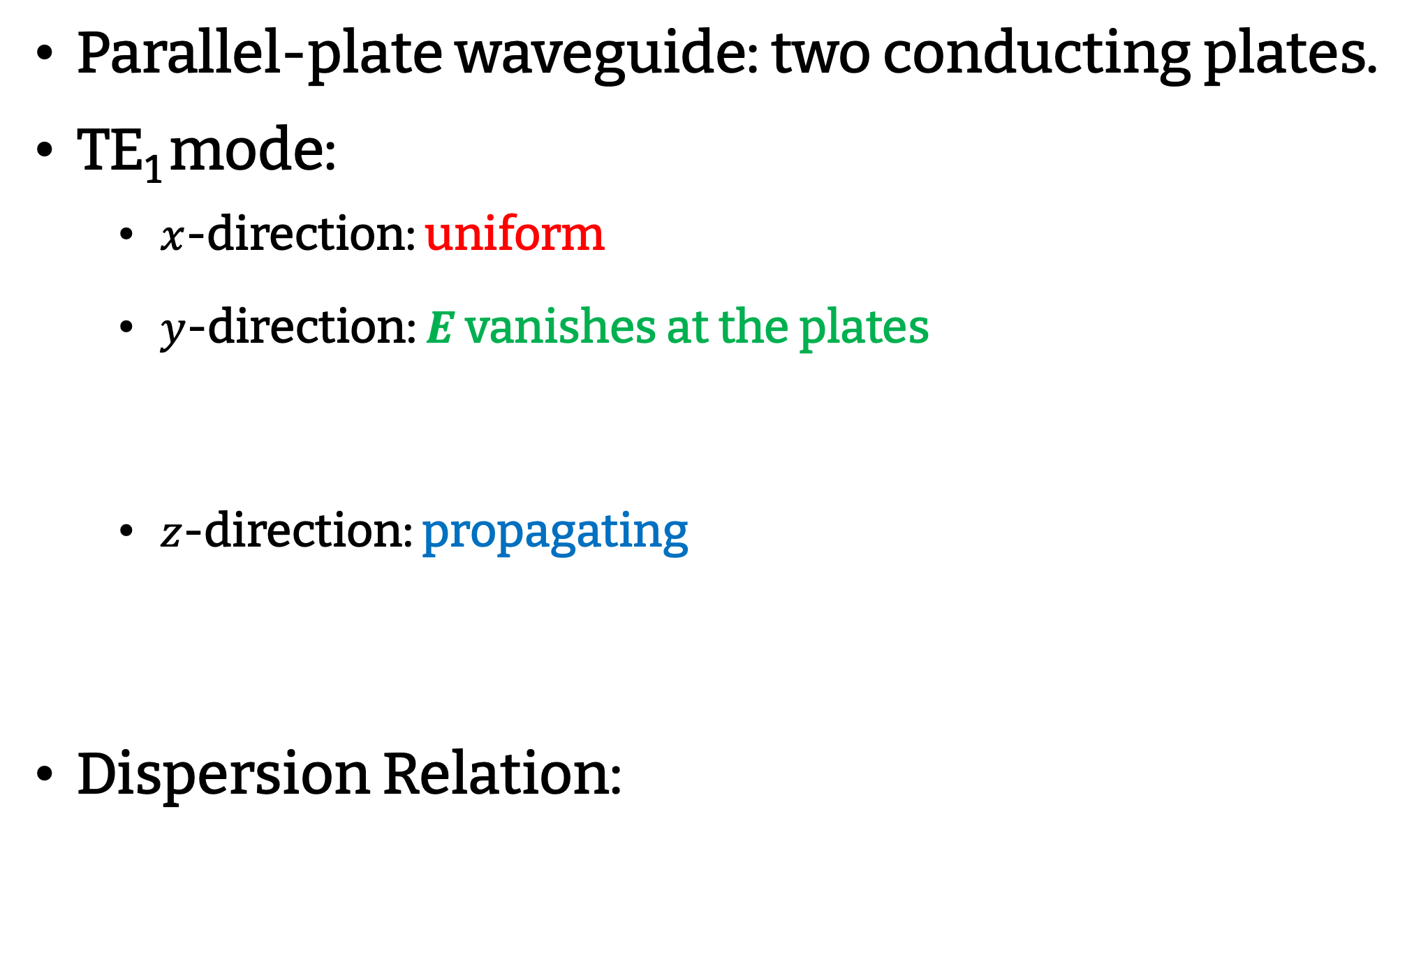
Parallel-Plate Waveguide
Parallel-plate waveguide: two conducting plates.
TE₁ mode:
  $x$-direction: uniform
  $y$-direction: $E$ vanishes at the plates
  $z$-direction: propagating
Dispersion Relation:
Propagation
Wavenumber
Transverse
Wavenumber

Slide 10
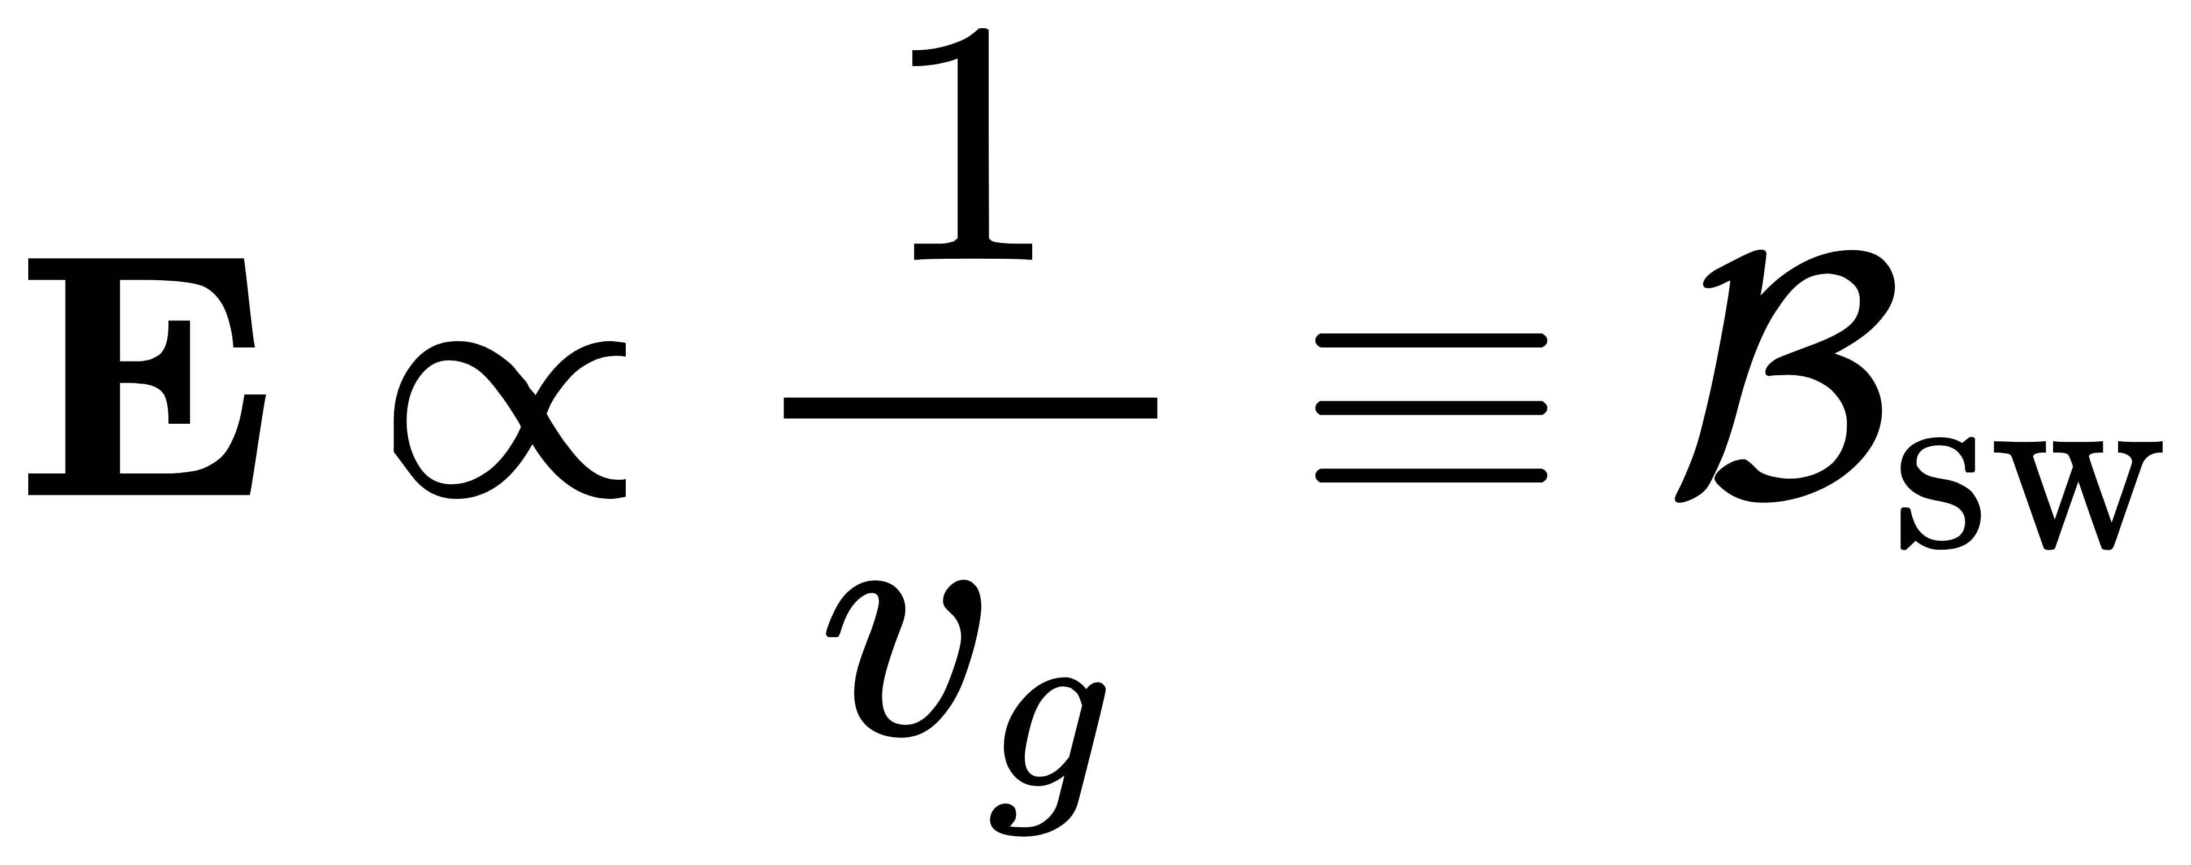
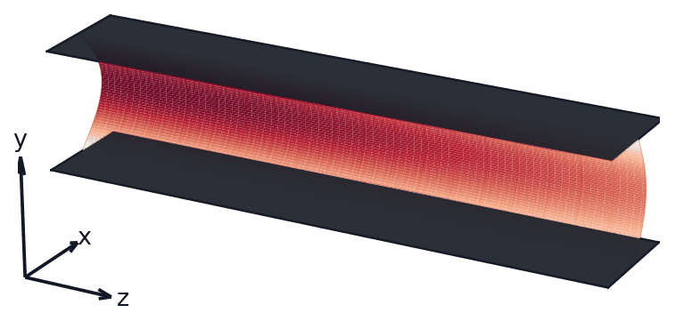

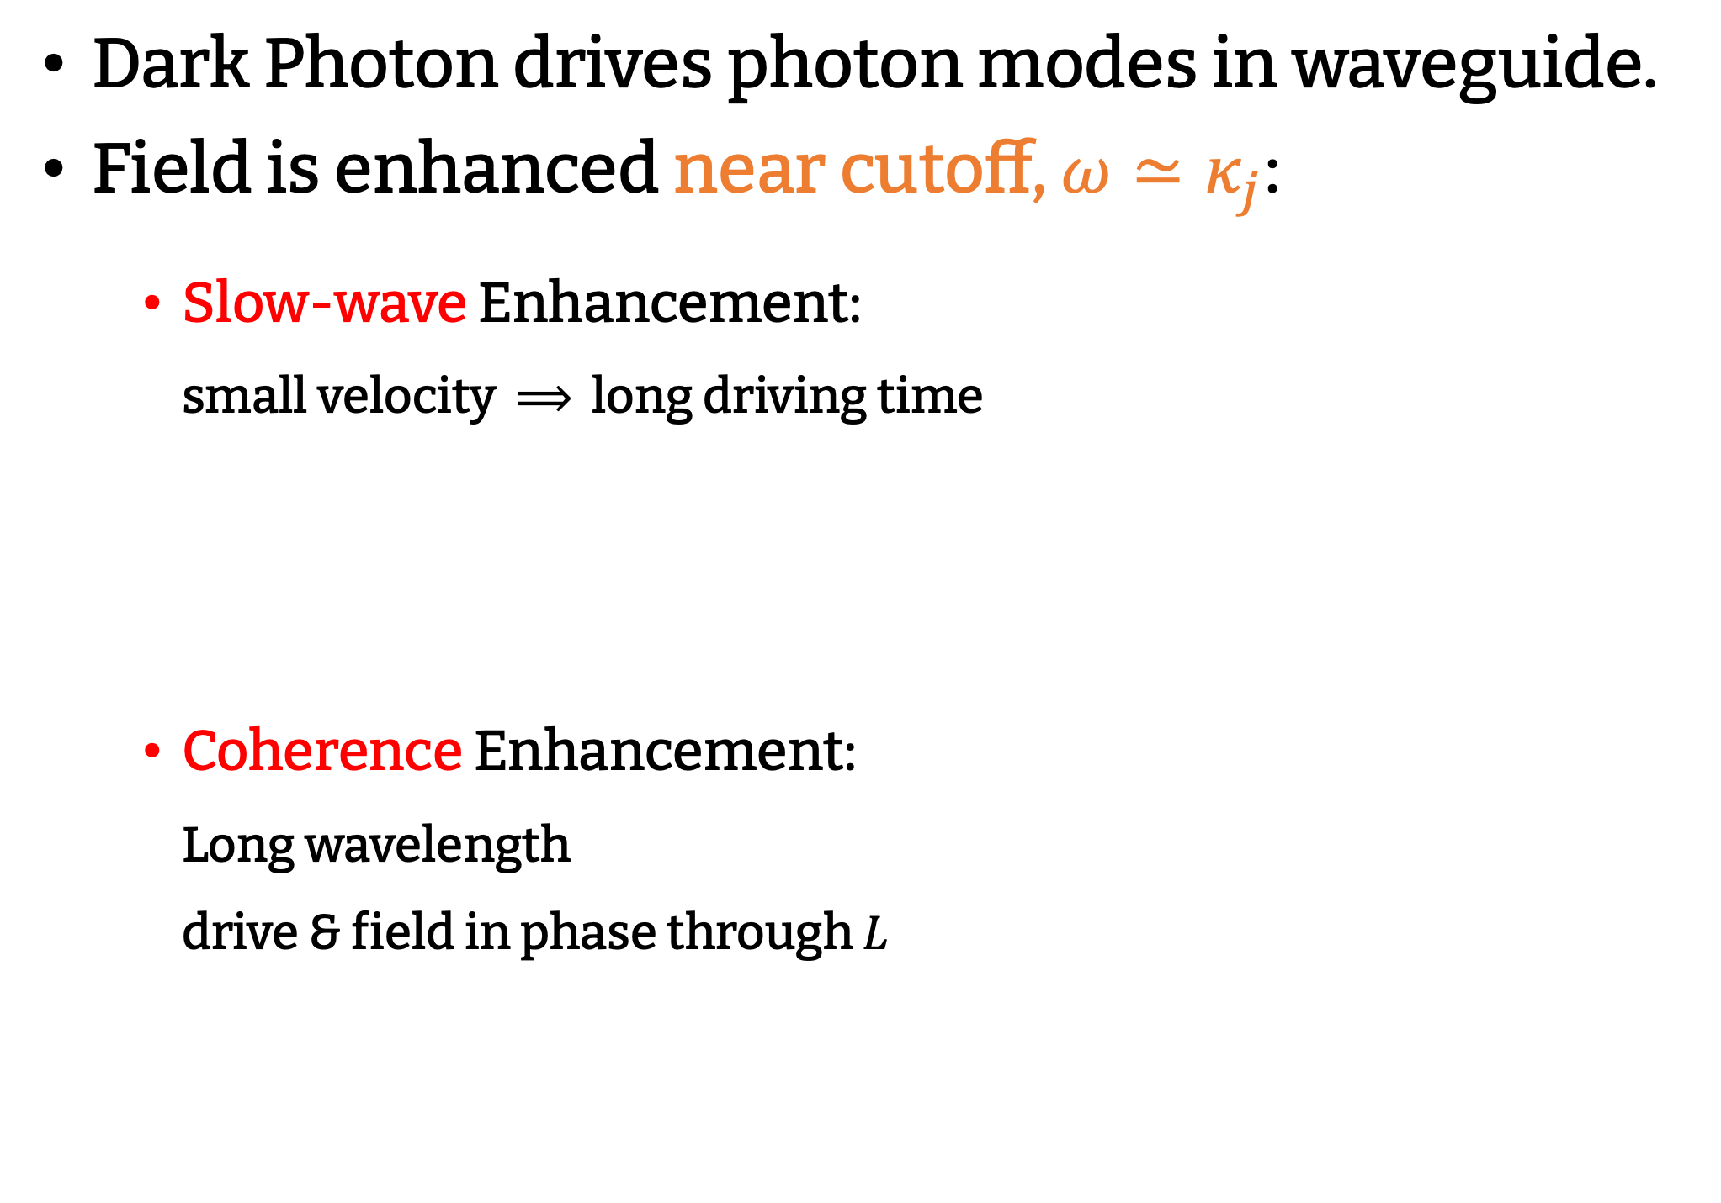
Field Enhancements
Dark Photon drives photon modes in waveguide.
Field is enhanced near cutoff, $ω≃κ_{j}$:
  Slow-wave Enhancement:
  small velocity $⟹$ long driving time
  Coherence Enhancement:
  Long wavelength
  drive & field in phase through $L$

Slide 11
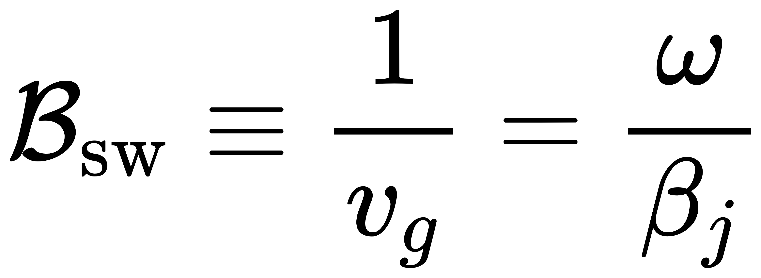
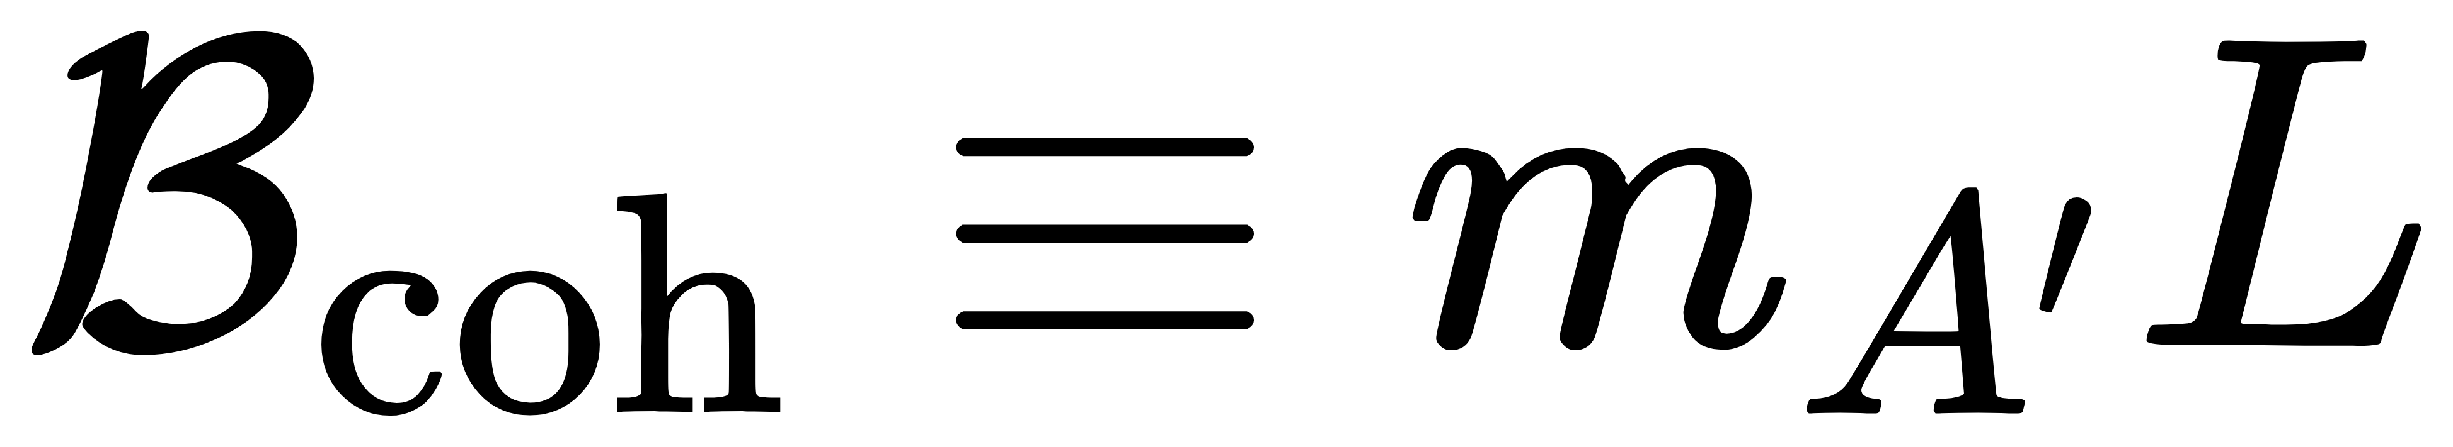
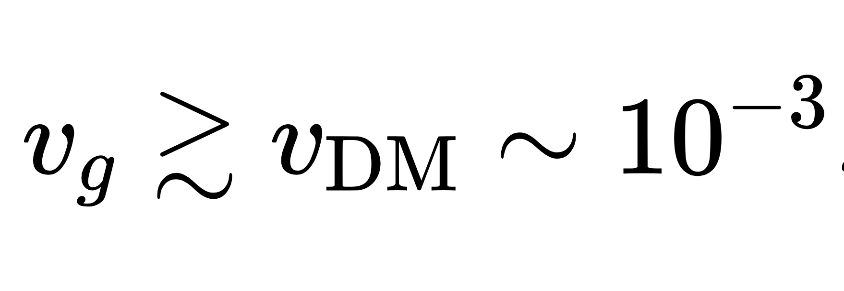
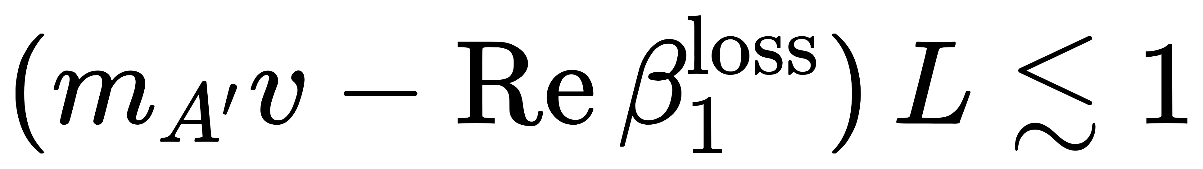
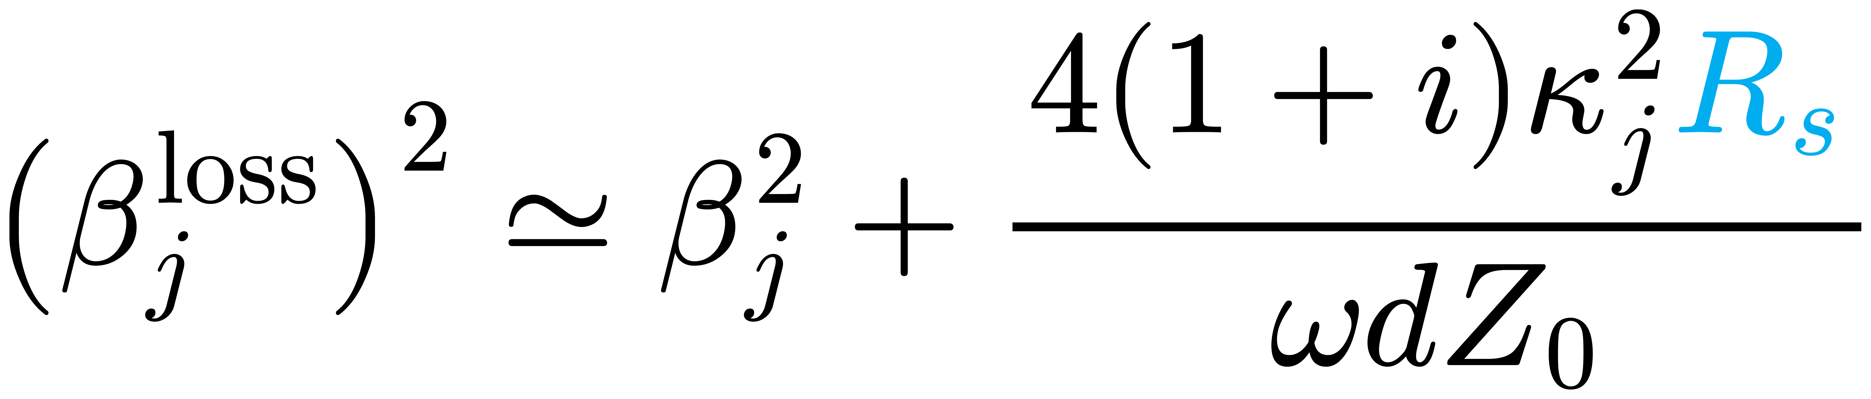
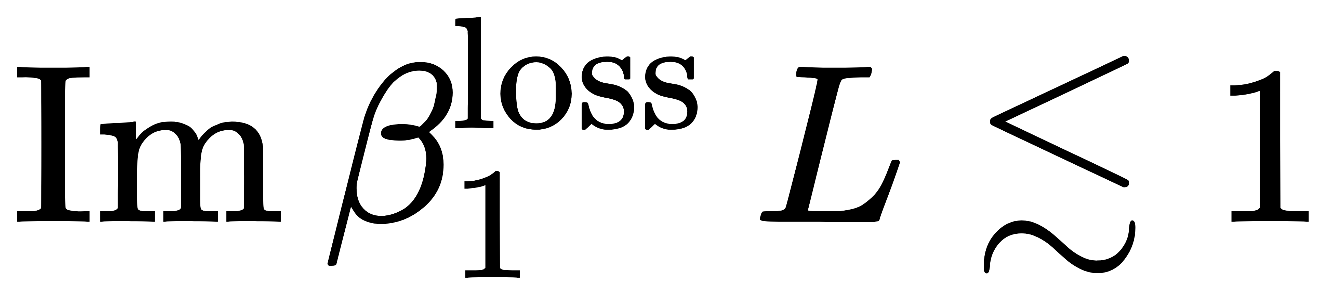
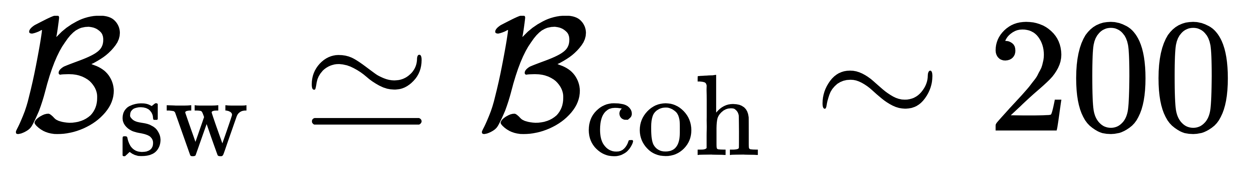
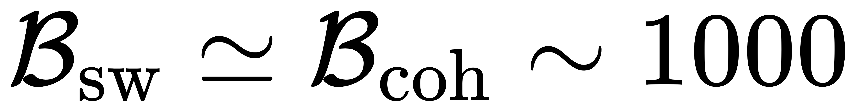
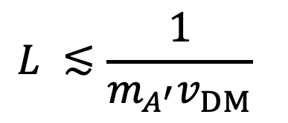
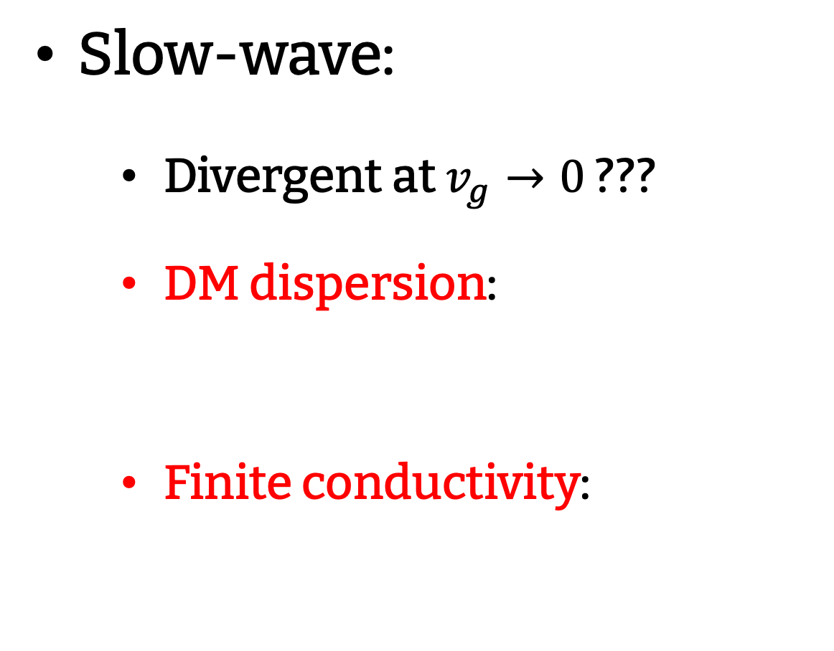
Magnitude of Enhancements
Slow-wave:
  Divergent at $v_{g}→0$ ???
  DM dispersion:
  Finite conductivity:
Coherence:
  DM coherence length:
  Drive–mode coherence:
  Propagation loss:
$$L ≲\frac{1}{m_{A^{′}}v_{DM}}$$
Resistence
Wall loss effect.
Copper
Superconductor

Slide 12
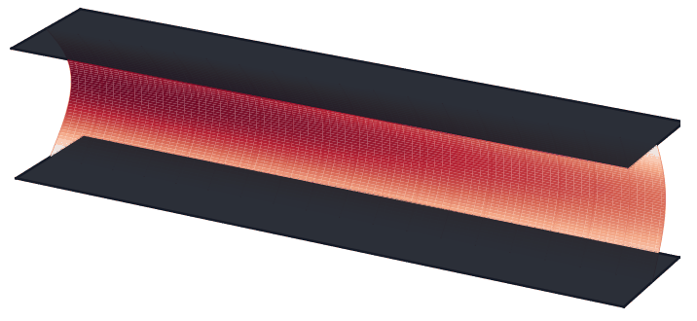
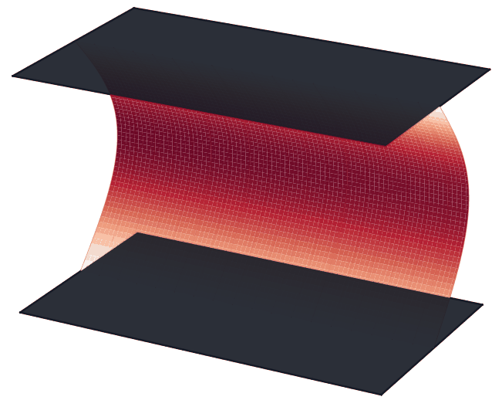
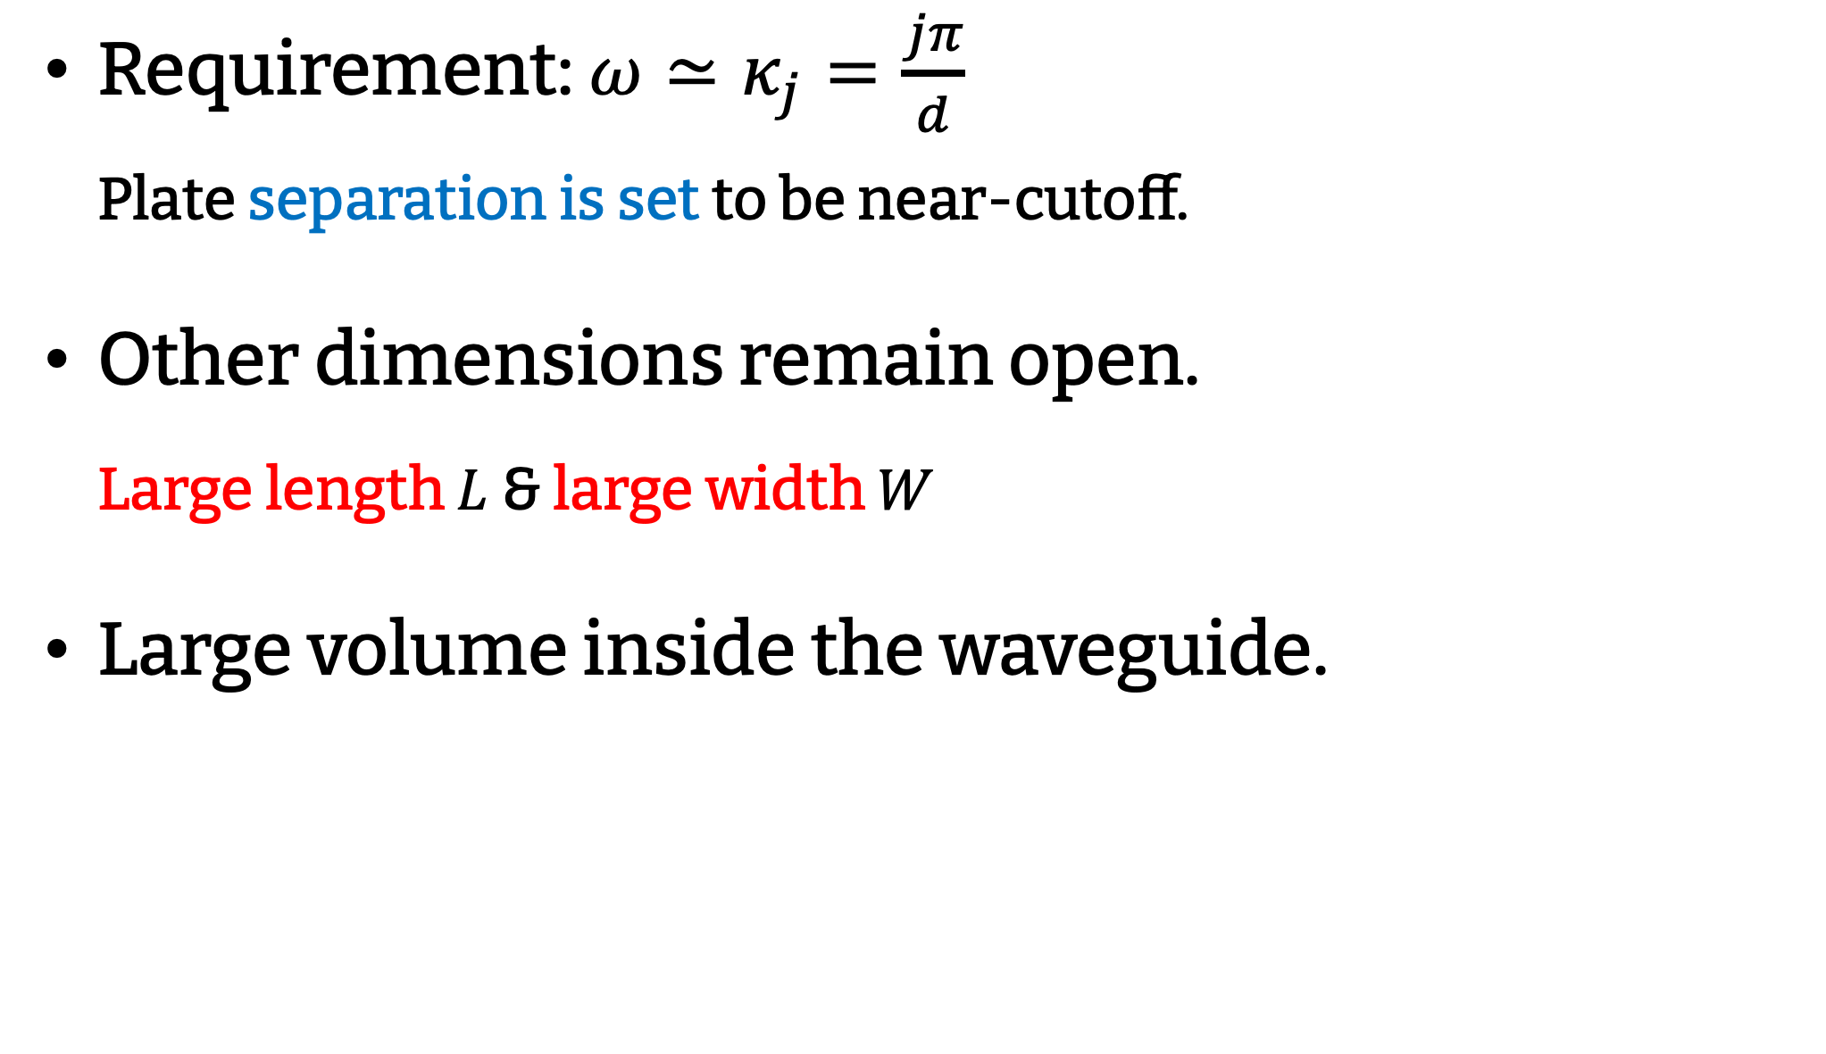
Large Volume
Requirement: $ω≃κ_{j}=\frac{jπ}{d}$
Plate separation is set to be near-cutoff.
Other dimensions remain open.
Large length $L$ & large width $W$
Large volume inside the waveguide.

Slide 13
Detection
New Method!
Large Volume
&
Field Enhancement
Waveguide Haloscope

Slide 14
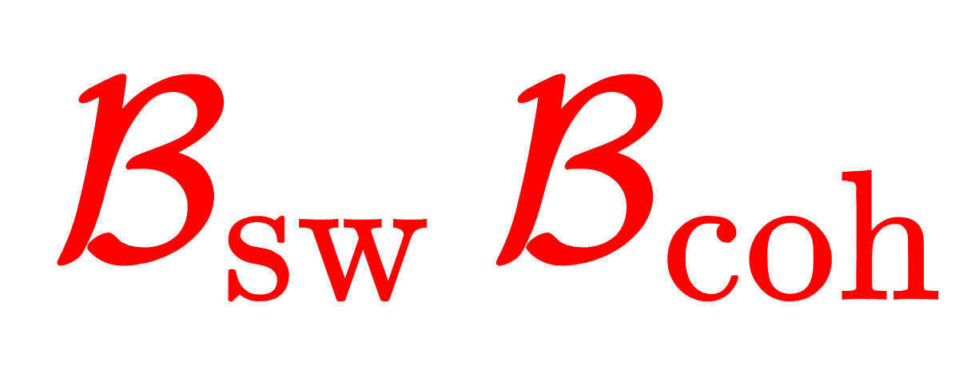
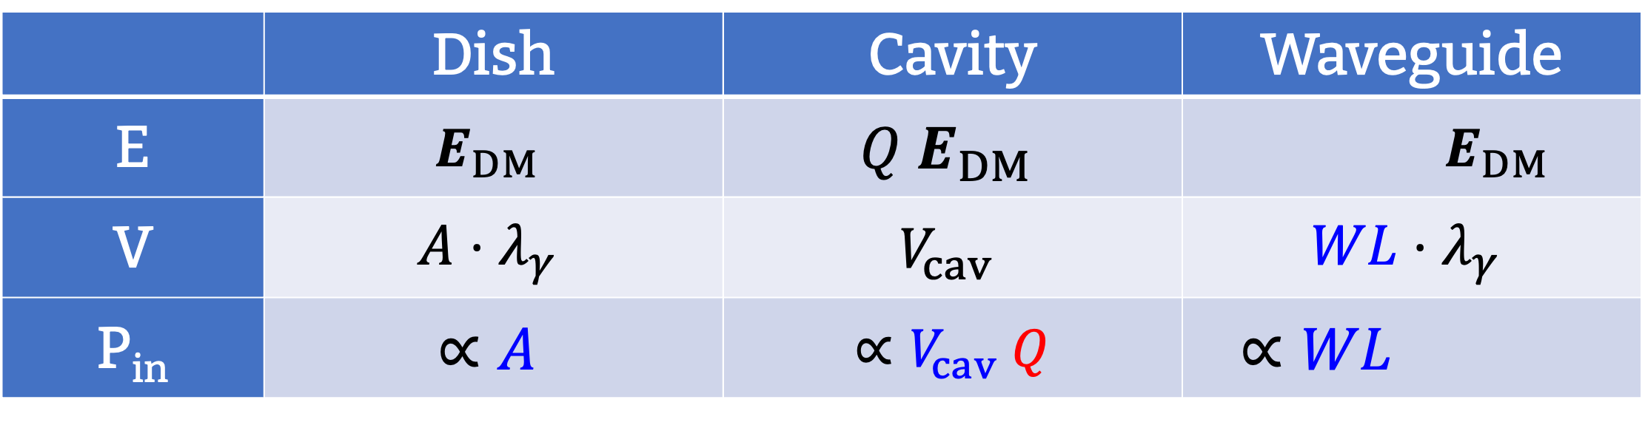
Detection Power
Output Power $≈$ Input Power:
is constant.
 | Dish | Cavity | Waveguide
E | $$E_{DM}$$ | $$Q E_{DM}$$ | $$E_{DM}$$
V | $$A⋅λ_{γ}$$ | $$V_{cav}$$ | $$WL⋅λ_{γ}$$
P_{in} | $$∝A$$ | $∝V_{cav} Q$ | $∝WL$
mirror

Slide 15
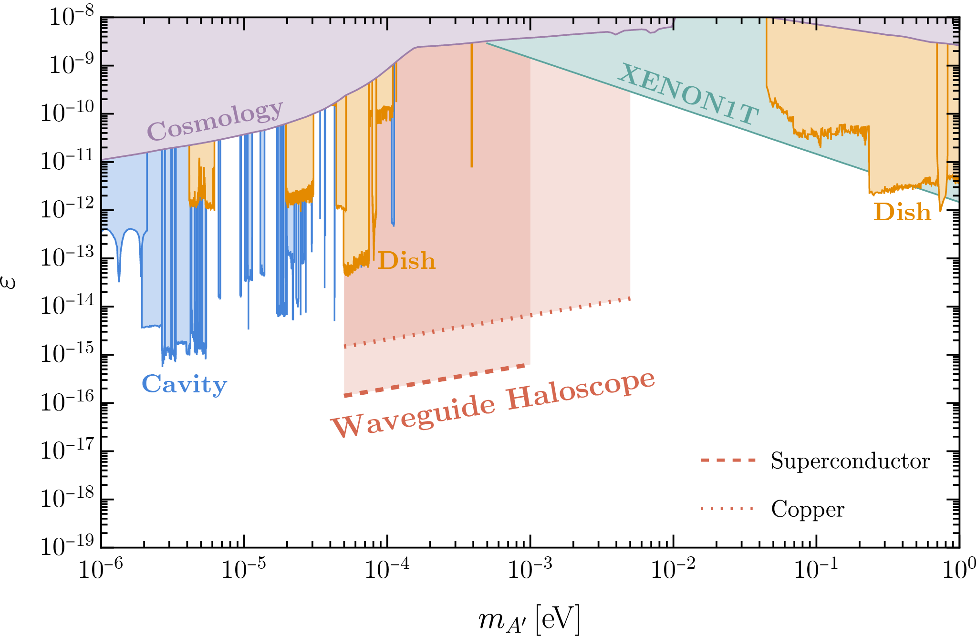
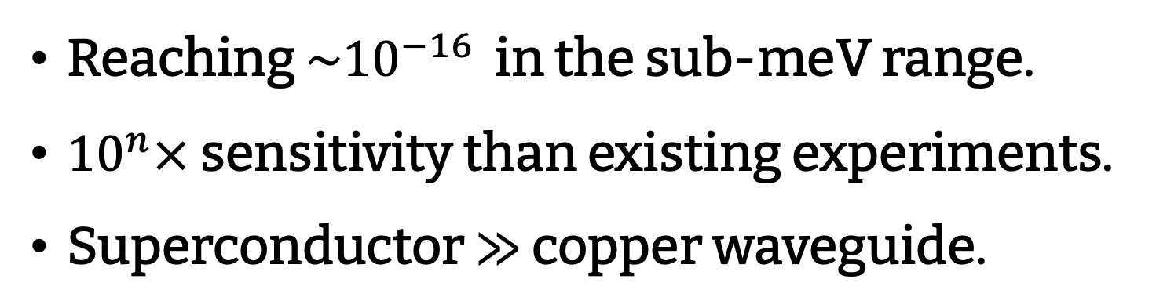
Sensitivity
Dark Photon:
Reaching $\sim {10}^{−16}$ in the sub-meV range.
${10}^{n}×$ sensitivity than existing experiments.
Superconductor $≫$ copper waveguide.

Slide 16
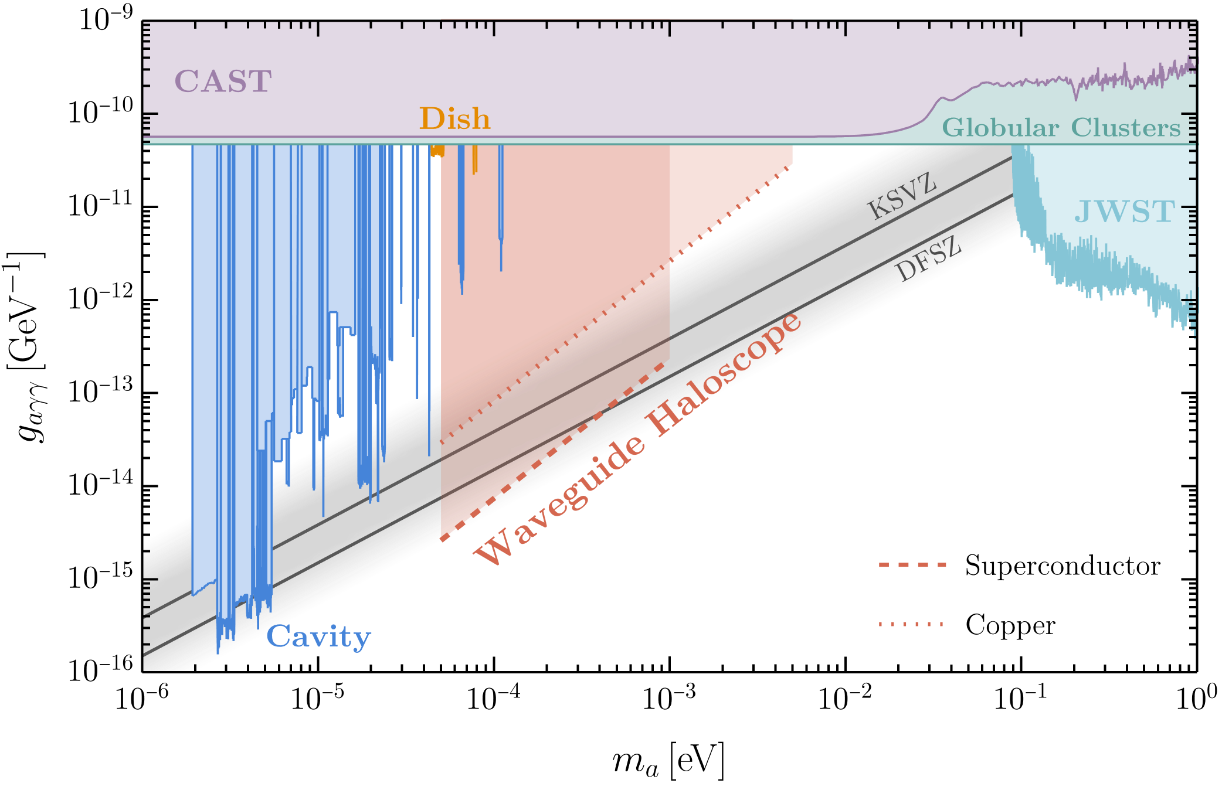
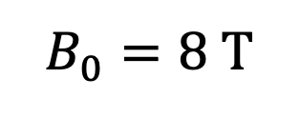

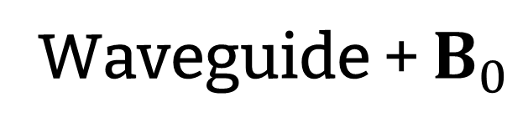

Sensitivity
Axion $a$
$$B_{0}$$
Waveguide + $B_{0}$
Axion Detector
$$B_{0}=8 T$$

Slide 17
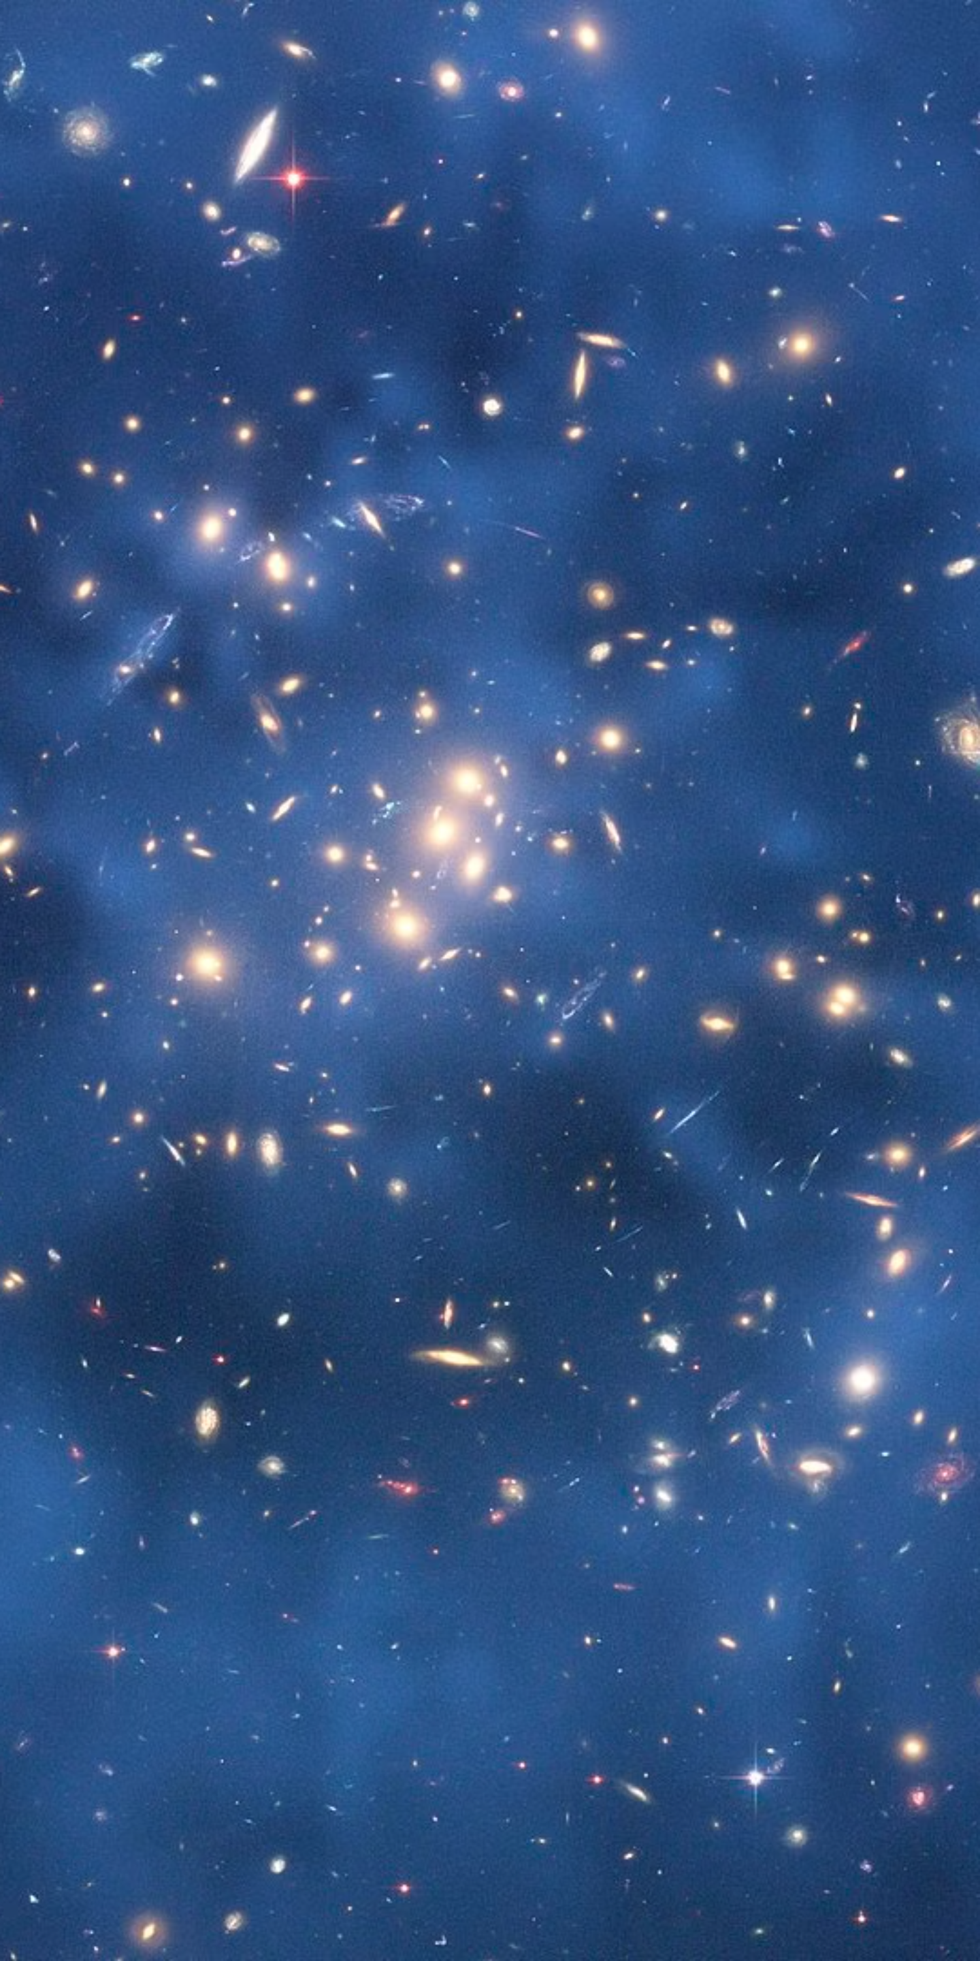
Summary
Waveguide Haloscope
Enhanced Field & Large Volume
High Sensitivity @ sub-meV
THANK YOU!

Slide 18
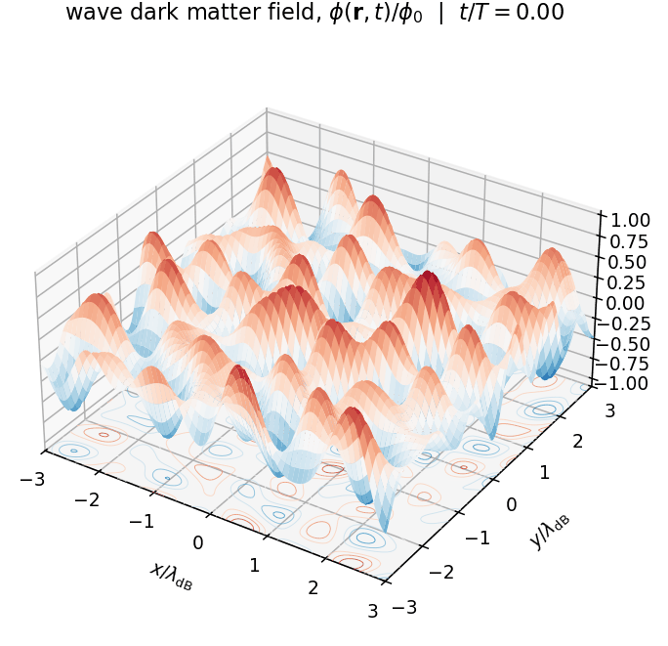


Wave Dark Matter
Ultralight DM behaves like an oscillating wave.
Locally, coherent (sin/cos) wave.
Frequency $ω≈m$.
Coherence length: $λ≃\frac{1}{m v}$.
Coherence time: $τ≃\frac{1}{m v^{2}}$

Slide 19




Detection: Dish Antenna
Lab Experiment：
Telescopes as Dark-Photon Dishes
Knirck et al. PRL 132.131004
Brun et al. PRL 122.201801
SHUKET
BREAD
An et al. JCAP 02 (2026) 009
An et al. PRL 130.181001
FAST
James Webb Space Telescope

Slide 20


Detection: Cavity
Lab experiments:
Cavity
ADMX, PRL 134.111002
SHANHE, PRL 133.021005
ADMX
SHANHE

Slide 21



Waveguide
Confines electromagnetic waves and guides them along one direction.
Dispersion relation:
$ω>κ_{j}$, waves propagate
$ω<κ_{j}$, waves are evanescent
Propagation
Wavenumber
(longitudinal)
Cutoff
Wavenumber
(transverse)

Slide 22



Field Enhancements
Slow-wave factor:
  Divergent at $v_{g}→0$ ???
  DM dispersion:
  Mode group velocity matches to the DM drive velocity.
  Finite conductivity:
  Wall loss makes $β_{j}$ complex.
Wall loss effect.

Slide 23

Field Enhancements
Coherence factor:
  DM coherence length:
  Waveguide size within DM coherence length, so the drive remains coherent.
  Drive–mode coherence:
  Same propagation wavenumber for phase matching.
$$L ≲\frac{1}{m_{A^{′}}v_{DM}}$$
Mode
Drive
Same wavenumber: in phase
Different wavenumbers: out of phase

Slide 24

Field Enhancements
Coherence factor:
  DM coherence length:
  Waveguide size within DM coherence length, so the drive remains coherent.
  Drive–mode coherence:
  Same propagation wavenumber for phase matching.
  Propagation loss:
  Loss attenuates the mode at long distance.
$$L ≲\frac{1}{m_{A^{′}}v_{DM}}$$

Slide 25



Sensitivity
Enhancement Factors:
  Copper
  Surface Resistance $R_{s}∼7 mΩ$,
  Superconductor
  Surface Resistance $R_{s}<0.2 mΩ$,
Waveguide Size:
  Width: $H \sim 1 m$
  Length: $L ≲ 40 cm$ (copper),
  $L ≲ 2 m$ (superconductor)
Detectable Power:

Slide 26

Output Power
Detector
Output Power:
Plate Area
Enhancements
Reflection at Ends
Dark Photon Polarization

