Slide 1





Search for Ultralight Dark Matter with
Quantum Magnetometer in the Earth’s Cavity
2026年紫金山暗物质研讨会
Yuanlin Gong (龚远林), GPEXers (+Lei Wu…)
Geomagnetic Probe for EXotic Physics (GPEX) collaboration
arXiv: 2511.16553
2026. 7. 22 新疆--乌鲁木齐

Slide 2

01
Introduction
02
Geomagnetic Signal
CONTENTS
03
Experiment Details
04
Data analysis
05
Result

Slide 3
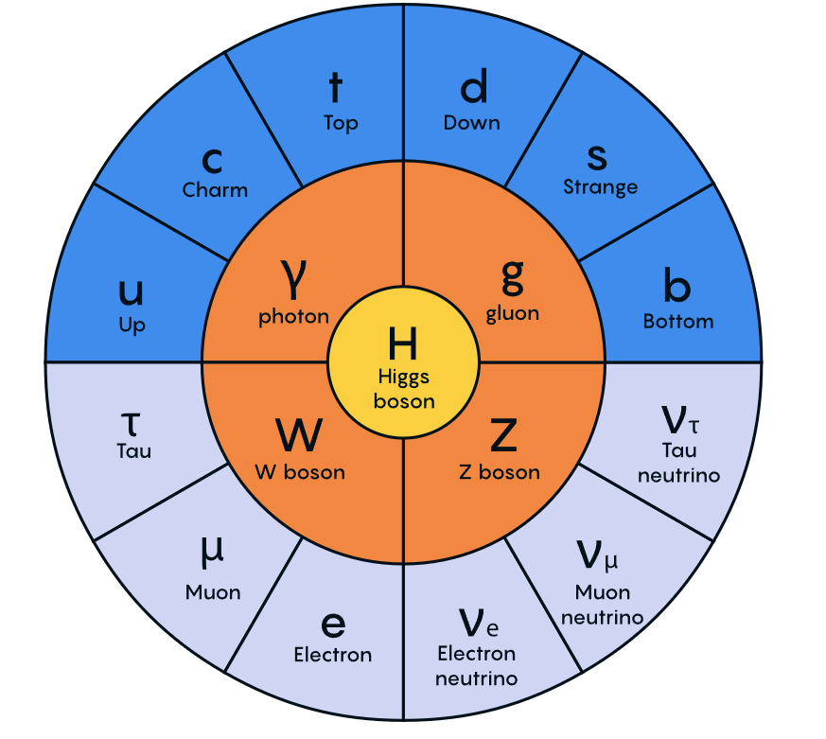
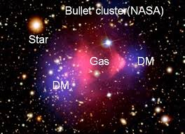
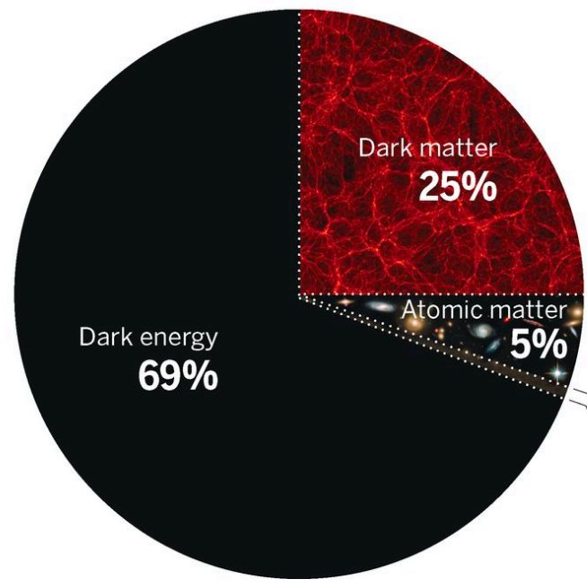
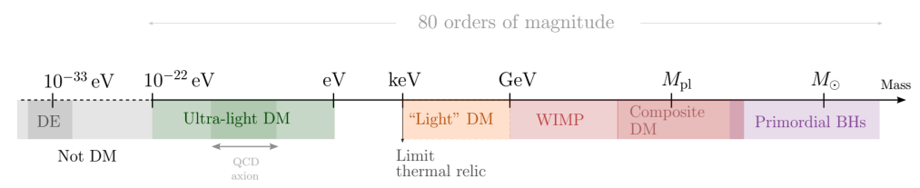
Introduction
Missing Matter
Standard Model
Dark Matter
New physics
?

Slide 4
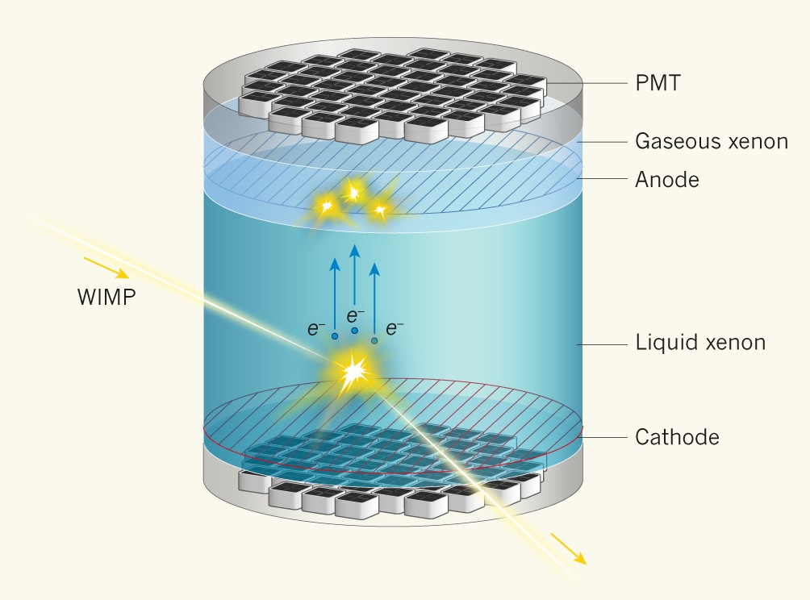
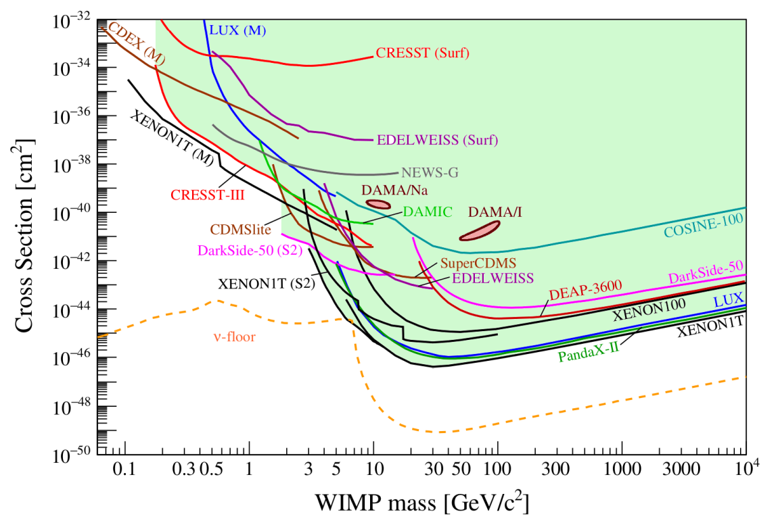
Introduction
WIMP Detection
Ji, X. Dark matter remains elusive. Nature 542, 172–173 (2017)
APPEC Committee Report： 2104.07634

Slide 5
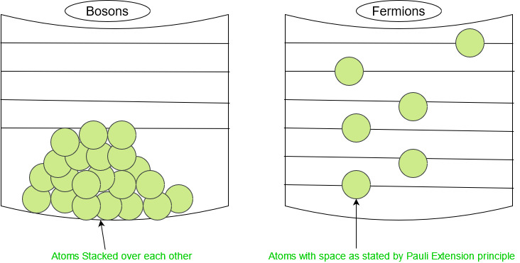
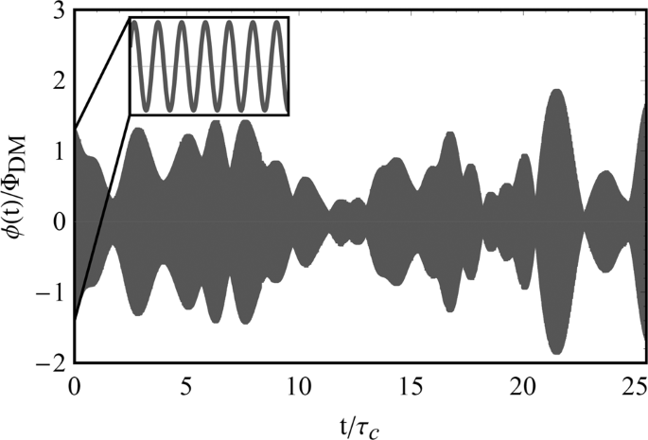

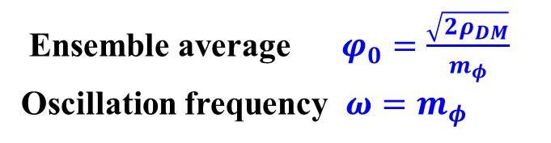
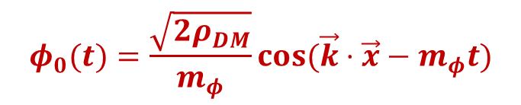
Introduction
Ultra-light Dark Matter
Gary P. Centers et al, 1905.13650, Nature Communication
Long wavelength
Huge occupation number
Stochastic oscillation of amplitude
$$N_{occ} \sim n_{DM}λ^{3}$$
$$φ_{0}(t)=\frac{\sqrt{2ρ_{DM}}}{m_{φ}}cos⁡(\vec{k}⋅\vec{x}−m_{φ}t)$$
e.g. m = 10⁻⁶ eV
～1 km
$${10}^{30}$$
Ensemble average $φ_{0}=\frac{\sqrt{2ρ_{DM}}}{m_{φ}}$
Oscillation frequency $ω=m_{φ}$

Slide 6
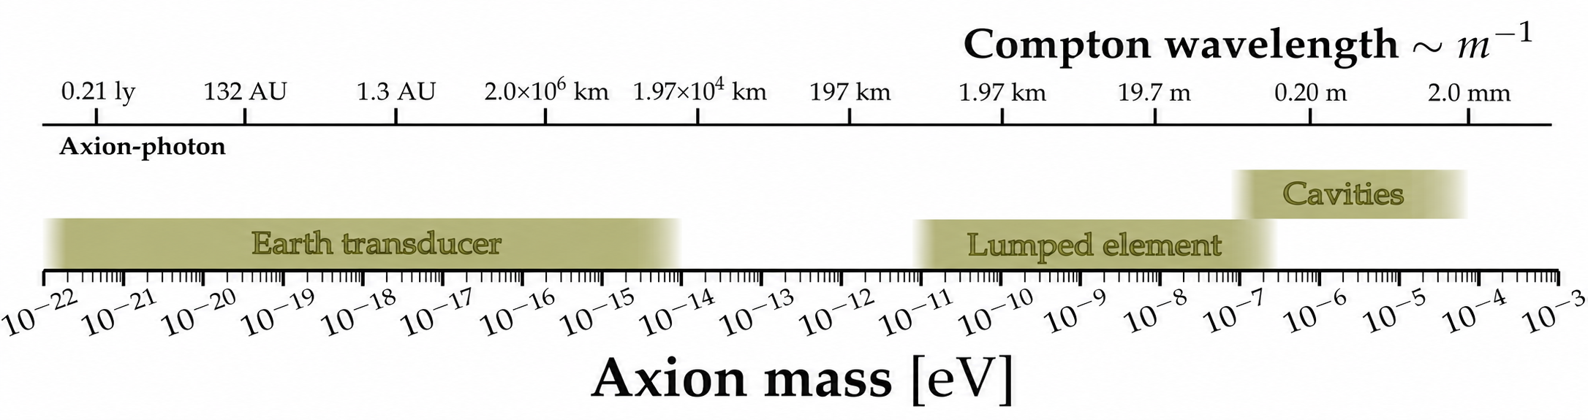


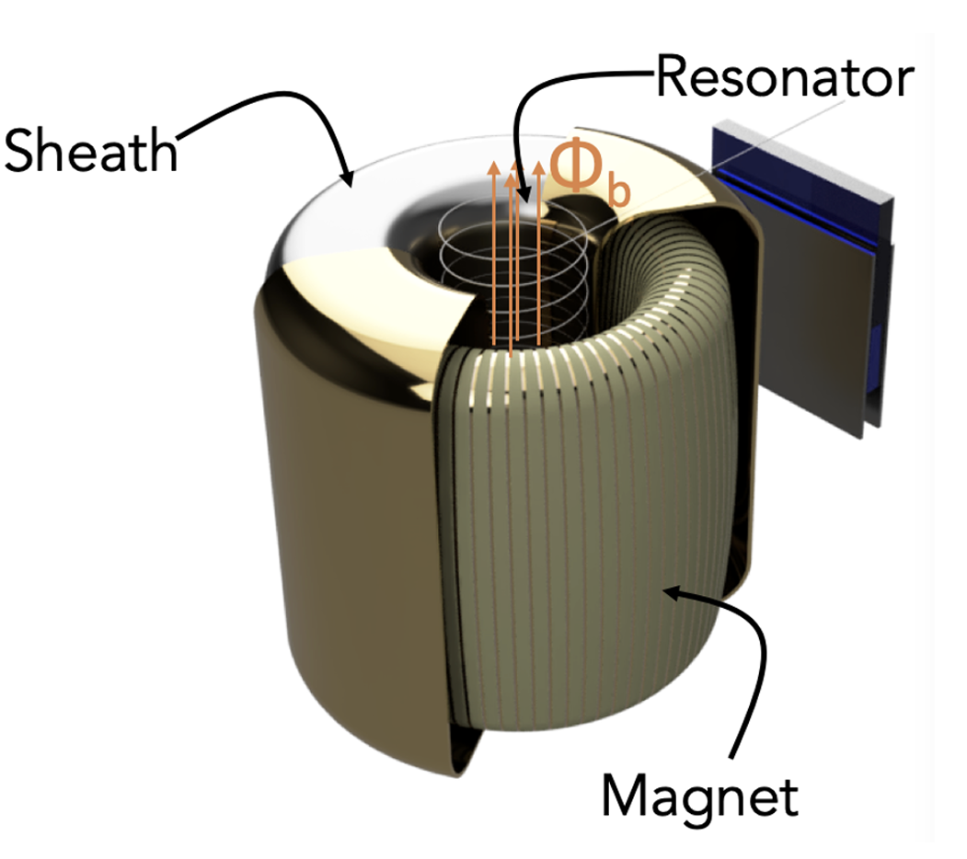
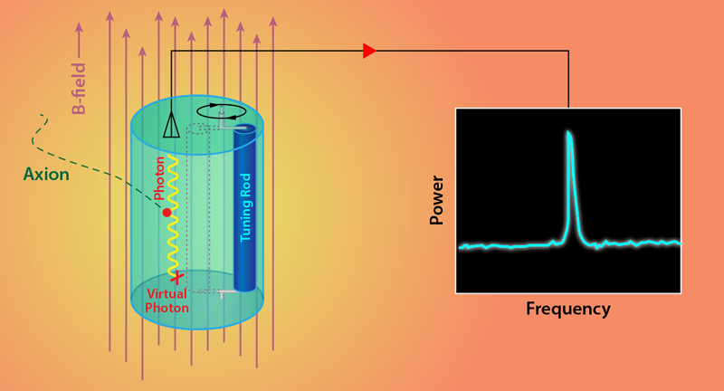

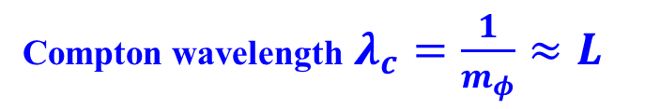






Cavity Search
$h\sim 100$ km
N. M. Rapidis, et al, arXiv:2210.07215
Earth
$$R_{e}\sim 6400 km$$
$$L\sim 0.1 m$$
$$B_{0}\sim {10}^{−5} T$$
ionosphere
$$B_{0}\sim 1 T$$
Earth transducer
DMRadio-50L Experiment
Resonant Cavity
$$λ_{c}≫{R_{e}}_{ }$$
$$λ_{c}≫L_{ }$$
Compton wavelength $λ_{c}=\frac{1}{m_{φ}}≈L_{ }$
Fedderke et al, 2106.00022 PRD
P. Sikivie et al, arXiv:1310.8545 PRL
Ariel Arza et al, 2112.09620 PRD
SC, PG,…,Yue Zhao, arXiv:1411.7382 PRD
P. Sikivie 1983
Ariel Arza YLG et al, 2501.14949 PRL
YK, B. R. Safdi, JT, arXiv:1602.01086 PRL

Slide 7


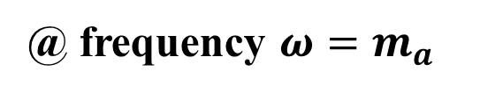

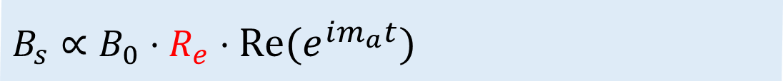
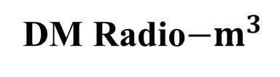



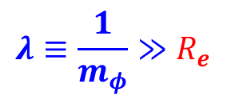
Cavity Search
Magnetic field signal
Fedderke et al, 2106.00022
Ariel Arza et al, 2112.09620
$$B_{s}∝B_{0}⋅R_{e}⋅Re(e^{im_{a}t})$$
@ frequency $ω=m_{a}$
$$λ≡\frac{1}{m_{φ}}≫R_{e}$$
DM Radio$−m^{3}$
Earth Cavity
$h\sim 100$ km
Earth
$$L\sim 1 m$$
$$R_{e}\sim 6400 km$$
$$B_{0}\sim 4 T$$
$$B_{0}\sim {10}^{−5} T$$
ionosphere
Scales with $L\sim 1 m$
Scales with $R_{e}\sim 6400 km≫h$

Slide 8
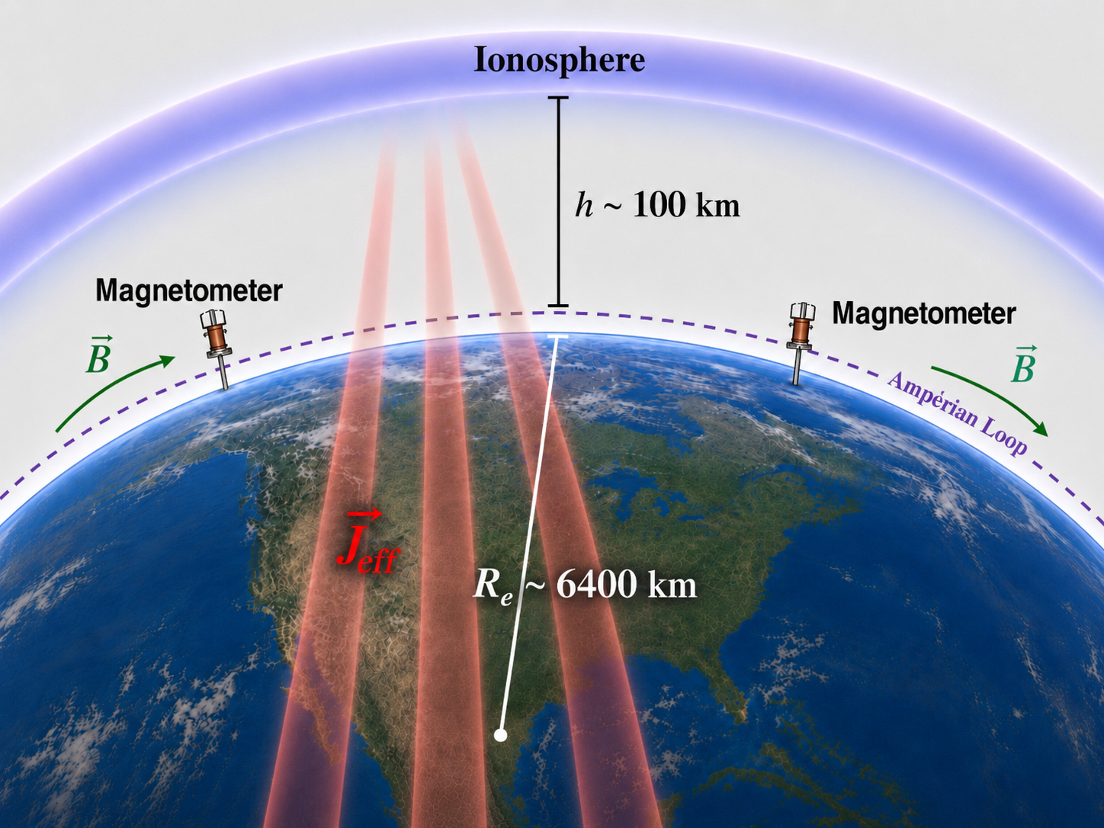

Slide 9
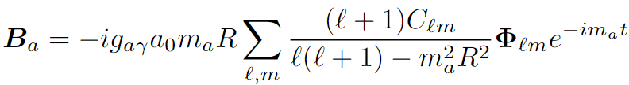
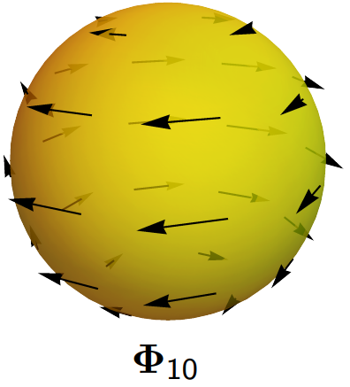
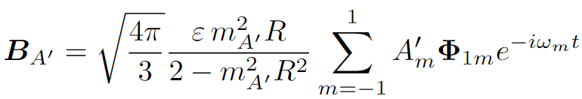

Geomagntic Signal
Magnetic field signal
Sulai et al, 2306.11575
Axion
$C_{lm}$ from IGRF-13 model
Dark Photon
Signal Properties
enhanced by Earth Radius $m_{a, A^{′}}R$not $m_{a, A^{′}}h$
oscillating frequency $ω=m_{a}, m_{A′}^{ }$
Spatially coherent: Global Signal ${\vec{Φ}}_{lm}(θ,φ)$

Slide 10
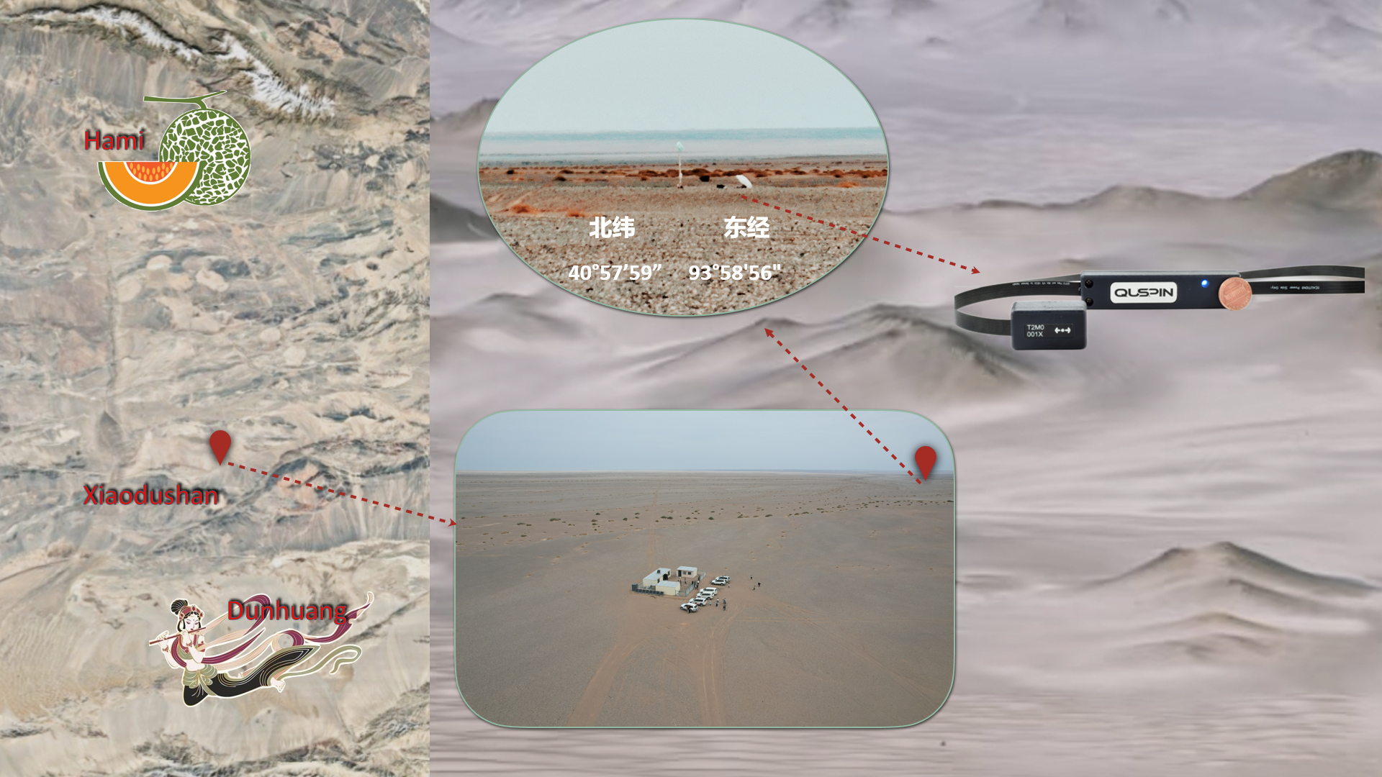

Geomagnetic Probe for EXotic Physics
Temperature 27 $℃$
Altitude 1268 m
120 km
Experiment Site
Notes:
磁阻的 Magnetoresistive

Slide 11
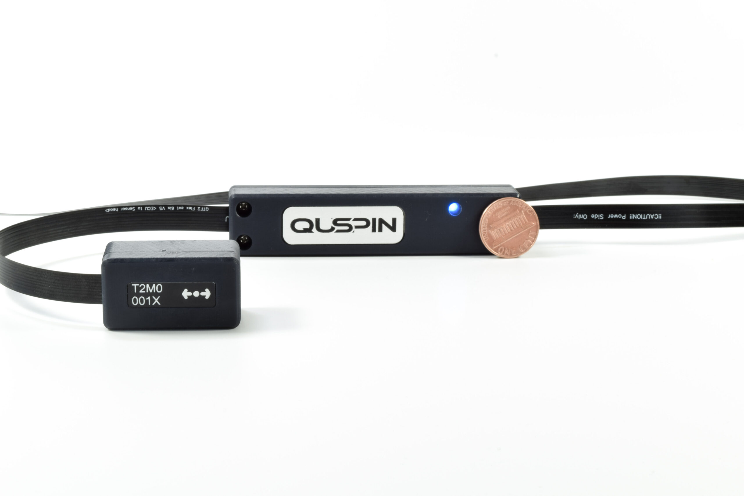

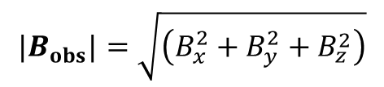
Experiment Details
QuSpin Total-Field Magnetometer (QTFM)
The sensitivity
QTFM-Gen2
Frequency range : sub– 500 Hz
Scalar module : 20 pT/√Hz
$${|B}_{obs}|=\sqrt{\left(B_{x}^{2}+B_{y}^{2}+B_{z}^{2}\right)}$$
vector module : 100 pT/√Hz
https://quspin.com/qtfm-gen-2/
sensor head (left) and control electronics (right)
$$B_{obs}=B_{x}+B_{y}+B_{z}$$
Operating at temperature : [-15, 55] ◦C
Notes:
磁阻的 Magnetoresistive

Slide 12
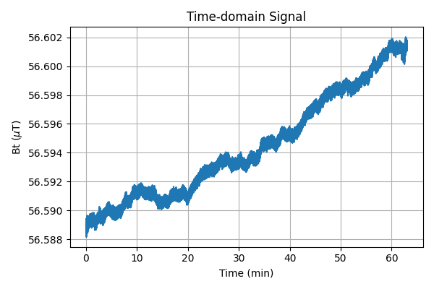
Experiment Details
Time series Data
During 1:30 pm to 3:30 pm at 7th August, 2025
Make a trial measurement about 30 minutes to check the sensor goes well, i.e., the sampling rate and data record
Make 1.05 hour measurement
Sampling frequency 62.5 Hz
The time series of measurements
Notes:
磁阻的 Magnetoresistive

Slide 13
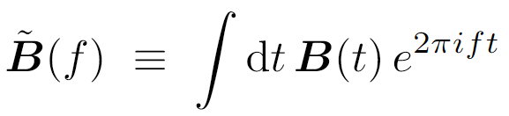

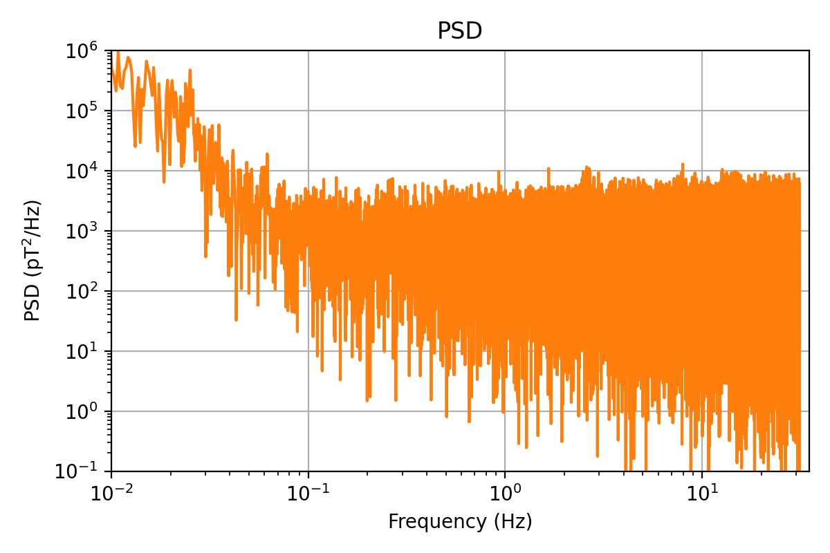







Data Analysis
Statistic Test
$$S\left(f\right)=2{\left|\tilde{B}\left(f\right)\right|}^{2}/T_{obs}$$
Scalar data
Vector data
Power Spectrum Density (PSD, single-side)
PSD of observed magnetic field
$\hat{S}\left(f_{s}\right)= S_{n}\left(f_{s}\right) + S_{s}(f_{s} , g_{s} , 𝒜_{s})$
PSD of signal
PSD of noise
signal
PSD
$B_{0}$ is DC component, can remove
Coupling $g_{s}= g_{a, γ^{′}}=g_{aγ}, ε$
Noise floor
Frequency $f$
Amplitude $𝒜_{s}= 𝒜_{a, γ^{′}}=a_{0}, A^{′}$
Signal vs Noise
Notes:
evaluate from the data of ±200 frequency bins around $f=f_{s}$except for 3 frequency bins centered around $f=f_{s}$

Slide 14
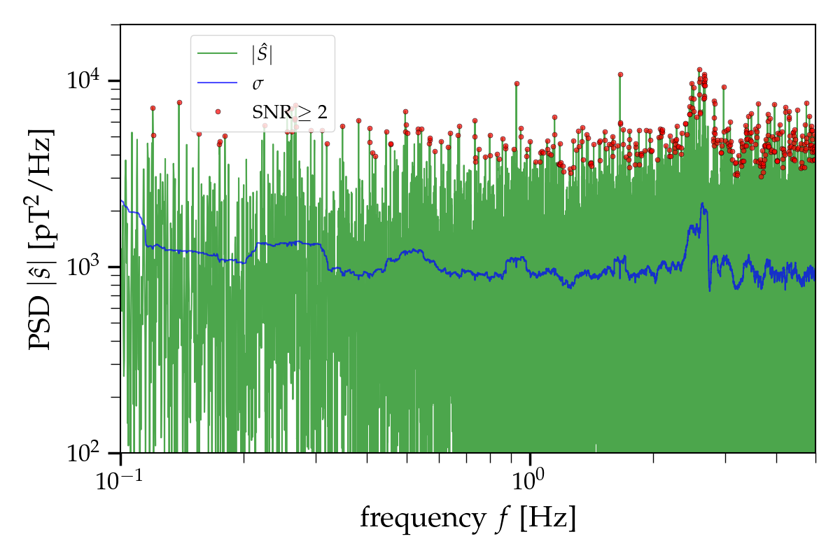
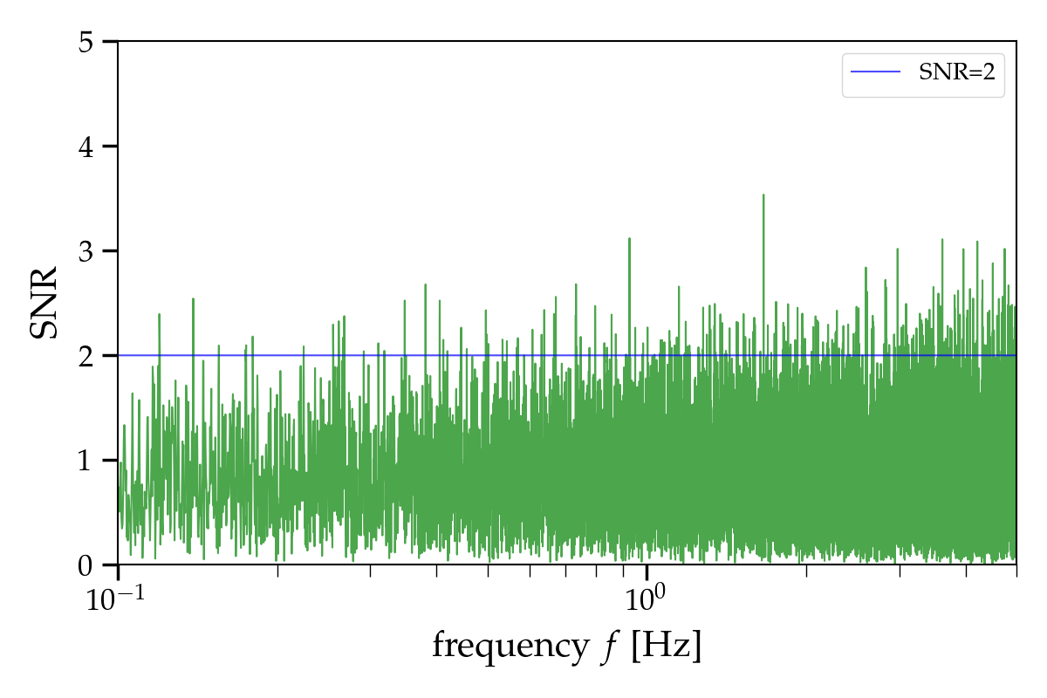

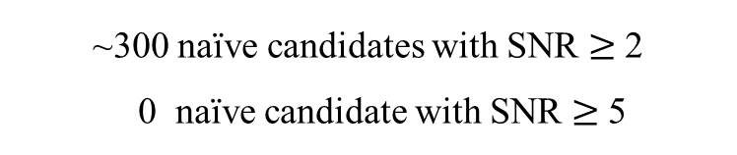


Data Analysis
Signal to Noise Ratio
Noise standard deviation: $σ_{n}(f_{s})$
$$SNR≡\sqrt{\hat{S}/σ_{n}}$$
Observed psd $\hat{S}$
~300 naïve candidates with SNR $≥$ 2
0 naïve candidate with SNR $≥$ 5
NO Robust Candidate !

Slide 15
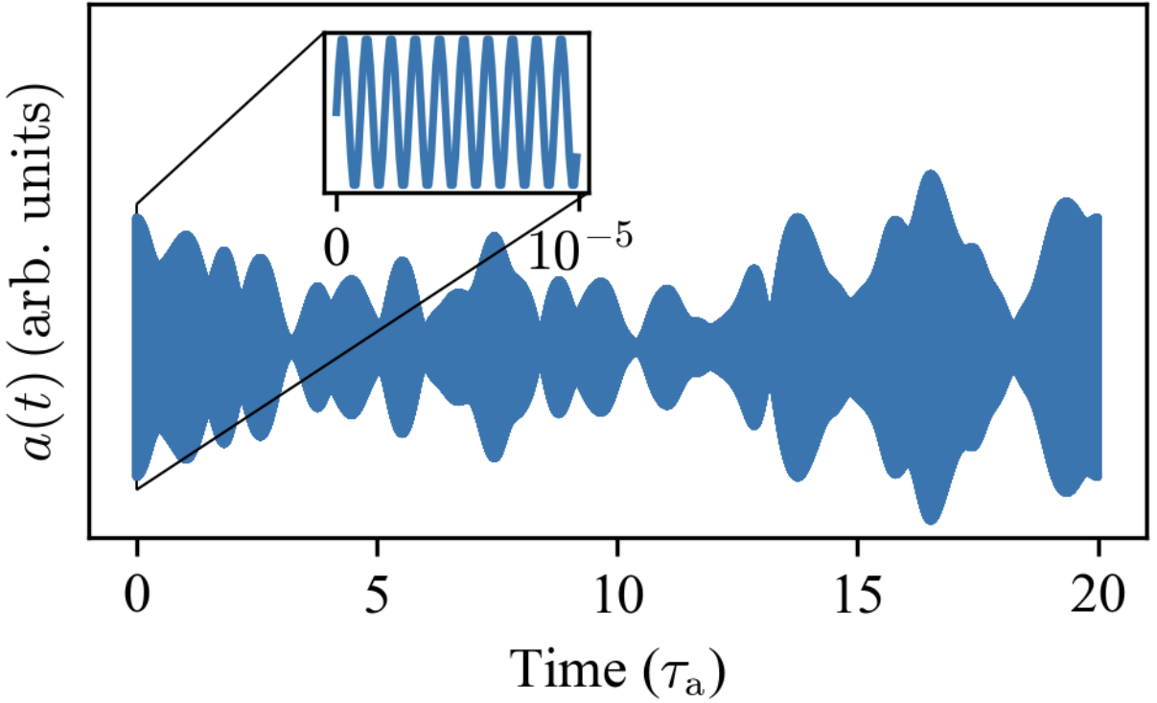

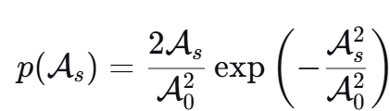
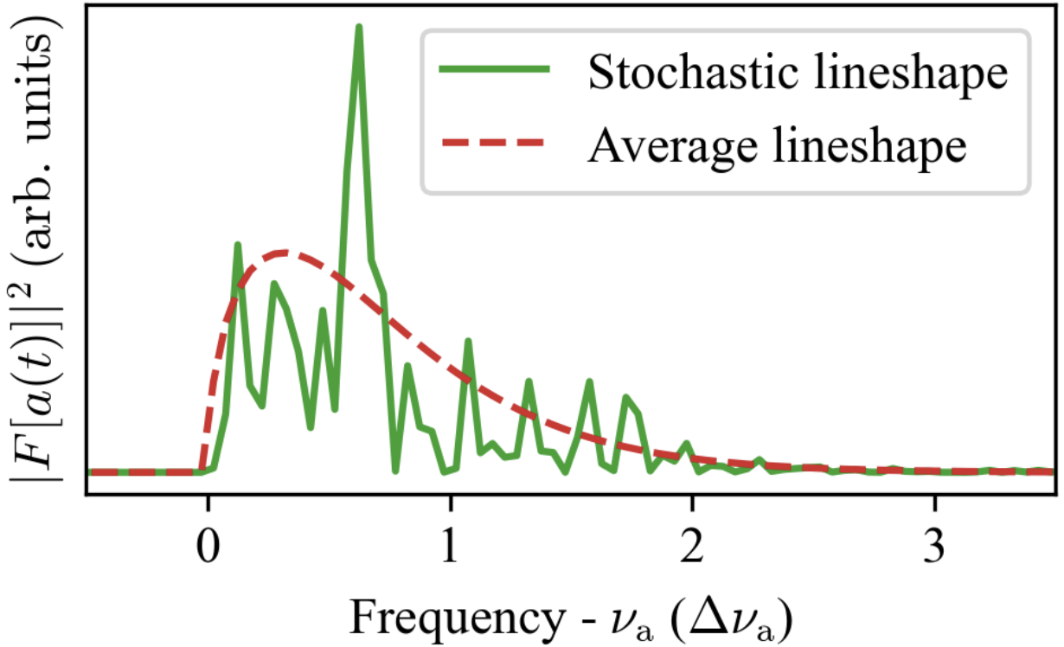

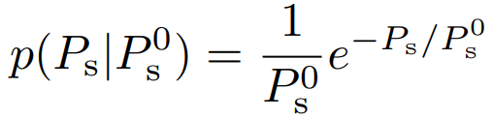





Data Analysis
Statistic Test
Gary P. Centers et al, 1905.13650, Nature Communication
$$P=\frac{\hat{s}\left(f\right)}{σ_{n}(f)}, P_{s}=\frac{S_{s}(f , g_{s} , 𝒜_{s})}{σ_{n}(f)}∝𝓐_{s}^{4}$$
Estimator
Likelihood
Stochastic oscillation of amplitude $𝓐_{s}$
stochastic oscillation of amplitude
Rayleigh distribution of $𝓐_{s}$
$$a(t)=𝒜_{s}cos⁡(\vec{k}⋅\vec{x}−m_{a}t)$$
ensemble average
Exponential distribution of $P_{s}$
stochastic lineshape of signal
Fig: 2602.06726

Slide 16
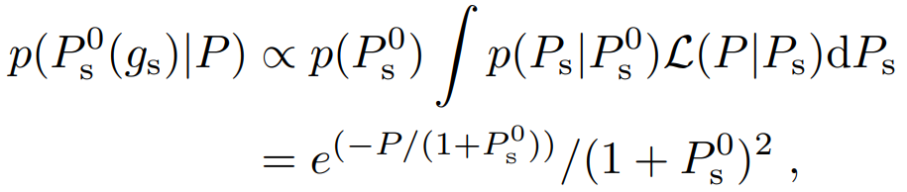

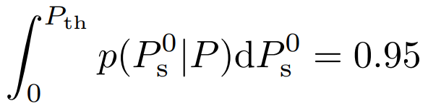

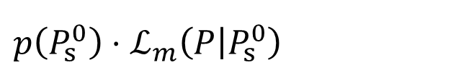

Data Analysis
Statistic Test
Marginalized Likelihood
$$ℒ_{m}\left(P | P_{s}^{0}\right)=$$
Jefferey’s Prior
Stochastic oscillation
Posterior
$p\left(P_{s}^{0}\right)⋅ℒ_{m}\left(P | P_{s}^{0}\right)$
95% Upper Limit
$$P_{th} → g_{s}^{95\%}$$

Slide 17
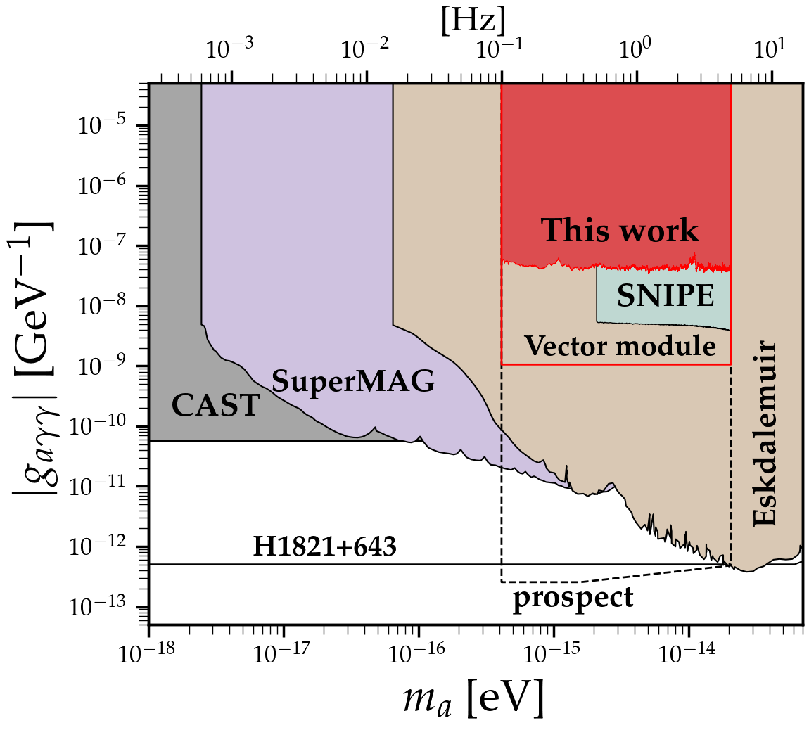
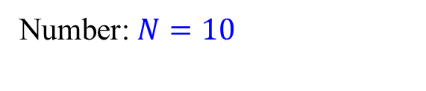
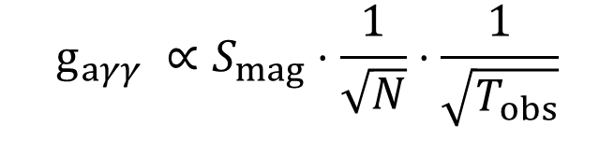
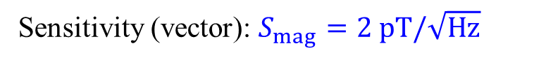
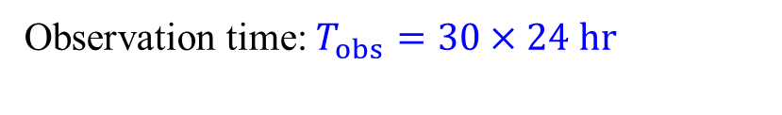
Result
Axion Bounds
Future Prospect
$$g_{aγγ} ∝S_{mag}⋅\frac{1}{\sqrt{N}}⋅\frac{1}{\sqrt{T_{obs}}}$$
Number: $N=10$
Observation time: $T_{obs}=30×24 hr$
Sensitivity (vector): $S_{mag}=2 pT/\sqrt{Hz}$
https://twinleaf.com/magnetometers/PPMV/
Yuanlin Gong, Lei Wu, et al, 2511.16553

Slide 18
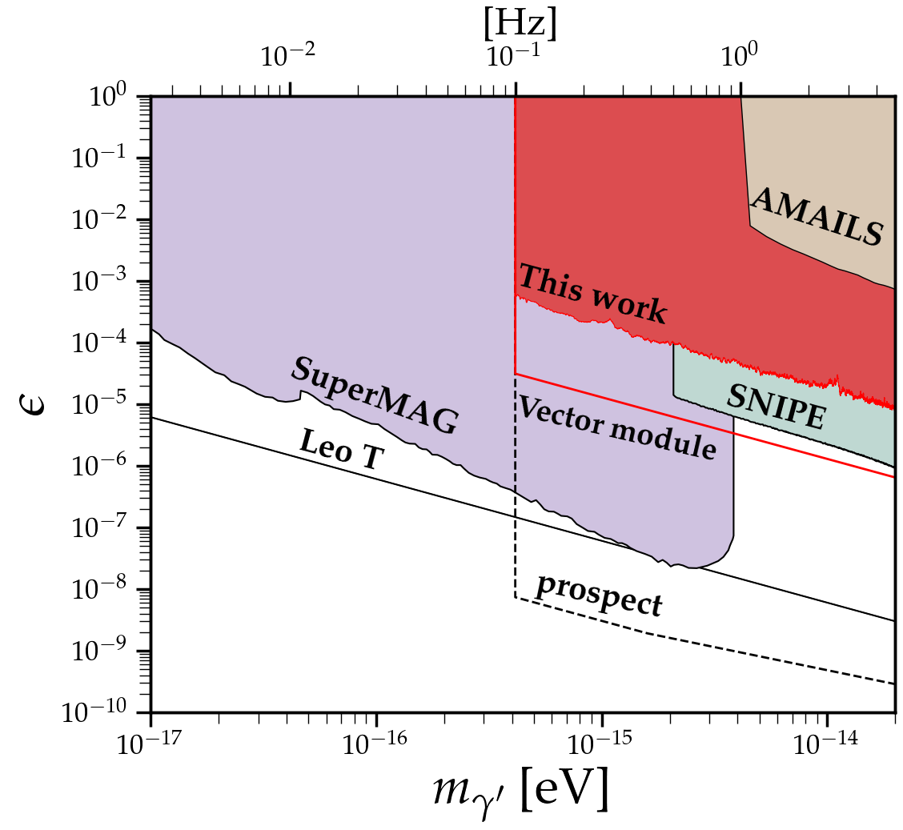
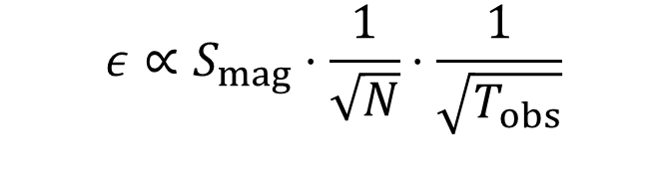
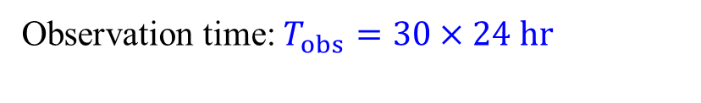
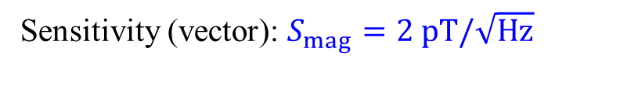

Result
Dark Photon Bounds
Future Prospect
$$ε∝S_{mag}⋅\frac{1}{\sqrt{N}}⋅\frac{1}{\sqrt{T_{obs}}}$$
Number: $N=10$
Sensitivity (vector): $S_{mag}=2 pT/\sqrt{Hz}$
Observation time: $T_{obs}=30×24 hr$
Yuanlin Gong, Lei Wu, et al, 2511.16553

Slide 19
Thanks for your attention!
Yuanlin Gong (龚远林)
Geomagnetic Probe for EXotic physics (GPEX) collaboration
2026.7.22

Slide 20
Backup

Slide 21
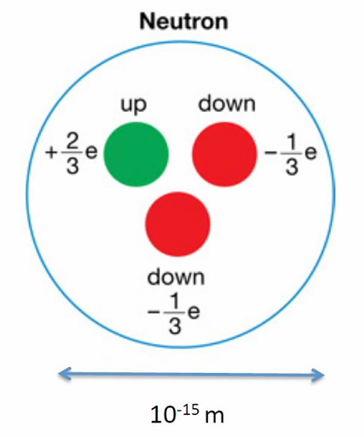
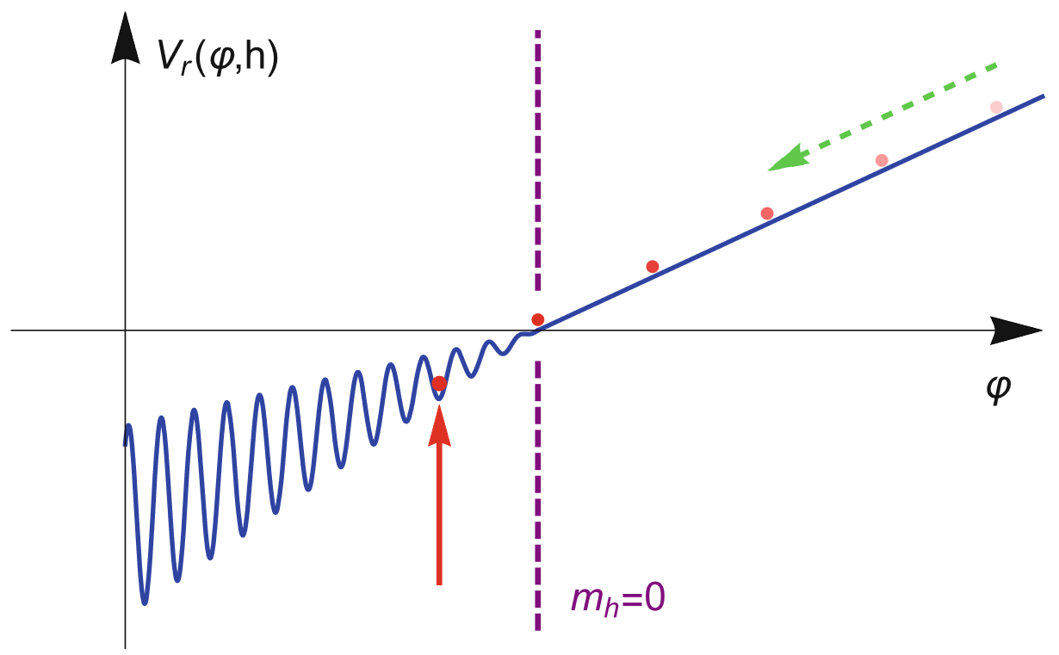


Introduction
Axion Dark Matter
Axion: Spin-0 pseudoscalar
Solve the strong CP problem
Solve the Natureless problem
Naïve estimation: ${10}^{−16}e^{−1}$ cm
Experiment: ${10}^{−26}e^{−1}$ cm
dynamical solution to the hierarchy problem
R. D. Peccei and H. Quinn, Phys. Rev. Lett. 38 (1977) 1440
Peter W. Graham et al, Phys. Rev. Lett. 115 (2015) 22, 221801
S. Weinberg, Phys. Rev. Lett. 40 (1978) 223–226
Jackson Kimball et al, The Search for Ultralight Bosonic Dark Matter
F. Wilczek, Phys. Rev. Lett. 40 (1978) 279–282
Notes:
(anomaly cancellations fix some SM ${U(1)}_{Y}$ charge assignments)？？？？

Slide 22
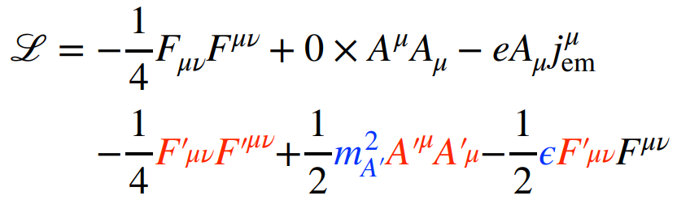







Introduction
Dark Photon Dark Matter
Dark Photon: Spin-1 vector
$U{\left(1\right)}_{d}$ extenstion
B. Holdom, Phys. Lett. B 166 (1986) 196–198
$$ℒ$$
A. E. Nelson and J. Scholtz,1105.2812, PRD
$ε$ coupling
kinetic mixing dark photon
$m_{A′}^{ }$ dark photon mass
Higgs mechanism
Stueckelberg mechanism
$U{\left(1\right)}_{B−L}$ dark photon
Interaction
$$ℒ_{int}=ε{A′}_{μ}j_{em}^{μ}$$
Notes:
(anomaly cancellations fix some SM ${U(1)}_{Y}$ charge assignments)
The heavier version is usually called a Z ′ in the literature, whereas lighter ones are called dark photons

Slide 23





Introduction
Axion Dark Matter Search
$$ℒ_{int}=$$
Effective current:
$B_{0}$ is the external magnetic field
https://cajohare.github.io/AxionLimits/docs/ap.html
Notes:
(anomaly cancellations fix some SM ${U(1)}_{Y}$ charge assignments)？？？？

Slide 24







Introduction
Dark Photon Dark Matter
$$ℒ_{int}=ε{A′}_{μ}j_{em}^{μ}$$
DM Radio
$$ε$$
$$L$$
$$B_{DM}$$
Effective current
https://cajohare.github.io/AxionLimits/docs/dp.html
Notes:
(anomaly cancellations fix some SM ${U(1)}_{Y}$ charge assignments)？？？？

Slide 25






Ultra-light Dark Matter
Small Scale Problem
Schive, Chiueh, Broadhurst, 1406.6586
Core-cusp problem
Comparison of cosmological large-scale structures formed ψDM(wave DM) and by ρDM(particle DM)
Radial density profiles of haloes formed in the wave DM model
A slice of density field of wave DM simulation
Lensing Image Anomly
Alfred Amruth et al, 2304.09895
Isomagnification contours of ψDM versus ρDM halos
Lensing magnification of ψDM versus ρDM halos
ψDM versus ρDM model predictions for HS 0810+2554

Slide 26





Particle-like vs Wave-like DM
How to search?
Particle-like DM
Wave-like DM
$$N_{occ} \sim n_{DM}λ^{3} \sim {10}^{20}{\left(\frac{{10}^{−6} eV}{m_{a}}\right)}^{4}$$
Number density: small
Number density: huge
Wavelength: short
Wavelength: long
Coherence: at detector size
Coherence: not at detector size
$$a=\frac{\sqrt{ρ_{0}}}{m_{a}}cos⁡(\vec{k}⋅\vec{x}−m_{a}t)$$
PandaX Collaboration, Xuyang Ning, et al, 2023, Nature
Count scattering events
Search for Classical, oscillating field

Slide 27







Cavity Search
Low frequency magnetic field signal
DMRadio-50L Experiment
For DM with Compton wavelength $λ_{c}=\frac{1}{m_{φ}}≫L_{ }$
$$∇×{\vec{ℬ}}_{s}−∂_{t}\vec{E}=$$
$$L\sim 0.1 m$$
$$B_{s}(r)=\int{d^{3}r^{′}\frac{𝒥_{eff}(r′)×|r−r^{′}|}{4π{\left(r−r^{′}\right)}^{3}}}$$
$$B_{0}\sim 1 T$$
SQUID Magnetometer
$$≈\left|𝒥_{eff}\left(r^{′}\right)\right|⋅L$$
$$∝g_{aγ}⋅Re(e^{im_{a}t})⋅B_{0}⋅L$$
@ frequency $ω=m_{a}$
YK, B. R. Safdi, JT, arXiv:1602.01086
P. Sikivie et al, arXiv:1310.8545 PRL
N. M. Rapidis, et al, arXiv:2210.07215

Slide 29






Ionosphere
Magnetometer
Earth
$R$
$h$
$${\vec{J}}_{eff}$$
$\vec{B}$
Amperian Loop

Slide 30





Geomagnetic Signal
Effective current
Magnetic field signal $B$
Biot Savart Law
$\sim$ 25$pT \left(\frac{ε}{10^{−5}}\right){\left(\frac{m_{A^{′}}}{10^{−14} eV}\right)}^{2}{\left(\frac{ρ_{DM}}{0.3 GeV/cm^{3}}\right)}^{1/2}$
Magnetoresistive sensors
20$pT/\sqrt{Hz}$ over the frequency 0.1–100 Hz

Slide 31







Geomagntic Signal
vector spherical harmonics basis

Slide 32








Geomagntic Signal
Modified Maxwell Equation
amplitude
Under $1>ωR_{e}≫ωh$
$R_{e}$ = 6371.2 km
$h≈100$ km
direction
boundary conditions
$E_{lm}^{\left(1\right)}$and $E_{lm}^{\left(2\right)}$both vanish at $R_{e}$ and $R_{e}+h$
Sulai et al, 2306.11575

Slide 33






Geomagntic Signal
Effective current and signal
Axion
$C_{lm}$ from IGRF model
Dark Photon
$$ω_{m}= m_{A^{′}}− 2πf_{d}m ≈m_{A^{′}}$$
where $f_{d}$ is the frequency associated to the sidereal day
Sulai et al, 2306.11575

Slide 34








Data Analysis
Statistic Test
$$S\left(f\right)=2{\left|\tilde{B}\left(f\right)\right|}^{2}/T_{obs}$$
Power spectrum density (psd, single-side)
$\hat{S}\left(f_{s}\right)= S_{n}\left(f_{s}\right)+S_{s}(f_{s} , g_{s} , 𝒜_{s})$
Coupling $g_{s}= g_{a, γ^{′}}=g_{aγ}, ε$
Amplitude $𝒜_{s}= 𝒜_{a, γ^{′}}=a_{0}, A^{′}$
$S_{n}(f)$ psd of noise
Mean: ${\overline{S}}_{n}\left(f_{s}\right)$ from Butterworth filter
Standard deviation: $σ_{n}(f_{s})$ evaluate from the data
psd of observed magnetic field
$S_{s}(f)$ psd of signal
signal
psd
Mean: $S_{s}(f)$ , variance 2 $σ_{n}(f_{s})$ $S_{s}^{ }(f)$
Noise floor
Frequency $f$
Notes:
evaluate from the data of ±200 frequency bins around $f=f_{s}$except for 3 frequency bins centered around $f=f_{s}$

Slide 35


GPEX
QuSpin Total-Field Magnetometer (QTFM)
QTFM-Gen2
Working Principle
https://quspin.com/qtfm-gen-2/
sensor head (left) and control electronics (right)
Polarized rubidium atoms in the vapor cell undergo Larmor spin precession with the presession frequency that is directly proportional to the external magnetic field
Scalar module: ${|B}_{obs}|=\sqrt{\left(B_{x}^{2}+B_{y}^{2}+B_{z}^{2}\right)}$
Notes:
磁阻的 Magnetoresistive

Slide 36



SuperMAG Dataset
▶ 500+ ground-based magnetometers
▶ 50 years of data
▶1-second, 1-minute resolution
Locations of SuperMAG geomagnetic observatories
▶Typical frequency: ${10}^{−3} −1$ Hz
Number of stations in the SuperMAG dataset in time

Slide 37


SNIPE Hunt
Magnetometers are located away from man-made magnetic noise sources:
Hayward, Lewisburg , Oberlin
Measurement campaign over 3 days in July
Typical frequency: 1- 1000 Hz band
Module: 3-Axis vector magnetic field

