Slide 1

Probing detection of dark photon oscillation in a waveguide
Wenyu Wang
Beijing University of Technology
2026.07 @Wulumuqi

Slide 2

超对称场论基础
超对称背景
超对称代数
超场
超对称拉氏量
超对称破缺
超对称粒子物理唯象
最小超对称标准模型
超对称破缺机制
重整化群和质量谱
超对称希格斯粒子唯象
超对称对撞机唯象
超对称暗物质
超出最小超对称标准模型

Slide 3
CONTENT
Introduction to dark matter
Dark U(1) Theory and oscillation of the photon in a wave guide
Detection of oscillation by OTDR
Conclusion
Collaboration with Yu-Xin Tian, Wen-Na Yang and Bin Zhu

Slide 4
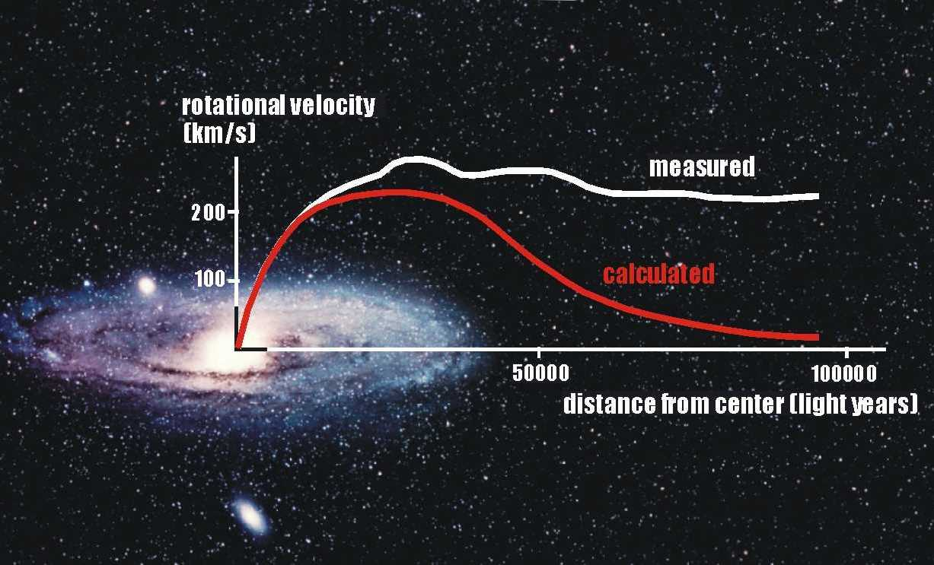

Slide 5
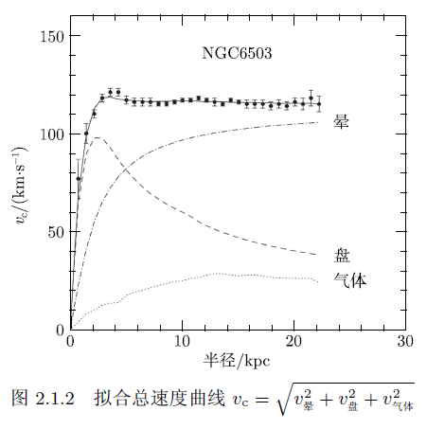

Slide 6
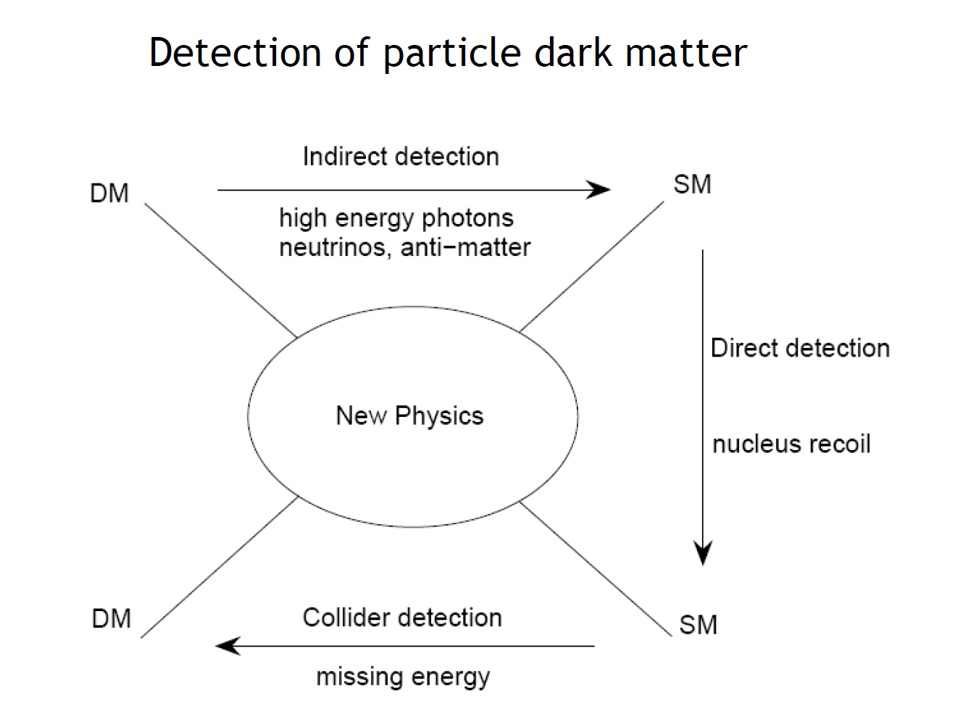
WIMP, EW?

Slide 7
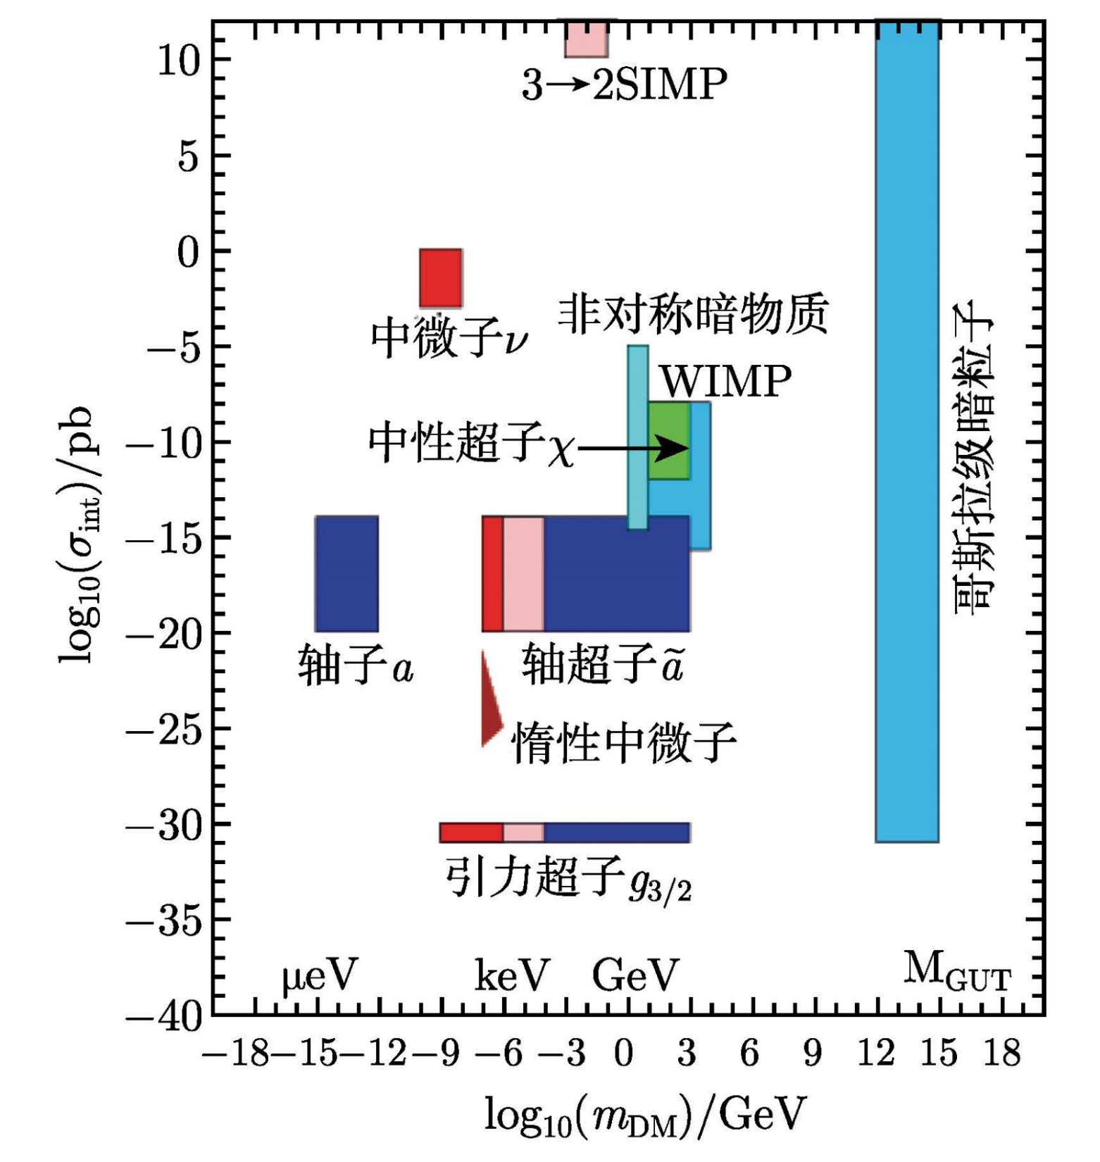

Slide 8
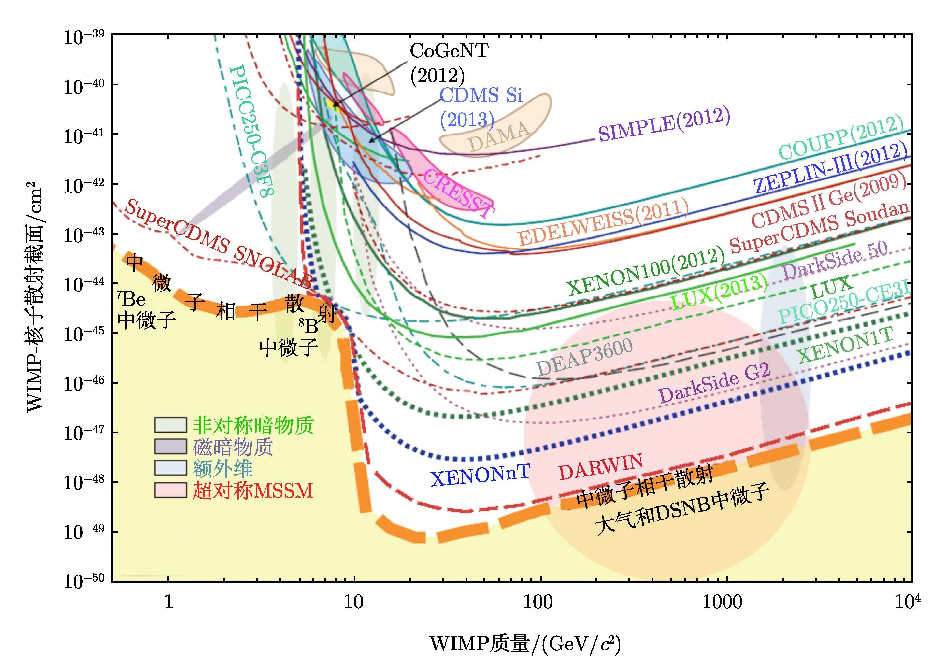
？
！

Slide 9
Axion and Dark Photon

Slide 10
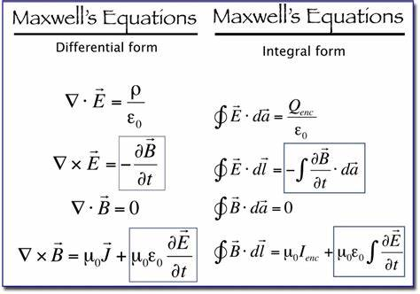
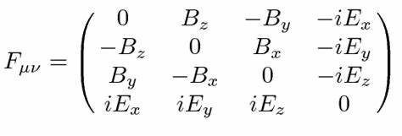


Electromagnetic Theory
Motion Equation：
Bianchi identity ：

Slide 11


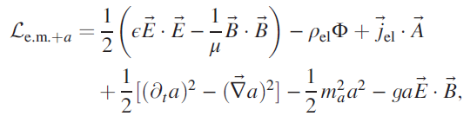
Axion
CP ODD
CP ODD
几何项

Slide 12

Modified Maxwell equations

Slide 13
Dark electromagnetic interaction

Slide 14
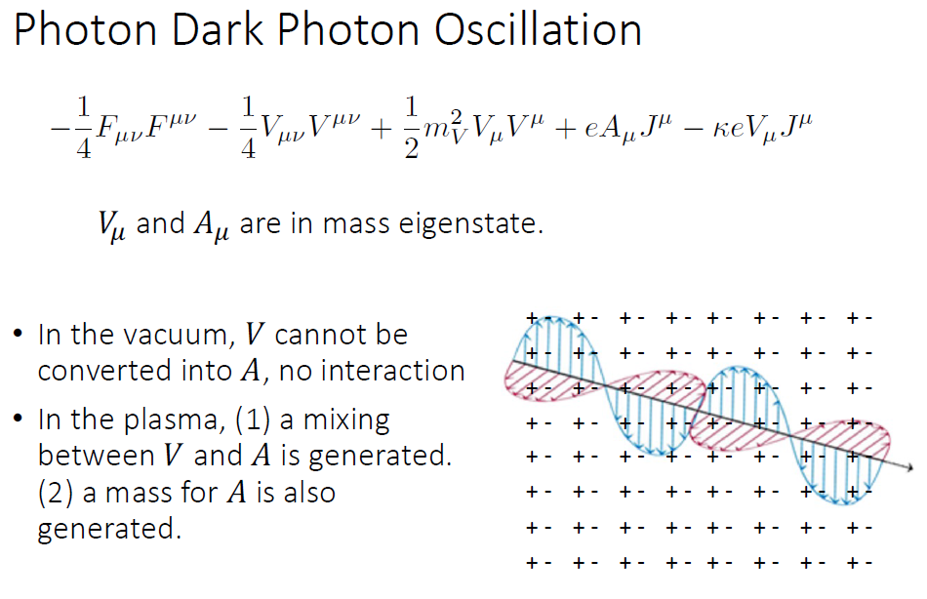

Slide 15
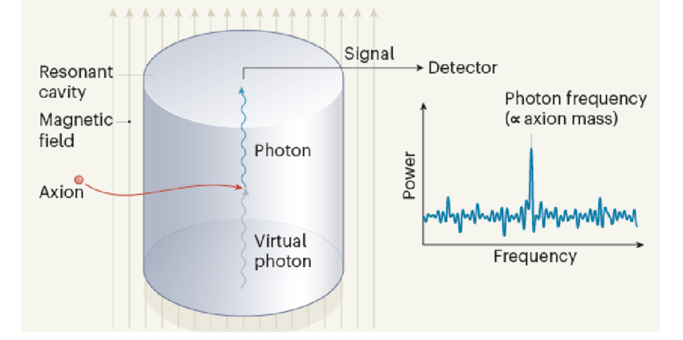
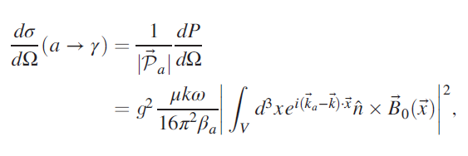

Slide 16
Other Detections
Wire array detector of dark matter axions
Dielectric plate detector of dark matter axions

Slide 17
Other Detections

Slide 18

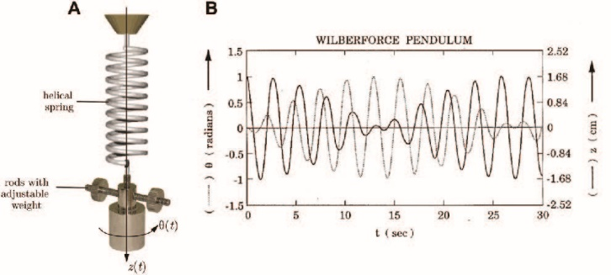
OSCILLIATION WHILE PROPAGATION

Slide 24
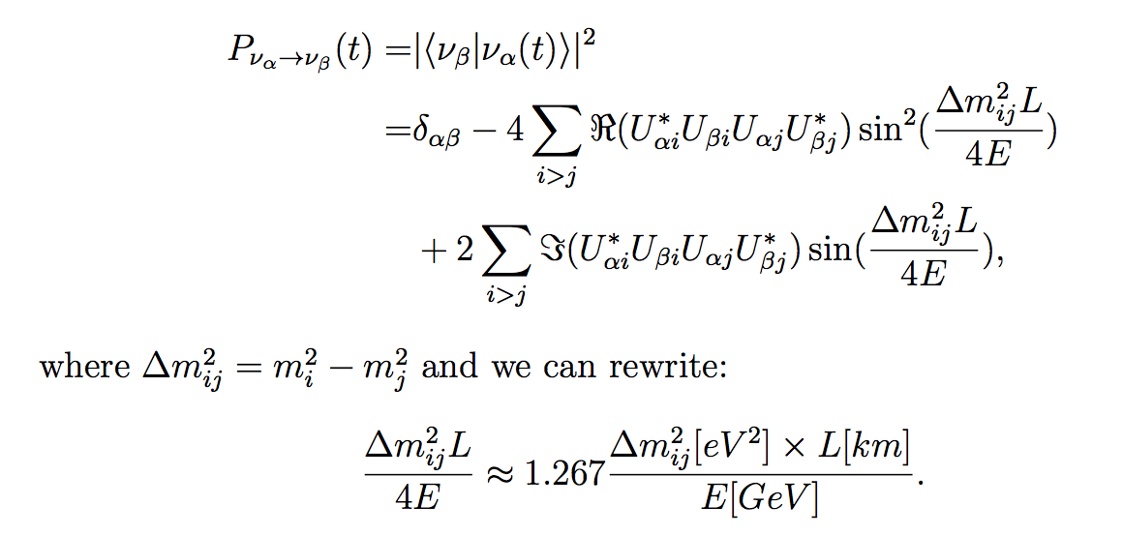
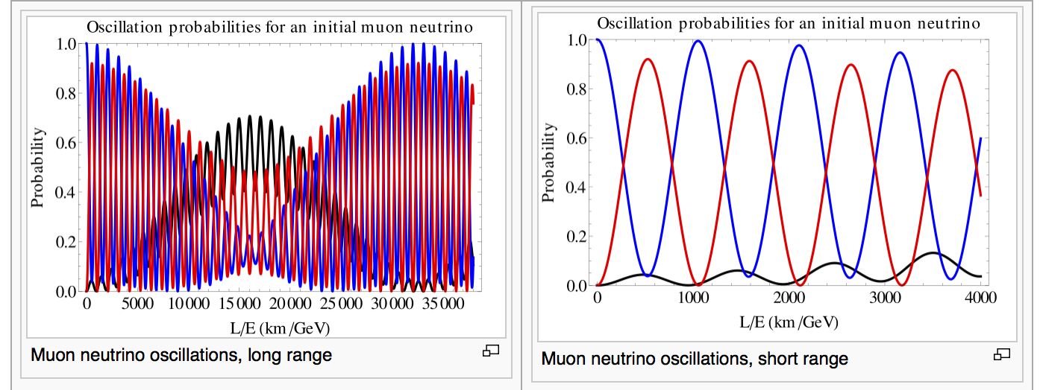
Neutrino Oscillation

Slide 25
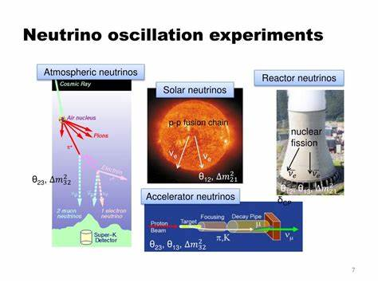

Slide 26
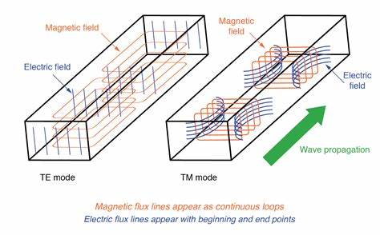

Can we use wave guide or optical fiber to detect the oscillation of dark photon?

Slide 27
Detection of Oscillation by OTDR

Slide 28
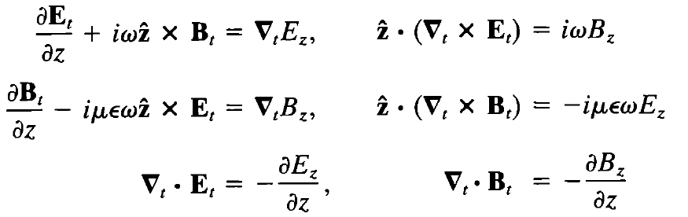

Slide 29
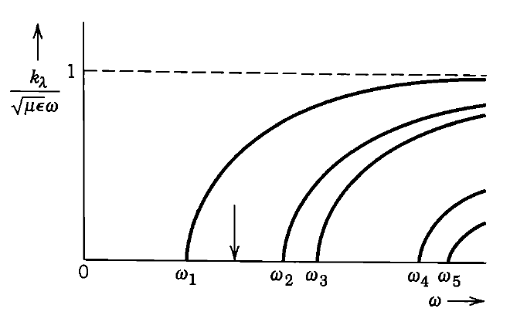
Electromagnetic field in a waveguide

Slide 30
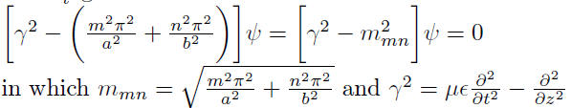
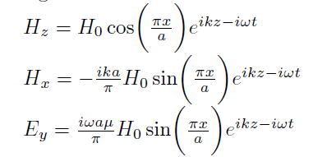
Effective mass
Propagation
TM01 mode:

Slide 31
Energy flow
Group Velocity

Slide 32
Decay:

Slide 33
Oscillation in waveguide
visible
dark

Slide 34


Slide 35

In case of decay

Slide 36
This strategy is not detection of conversion from the background dark photon, but input the mixed interaction state, oscillation happens in the propagation!

Slide 37
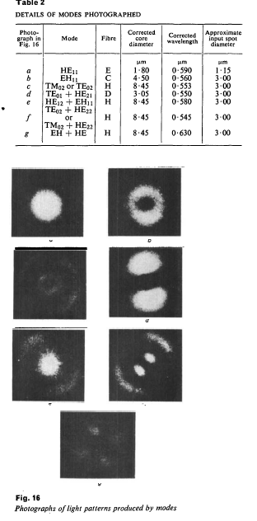
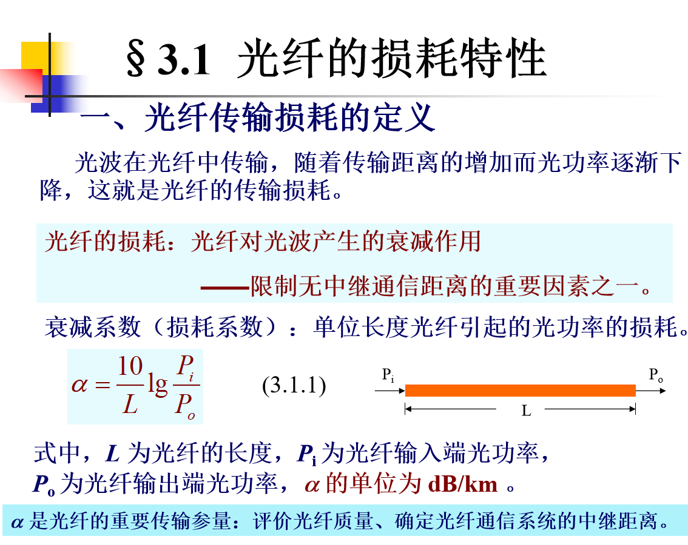

Slide 39
The detection strategy

Slide 40
Optical Time-domain Relectometry

Slide 41
NOTIFICATION
The reason for the proposal to scan of single mode of the optical fiber is only for a simplest demonstration.
The propagation of light in the real optical fiber may be is modified by medium of the fiber, such as the index of refraction, cladding, etc.
The differences caused by different setup, including interfaces, spools of the fiber, etc. need further mode detailed studies.

Slide 42


Slide 43




Slide 44





Slide 45
Noise
Noise
The linear relation:
The coefficients are
Define
Then

Slide 46
Finally

Slide 49
Conclusion
Motivated by neutrino oscillation mechanism, strategy for detection of the oscillation between visible and dark photon is proposed
The oscillation is the exchanging of the power flow between visible photon and dark photon, producing an oscillation in the amplitude and power flow. The darkness of dark photon distinguishes the oscillation from the ordinary measurements on the optical fiber.
The optical time-domain relectometry (OTDR) is adopted for the measurement of the oscillation which is found out to be very efficient in the exploration.
The operation in the lab and the data processing are simple. Thus the strategy proposed in the paper may give us a novel and better means to explore the mysterious dark universe.

Slide 50
THANKS

