Slide 1
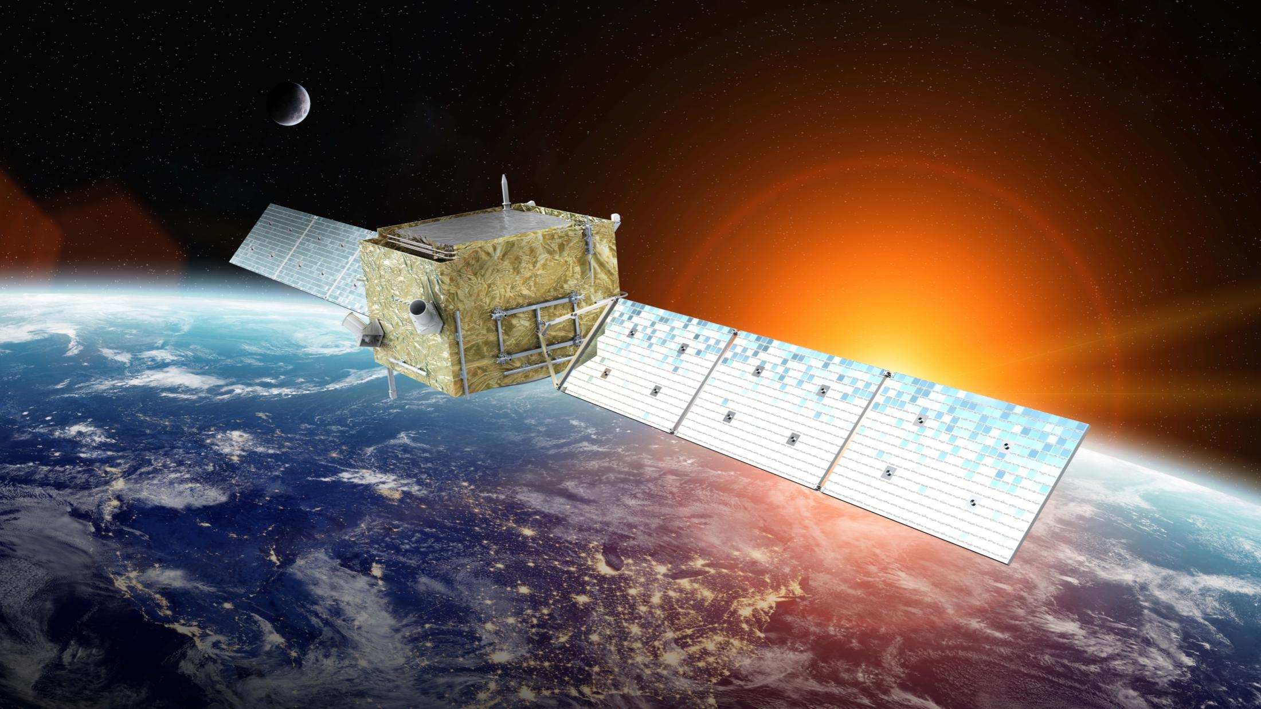
2026年紫金山暗物质会议（新疆乌鲁木齐）问题研讨会
多信使宇宙研究
Yi-Zhong Fan (范一中)
（中国科学院紫金山天文台）
2026年7月21日

Slide 2
Outline
暗物质信号搜寻：空间多信使探测
暗能量状态方程：FRB作为新探针
解禁闭夸克物质：BNS引力波事件

Slide 3

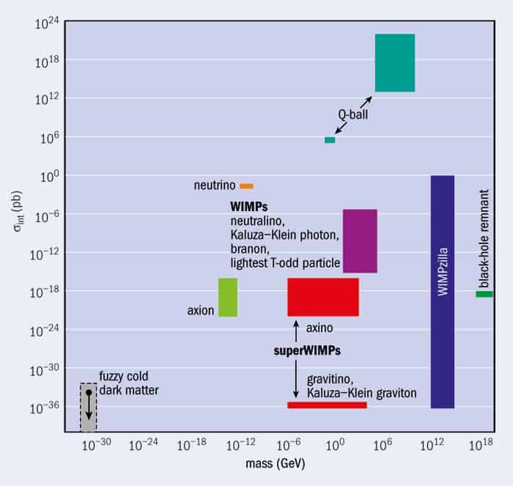
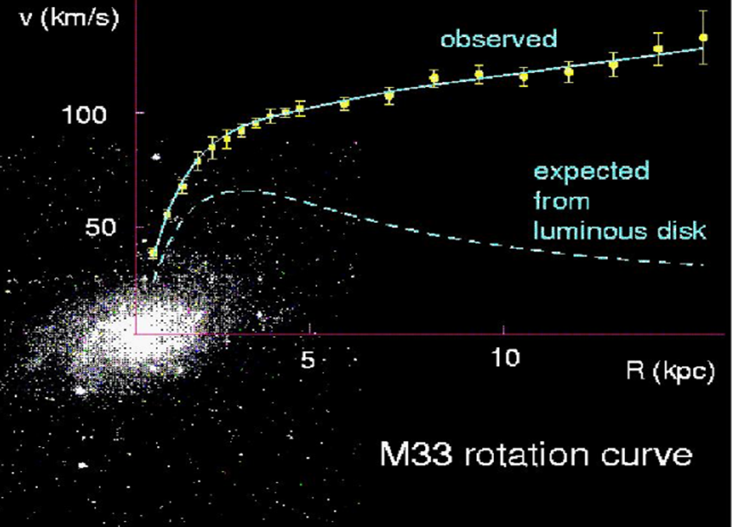
Dark Matter: a new particle?
All of the particles predicted in the SM have been detected，
but none can well account for the dark matter！
Notes:
如今我们已经建立起一个标准的粒子物理模型，夸克构成核子，核子结合形成原子核，原子核和电子结合形成原子，原子作为物质世界的单元构成宏观物体甚至天体。但是根据天文观测所揭示出的暗物质性质不同于标准粒子物理模型里的任何一种，因此暗物质很可能是一种或者多种超出标准模型的新粒子。
We have already built a standard model of particle physics. In this model, quarks form nucleons, nucleons combine to form nuclei, nuclei and electrons make up of atoms, and atoms form macro objects and even celestial objects. But the properties of dark matter is different from any of the known particles in the standard model. Dark matter is most likely to be one or more kinds of new particles beyond the standard model.

Slide 4
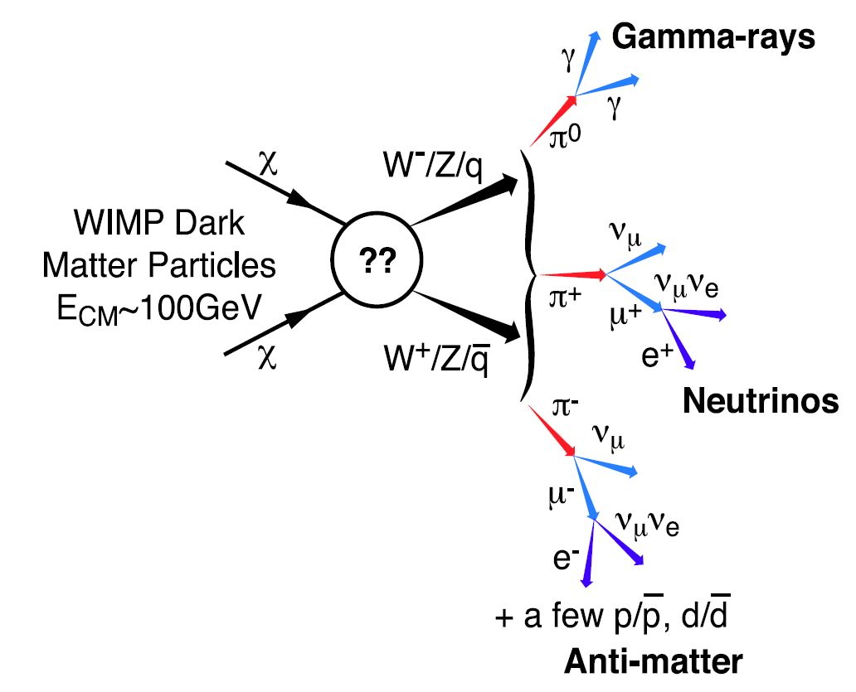
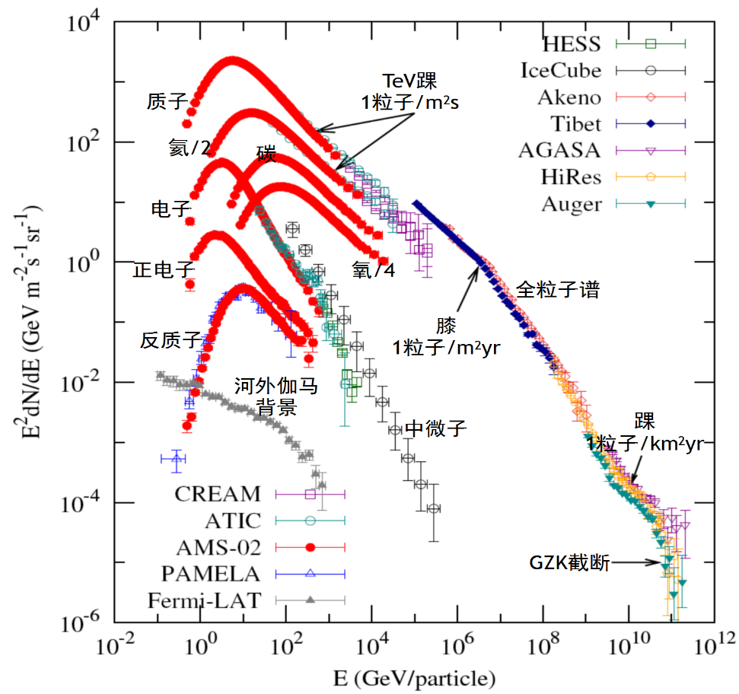
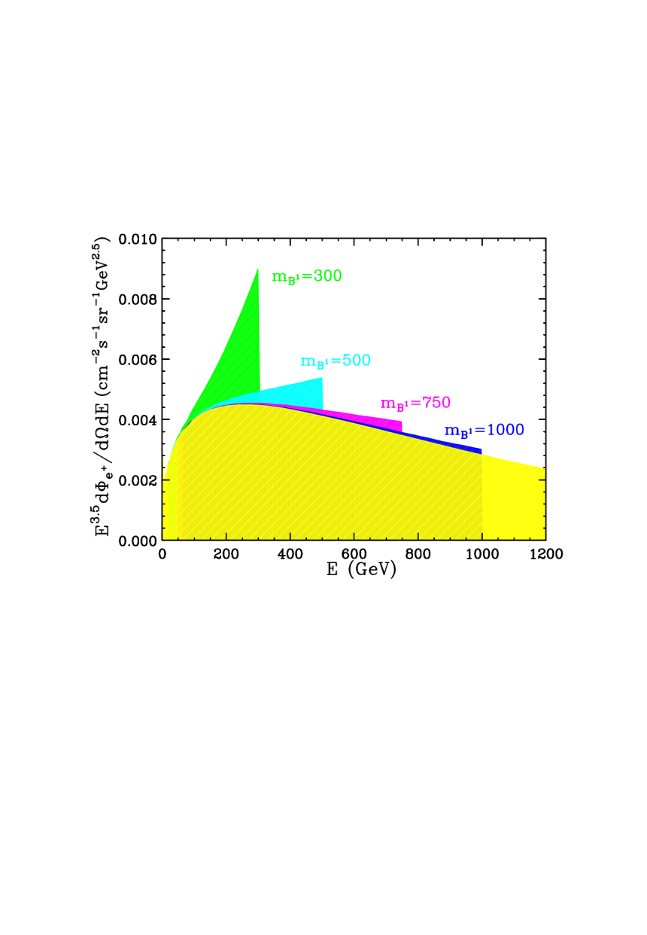
Dark matter: multi-messenger signals?
暗物质湮灭或衰变产生正负电子、正反质子、γ射线等粒子。间接探测暗物质主要搜寻反物质宇宙线、正+负电子宇宙线和γ射线的能谱及空间分布中出现的奇特现象，例如特殊的“峰”(超)、“掉”、“拐”等
暗物质间接探测的主要目标及当前国际引领性空间设施
目标信号 | γ射线超 | γ射线线谱 | 反质子超 | 正电子超 | 正负电子总能谱
引领性设施 | Fermi-LAT | 悟空号 | AMS-02 | AMS-02 | 悟空号

Slide 5
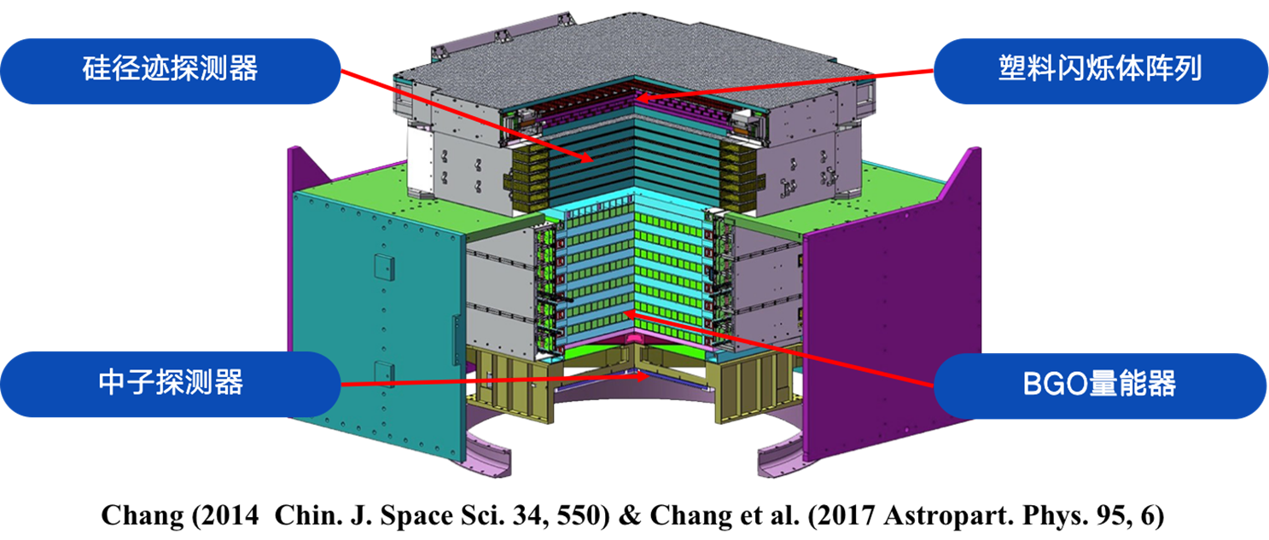
Dark Matter Particle Explorer (DAMPE)
2015.12.17发射，设计寿命3年，已经平稳运行了10+年

Slide 6
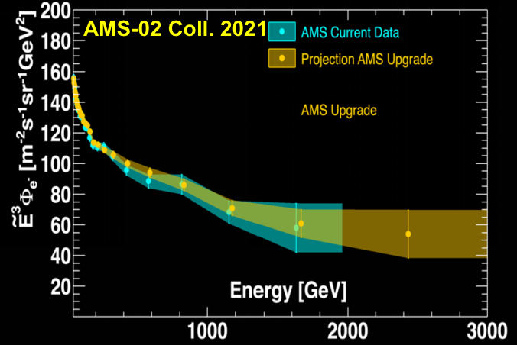
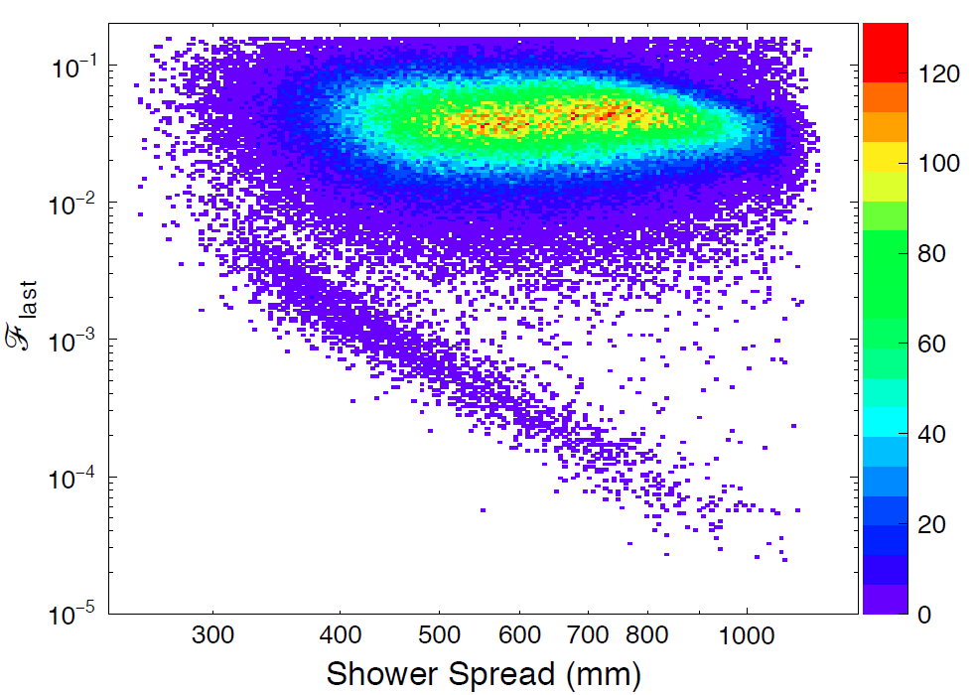
The spectrum of cosmic ray electrons
Candidate protons
0.9 TeV拐折
Candidate electrons
0.5-1.0 TeV
Nature, 552, 63 (2017)

Slide 7
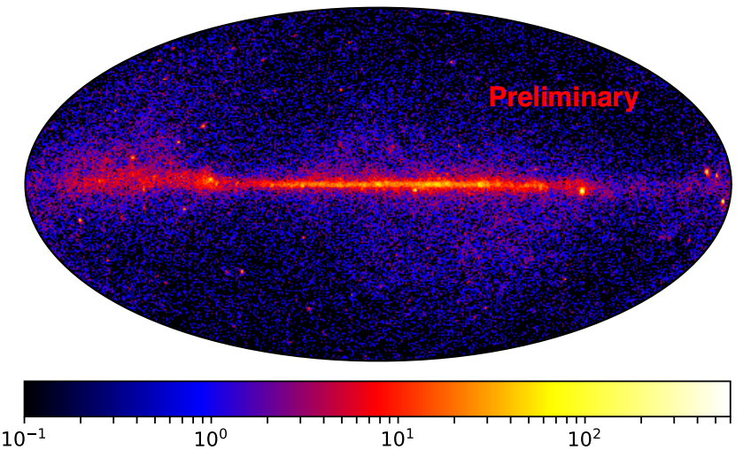
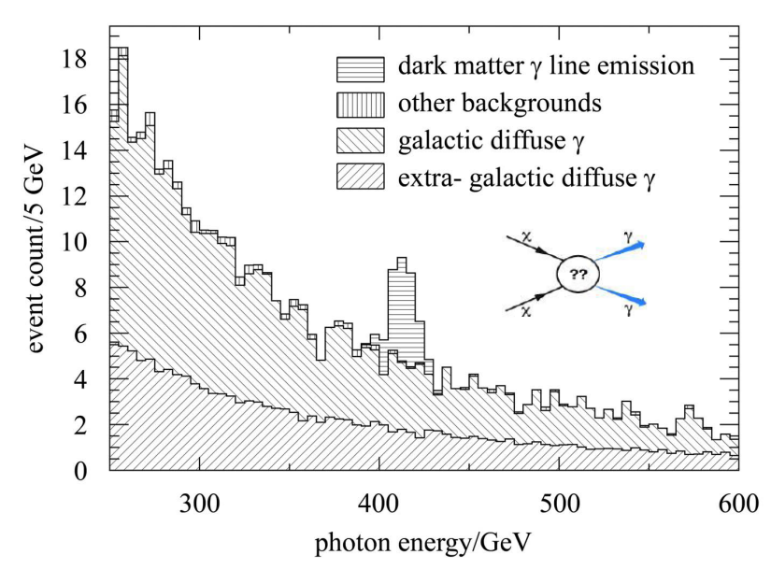
The gamma-ray line search with DAMPE
χχ→γγ
χχ→γγ
χχ→γγ
χ→γν
Thanks to the excellent energy resolution, DAMPE sets stringent constraints on DM line emission (2022 Sci. Bull.)

Slide 8
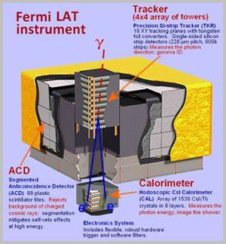
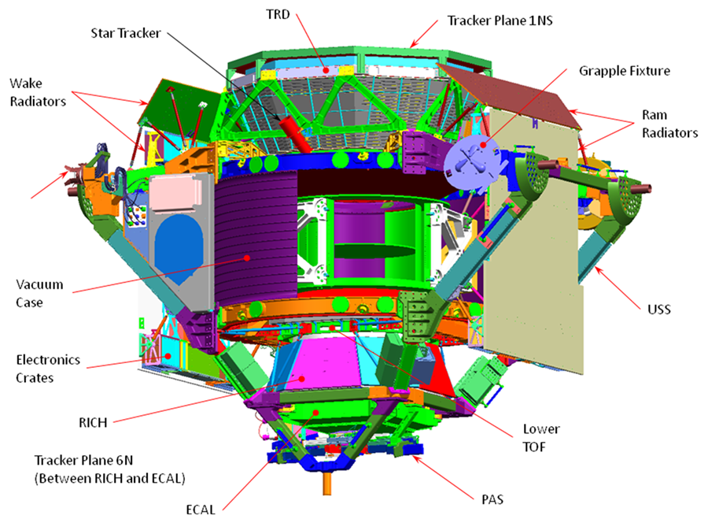
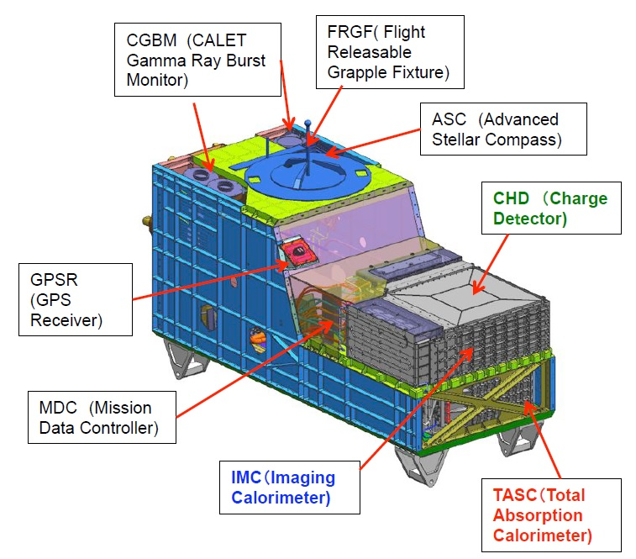
Other international experiments in space
Fermi-LAT (7亿美元，2008)
AMS-02 (20亿美元，2011)
CALET (未报道，2015)

Slide 9
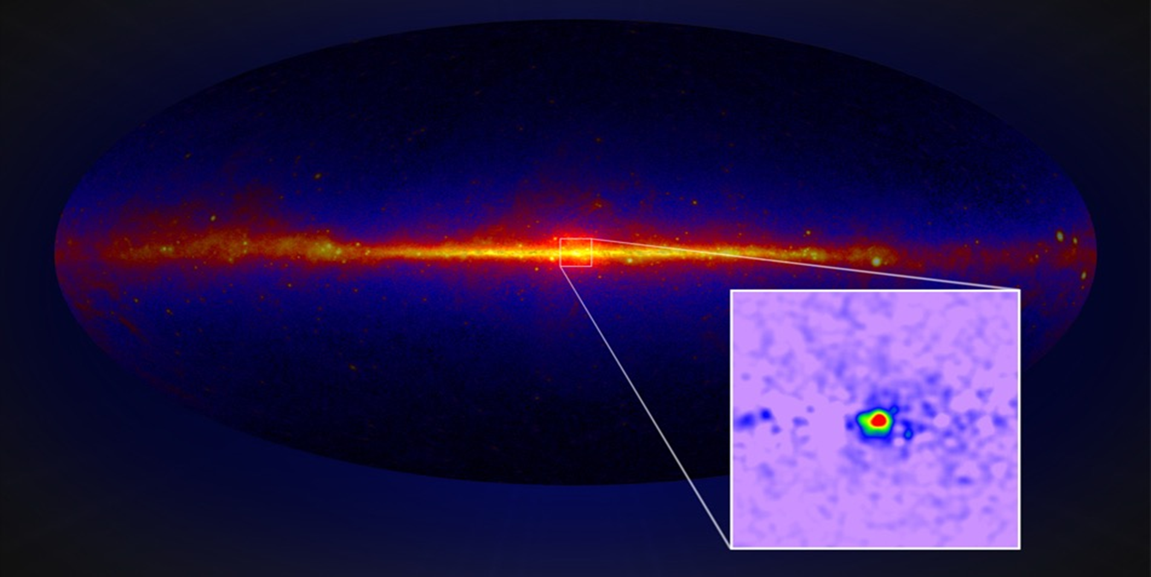
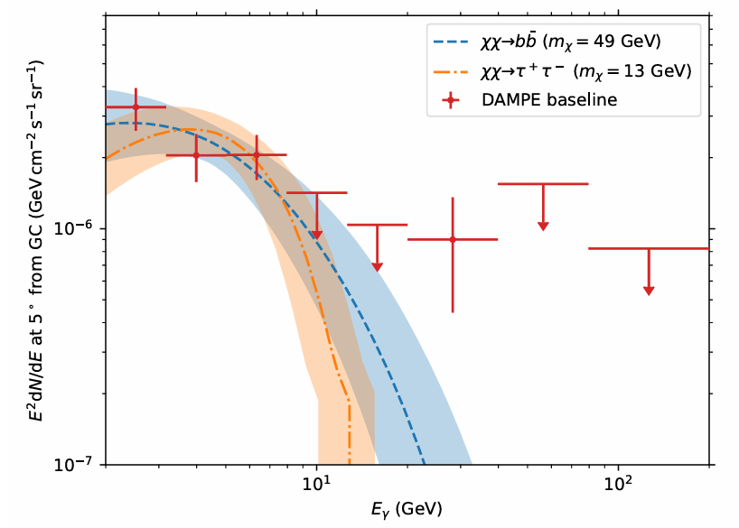
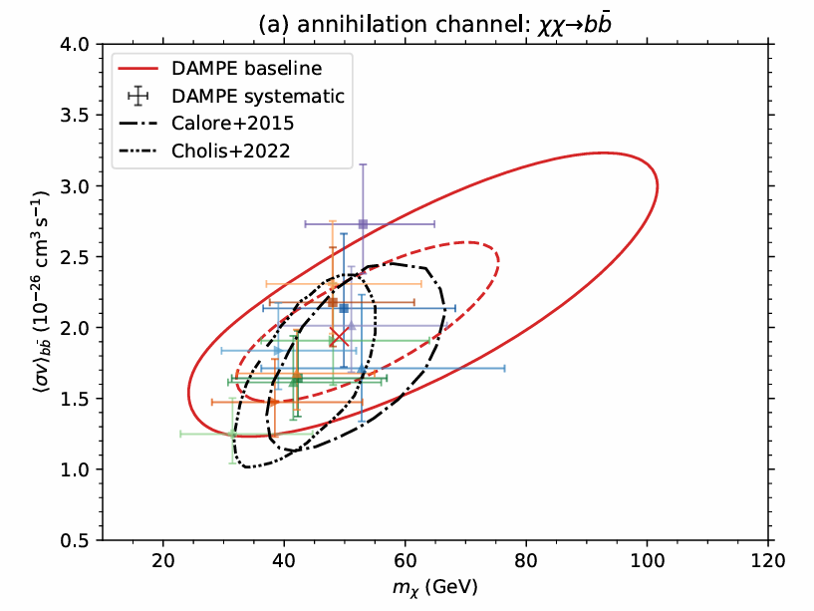
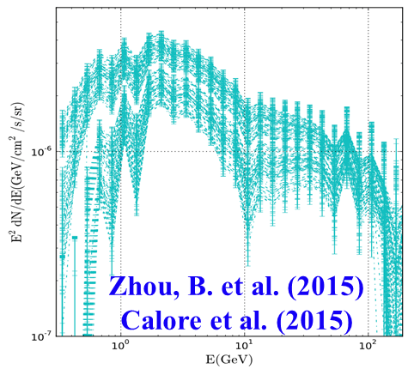
Fermi-LAT GeV excess: DM annihilation?
银心GeV超出
DAMPE coll. 2026 ApJS
There is a bright GeV excess in the direction of the Galactic center.
Spatial distribution and spectrum are consistent with being DM annihilation signal.
DAMPE provides the first independent confirmation on this GeV signal!

Slide 10
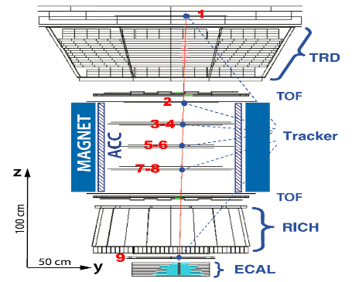
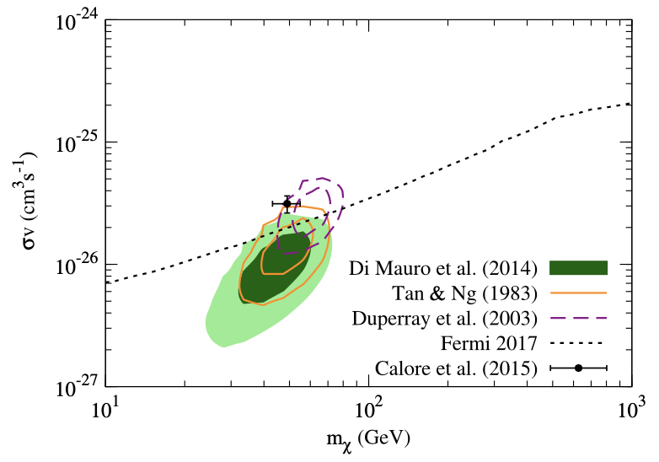
AMS-02 antiproton: the other DM signal？
银心GeV超
Cui, Yuan, Tsai & Fan (2017 PRL)：there is a GeV antiproton excess，
if interpreted as DM annihiltion, the parameters are similar to that of GeV excess

Slide 11
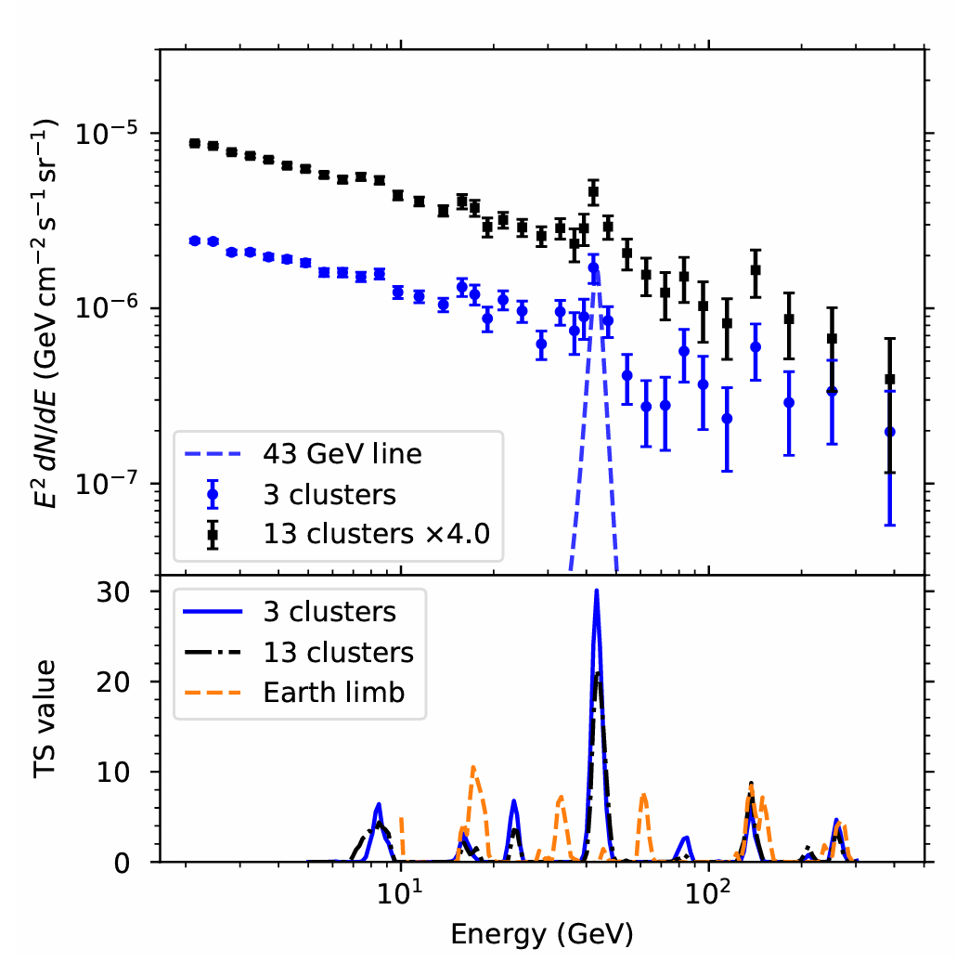
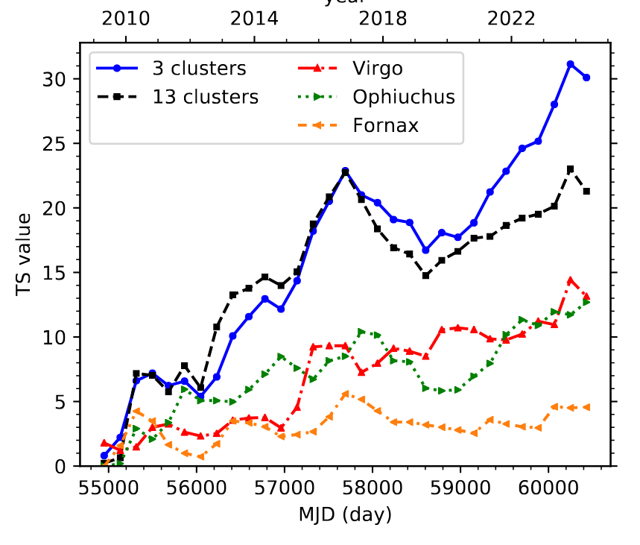
Fermi-LAT: 43 GeV line emission?
Fan et al. 2026 PRL in press (arXiv:2407.11737)

Slide 12
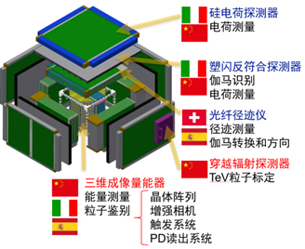
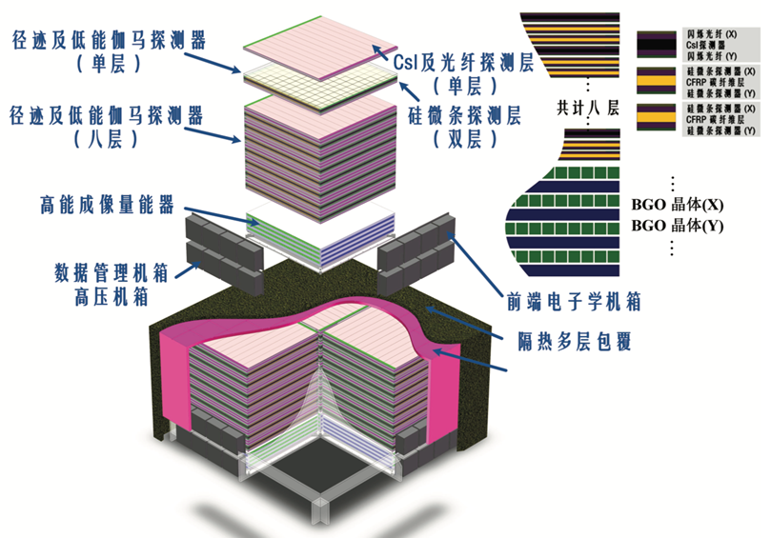
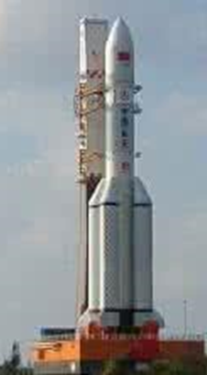
Spaced-based experiments: the future
HERD
VLAST
Larger acceptance, wider energy range
Better angular and energy resolution
An acceptance of ~10 m² Sr
A total weight of ~20 Tonnes

Slide 13
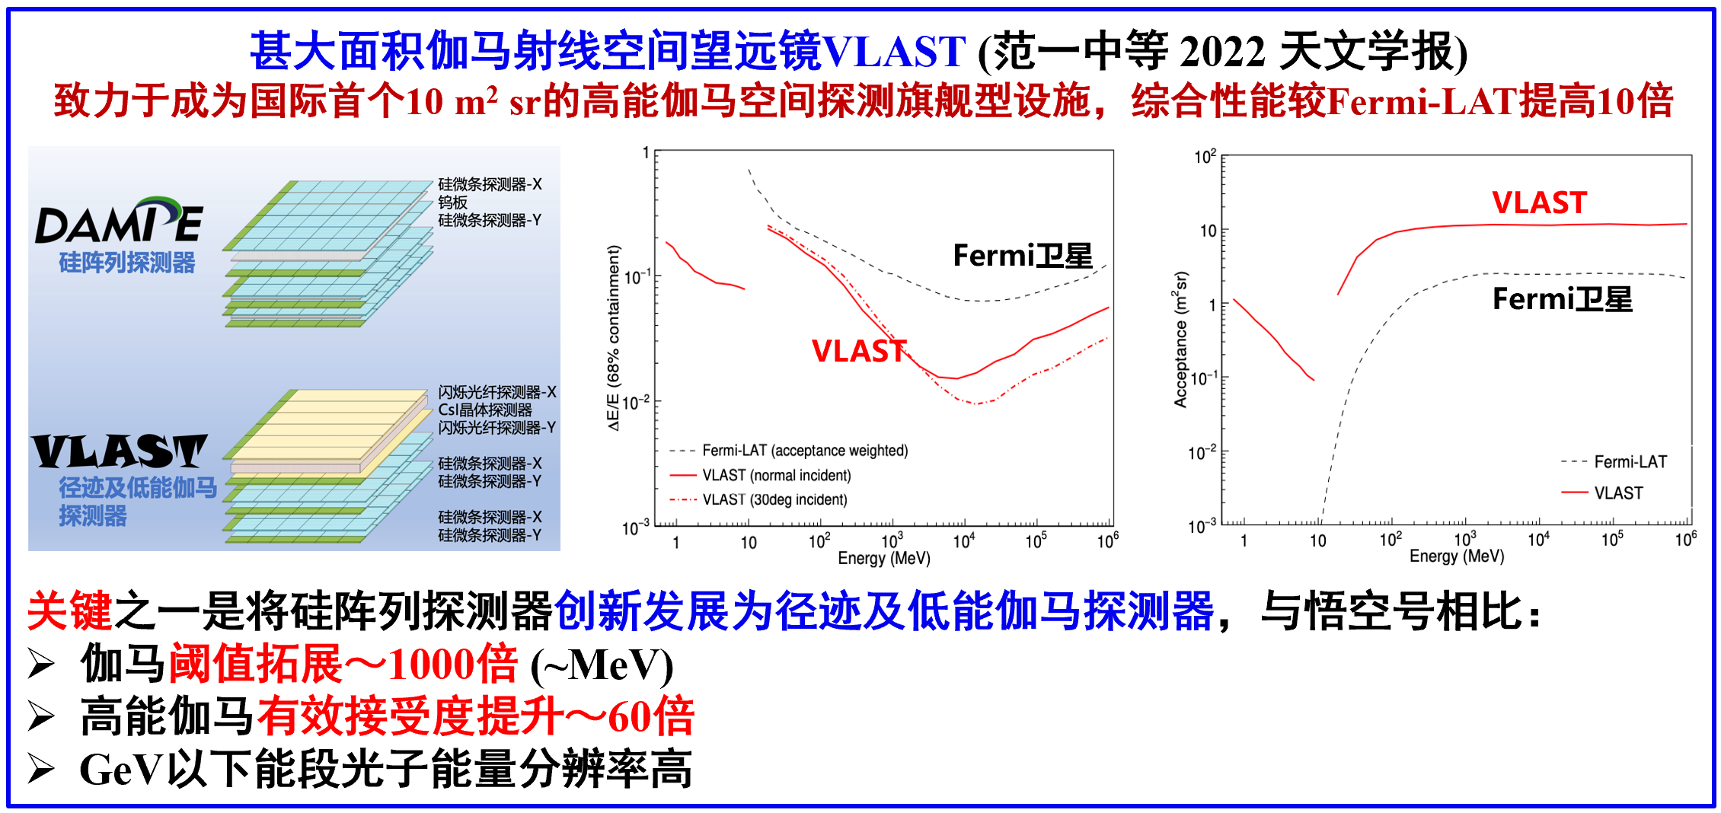
Very Large Area gamma-ray Space Telescope

Slide 14
Outline
暗物质信号搜寻：空间多信使探测
暗能量状态方程：FRB作为新探针
解禁闭夸克物质：BNS引力波事件

Slide 15
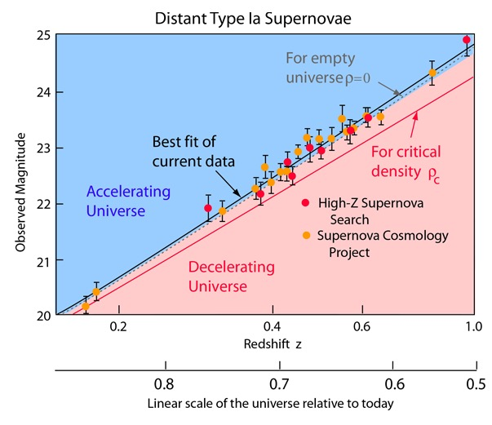
The expansion of the Universe is accelerating

Slide 16

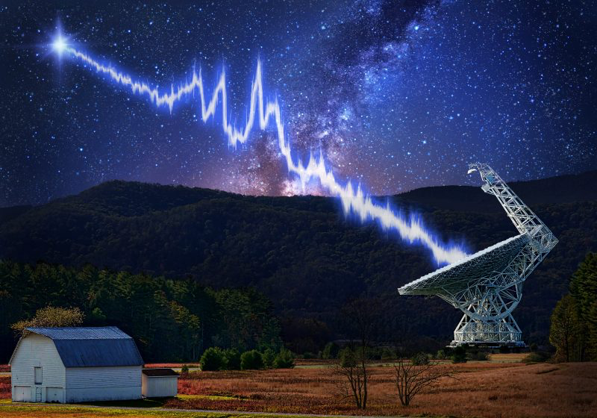
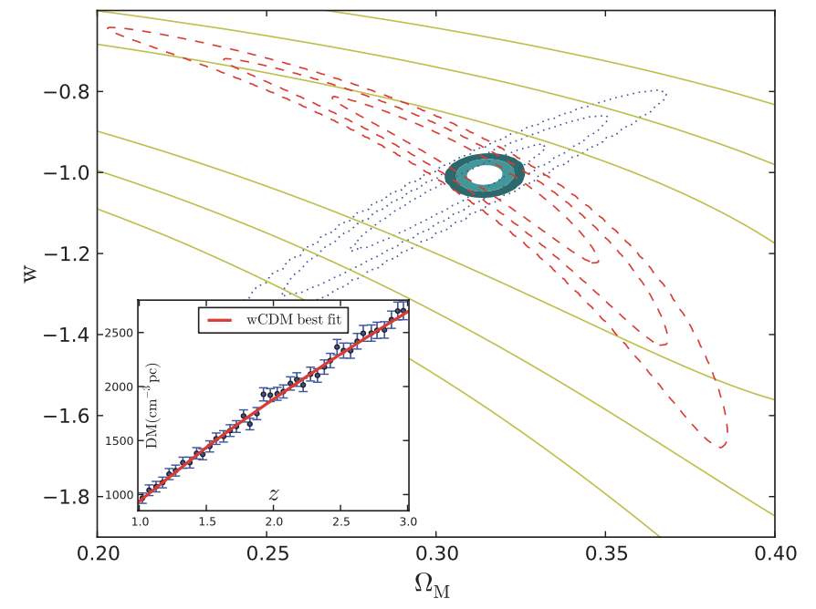
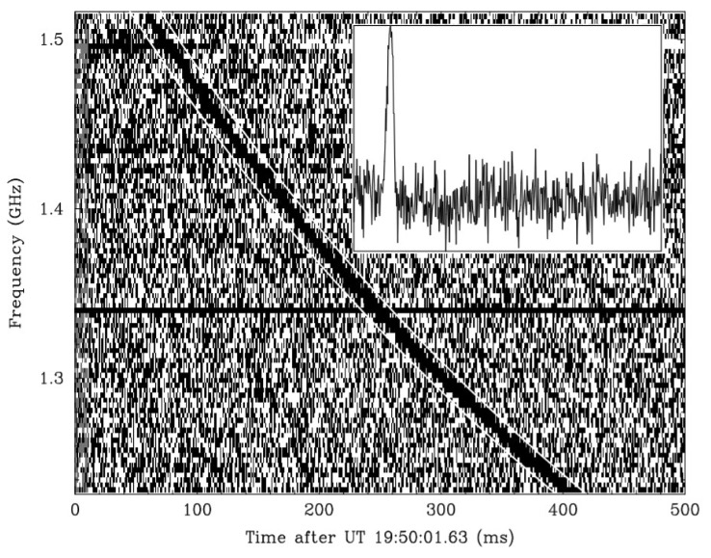
FRB as a powerful probe of the EoS of DE

Slide 17
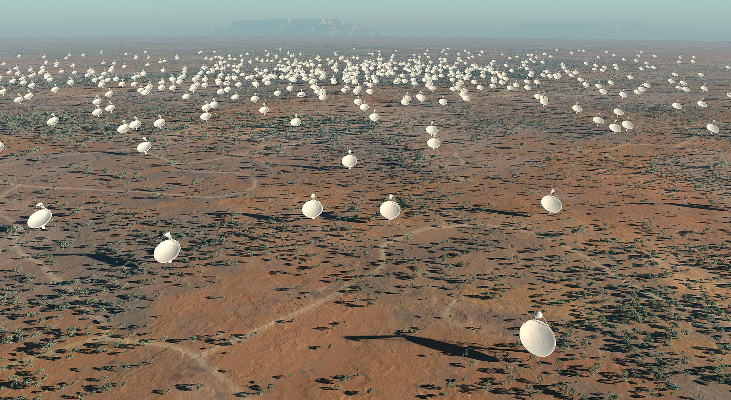
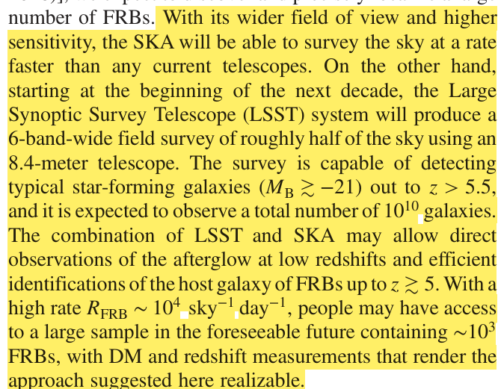
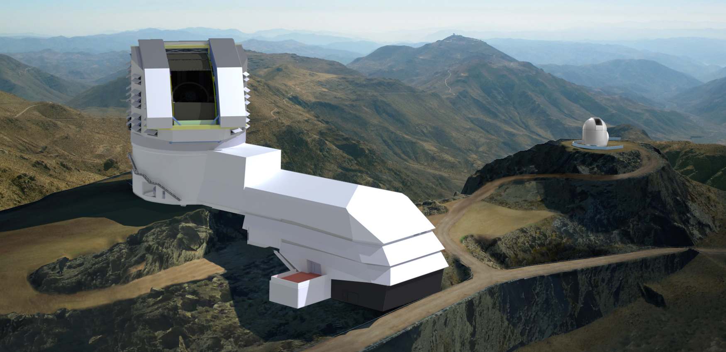
FRB as a powerful probe of the EoS of DE
Zhou et al. 2014: SKA + LSST 的未来观测可望使FRB成为DE的可靠探针

Slide 18
Outline
暗物质信号搜寻：空间多信使探测
暗能量状态方程：FRB作为新探针
解禁闭夸克物质：BNS引力波事件

Slide 19
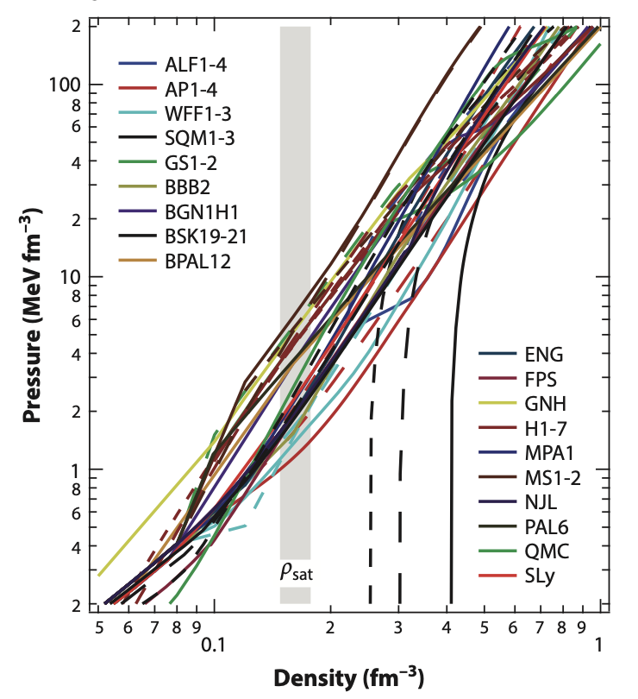
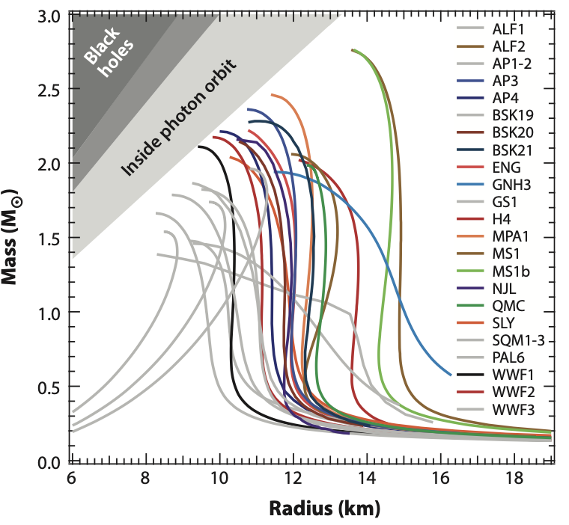
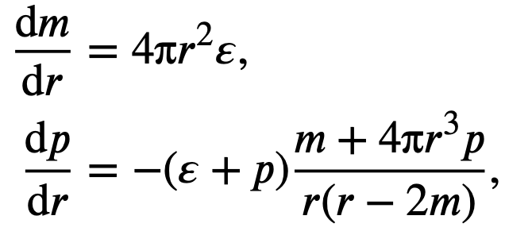
Equation of state of very dense matter
TOV
Bayesian infer.
TOV equations
The reliable mass/radius measurements are essential for EoS reconstruction
（Ozel et al. 2016 ARA&A）

Slide 20
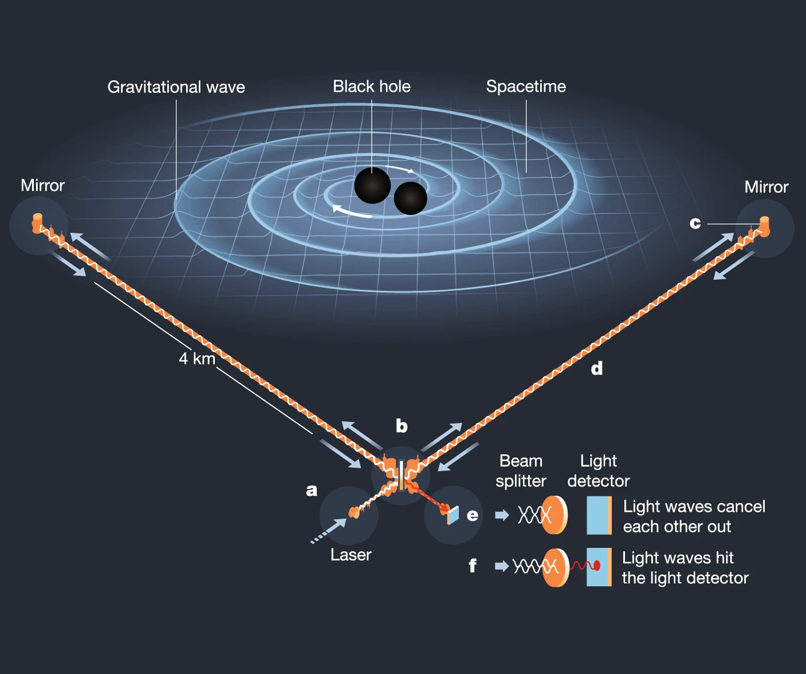
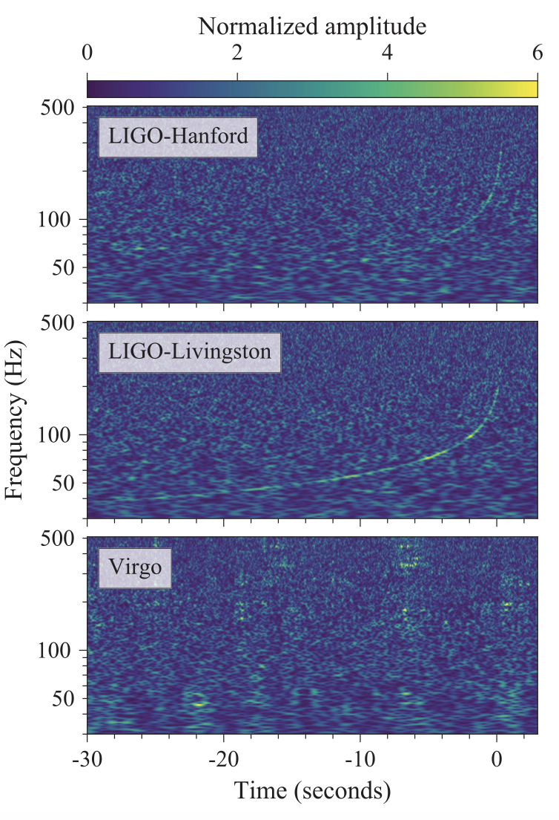
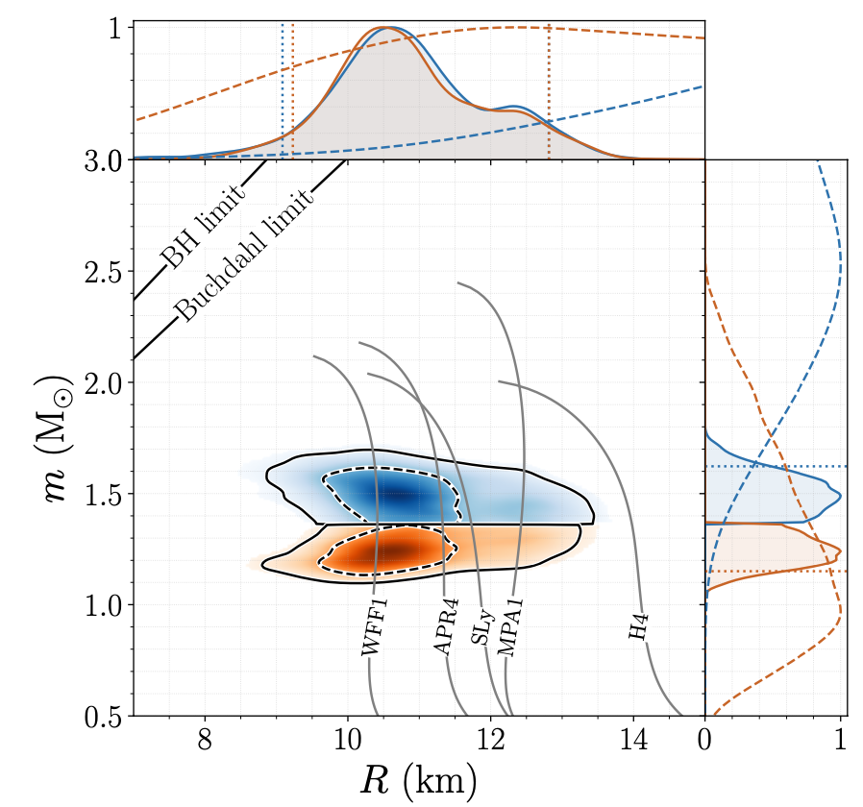
GW170817: measurements of NS properties
GW170817的前～100s信号可以测出两个中子星的质量；最后～0.1s信号可以测出潮汐形变度，它是M/R的函数关系! 综合这些数据可以得到两个中子星各自的质量与半径
(Abbott et al. 2017 PRL, 2018 PRL)

Slide 21
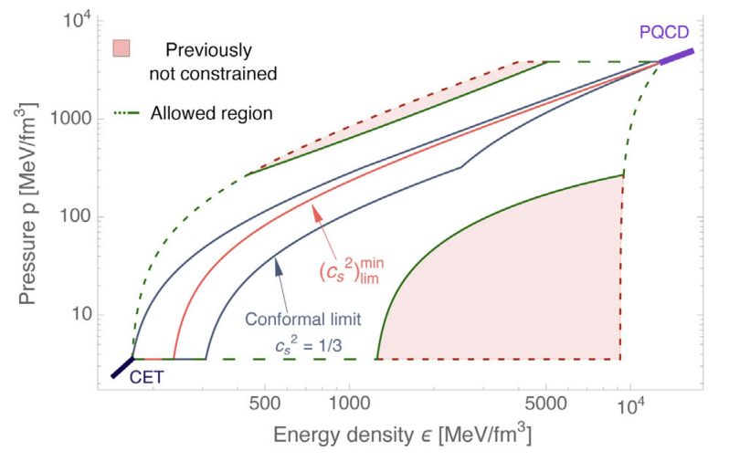
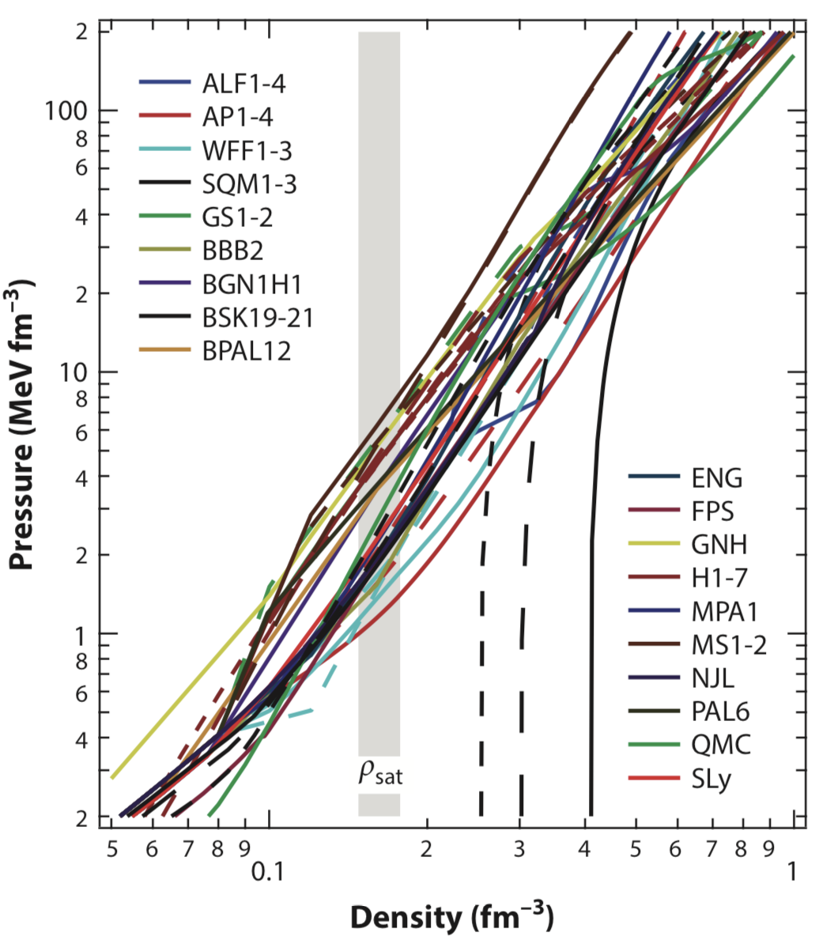
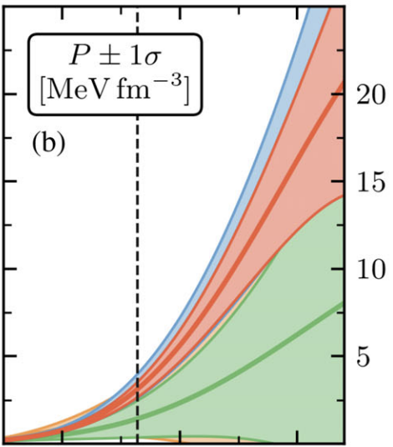
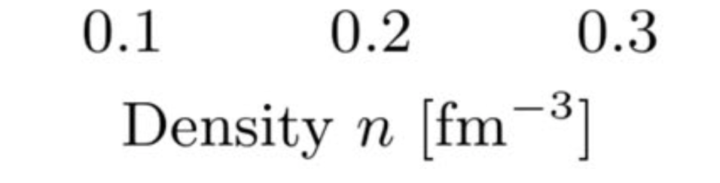
Additional physical information/constraints
NS data
pQCD
χEFT
Chiral effective field theory: yields reliable EoS up to the nuclear saturation density n_{s}
The boundary constraint from pQCD: valid at ultra-high densities, can be reasonably extrapolated to low densities, say 5-10n_{s}, under the conditions of causality and microscopic stability (0≤c_{s}²≤1)
(Drischler et al. 2021 PRL; Gorda et al. 2022 PRL)
Notes:
The mass and radius data of neutron stars mainly govern /ˈɡʌv.ɚn/ the EoS in the middle density regime. In the low density region,
the chiral /ˈkaɪrəl/ effective field theory calculation has reached a high accuracy in recent years, which yields reliable EoS up to the nuclear saturation density. Although dense matter cannot be described with a perturbative theory until ultra-high density (∼ 40n0)，under the conditions of causality [kɔˈzæləti] and microscopic stability, the pQCD constraint can be reasonably extrapolated to the low density region.
In our inference, both the NS mass and radius data and the theoretical information have been taken into account.

Slide 22
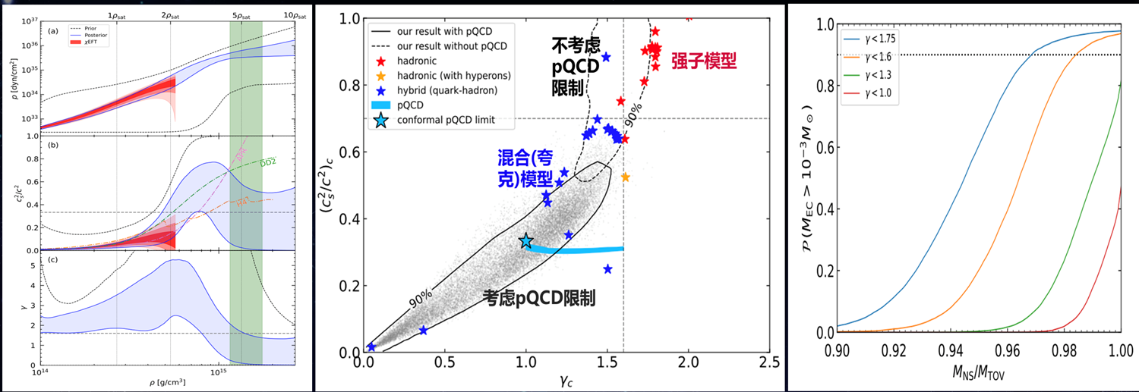
A quark matter core in the massive NSs?
我们发展了基于前馈神经网络的状态方程重建算法，可以高效的生成强子、强子夸克连续过渡、强子夸克相变这三大类物态方程；并用天文与物理数据/信息予以了约束。发现最重中子星内部物质很软(多方指数γ偏小)，与强子模型区别显著，很可能(>90%)由自由夸克物质组成(Han, Huang, Tang & Fan 2023 Sci. Bull.)

Slide 23
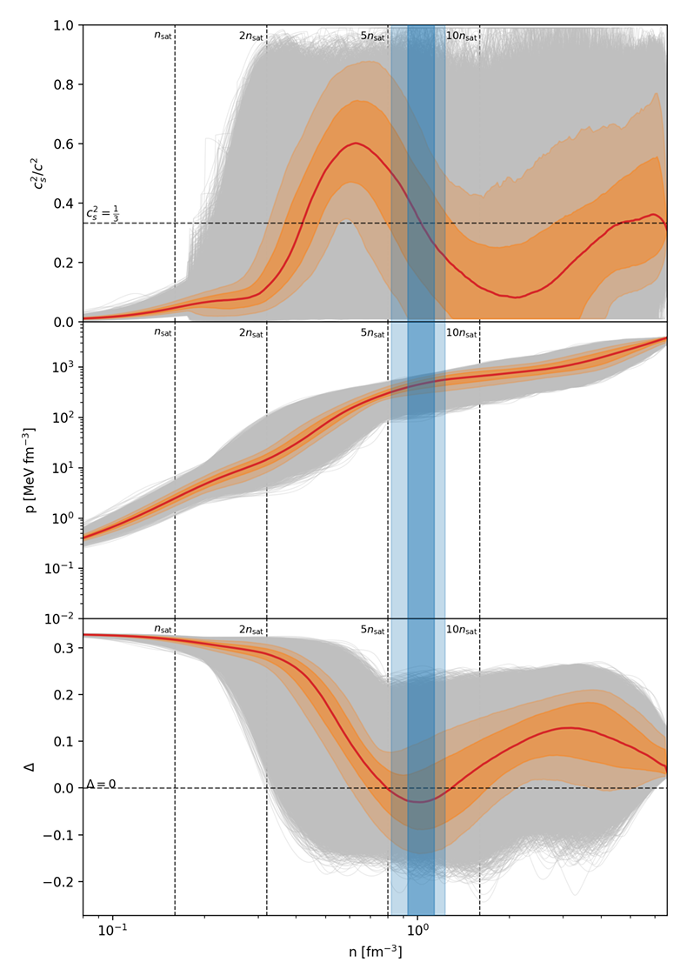
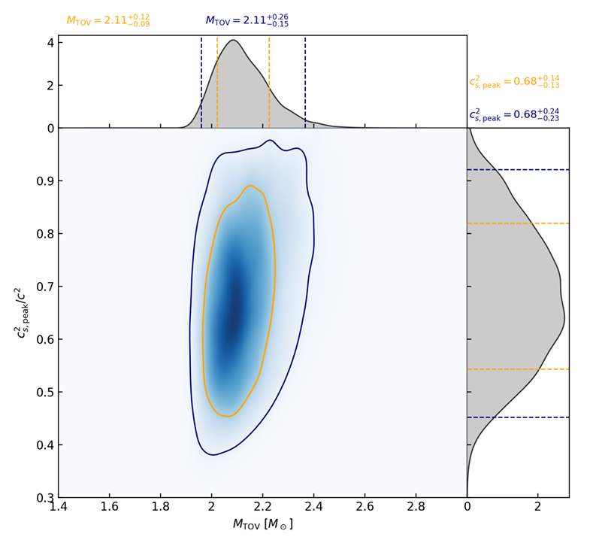
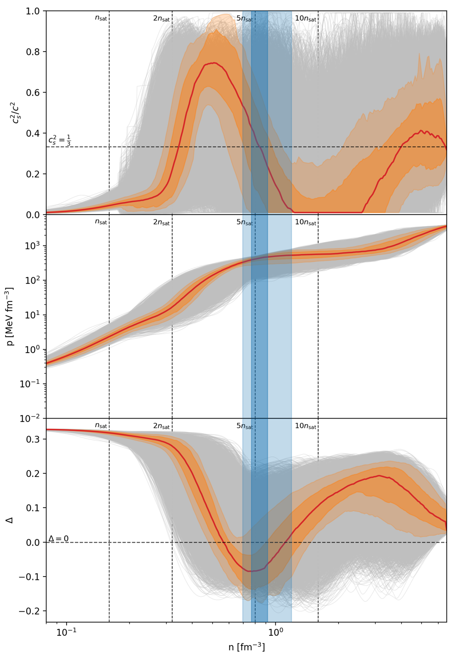
最重的中子星内部重子-夸克crossover相变?
M_{TOV}>2.5M⊙
我们发展了非参数化方法来更合理的构造中子星-pQCD密度区间的物态方程，发现中子星密度之上EoS存在显著的软化，并且中子星的最大质量不会很高。如果真有2.5M⊙的中子星，那么EoS大概率出现强一阶相变 (Huang, Tang & Fan 2026 arXiv:2605.08584)

Slide 24
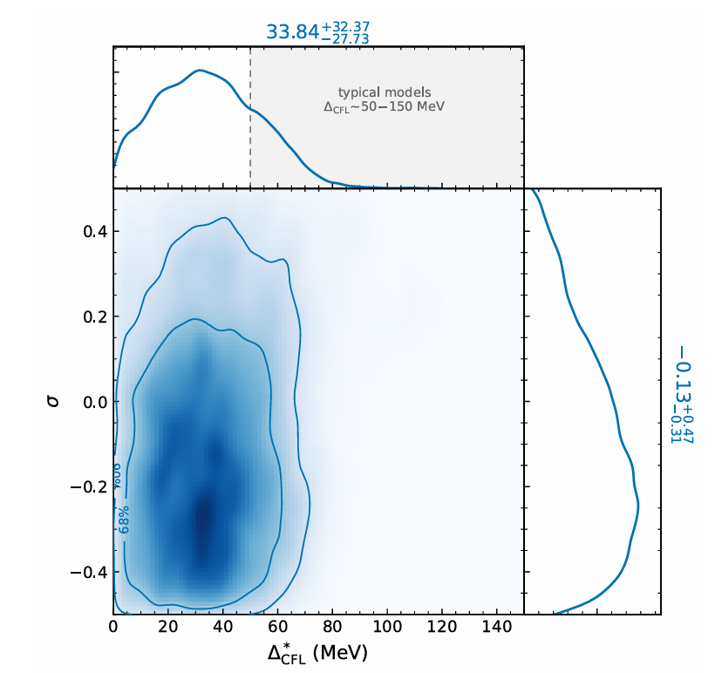
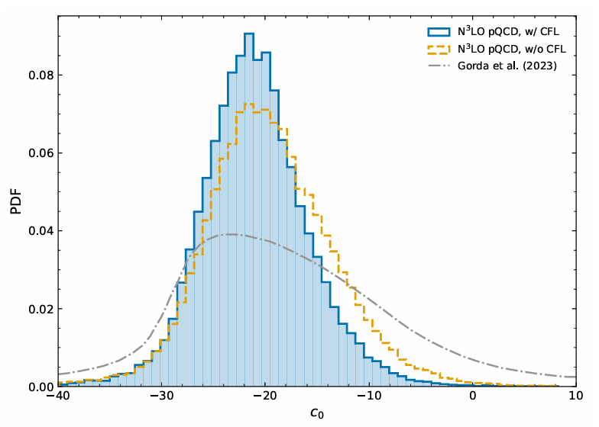
基本参数限制: Color-Superconducting Gap and N³LO parameter c₀?
M_{TOV}>2.5M⊙
我们发展了GP+前馈神经网络的方法来构建中子星-pQCD密度区间的物态方程，并进行MCMC采样。色超导能隙 Δ*_{CFL}<66 MeV, c₀ =-21⁺⁹₋₈ (Tang, Huang & Fan 2026 arXiv:2606.03707 )
Notes:
‌Colour-Superconducting Gap 是粒子物理/核天体物理领域的标准术语，国内学界统一译为「色超导能隙」‌，它是描述致密夸克物质色超导态的核心物理参数，具体含义如下：它类比传统电超导的BCS能隙：在中子星核心的极端高密低温环境下，解禁的夸克通过强相互作用的吸引力形成夸克库珀对，色超导能隙就是打破这些库珀对所需要的最小能量，通常用符号$Δ$表示。这个参数直接决定了色超导夸克物质的物态方程（压力与能量密度的对应关系），进而影响中子星的最大质量、冷却速率、潮汐形变等可观测天体物理性质，是连接QCD微观理论和中子星天文观测的关键桥梁参数。
在你此前关注的色味锁定（CFL）相中，所有夸克自由度都参与配对，会形成数值更大的色超导能隙，对应的物态方程也会更“硬”，能支撑质量更大的中子星。目前通过中子星观测约束，在质子数化学势2.6GeV的条件下，国外学者将色超导能隙的上限限定在140MeV区间内。

Slide 25
Summary
Dark Matter: dedicated efforts have been made and some potential signals have been claimed. Further tests are needed
Dark Energy: the well localized FRBs can serve as a powerful probe
Quark Matter: plausibly there is a new state, likely made of quark matter, in the most massive neutron stars
Thank you!

