Slide 1
On the delay time characteristics of GCRs
Yubao Wang, Yuming Wang, Jingnan Guo，
Gang Li , Elias Roussos , and Junwei Zhao
Claudio Corti, Weihao Liu, Robert Wimmer-Schweingruber
* University of Science and Technology of China

Slide 2
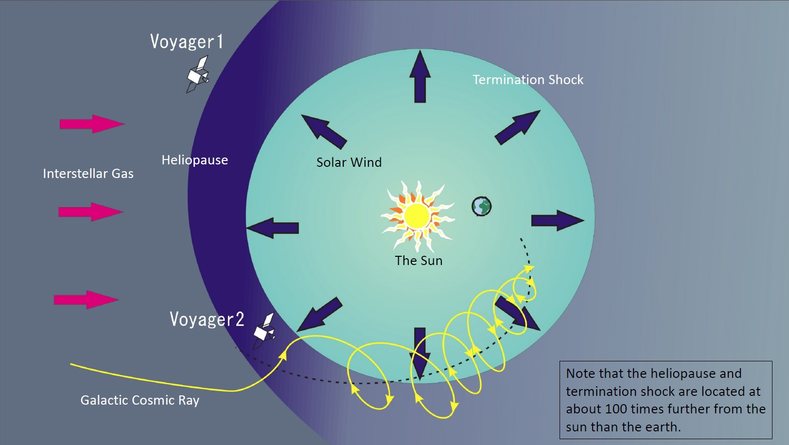
$∆t$_{s}
$∆t$_{p}

Slide 3
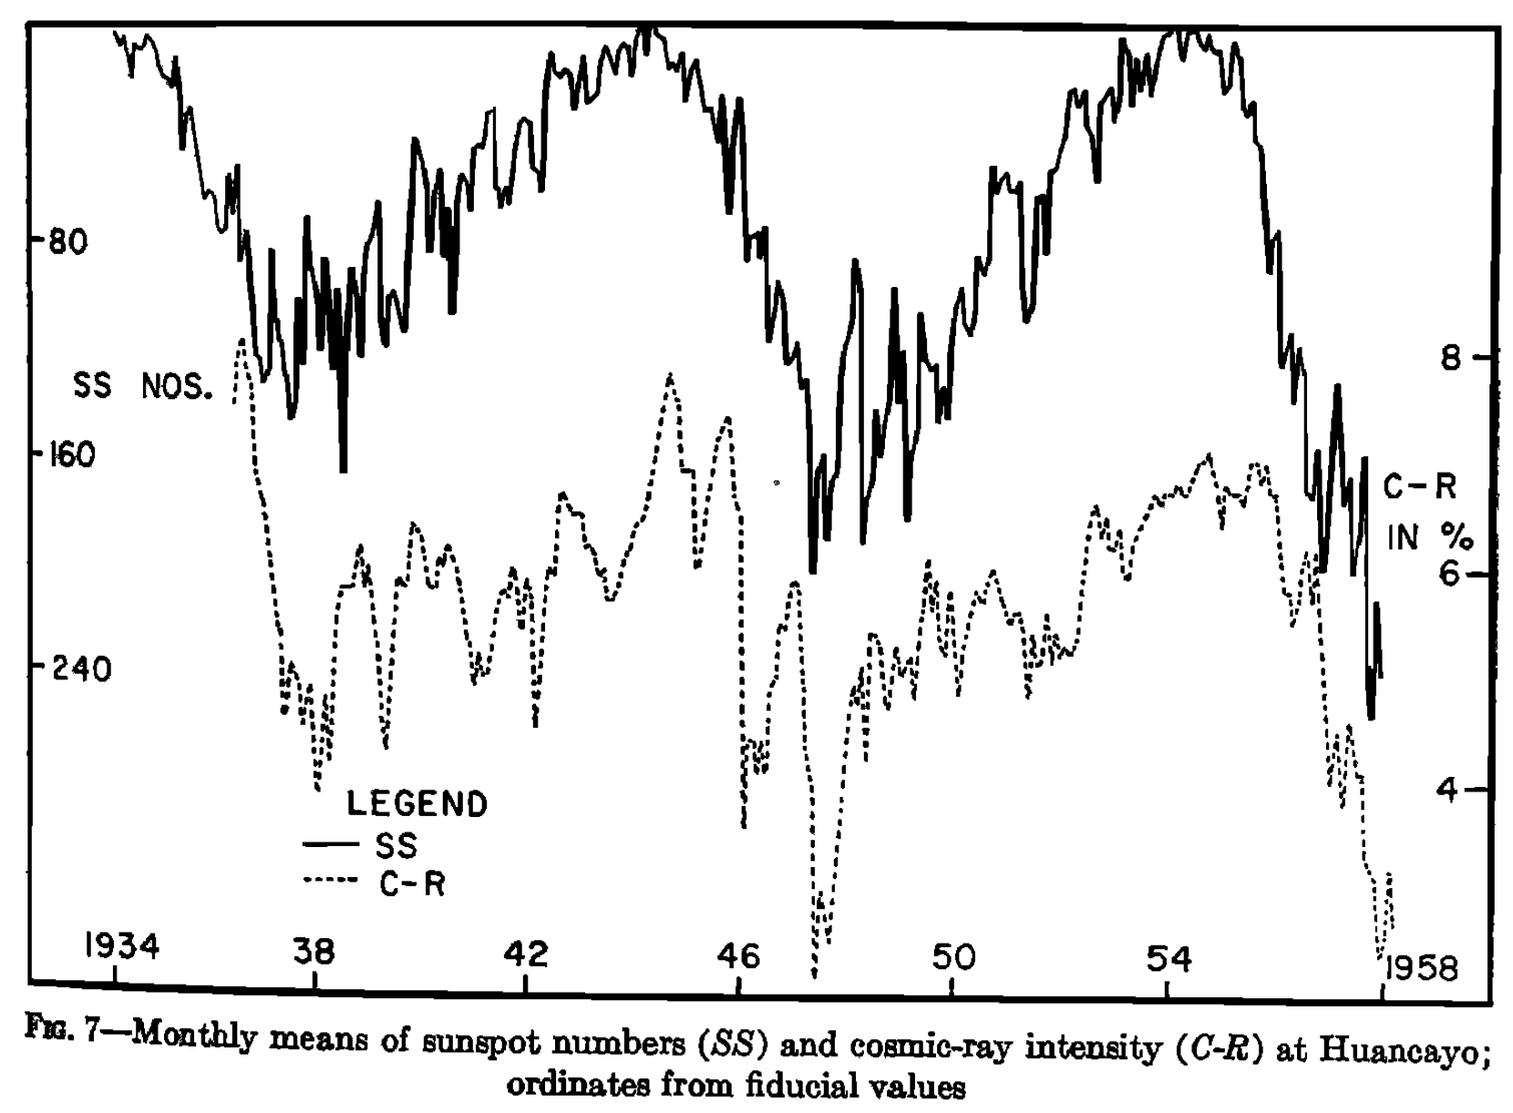
Introduction: Hysteresis of GCR modulation
As early as the 1960s, people have noticed that the variation of GCR intensity relative to the sunspots number (SSN) exhibited a hysteresis phenomenon.
I. V. Dorman and L. I. Dorman 1967
Forbush 1958
Notes:
The charged extrasolar cosmic ray particles are strongly influenced by magnetic field as they penetrate from the outside into the heliosphere.
Cosmic rays with rigidity R (= total moment um per unit charge) > 10 GV have Larmor radii smaller than the characteristic dimension of the sector structure anywhere in the interplanetary medium, and move along the largescale interplanetary magnetic field.
During their movement they are scattered by the small-scale magnetic field irregularities. Since the irregularities, along with the large-scale n lagnetic field, are moving essentially outward with the
solar wind, this scattering process tends to sweep cosmic rays out of the solar system. Then the density of extrasolar cosmic rays that we observe at Earth is lower than the density present in the local interstellar medium, and the observed spectra are altered from their interstellar forms.
The spectra are modulated as these particles pass through the interplanetary medium.

Slide 4
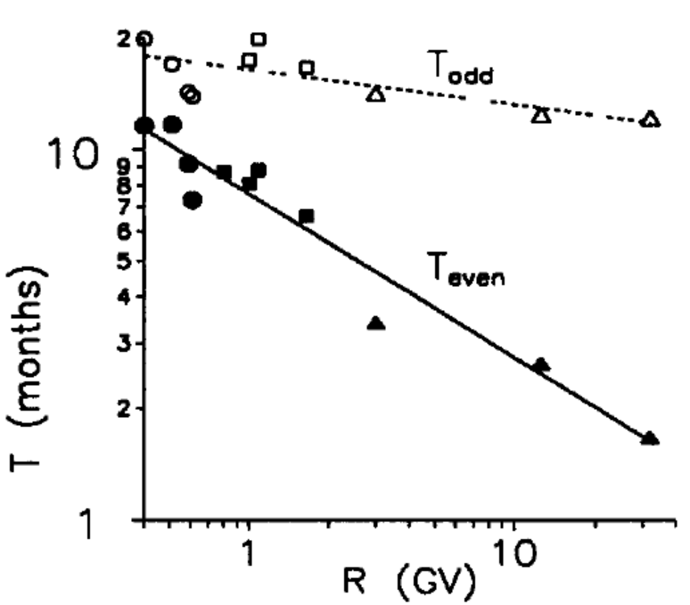
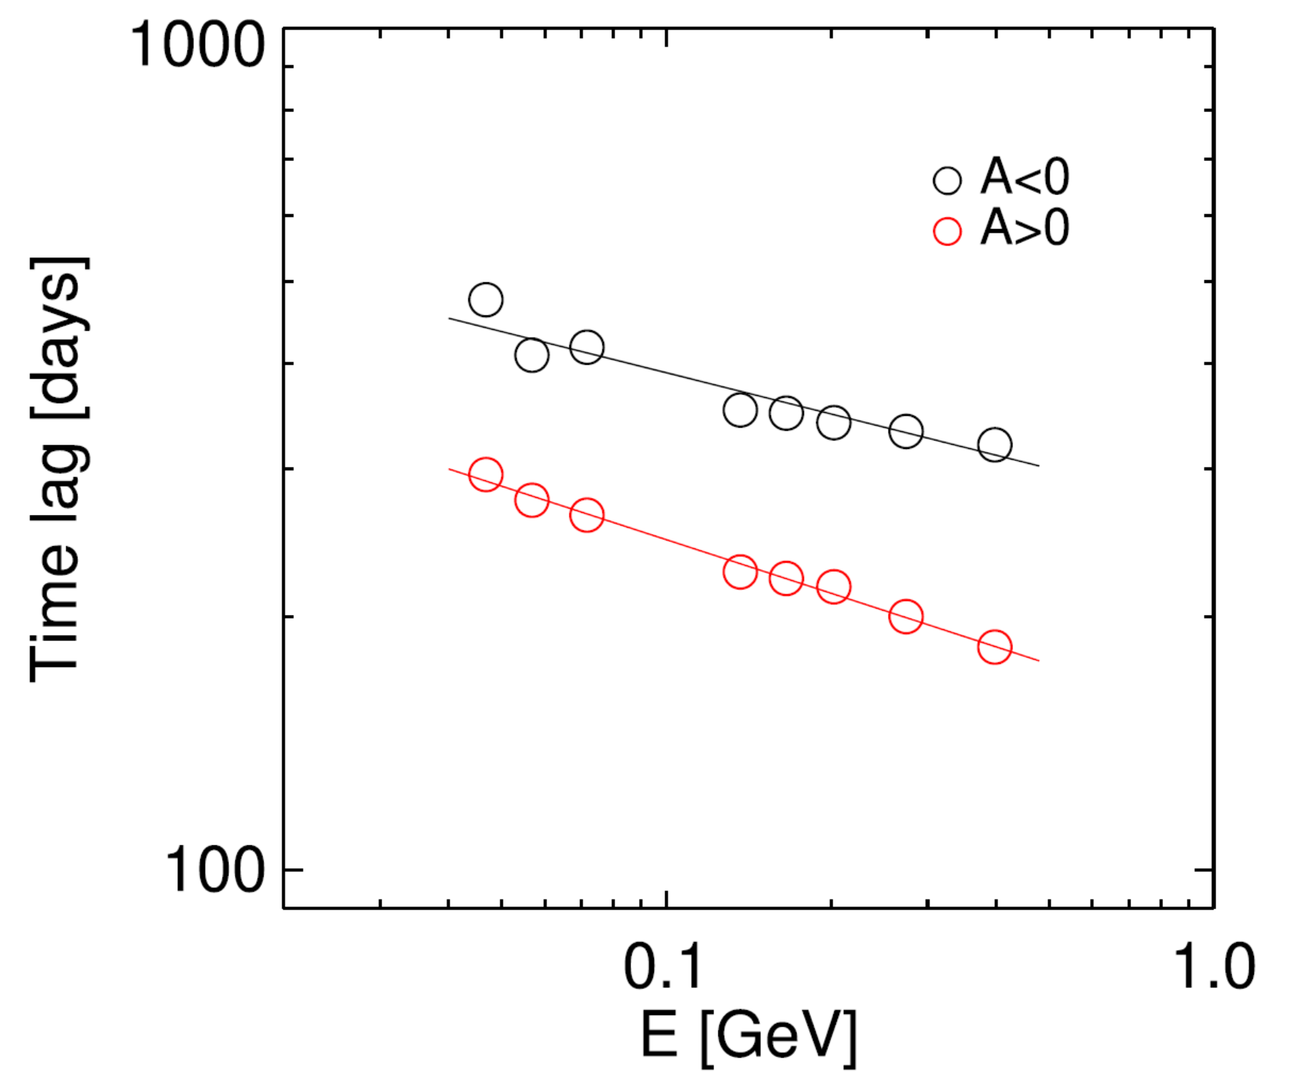
Introduction: Hysteresis of GCR modulation
Observation experiments in space significantly improved the energy resolution of GCRs, and it has been found that the delay time (dT) can depend on solar cycle, polarity and energy.
Nymmik 2000
Shen et.al 2020
Notes:
The charged extrasolar cosmic ray particles are strongly influenced by magnetic field as they penetrate from the outside into the heliosphere.
Cosmic rays with rigidity R (= total moment um per unit charge) > 10 GV have Larmor radii smaller than the characteristic dimension of the sector structure anywhere in the interplanetary medium, and move along the largescale interplanetary magnetic field.
During their movement they are scattered by the small-scale magnetic field irregularities. Since the irregularities, along with the large-scale n lagnetic field, are moving essentially outward with the
solar wind, this scattering process tends to sweep cosmic rays out of the solar system. Then the density of extrasolar cosmic rays that we observe at Earth is lower than the density present in the local interstellar medium, and the observed spectra are altered from their interstellar forms.
The spectra are modulated as these particles pass through the interplanetary medium.

Slide 5
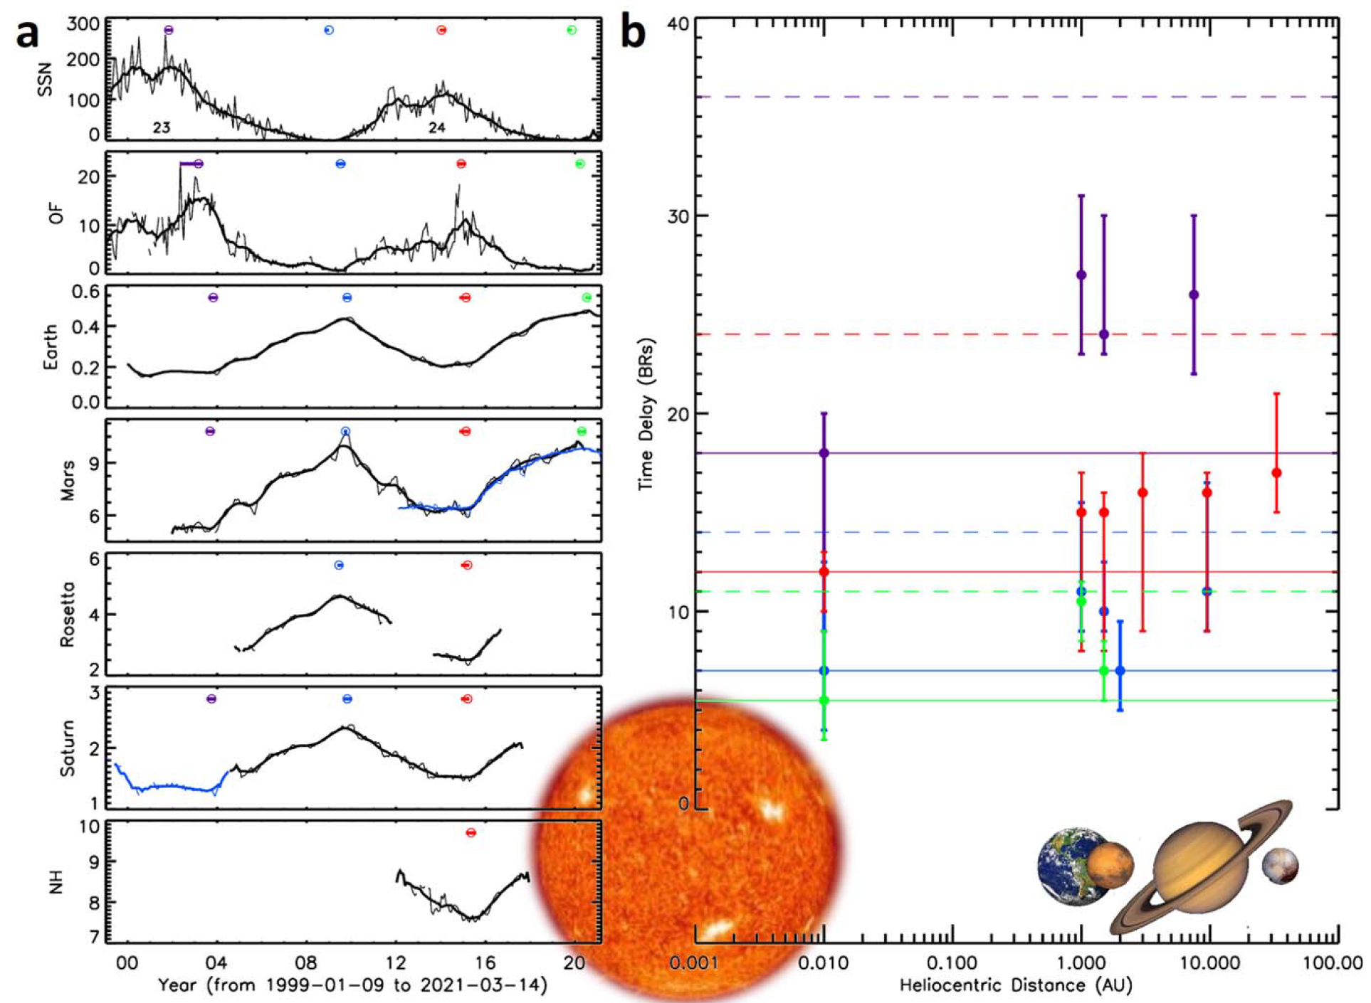
GCR delay is observed at all distances
Wang & Guo et.al 2022 ApJ
The measurement results from multiple deep space projects indicate that the delay phenomenon is prevalent at all distances.
dT in Cycle 23 (odd) is much longer than dT in Cycle 24 (even).
There is a slightly increase of dT with distance.
Cycle-dependence is likely not dominated by transport!
太阳
Peak delay time
Cycle
23
1
au
1.5
au
Cycle
24
3
au
9.5
au
~30
au
Notes:
The charged extrasolar cosmic ray particles are strongly influenced by magnetic field as they penetrate from the outside into the heliosphere.
Cosmic rays with rigidity R (= total moment um per unit charge) > 10 GV have Larmor radii smaller than the characteristic dimension of the sector structure anywhere in the interplanetary medium, and move along the largescale interplanetary magnetic field.
During their movement they are scattered by the small-scale magnetic field irregularities. Since the irregularities, along with the large-scale n lagnetic field, are moving essentially outward with the
solar wind, this scattering process tends to sweep cosmic rays out of the solar system. Then the density of extrasolar cosmic rays that we observe at Earth is lower than the density present in the local interstellar medium, and the observed spectra are altered from their interstellar forms.
The spectra are modulated as these particles pass through the interplanetary medium.

Slide 6
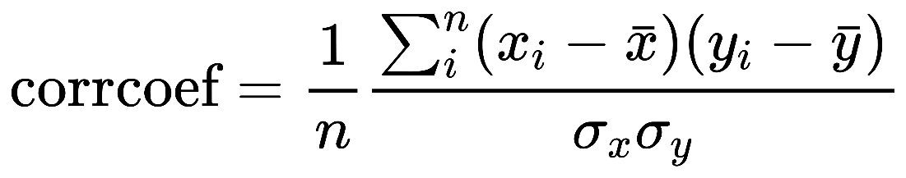
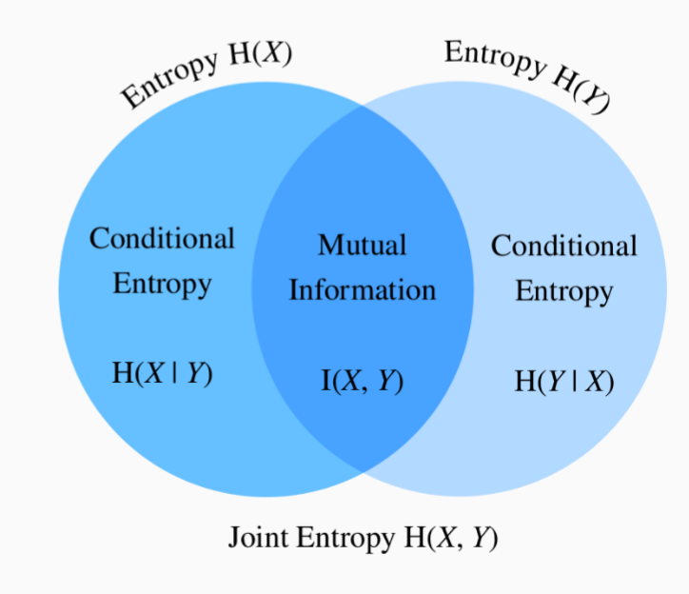
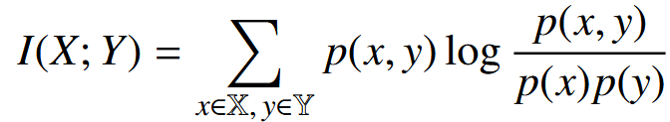
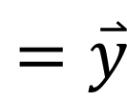
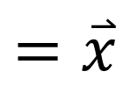
Various Methods to define the delay time
6
Peak Identification and Peak delay
The maximum cross coefficient
The maximum mutual information (Kraskov+20024, 最大互信息法，
for complex and non-linear system)
If X and Y are statistically independent, then p(x; y) = p(x)p(y), resulting in I(X; Y) = 0; Otherwise, a larger I(X; Y) implies that the variables share more information.
GCR
Phi / flux
$$=\overset{⃑}{x}$$
SSN/
F10.7
$$=\overset{⃑}{y}$$
Time
Notes:
最大互信息法可以找到使两个序列共享信息最多的那个时间偏移量 τ
互相关：只测线性关联。 MMI：测任意统计依赖（线性 + 非线性），更适合复杂 / 非线性系统。
where p(x) and p(y) represent the marginal probability density functions of X and Y, respectively, and p(x; y) is their joint probability
density function. Generally, if X and Y are statistically independent, then p(x; y) = p(x)p(y), resulting in I(X; Y) = 0, which indicates that X and Y do not share information.
On the other hand, a larger I(X; Y) implies that the variables share more information, which also implies a stronger association, whether
linear or nonlinear in nature.

Slide 7
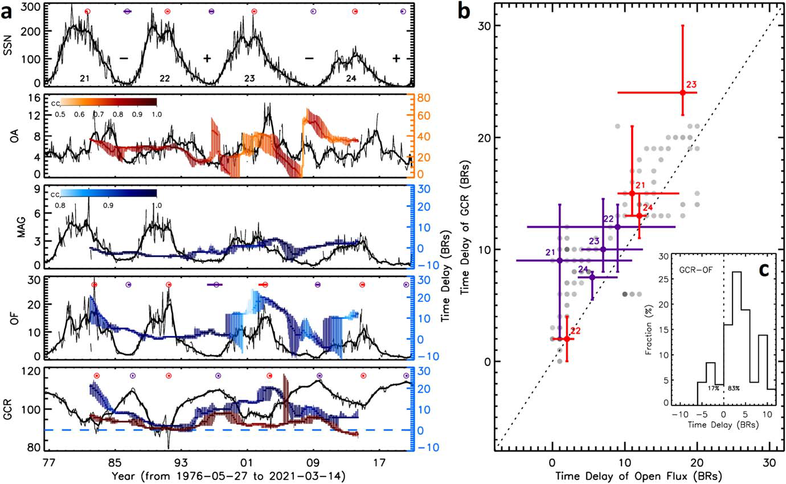
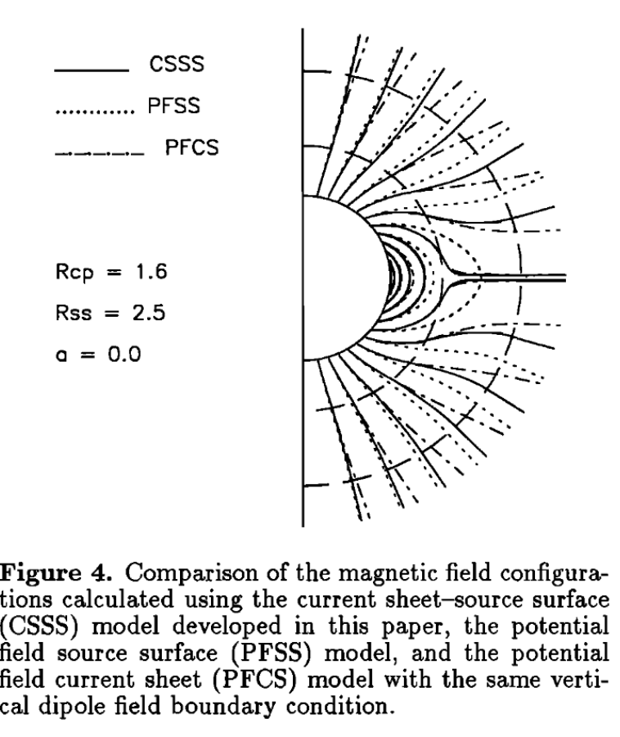
Solar-cycle dependence of the GCR delay
Wang & Guo et.al 2022 ApJ
CSSS（current-sheet source–surface
，Zhao & Hoeksema, 1995）：增加尖点面，允许在闭合 - 开放过渡区存在电流片，更符合真实日冕的大尺度结构。
Sunspot number
open magnetic field area
open field strength
Solar open flux OF
OF-SSN dT
OULU GCR
GCR-SSN dT
GCR-OF dT
Notes:
CSSS 模型是日冕磁场外推中广泛使用的模型。与势场源面（PFSS）模型相比，该模型包含了内日冕中大尺度水平电流片、上日冕中扭曲的日球电流片以及外日冕中的体电流效应，能够更好地预测日球磁场（HMF）的强度与极性（Zhao & Hoeksema 1995）。

Slide 8
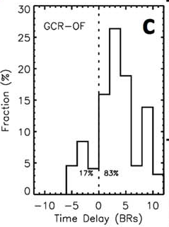
Three factors of GCR-SSN dT
Nymmik 2000
Shen et.al 2020
dT of GCR-SSN needs to take into account the late opening of solar magnetic field which is dependent on solar cycle (odd/even).
dT of GCR-OF has an average value of 2-3 months
Even/odd cycle-dependence is not a transport effect
How about polarity (or charge)- and energy-dependence?
Notes:
The charged extrasolar cosmic ray particles are strongly influenced by magnetic field as they penetrate from the outside into the heliosphere.
Cosmic rays with rigidity R (= total moment um per unit charge) > 10 GV have Larmor radii smaller than the characteristic dimension of the sector structure anywhere in the interplanetary medium, and move along the largescale interplanetary magnetic field.
During their movement they are scattered by the small-scale magnetic field irregularities. Since the irregularities, along with the large-scale n lagnetic field, are moving essentially outward with the
solar wind, this scattering process tends to sweep cosmic rays out of the solar system. Then the density of extrasolar cosmic rays that we observe at Earth is lower than the density present in the local interstellar medium, and the observed spectra are altered from their interstellar forms.
The spectra are modulated as these particles pass through the interplanetary medium.

Slide 9
Data selection
9
Solar activity index
Parameter | Source | Time period | Temporal resolution
SSN | WDC-SILSO, Royal Observatory of Belgium, Brussels | 1818-01 to 2023-03 | 1 Month
F10.7 | Canadian Solar Radio Monitoring Program | 1947-02 to 2024-10
OF | Wang et.al 2022 by CSSS model based on WSO observations | 1976-06 to 2021-01
GCR flux (E-dependent) & Force-field derived Modulation Phi
Particle | Instrument | Rigidity Range | Time period | Solar Cycle | Temporal resolution
Protons | IMP-8 | 0.33–1.07 GV, 6 rigidity bins | 1974-03 to 2001-09 | 21, A-, 22, A+, 23 | 1 Month
 | SOHO EPHIN | 0.71-2.47 GV, 14 rigidity bins | 1995-12 to 2016-12 | 23, A-, 24
 | AMS02 | 1-11 GV, 8 rigidity bins | 2011-05 to 2022-05 | 24, A+, 25
Electrons | AMS02 | 1-11 GV, 8 rigidity bins | 2011-05 to 2022-05 | 24, A+, 25
More details in Wang & Guo et.al 2025 AA
Notes:
CSSS model: current-sheet source–surface

Slide 10
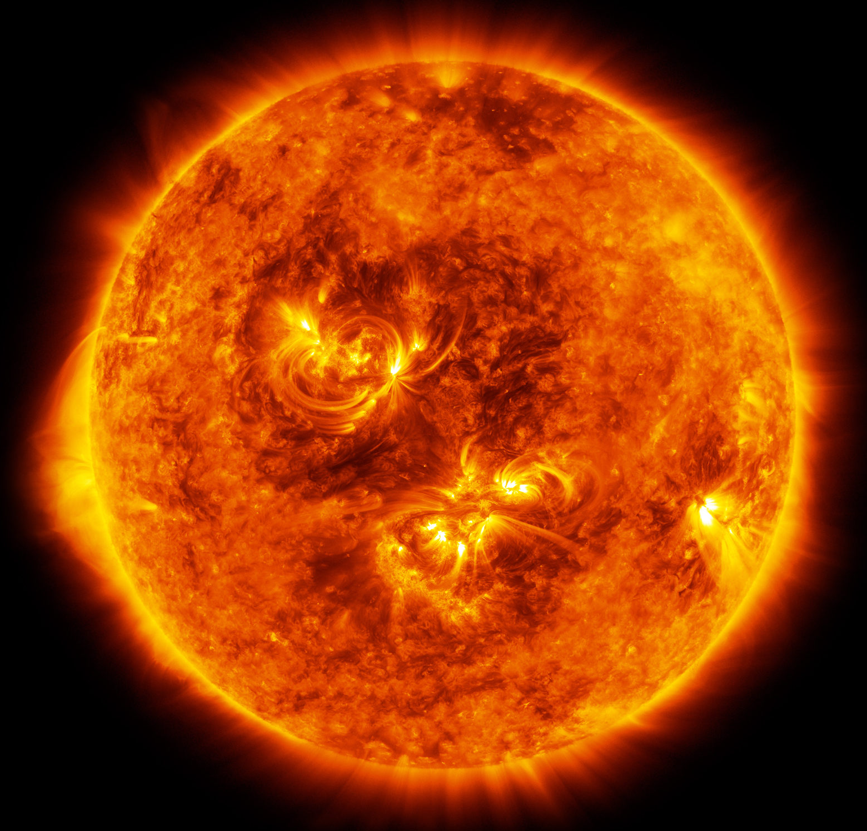
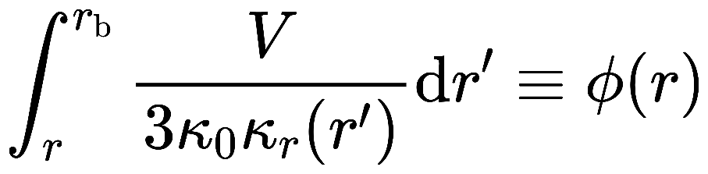
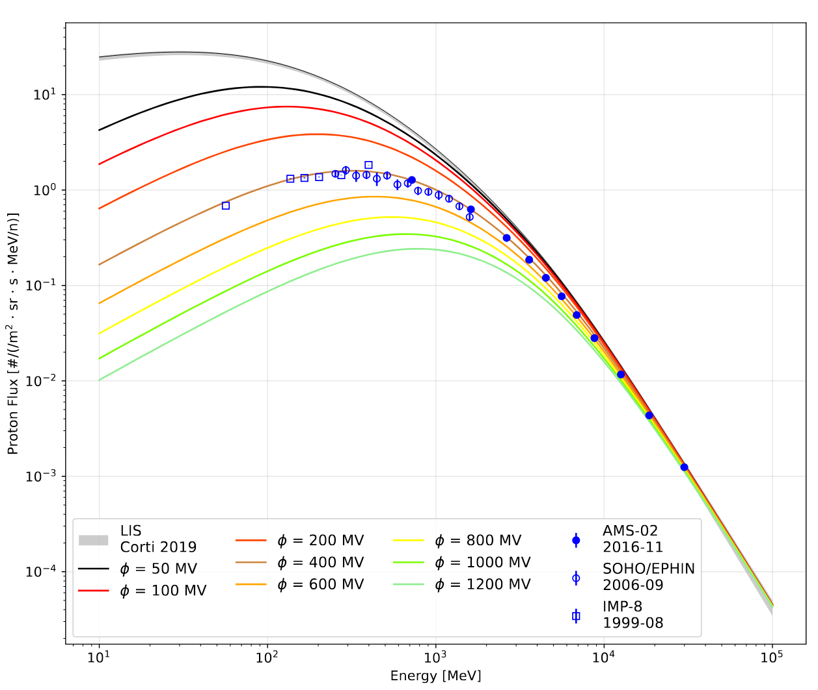
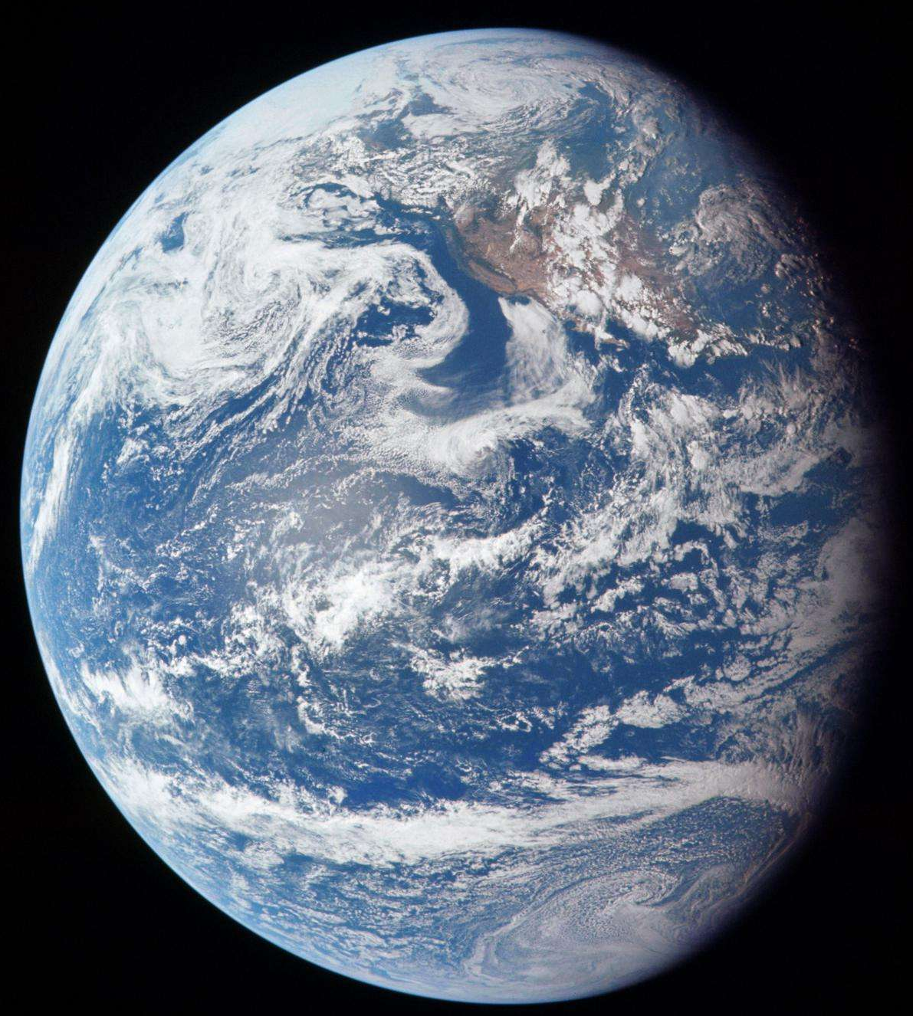
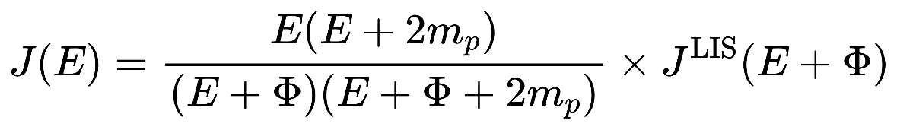

Terminal shock
Heliopause
Force field approximation
LIS
OF
IMF
Solar activity
GCR modulation
OF
GCR flux
F10.7
SSN
Measured J(E,t) & FFA J($φ$,E,t) → $φ$(E,t)
Notes:
The observed GCR energy spectrum in the inner heliosphere can be related to the GCR Local Interstellar Spectrum(LIS) by a single parameter \phi depending on the heliocentric distance r.
V and \kappa_r represent the solar wind speed and the radial dependence of the diffusion coefficient at the heliocentric distance r’, respectively. This means that the solar modulation potential contains the integrated effect of the diffusive medium from the heliocentric distance, r, to the GCR modulation boundary, rb.

Slide 11
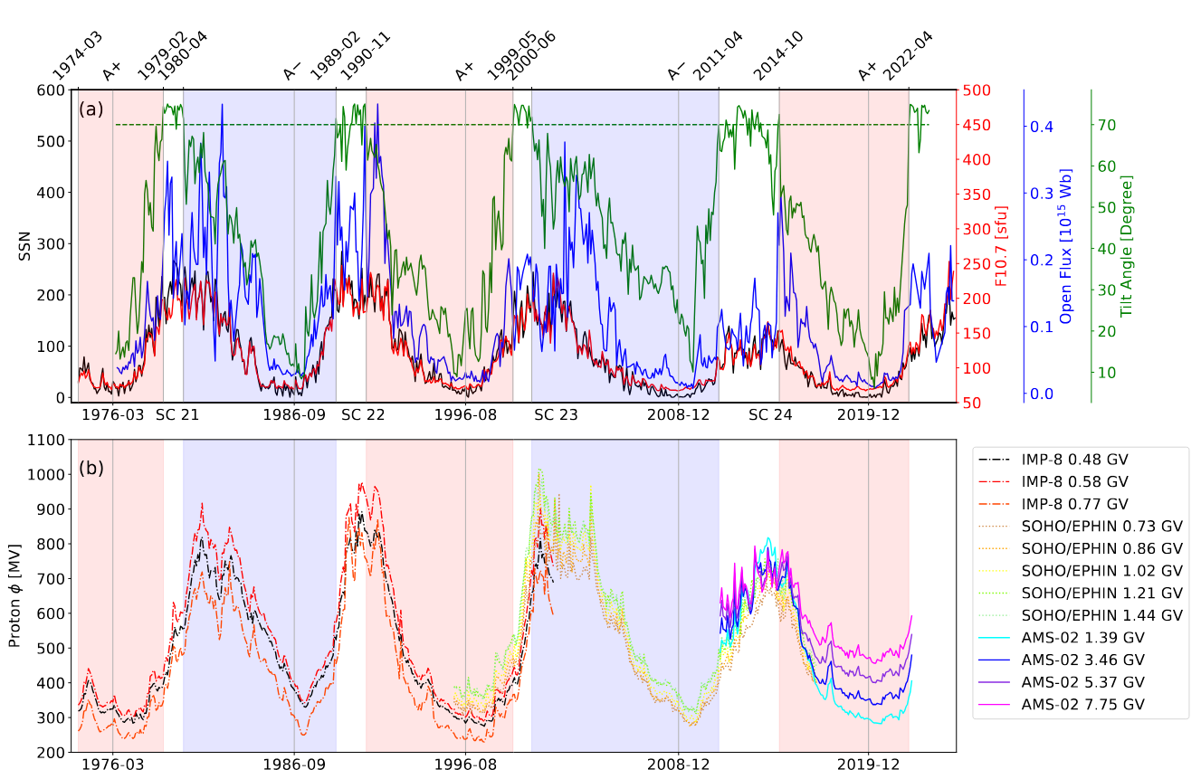
Data selection
11
Solar activity index
GCR modulation

Slide 12

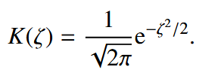
3 Methods to define the delay time
12
Peak Identification and Peak delay
The maximum cross coefficient
The maximum mutual information (Kraskov+20024, 最大互信息法，
for complex and non-linear system)
Kernel Density Estimation (KDE)
GCR
Phi / flux
$$=\overset{⃑}{x}$$
SSN/
F10.7
$$=\overset{⃑}{y}$$
Time
Notes:
最大互信息法可以找到使两个序列共享信息最多的那个时间偏移量 τ
互相关：只测线性关联。 MMI：测任意统计依赖（线性 + 非线性），更适合复杂 / 非线性系统。
An accurate computation of mutual information critically depends on a reliable estimation of the joint probability density function, p(x; y), which can be challenging, especially with a limited sample size of observational data. A straightforward estimation technique for p(x; y)
is the histogram (data-bins) method, which partitions data into a series of preset bins and counts the number of samples falling
within each bin. Note that the data-bin method can be sensitive to the chosen bin size, particularly when applied to small datasets.
A more robust approach is the kernel density estimation 核密度估计

Slide 13

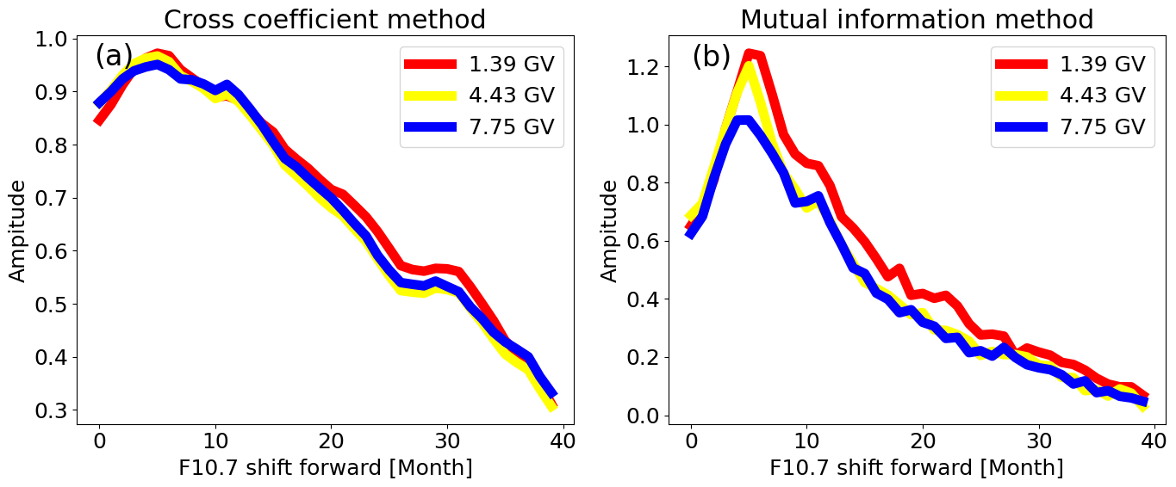
Methods: delay time (comparison of 2 methods)
13

Slide 14
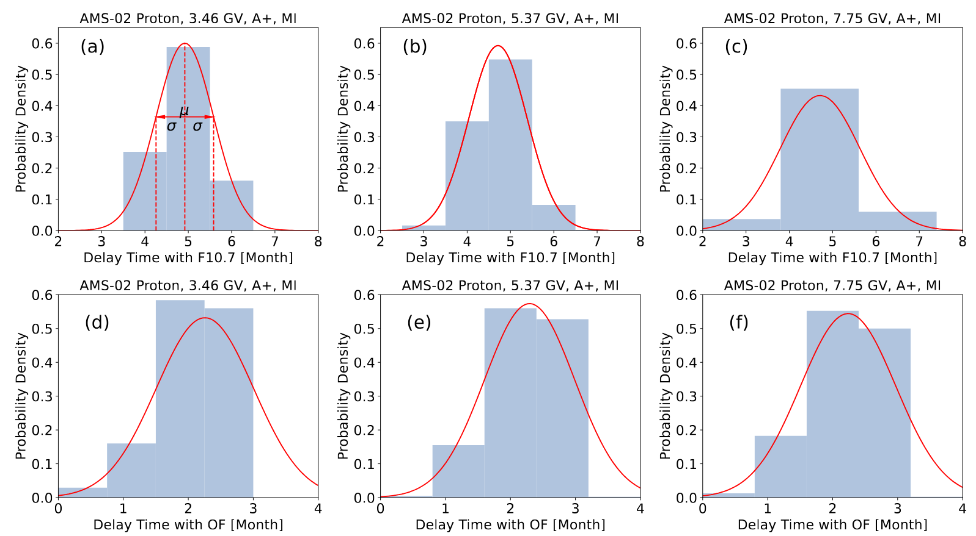
Methods: delay time (Monte Carlo uncertainty)
14
dT (GCR & F10.7)
dT (GCR & OF)
Notes:
We generated 500 new sets of GCR flux–time data by Gaussian sampling, using the measured GCR fluxes and their uncertainties as means and standard deviations, respectively. For each realization, we repeated the method described in the previous paragraph to calculate the delay time.

Slide 15
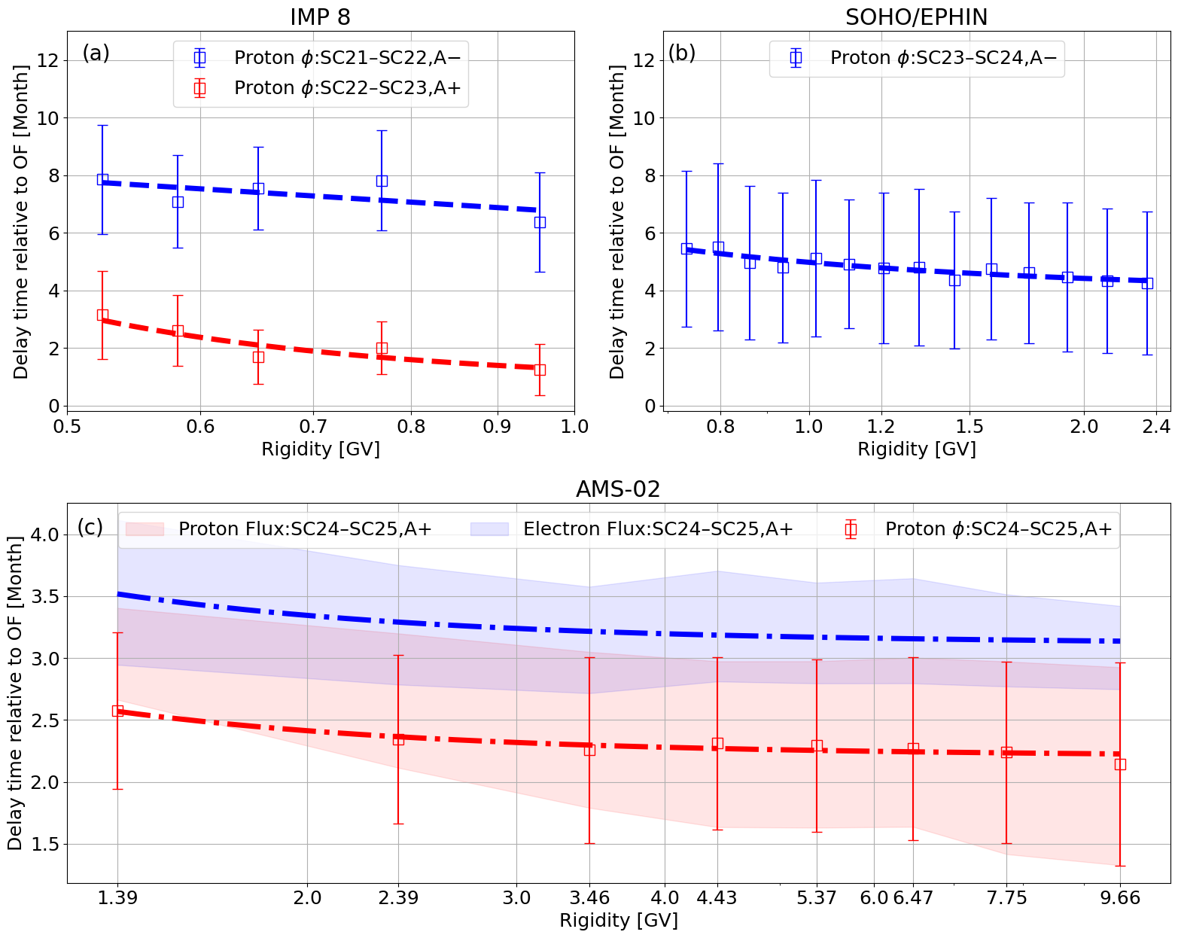
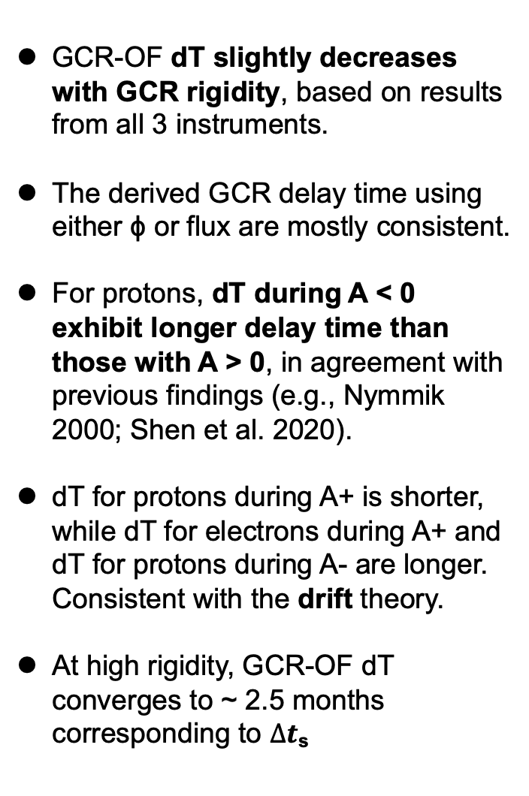
Results: Solar open magnetic flux
15
GCR-OF dT slightly decreases with GCR rigidity, based on results from all 3 instruments.
The derived GCR delay time using either ϕ or flux are mostly consistent.
For protons, dT during A < 0 exhibit longer delay time than those with A > 0, in agreement with previous findings (e.g., Nymmik 2000; Shen et al. 2020).
dT for protons during A+ is shorter, while dT for electrons during A+ and dT for protons during A- are longer. Consistent with the drift theory.
At high rigidity, GCR-OF dT converges to ~ 2.5 months corresponding to $∆t$_{s}
Notes:
Due to the lack of a reliable LIS for GCR electrons, the delay time corresponding to its modulation potential is not included.
The uncertainty in the delay time arises from two major sources. 1) uncertainties associated with the GCR measurements, especially for SOHO/EPHIN. 2) the highest resolution available is monthly for most datasets used here.

Slide 16



Summary
Terminal shock
Heliopause
Even/odd cycle-dependence of SSN&OF
LIS
OF
IMF
$$∆t$$
$∆t$_{s} SW transport
$∆t$_{p} Particle transport
Solar activity
GCR modulation
OF
GCR flux
F10.7
SSN

Slide 17
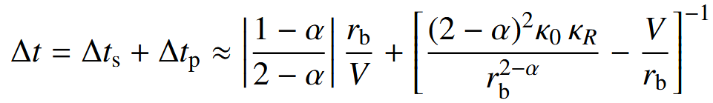
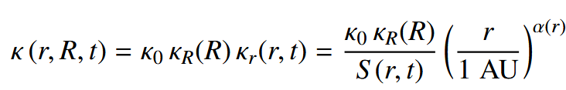
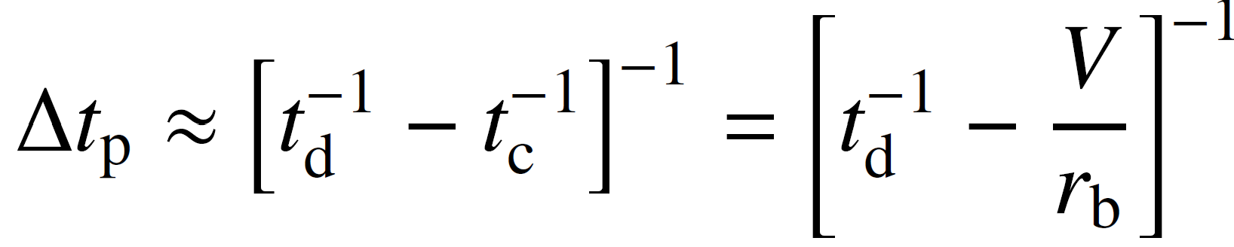
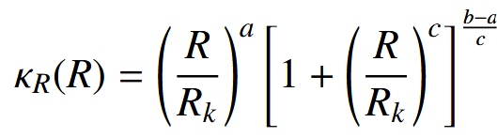
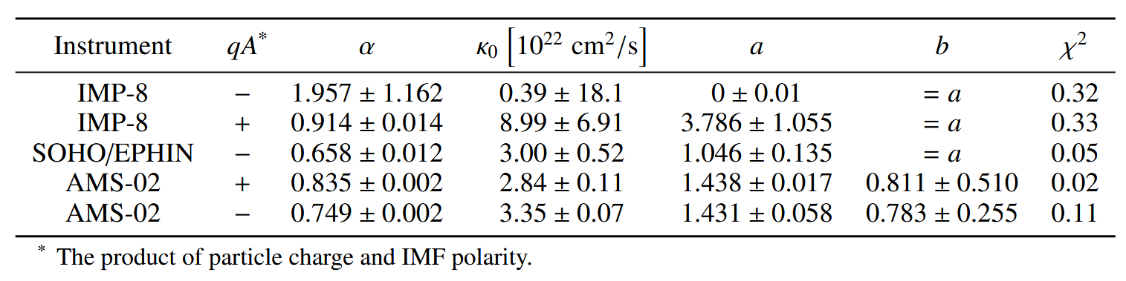

Theory: Derivation of delay time $∆t$_{s} and $∆t$_{p}
17
More details in Wang & Guo et.al 2025 AA
With r_{b}=120 AU and V=450 km/s, we fit the delay time by adopting a double power-law form of κ_{R} , with c=3 and R_{k}=4 GV (Corti+ 2019)
Less reliable for low energy protons (60–300MeV)
The fitting parameters agree with those reported in previous numerical studies: Corti et al. (2019b), Fiandrini et al. (2021), and Song et al. (2021).
Notes:
Kappa (r, R, t) follows Gleeson & Axford (1968) and Slaba & Whitman (2020).
The equation shows that: as the rigidity of the GCRs increases, the diffusion coefficient increases, leading to a gradual decrease in delta_t_p.
For the delay time of IMP-8, the fitting parameters are quite different from those of SOHO/EPHIN and AMS-02, especially for periods of qA < 0. This may be attributed to the limitations of the force-field approximation in the low rigidity range (0.3–0.8GV, or 60–300MeV for protons).

Slide 18

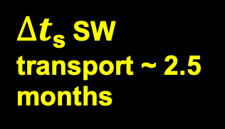
Summary
Terminal shock
Heliopause
Even/odd cycle-dependence of SSN&OF
LIS
$∆t$_{s} SW transport ~ 2.5 months
OF
IMF
Solar activity
GCR modulation
$∆t$_{p}
Polarity/charge dependence: smaller dT for qA>0 due to drift
Energy dependence: dT decreases with rigidity due to diffusion
OF
GCR flux
F10.7
SSN

Slide 19
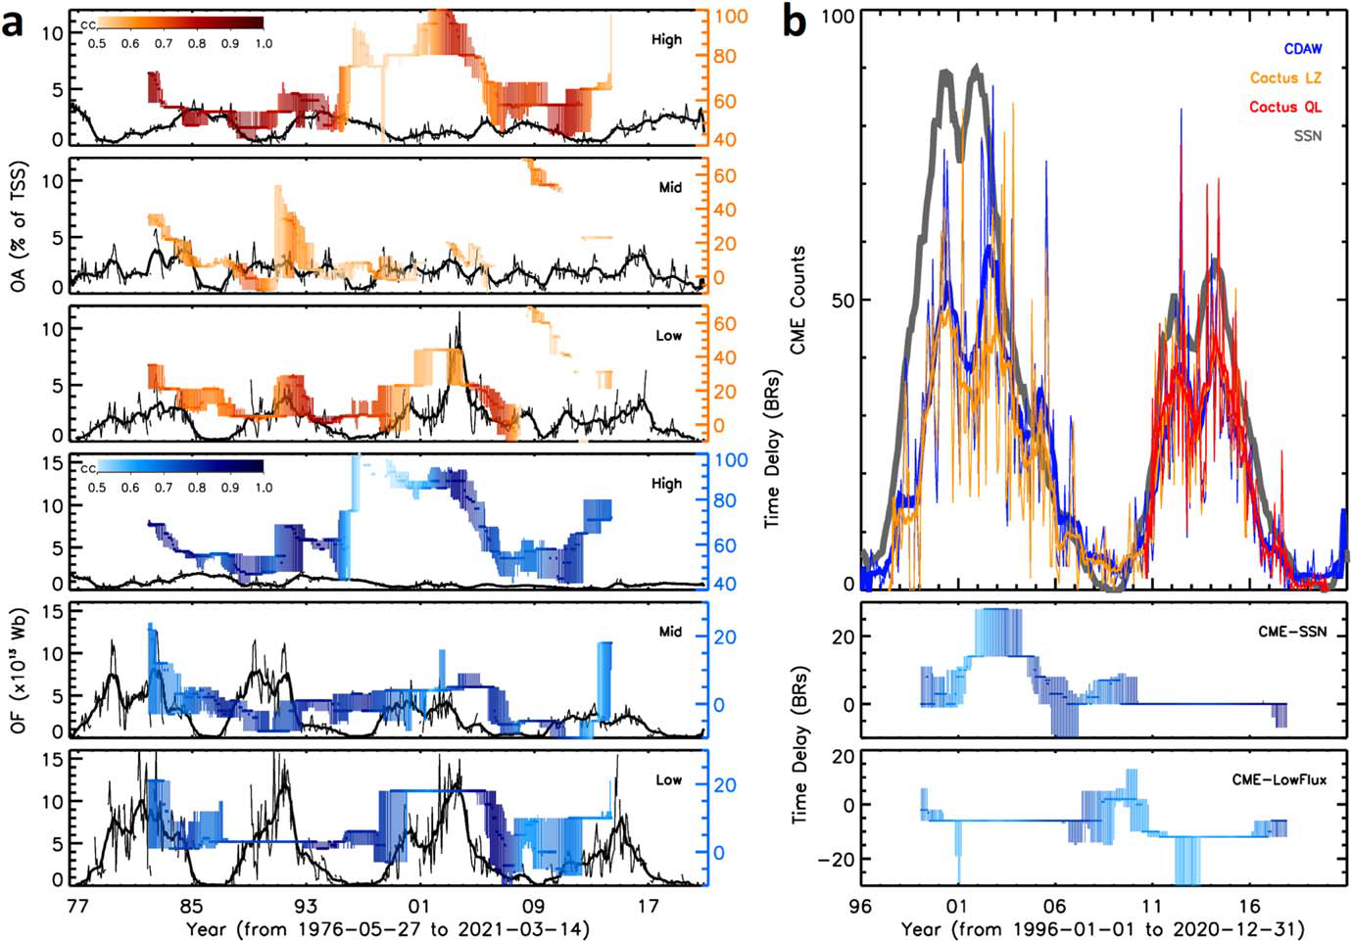
Solar-cycle dependence of SSN & OF correlation
The CME occurrence rate also shows the odd–even solar cycle pattern, i.e., it notably lagged behind the SSN in Cycle 23, but changed synchronously with the SSN in Cycle 24.
Studies of solar flare rates and SSN over five solar cycles confirmed this time delay and also found it to be much longer for odd solar cycles than for even cycles (Temmer et al. 2003).
Both flares and CMEs represent the process of the gradual accumulation and impulsive release of the magnetic energy in the solar corona. This process may explain the flare/CME lagging behind the SSN, but not their odd–even behavior, which deserves further studies.

Slide 20

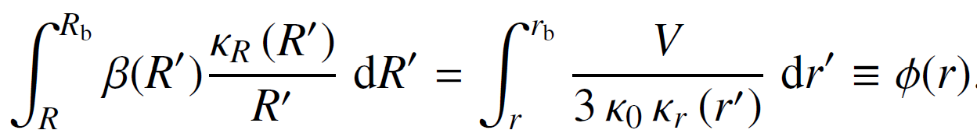

Force-field approximation
Force Field model Glesson&Urch 1973
The observed GCR energy spectrum in the inner heliosphere can be related to the GCR Local Interstellar Spectrum(LIS) by a single parameter depending on the heliocentric distance r:
With
The observed GCR energy spectrum can be expressed by
Notes:
The charged extrasolar cosmic ray particles are strongly influenced by magnetic field as they penetrate from the outside into the heliosphere.
Cosmic rays with rigidity R (= total moment um per unit charge) > 10 GV have Larmor radii smaller than the characteristic dimension of the sector structure anywhere in the interplanetary medium, and move along the largescale interplanetary magnetic field.
During their movement they are scattered by the small-scale magnetic field irregularities. Since the irregularities, along with the large-scale n lagnetic field, are moving essentially outward with the
solar wind, this scattering process tends to sweep cosmic rays out of the solar system. Then the density of extrasolar cosmic rays that we observe at Earth is lower than the density present in the local interstellar medium, and the observed spectra are altered from their interstellar forms.
The spectra are modulated as these particles pass through the interplanetary medium.

Slide 21

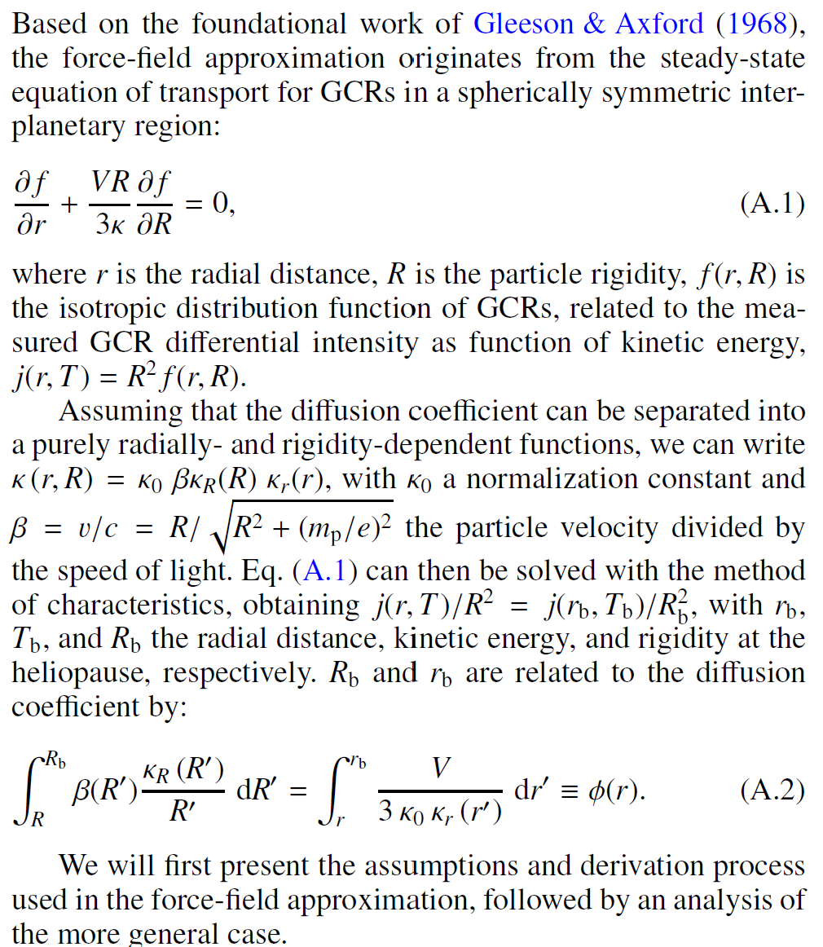
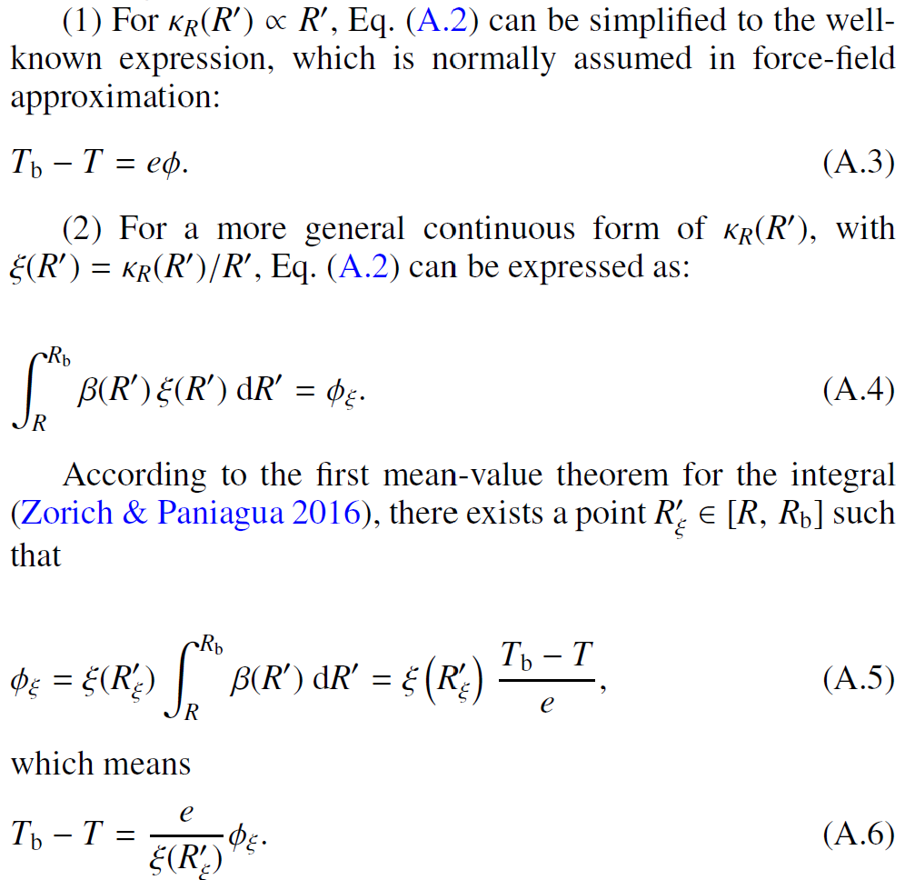
Extended force-field approximation
21

Slide 22
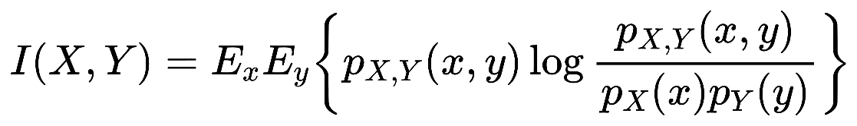
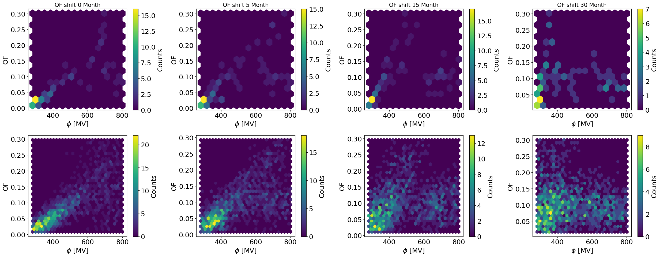
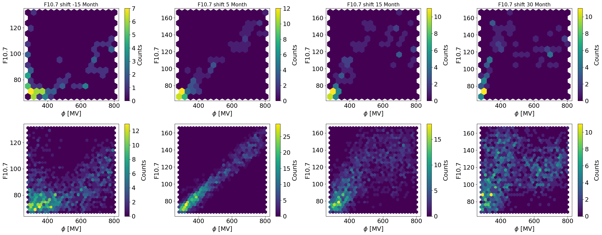
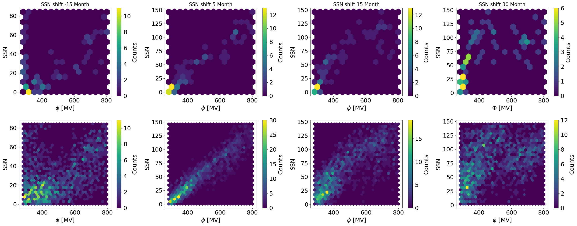
Methods: joint distribution
22
Two ways to estimate the joint distribution
1) upper panels: data bins; 2) bottom panels: kernel density estimation(kde).

Slide 23
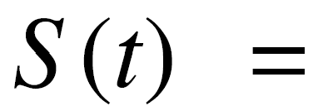
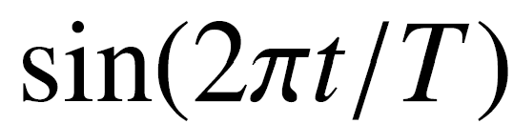
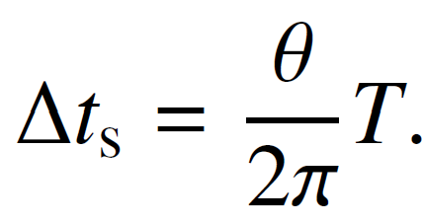
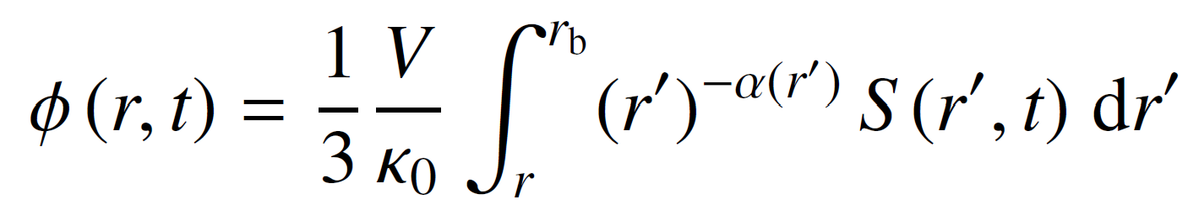
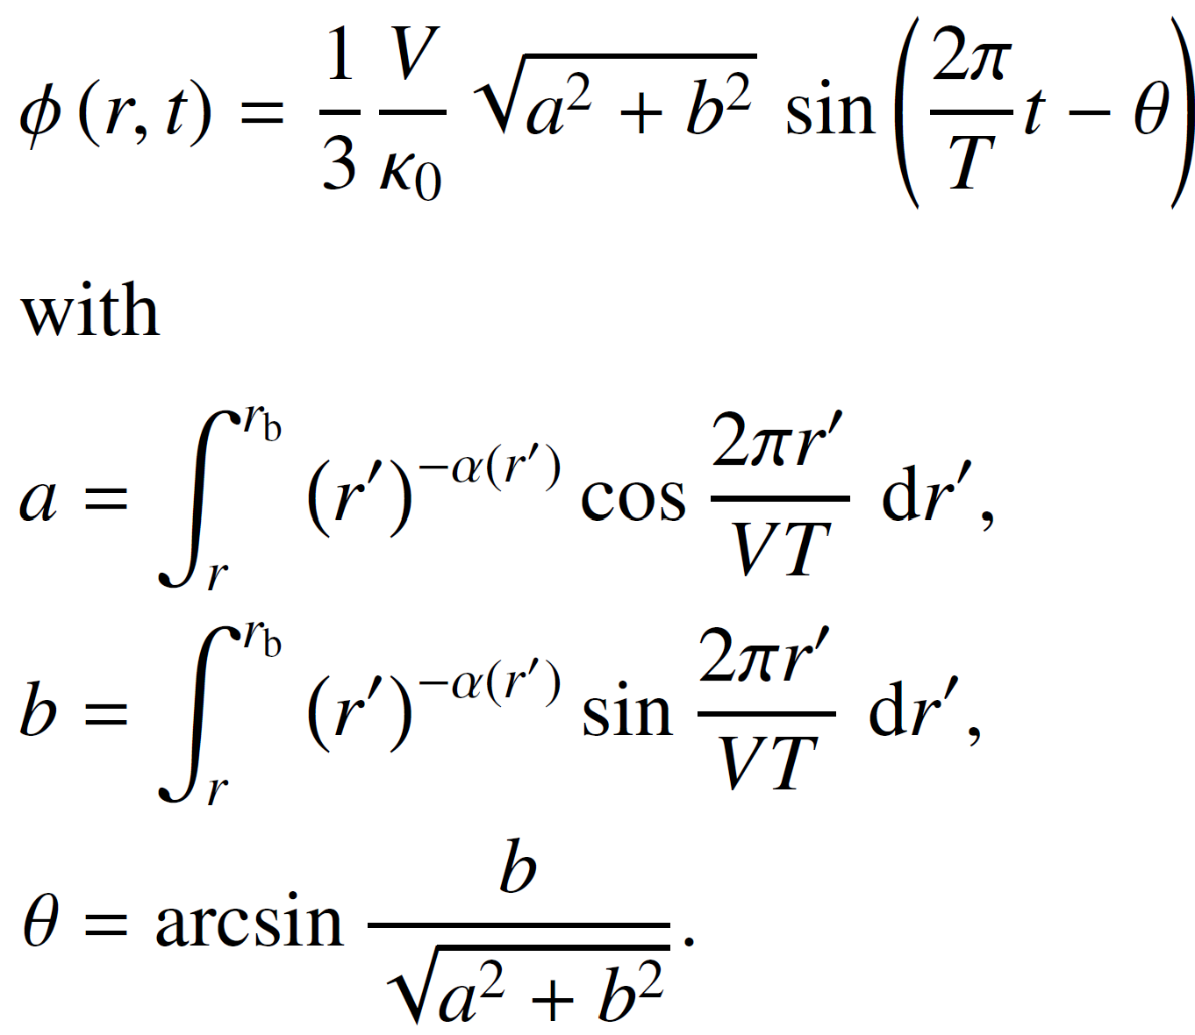
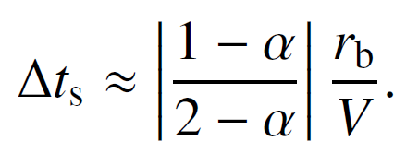
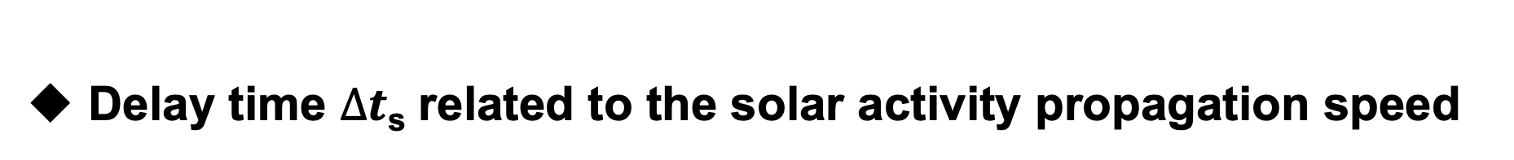
Delay time $∆t$_{s} related to the solar activity propagation speed
23
Assume a sinusoidally solar activity signal
,with T≈11 years
Substitute into solar modulation potential:
Yield
The phase shift θ, is the delay time,
For a typical solar wind speed of V=450 km/s, VT≫r_{b}≫r is valid. And assuming no radial dependence of α(r)=α, we can simplify the delay time,
If we set α=0, then Δts=r_{b} /(2V), which is about 7.7 months when V=450 km/s and r_{b} =120 AU. This is analogous to the findings obtained through perturbation analysis in Chih & Lee (1986).

Slide 24
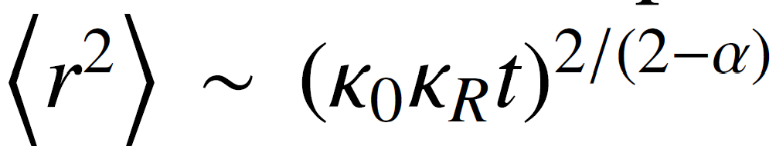
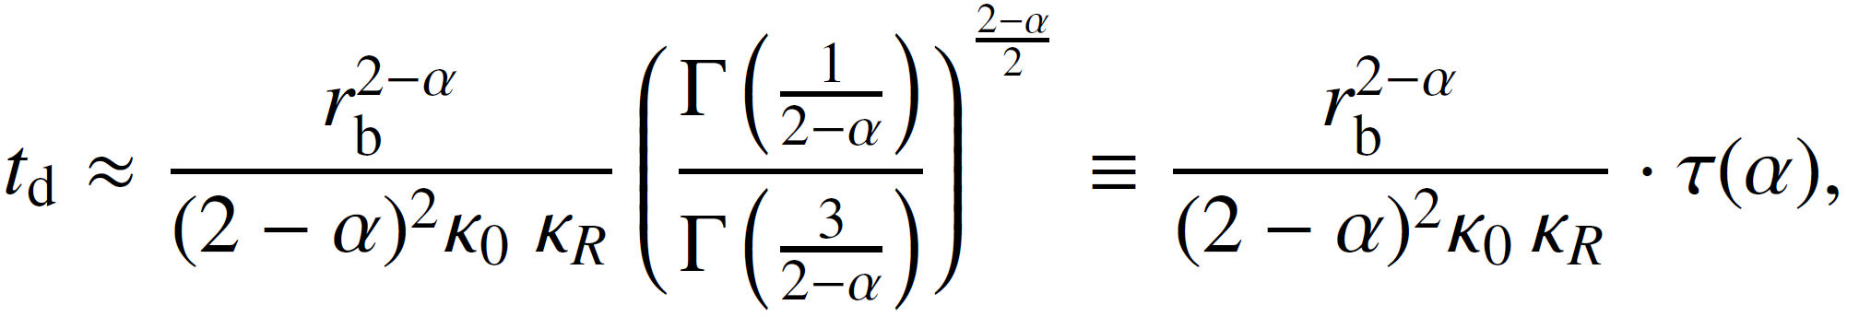

Delay time $∆t$_{p} related to the GCRs transport speed
24
We followed the approach of Parker (1965) and focused specifically on the contribution of diffusion and convection effects to the delay time.
The transport of GCR scattering centers from the edge of the heliosphere to its inner regions can be described as the superposition of two effects: inward diffusion and outward convection.
If α=0, t_{d}=r_{b}²/(6κ), as was adopted in previous studies (Strauss et al. 2011; Tomassetti et al. 2022).
If α≠0, the one-dimensional average quadratic spatial displacement for a GCR particle undergoing diffusion is , given by Fa & Lenzi (2003).
Thus the diffusion time can be expressed as

