Slide 1



April 21th, 2026 @ Wuhu
A Unified Charge-Dependent Modulation Model during Solar Minimum
S.-J. Lin
H. Zhang, J. Jiang
J. Feng, L. Yang
with:

Slide 2
Outline
• Charge-Dependent Modulation Effects
• Model Implementation - HELPROP
• ML-Powered Surrogate Model – PropMat
• Analysis of Fitting Results
• Conclusions & Outlook

Slide 3
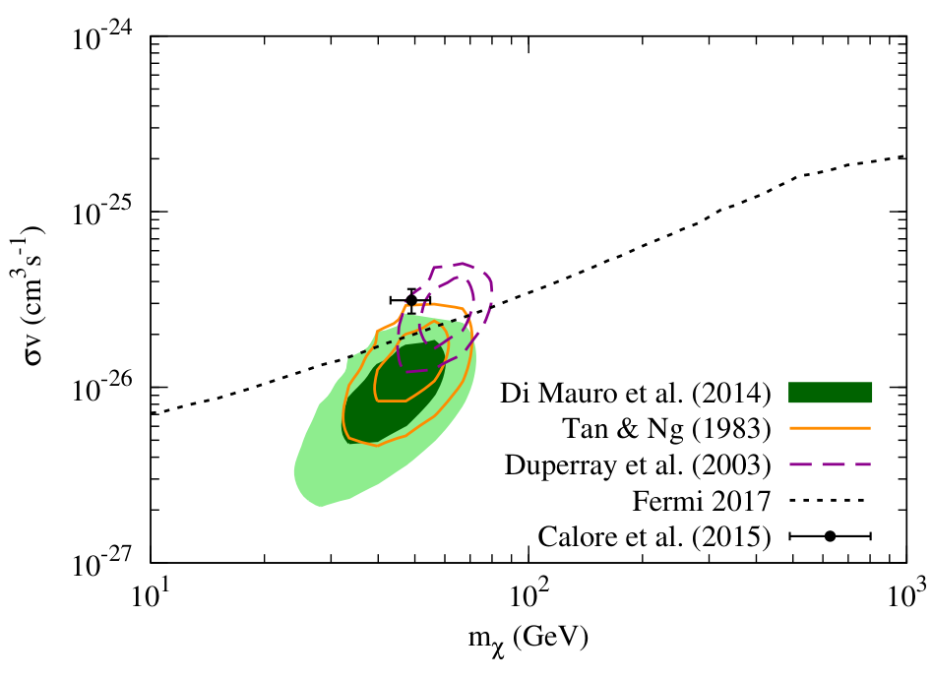
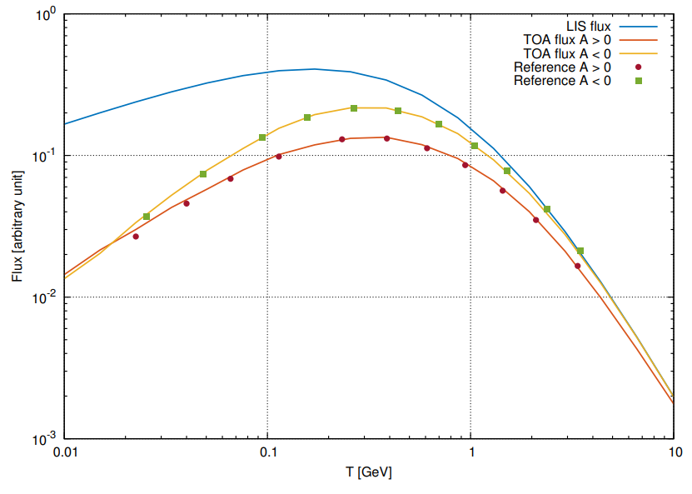
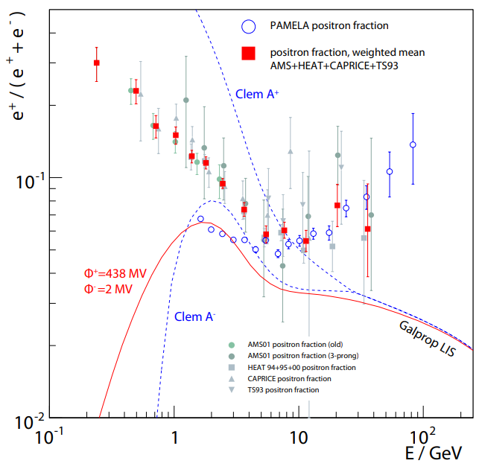
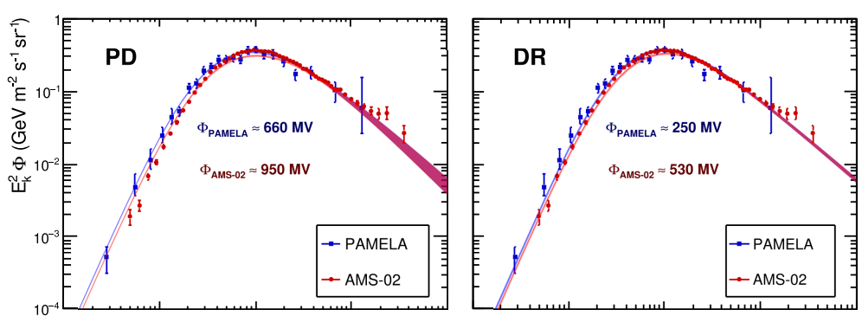
Charge-Dependent Modulation Effects
DM signals @ CRs ~ GeV
Charge-Dependent Modulation Effects has long been recognized
From theory
From experiment
Affect
[Cui et al., PRL.118.191101]
CR propagation models
[Kappl, J. CPC.207.386]
FFA with deifferent potential
How to describe it?
[Gast et al., ICRC 2009]
Realistic model
[Yuan et al., PRD.95.083007]

Slide 4
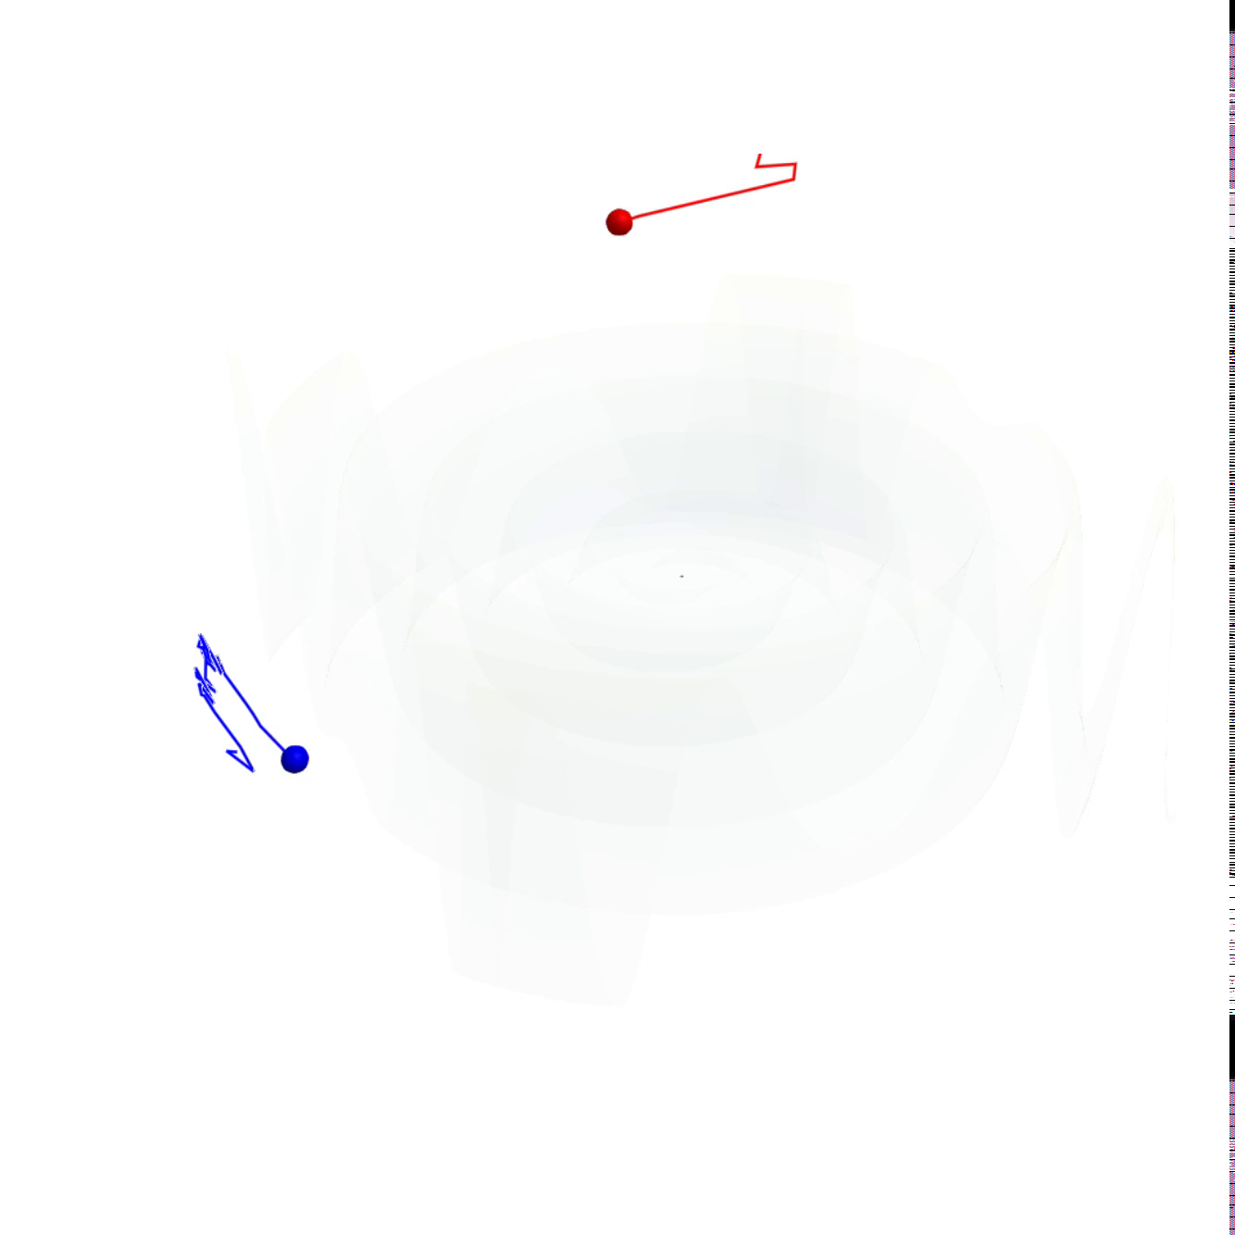
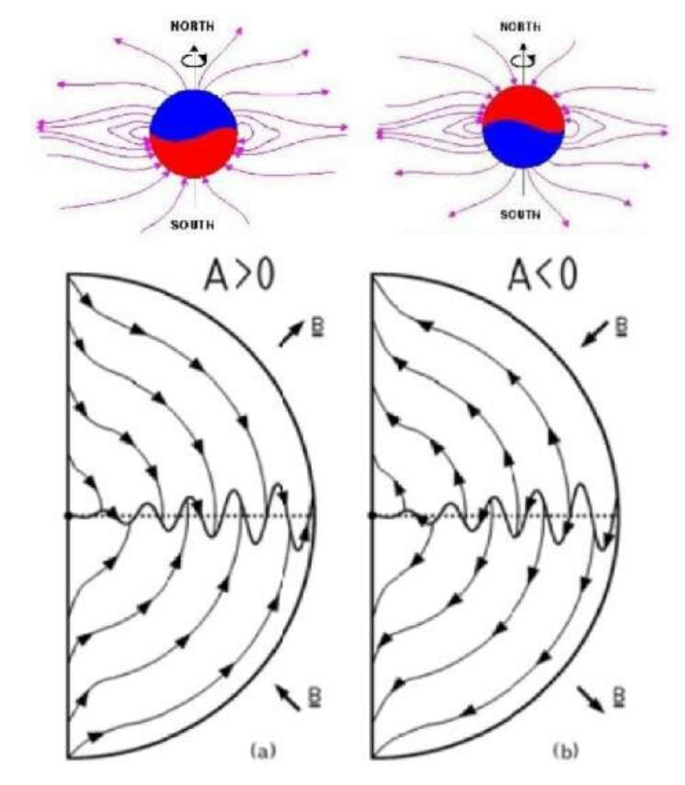
Model Implementation - HELPROP
HMF structure
3D Implementation
  open source
  simple
  user friendly
gradient drift curvature drift
An example for
antiproton
and proton
@ A > 0
HCS drift
Charge-dependent drift

Slide 5
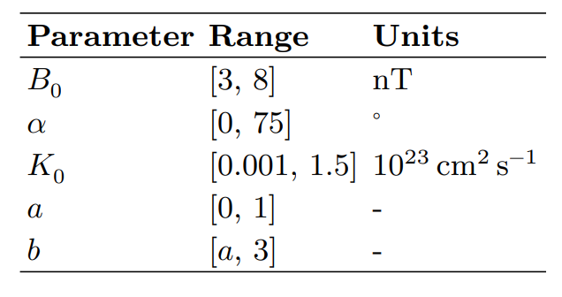
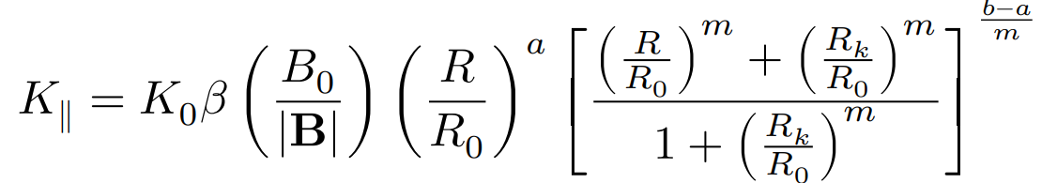
Model Implementation - HELPROP
HMF structure
3D Implementation
  open source
  simple
  user friendly
Relevant Parameters
gradient drift curvature drift
HCS drift
Charge-dependent drift

Slide 6
ML-Powered Surrogate Model – PropMat
To global fitting with GALPROP + HELPROP, we introduce PropMat
Input Spectra
Parameters
Parameters
Advantage
Keep linearity from input spectra
Input Spectra
Surrogate
Model
GALPROP
HELPROP
Transform
Matrix
Origin Models
Simulating minites to
O(10) minites
Guess from
trends ~ ms
Requirement
Transform Matrix ought to smooth
Output Spectra
Output Spectra

Slide 7
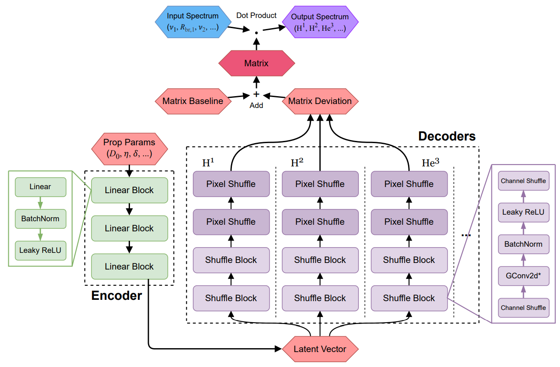
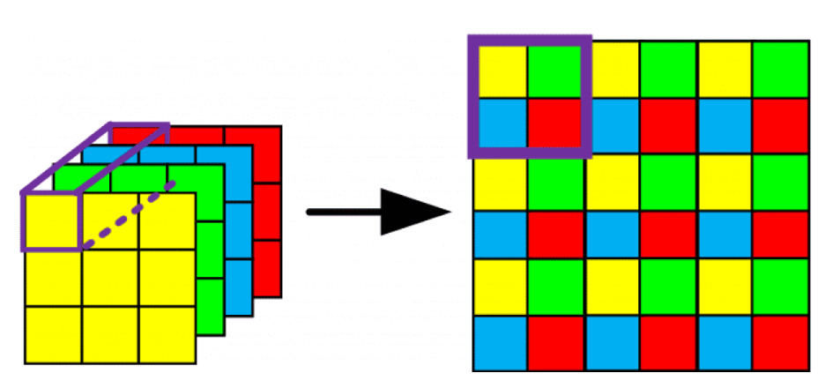
ML-Powered Surrogate Model – PropMat
To global fitting with GALPROP + HELPROP, we introduce PropMat
Pixel Shuffle
Multiple Pixel Shuffles to naturally keep the smoothness in output Matrix
Abstract physics learned inside

Slide 8
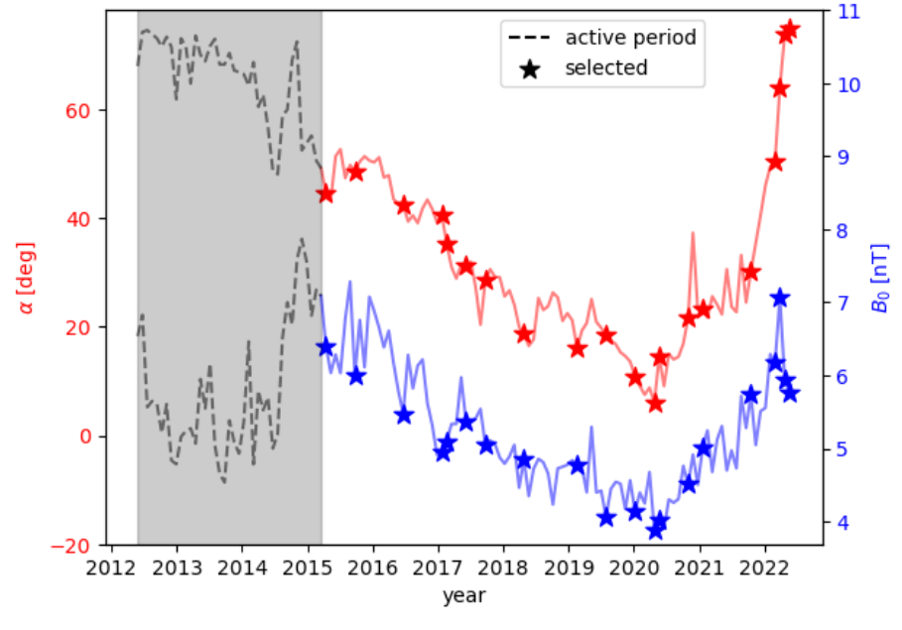
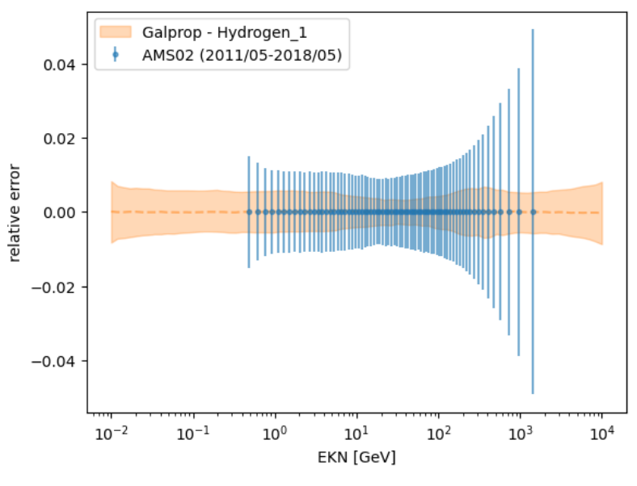
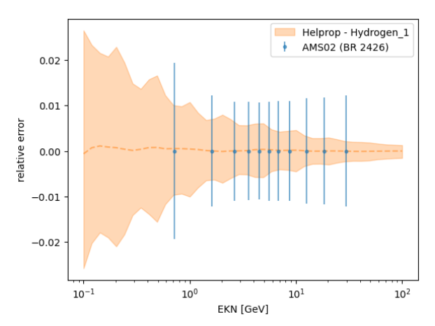
ML-Powered Surrogate Model – PropMat
Only several bartels to train, but all bartels works well
Training result for GALPROP and HELPROP at wide parameter region

Slide 9
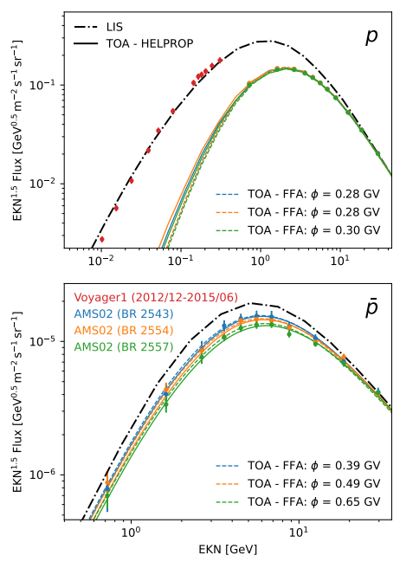
Analysis of Fitting Results
Global fitting for 92 bartels performed
Typical BRs shown
Same effective FFA potential for proton
Naturally predict different effective FFA potential for antiproton as tilt angle affect HCS drift

Slide 10
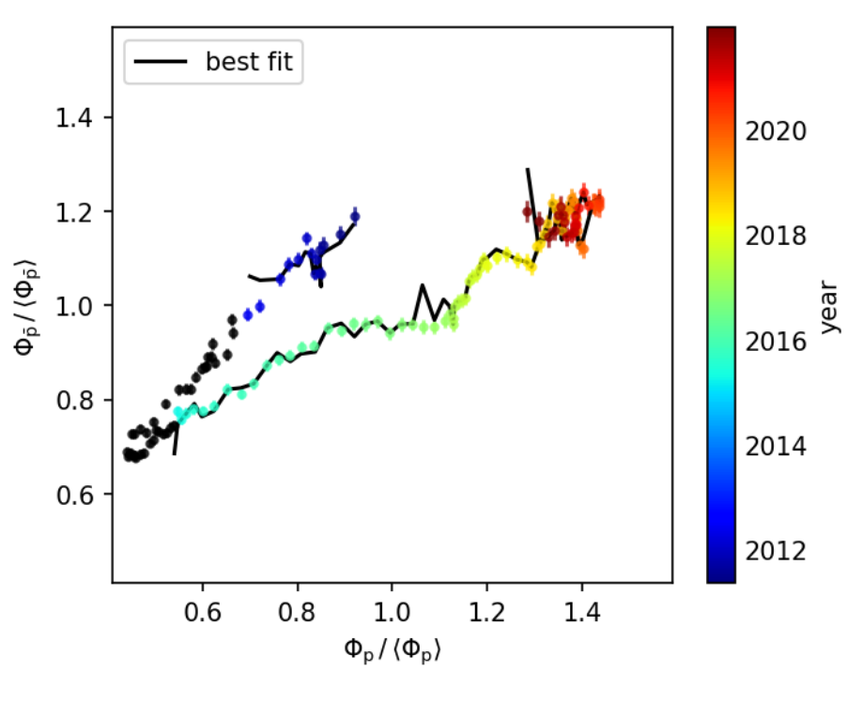
Analysis of Fitting Results
Global fitting for 92 bartels performed
Naturally predict the discrepancy between A > 0 and A < 0 period at proton vs antiproton plane

Slide 11
Conclusions & Outlook
A 3D modulation model deal with wavy HCS developed
The PropMat surrogate model introduced
Our charge-dependent modulation model uniformly work well for proton / antiproton
Todo:
  extend to electron / positron
  extend to solar maximum periods

Slide 12
Thanks for your attention!

