Slide 1


Study the Solar Modulation of GCRs with modified FFA
朱成瑞 安徽师范大学
2026.4.21 @ Wuhu

Slide 2
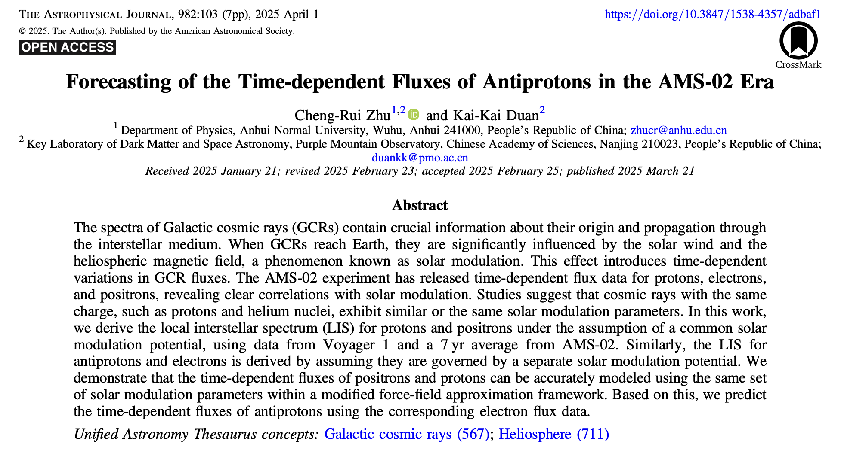
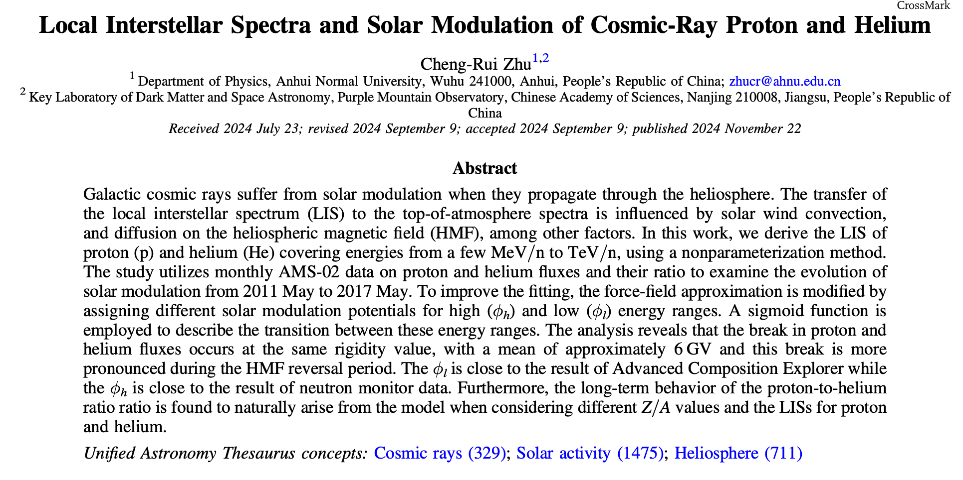
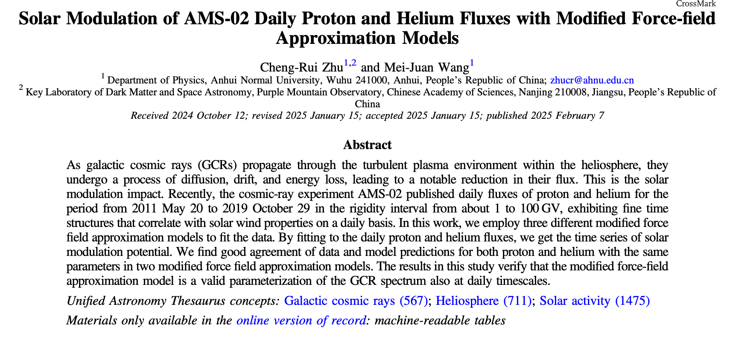
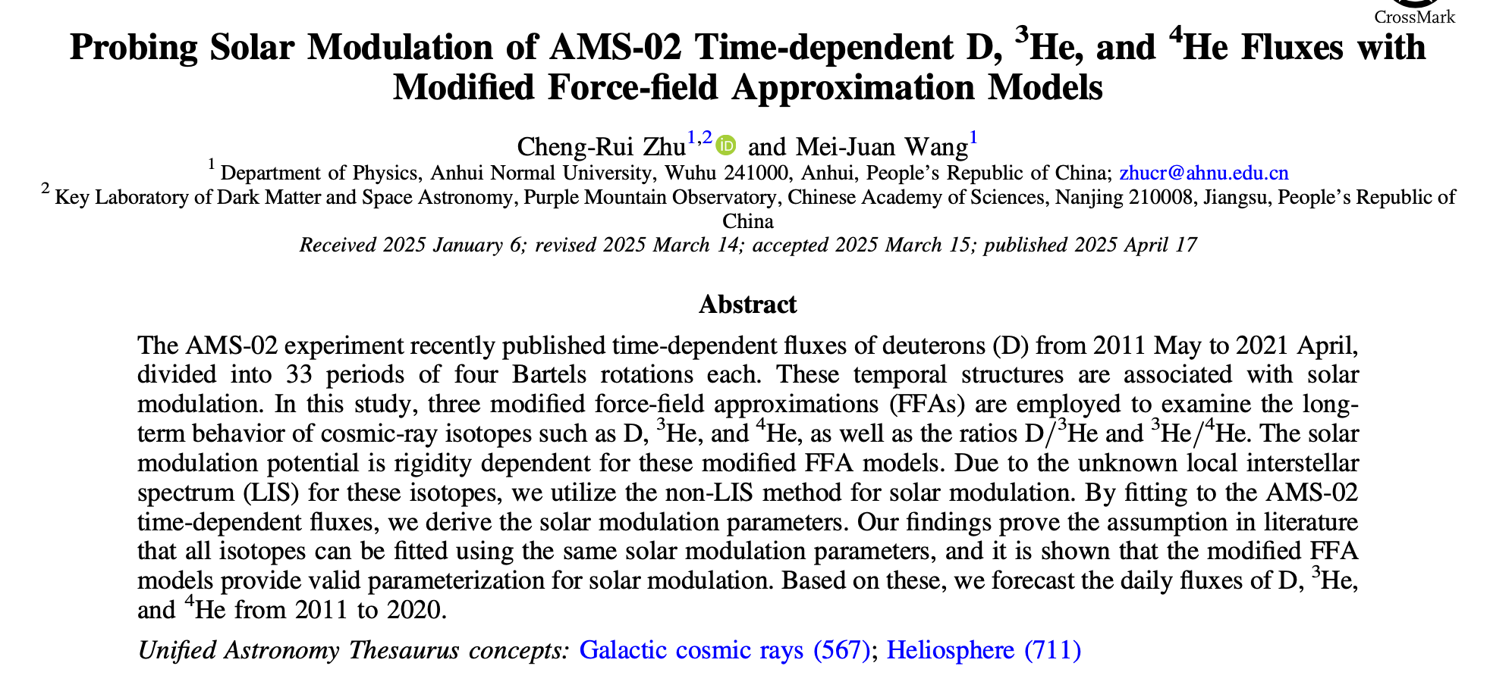

Slide 3
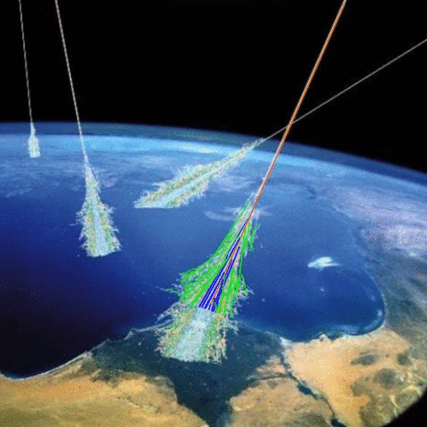
introduction to GCRs
Cosmic rays are high-energy particle streams originating from outer space and serve as one of the messengers for studying the universe.
cosmic rays refer to atomic nuclei such as protons, helium nuclei, up to iron nuclei, as well as electrons
in a broader sense, cosmic rays also include neutral particles such as gama-ray and neutrinos.

Slide 4
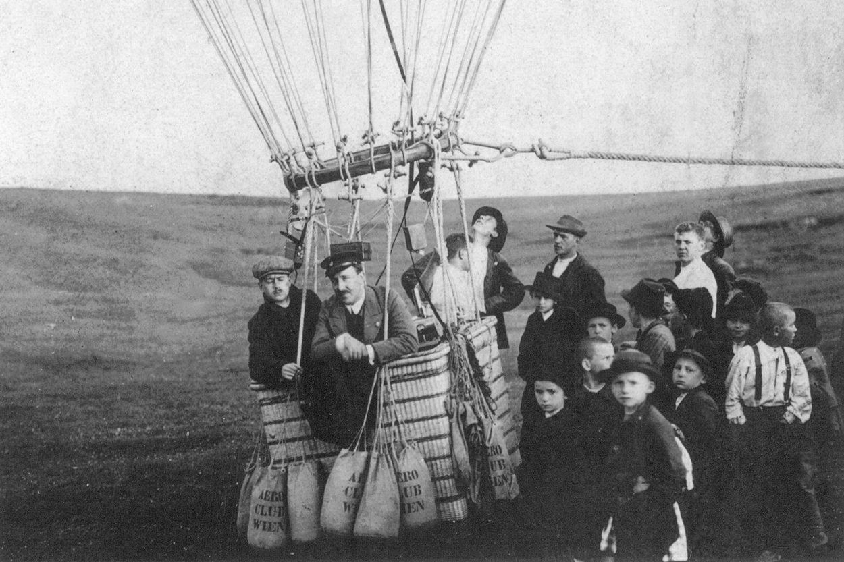
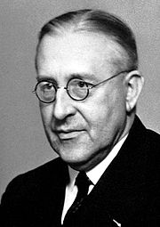
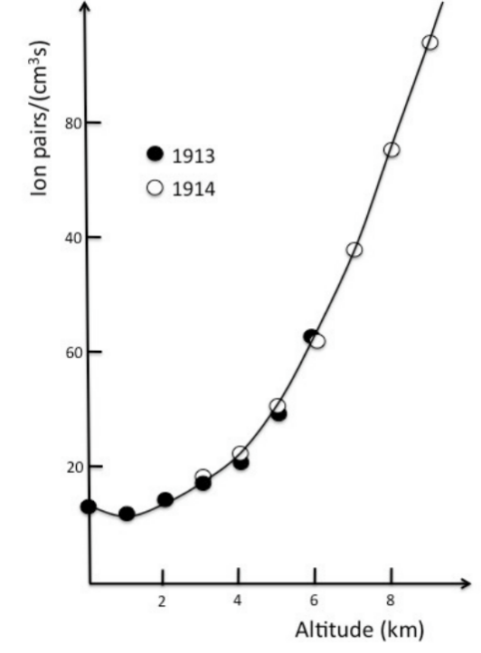
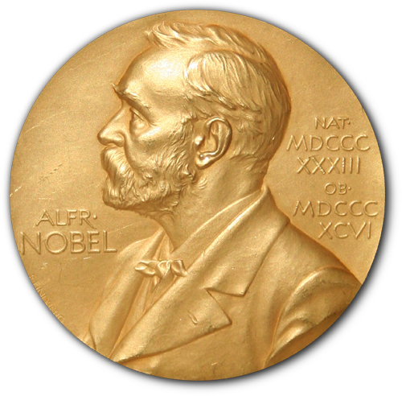
In 1912, Austrian physicist Hess discovered radiation originating from beyond the Earth through balloon experiments, leading to the discovery of cosmic rays. For this achievement, he was awarded the Nobel Prize in Physics in 1936.
维克托·弗朗西斯·赫斯

Slide 5
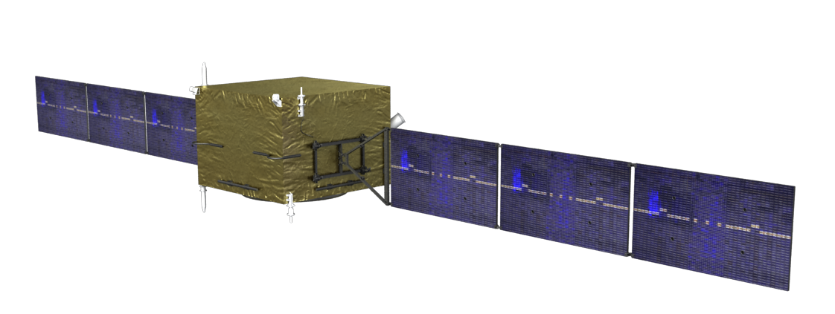
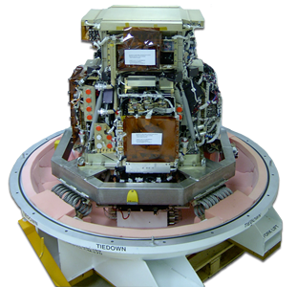
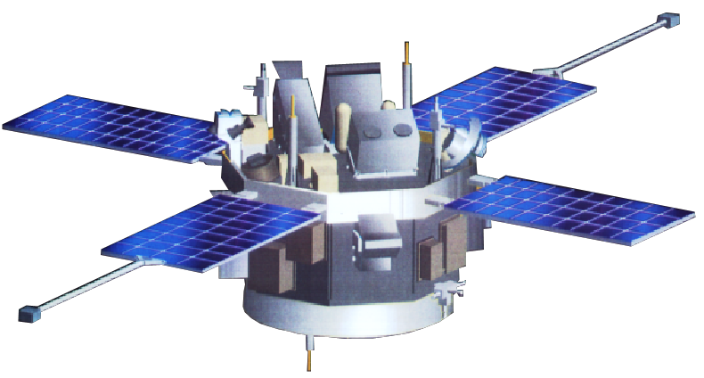
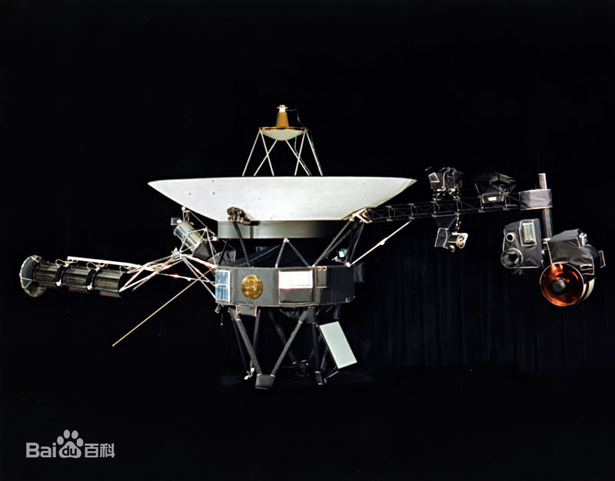
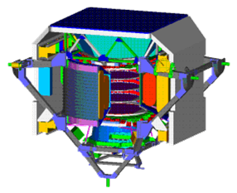
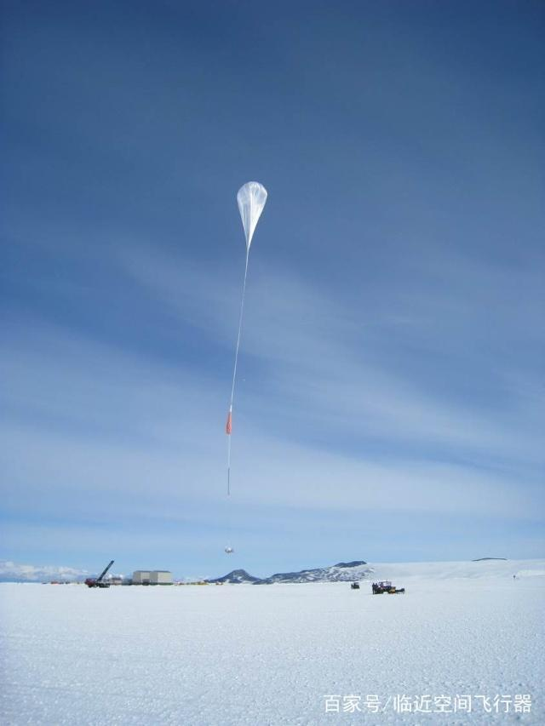
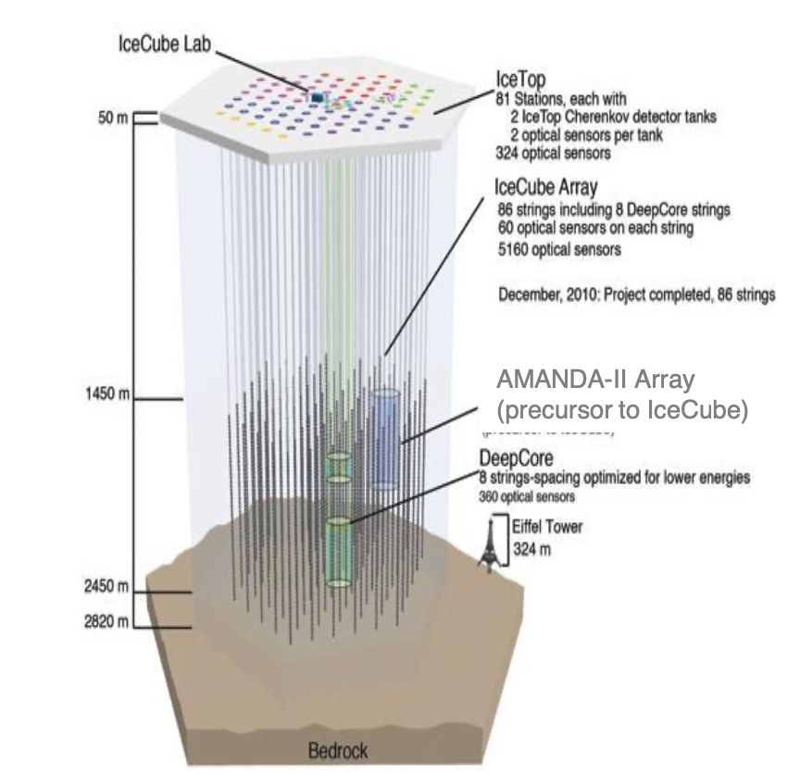
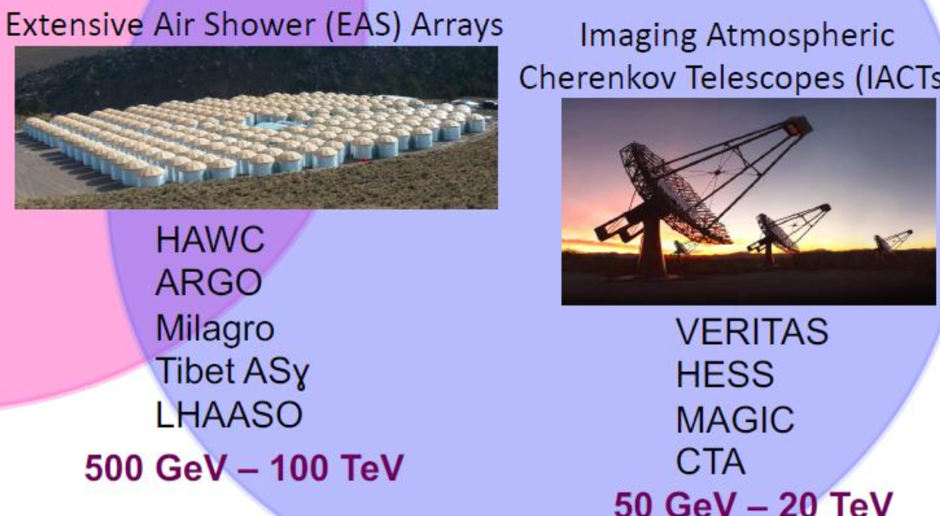
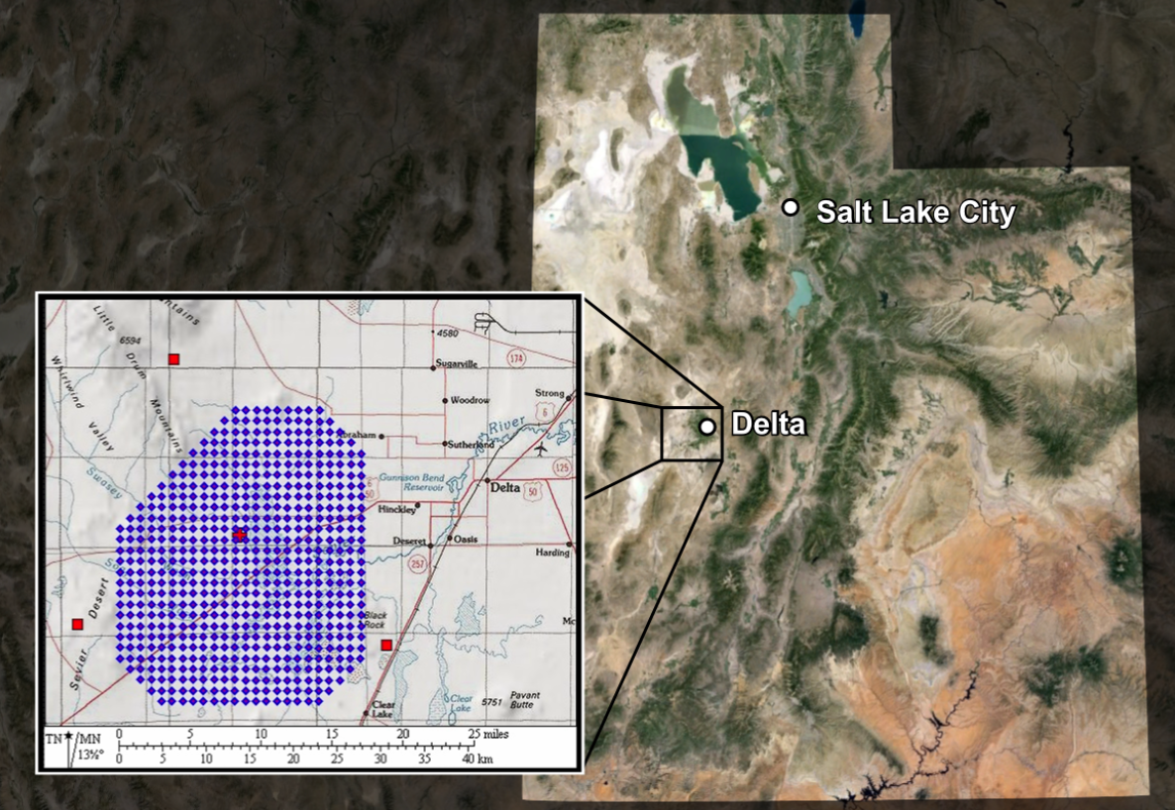
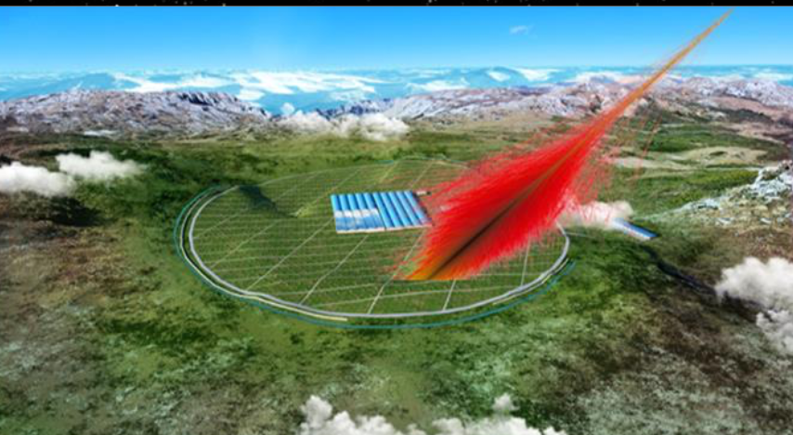
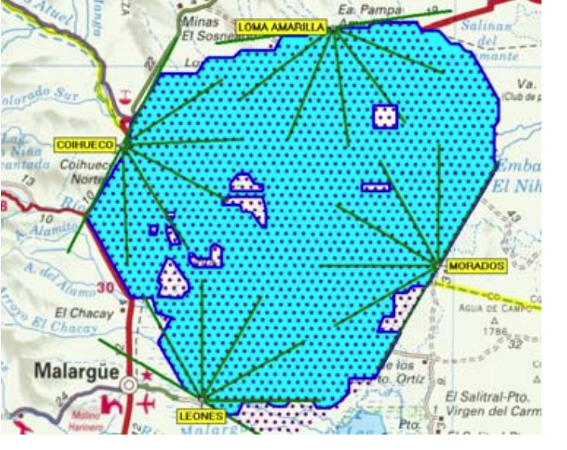
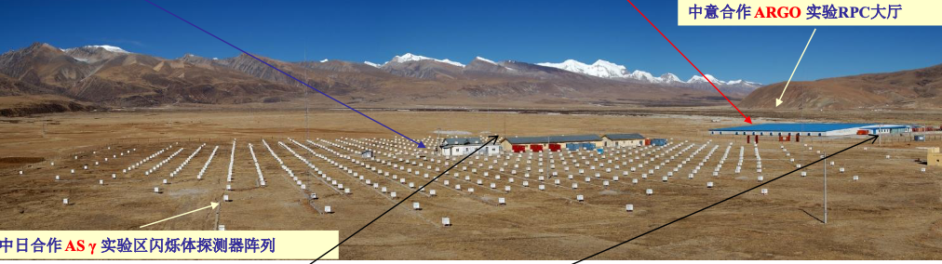
detection of GCRs
There are many methods for detecting cosmic rays today, primarily dividied as ground-based and space-based.

Slide 6
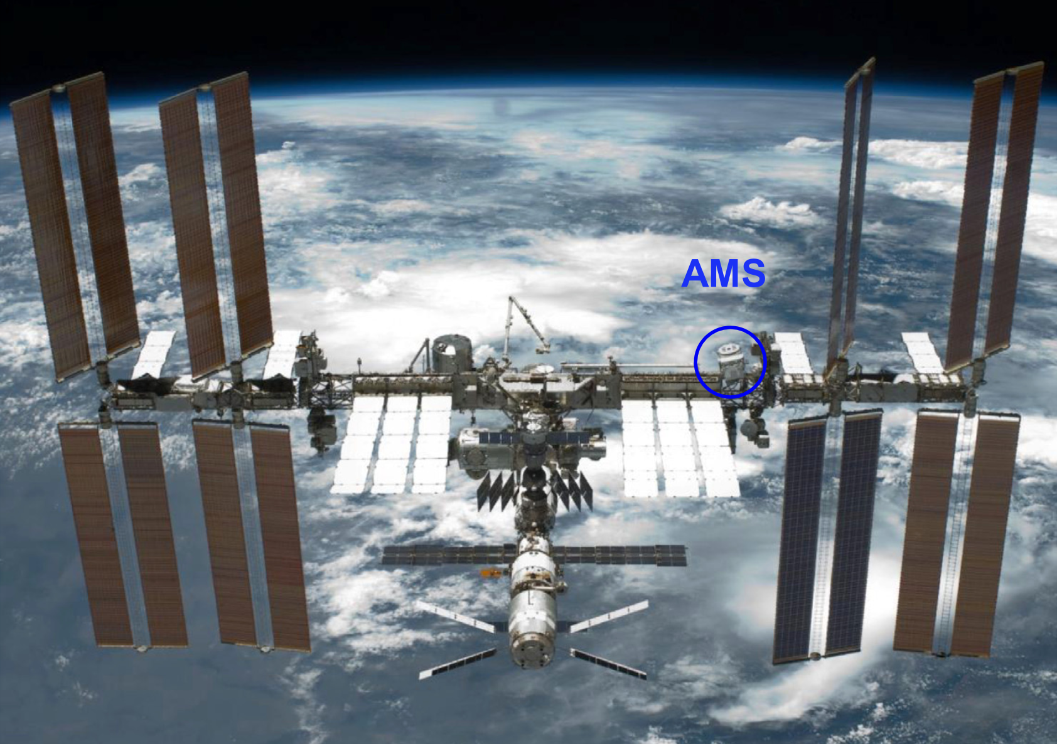

Slide 7
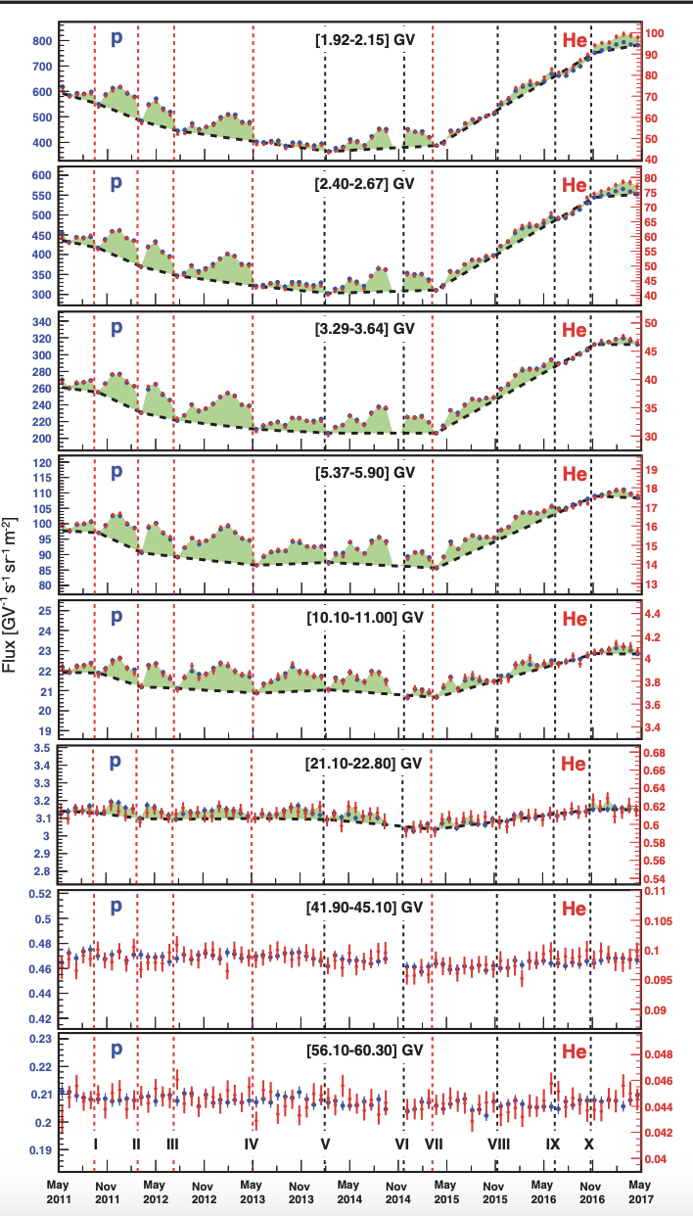
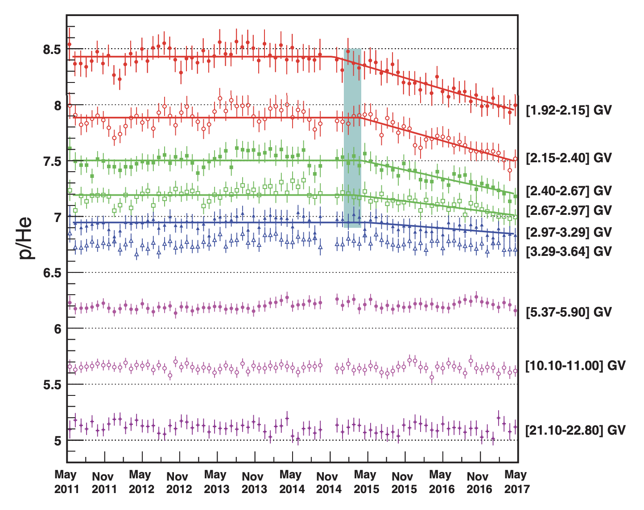

Slide 8
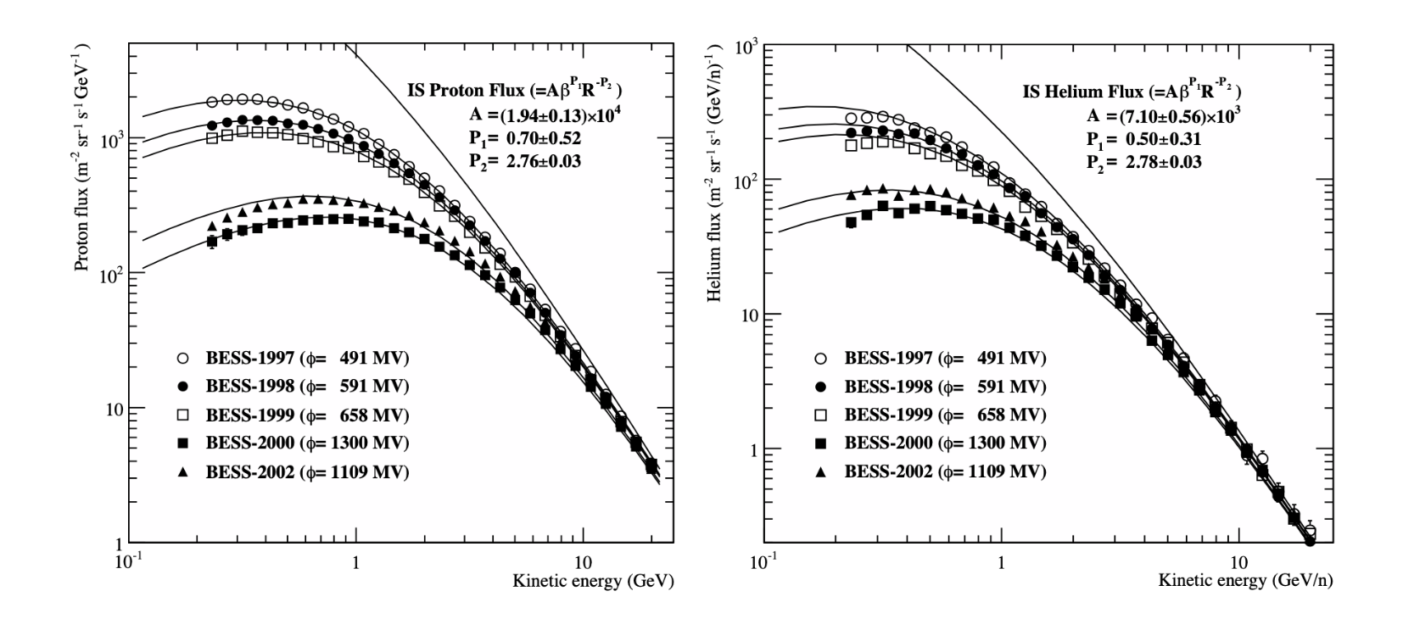
solar modulation

Slide 9
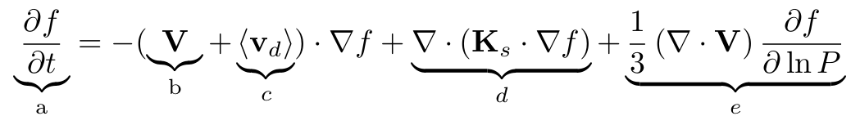
Basic transport equation (TPE)
convection
drift
diffusion
adiabatic
energy changes

Slide 10
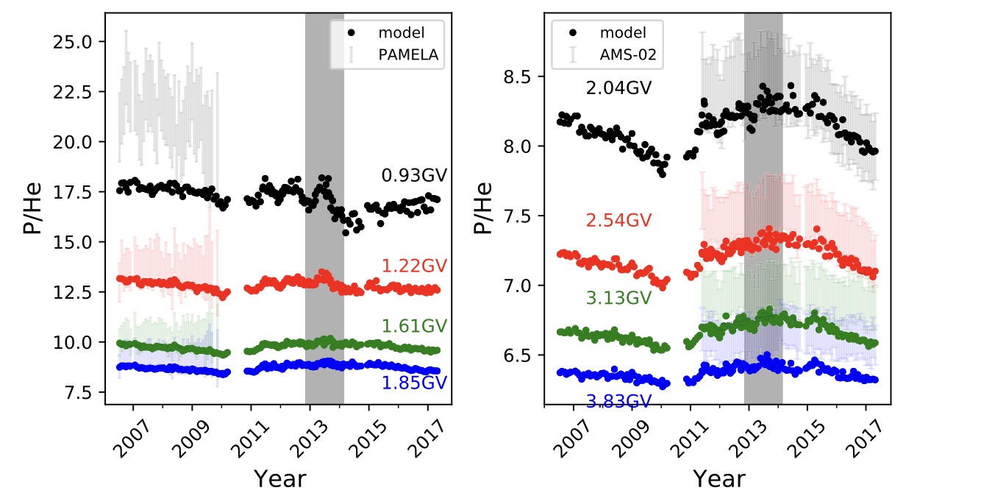
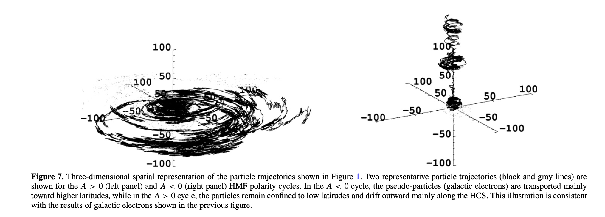
3D 随机微分方程
Strauss et al. 2011
Song et al. 2021

Slide 11
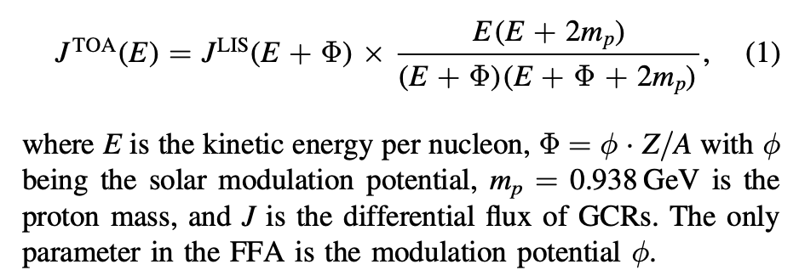
Force-field Approximation

Slide 12
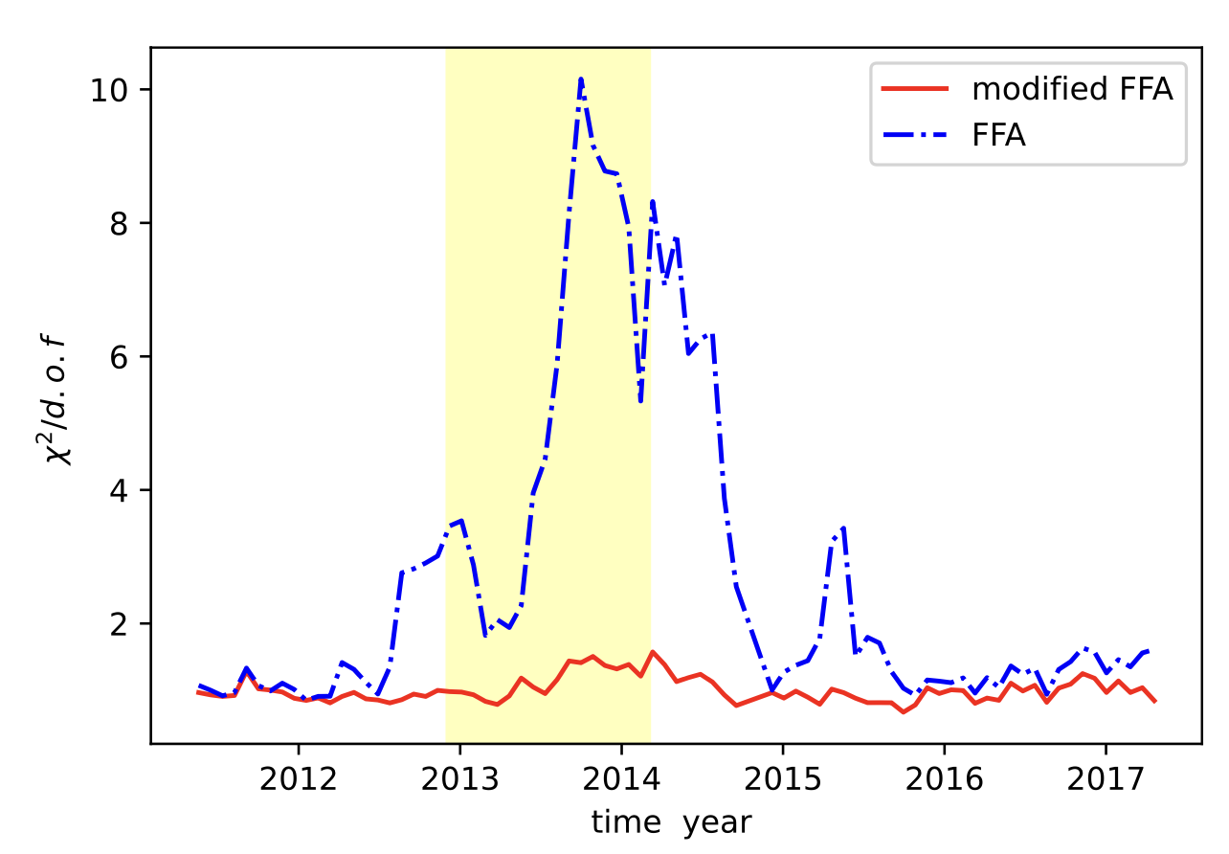
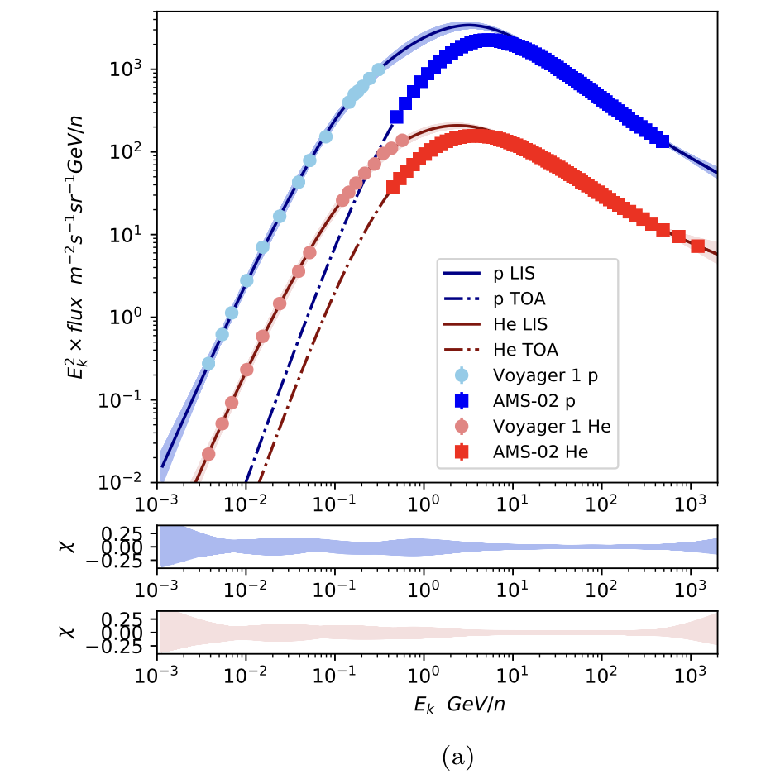
Fit to p and He
The force-field approximation struggles to account for the high-precision, time-dependent energy spectra of protons (p) and helium nuclei (He) obtained by AMS-02

Slide 13
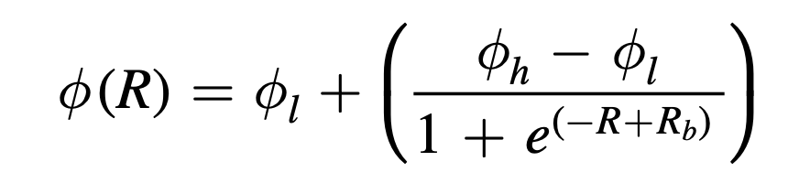
Modified Force-field Approximation Model
This model is developed from the model in C. Corti et al. (2016).

Slide 14
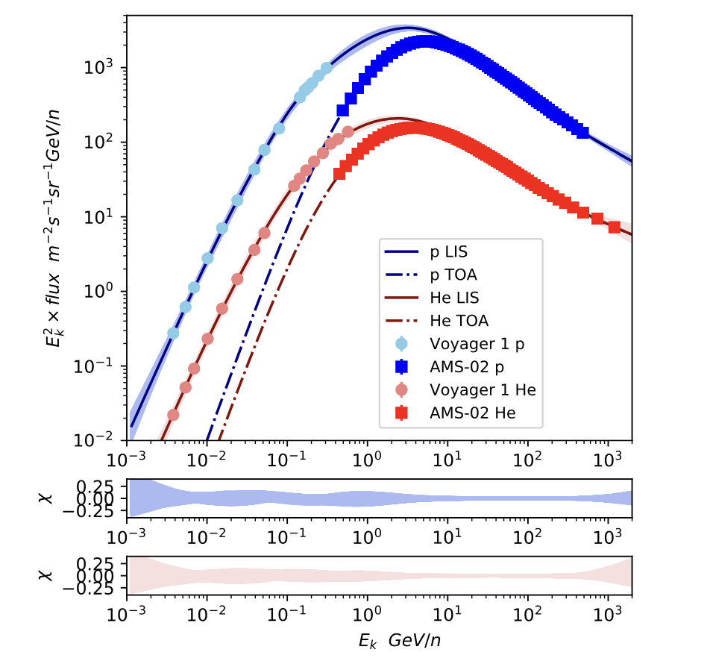

Slide 15
Fit to monthly p and He

Slide 16
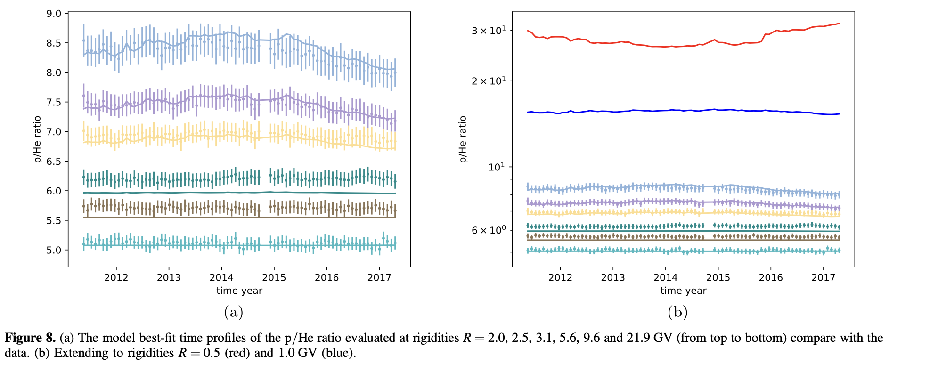
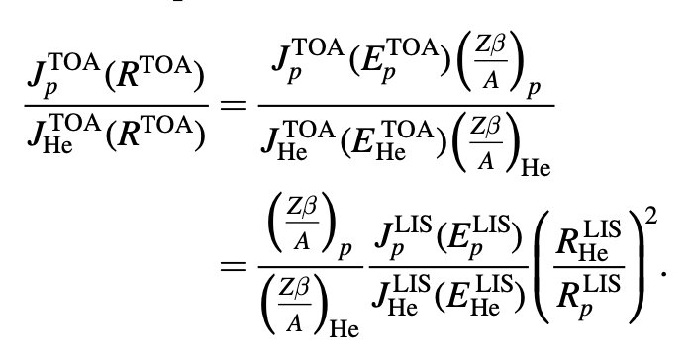

Slide 17
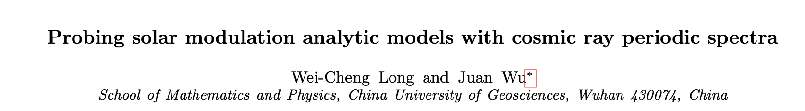
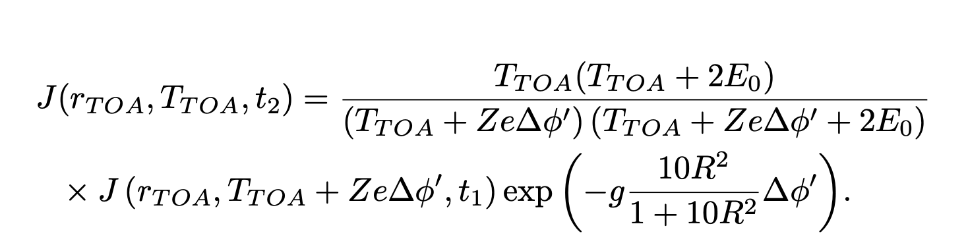
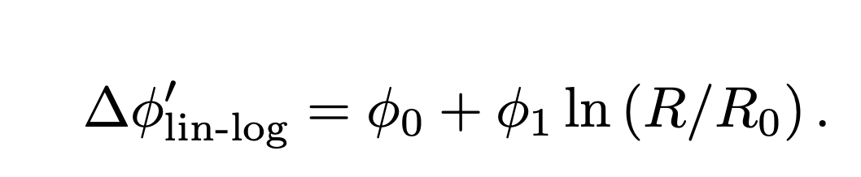

Slide 18
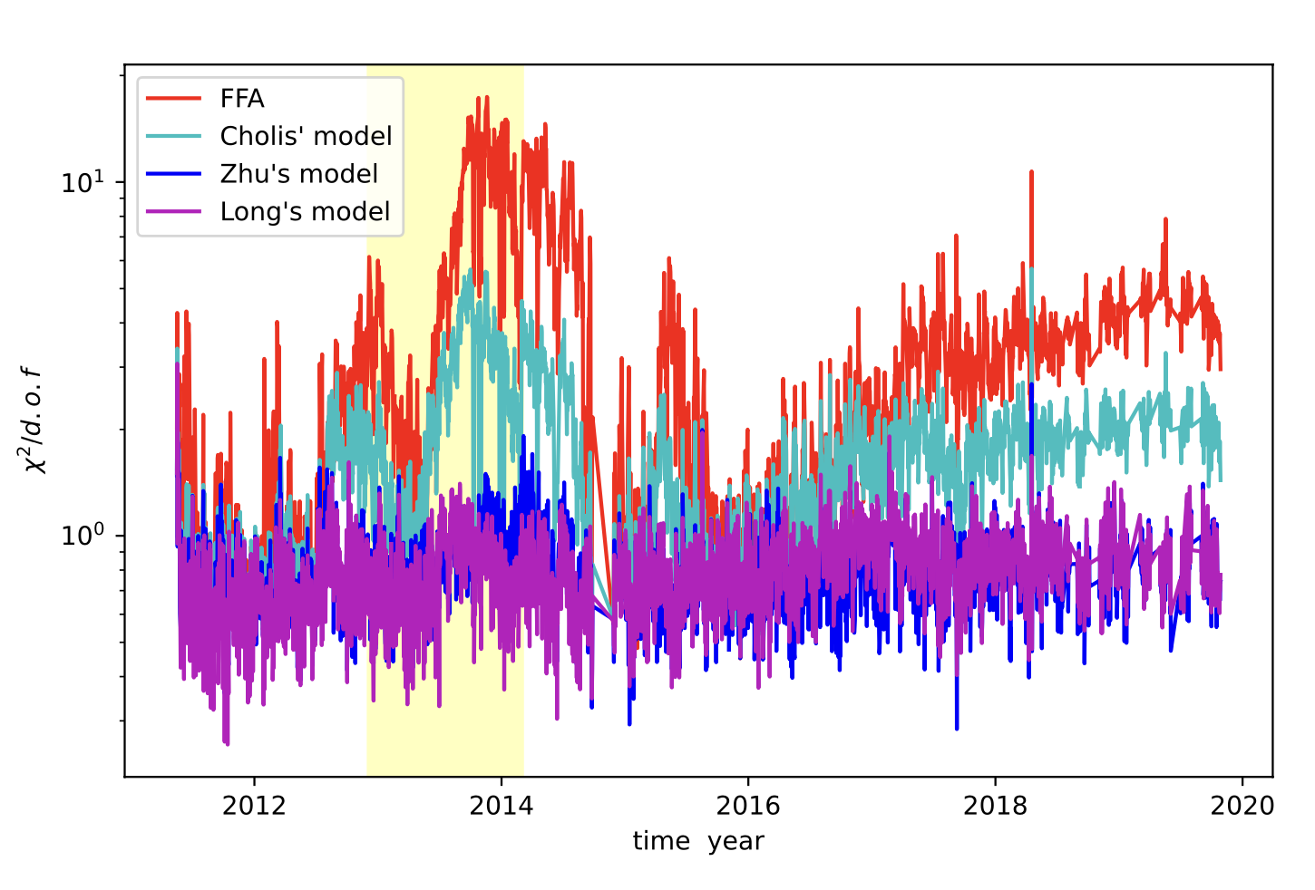
Fit to daily p and He

Slide 19
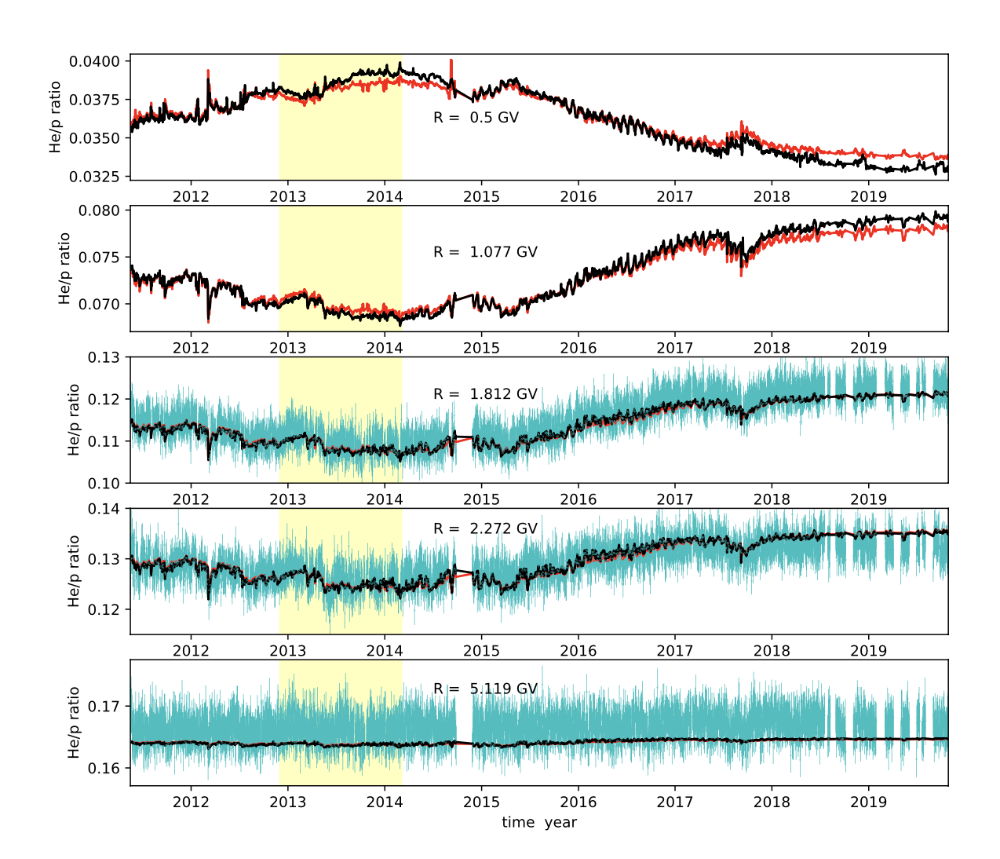

Slide 20
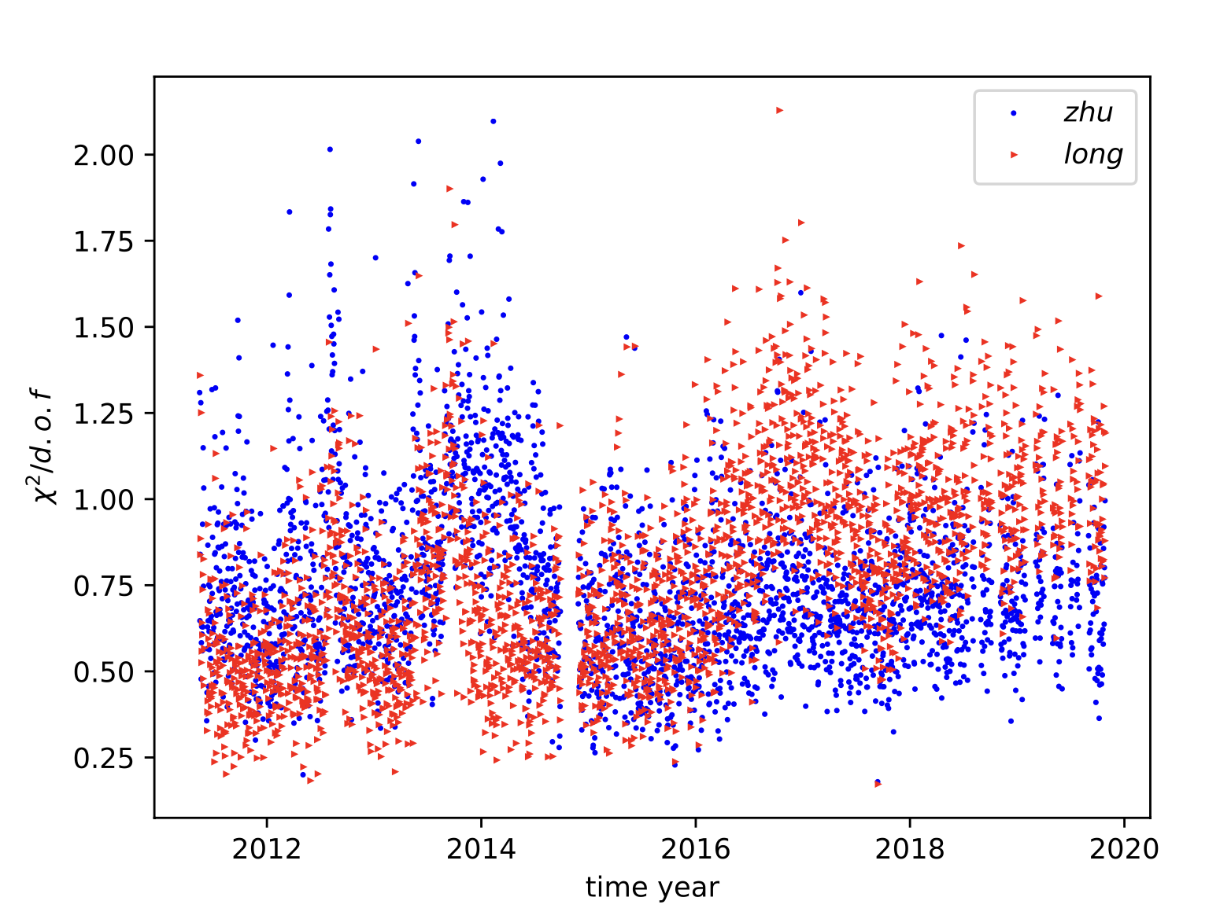
p and positron fit togetther？
can electron and antiproton be fitted with the same paramters ？
‘forcaste’ daily antiproton fluxes

Slide 21
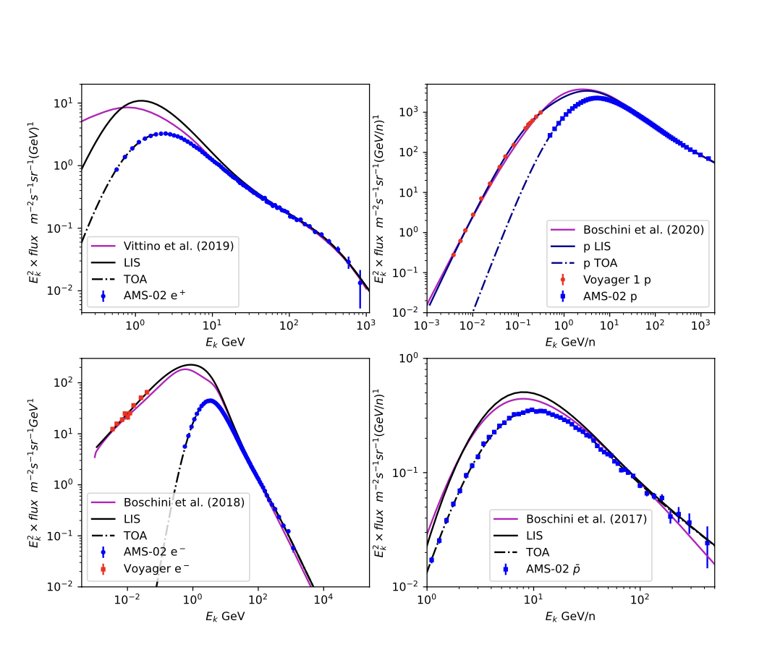
LIS of GCRs

Slide 22
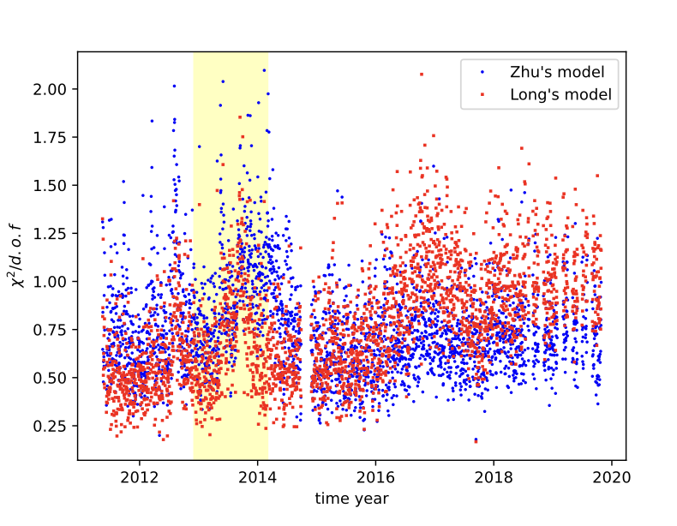
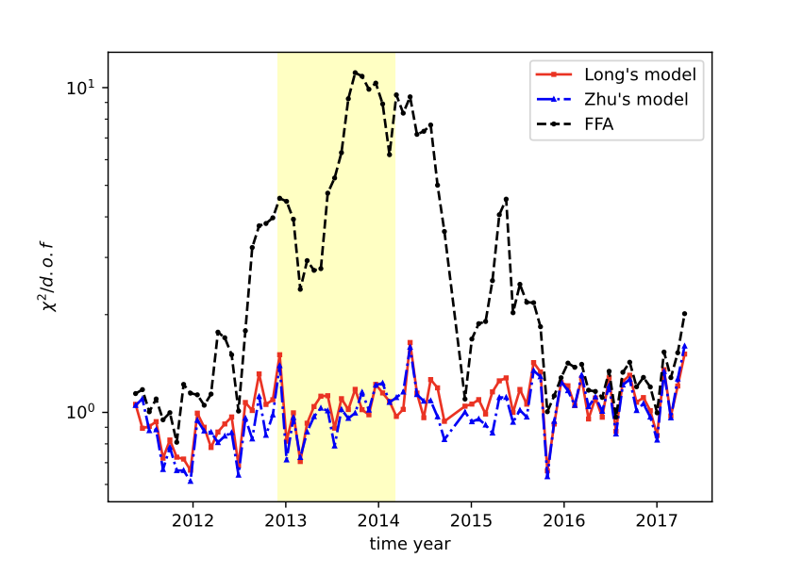
fit to p and positron

Slide 23
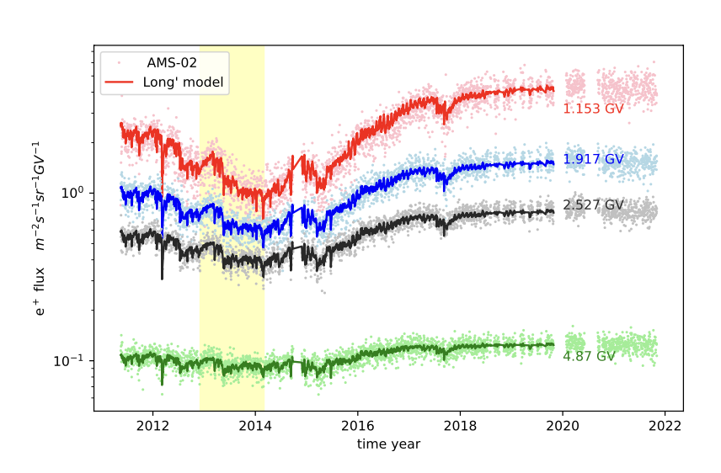
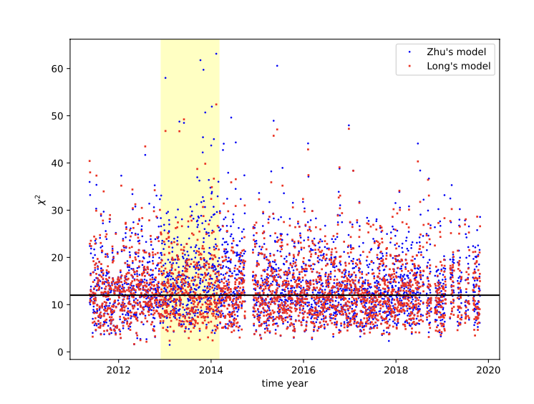


Slide 24
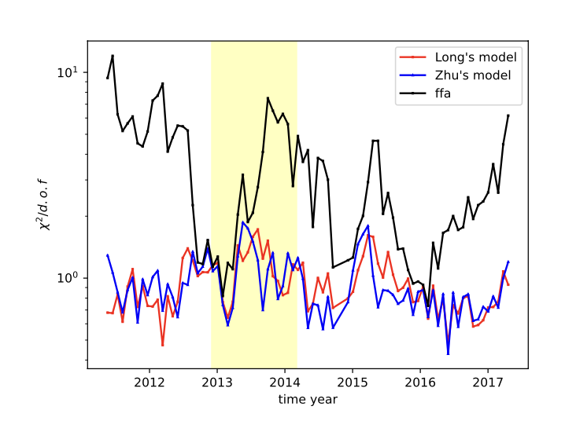
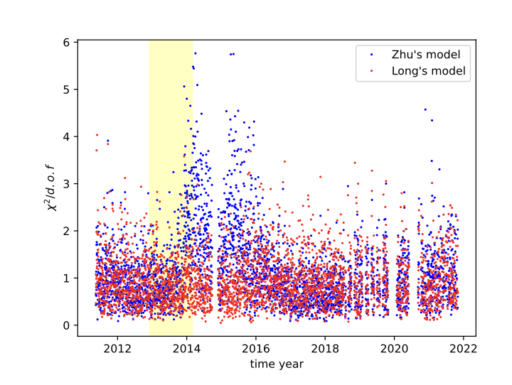
fit to time-dependent elcetron flux

Slide 25
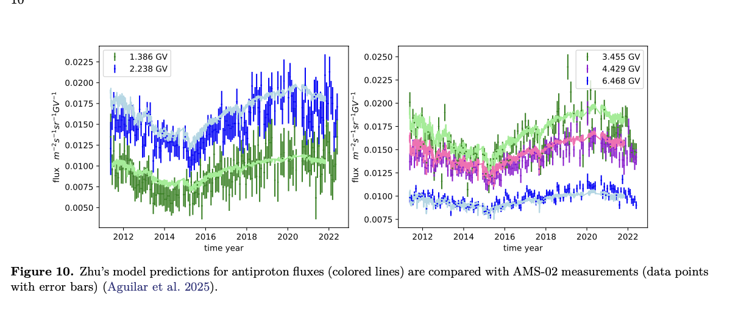
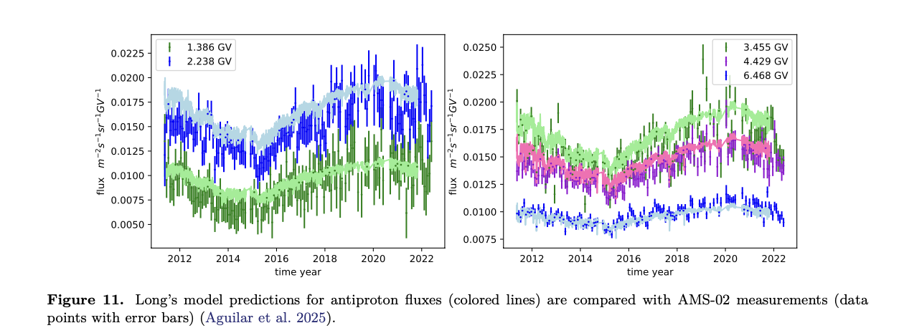

Slide 26


Slide 27

solar modulation of deuterons (D) He3 He4

Slide 28


Slide 29


Slide 30



Slide 31


Slide 32
conclusion
We can successfully account for the temporal evolution of solar modulation for the same charge-sign of cosmic rays and predict the fluxes of unmeasured species using our parameterized, improved force-field approximation model.
We hope that this model can be applied in the future to study the propagation of cosmic rays within the Galaxy.

Slide 33
谢谢
感谢非常大家到安徽师范大学指导工作

