Slide 1
Heavy Nuclei beyond Fe in Cosmic Ray
孙浩然
2023/3/1

Slide 2
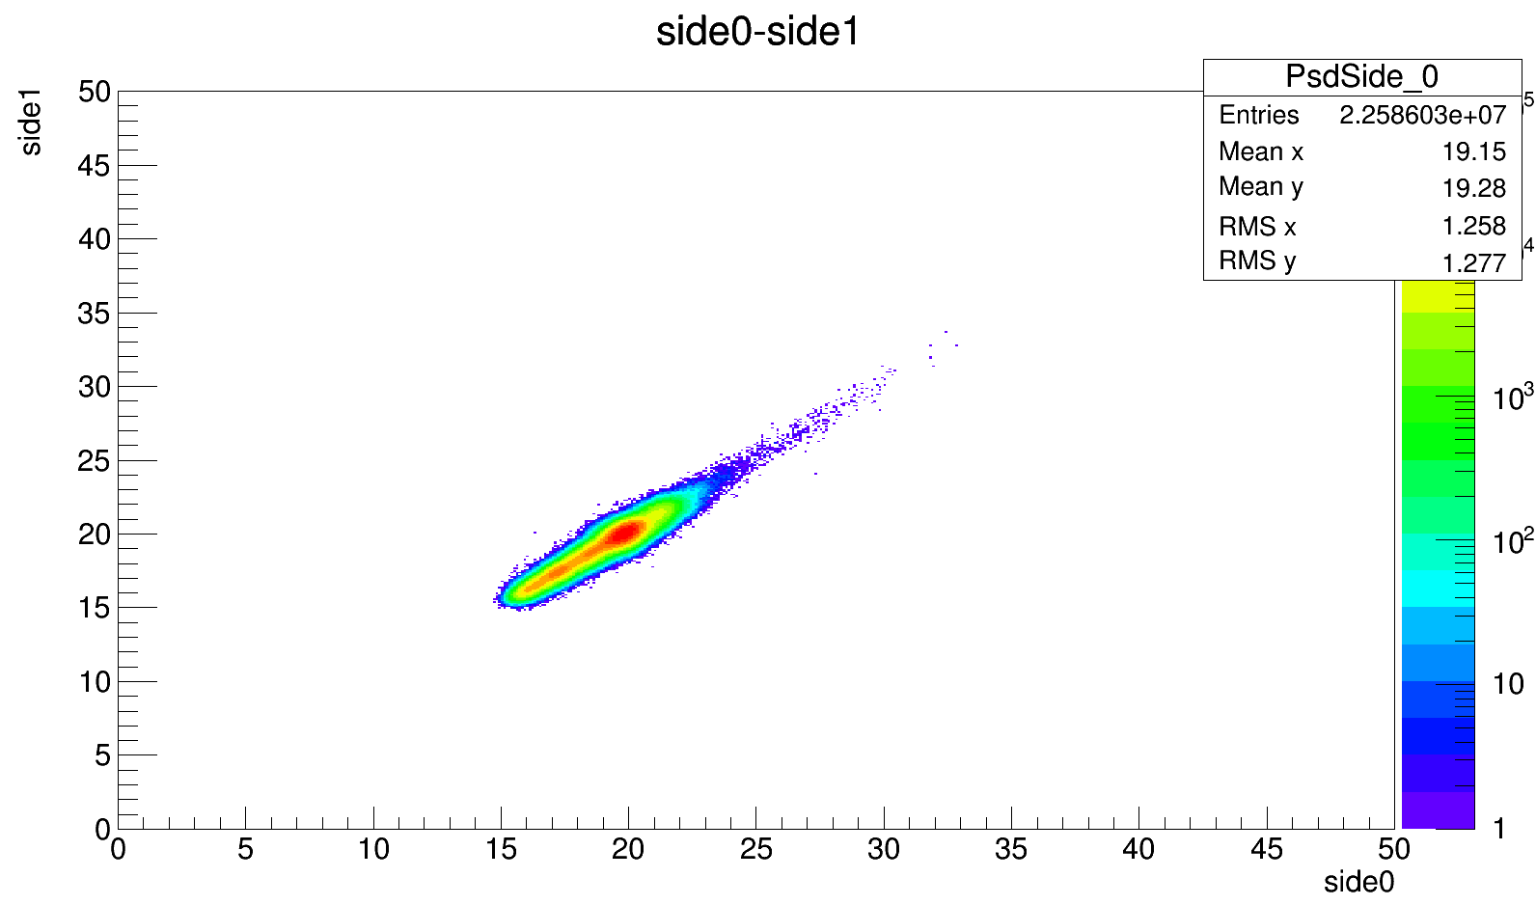
side0-side1 without quenching correct

Slide 3
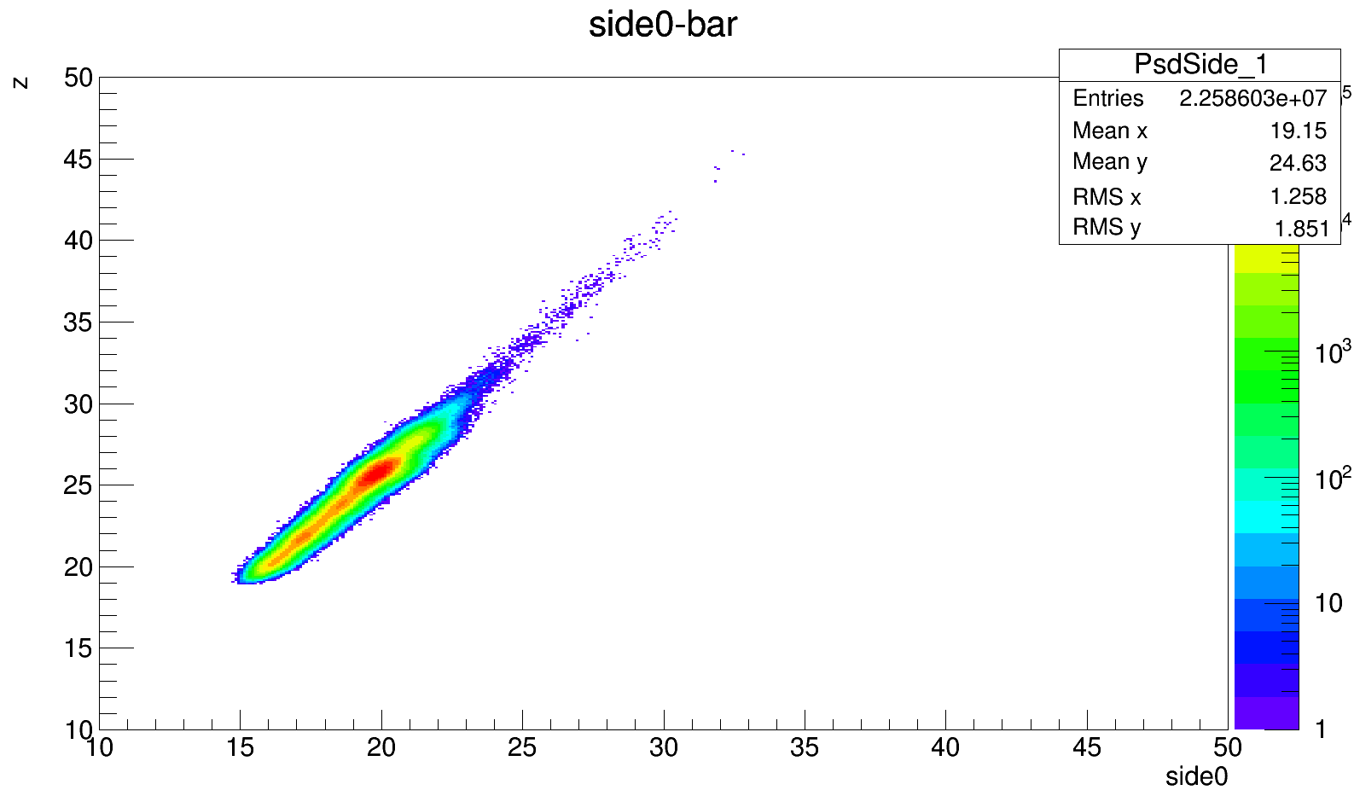

Slide 4
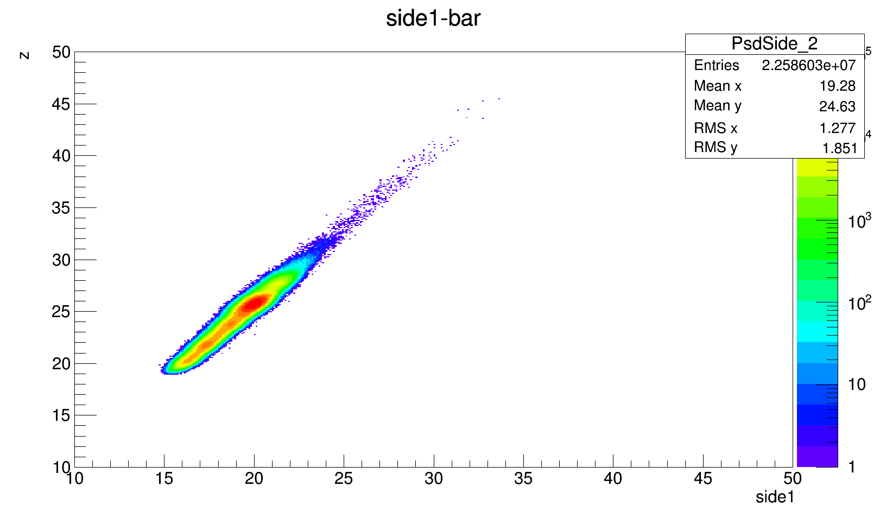

Slide 5
