Slide 1
PSD DAC calibration
Yapeng Zhang
Institute of modern physics, CAS
2017.10.23

Slide 2
Outline
PSD Dac calibration run
PSD Dac data fit
PSD calibration procedure
PSD calibration results
Application of PSD DAC calibration

Slide 3
PSD Dac calibration run
DAC精细刻度从9月7日开始到9月9日中午结束。
BGO量能器电子学线性刻度模式，的DAC步长设置更改为5，DAC范围从0到1995，分20次完成。
塑闪DAC刻度步长参考BGO量能器，设置为5，DAC值范围从0到1195，分12次完成。
每个文件有20点，共12个文件

Slide 4
Used calibration files (12 files)
DAMPE_1F_DAC_20160907_0013_00000_CEbDLhGU5eA1vUu9Sn9j.root
DAMPE_1F_DAC_20160907_0013_00000_KpXlMUg6fHVscxGO6jVt.root
DAMPE_1F_DAC_20160907_0013_00000_QAUEYxwJxiCx7hesAriO.root
DAMPE_1F_DAC_20160907_0013_00000_rPwnBPvUWbayc1Yhs3IL.root
DAMPE_1F_DAC_20160907_0013_00000_tE0ILIxRL8B8tPBaLrzN.root
DAMPE_1F_DAC_20160907_0013_00000_URwsROsZG7HU3aQ0PpJP.root
DAMPE_1F_DAC_20160907_0013_00000_WnRT3Wg13rBTPQ6CgWcH.root
DAMPE_1F_DAC_20160907_0013_00000_Y69WCQwXPZwFoI8H2PVi.root
DAMPE_1F_DAC_20160907_0013_00000_ZTAhqqxk62QZyQxXv6Ec.root
DAMPE_1F_DAC_20160908_0013_00000_bXZE9qYi3soQtxuQgRsS.root
DAMPE_1F_DAC_20160908_0013_00000_CUKi7LrJ4m217Nbbv6rZ.root
DAMPE_1F_DAC_20160908_0013_00000_guEGmFkrrn39cbOpS9aD.root

Slide 5
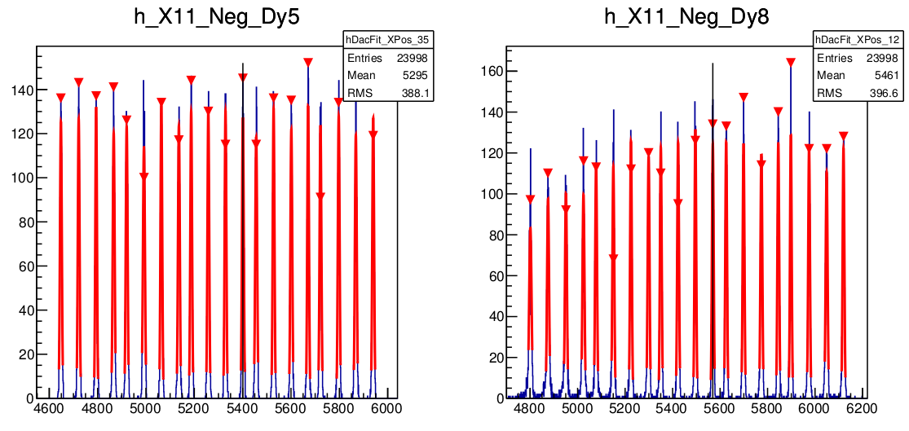
Find peaks in ADC spectra
ADC
Each file 20 peaks

Slide 6
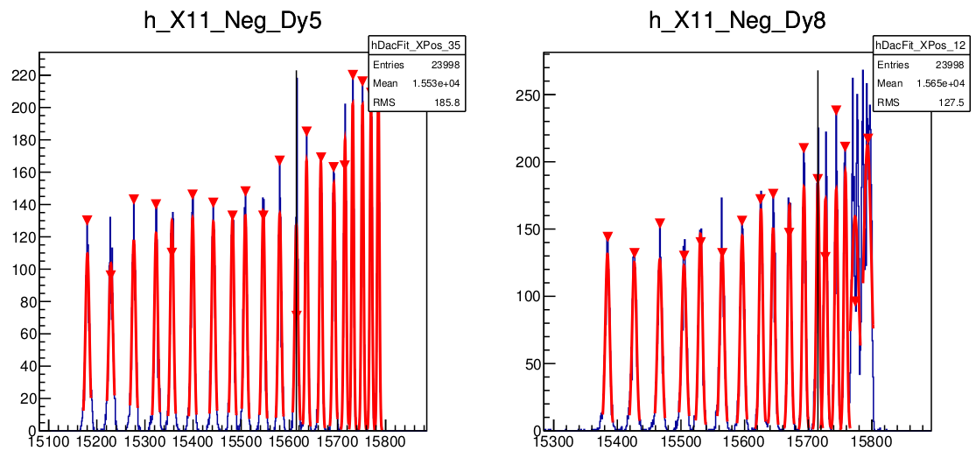
Find peaks in last ADC spectra
14 peaks in last DAC calibration file

Slide 7
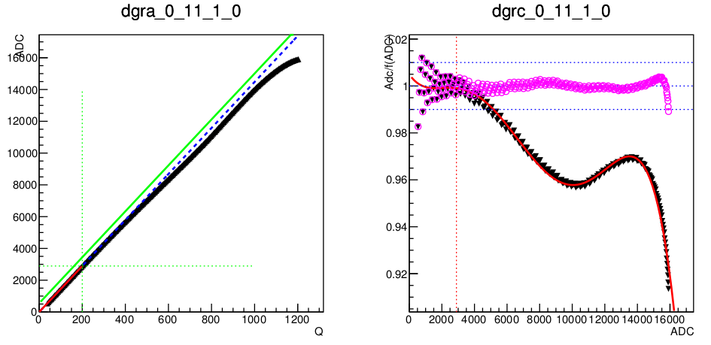
Input Charge Vs. ADC
Peak number: 20*11+14 = 234 (ADC_i, i=0,...,233)
Input step: 0, …, 1165 (233*5) (C0_i, i=0,5,...1165)
1st step:
G0 (ADC_i, C0_i) TF1* f0 = G0->Fit(pol1) in [10,200]
2nd step:
C_0 = f0⁻¹(ADC_0) (Pedestal)
C1_i = (Pedestal + C0_i)
3rd step:
G1 (ADC_i, C1_i, i=0,1,2)
TF1* f1 = G1->Fit(pol1) in [10,200]
[0,3000] ADC channels covers the energy losses of p and He

Slide 8
Extract ADC calibration parameters
G_i=(ADC_i/f1⁻¹(C1_i), ADC_i)
G_i->Fit(“pol5”)
ADC (ADC<2000)
ADC / pol5(ADC) (ADC>2000)
ADC_cali =

Slide 9
DAC influences
Pedestal does not change;
MIP calibration does not change;
Dynode ratio need to be checked;
The energy of PsdHits will be changed;
The reconstructed charge will be changes;
The quenching effect correction functions need to be updated.

