Slide 1
Preliminary Investigation into Anti-matter with DAMPE
徐志会(Zhi-Hui Xu)
xuzh@impcas.ac.cn
Institute of Modern Physics(IMP), CAS
2023-11-09

Slide 2
Out-Line
Motivation
Data Used
Pre-selection
Anti Matters response in DAMPE
Summary

Slide 3
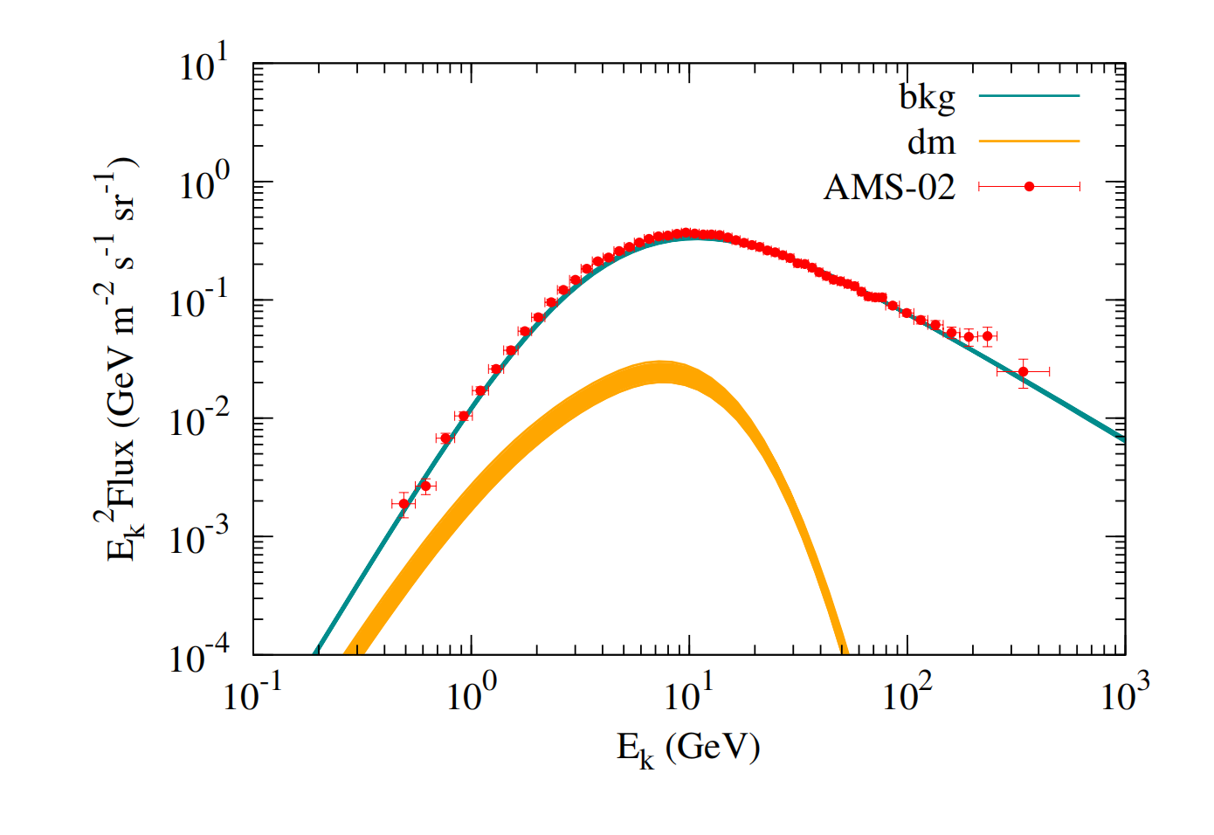
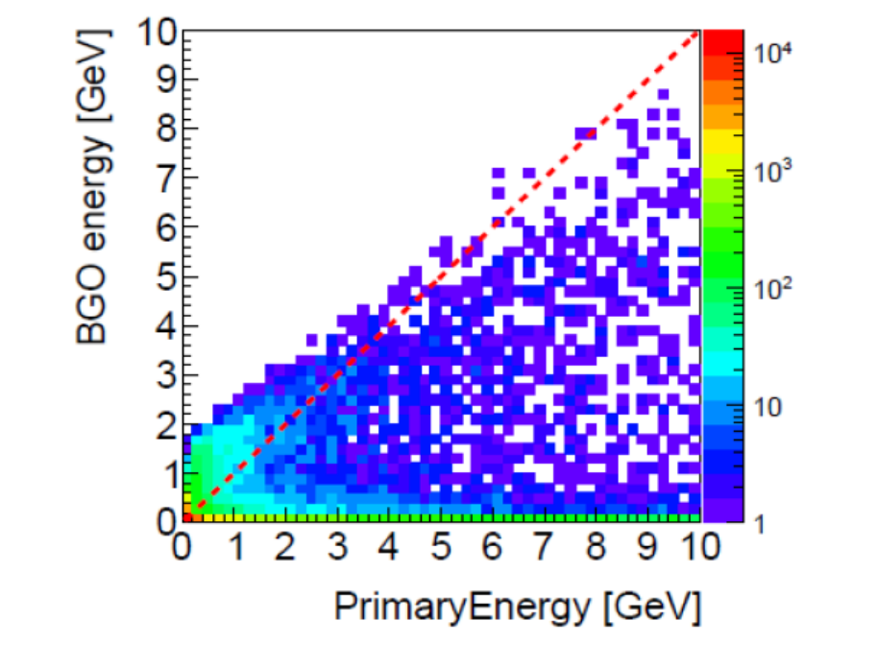
Motivation
Phys. Rev. Lett. 118, 191101
Antimatter Cosmic Rays Are of Significance in Constraining Dark Matter Parameters.
Antimatter particles deposit more energy inside the detector.

Slide 4
Data Used
DimuData :
Energy Range: 0.1GeV to 10GeV
Module : FTFP_BERT_TRV

Slide 5
Pre-selection
$E_{dep}>0.01$ GeV
STK track selection:
${chi}^{2}$/$ndf$< 50 & Angle to BGO track < $15°$
Match with MGO shower
Selected the track with max Energy deposition in STK detector
Track Pass PSD top and BGO buttle
PSD selection
PASS two layer PSD, $Q_{0}$ < 3 || $Q_{1}$< 3

Slide 6
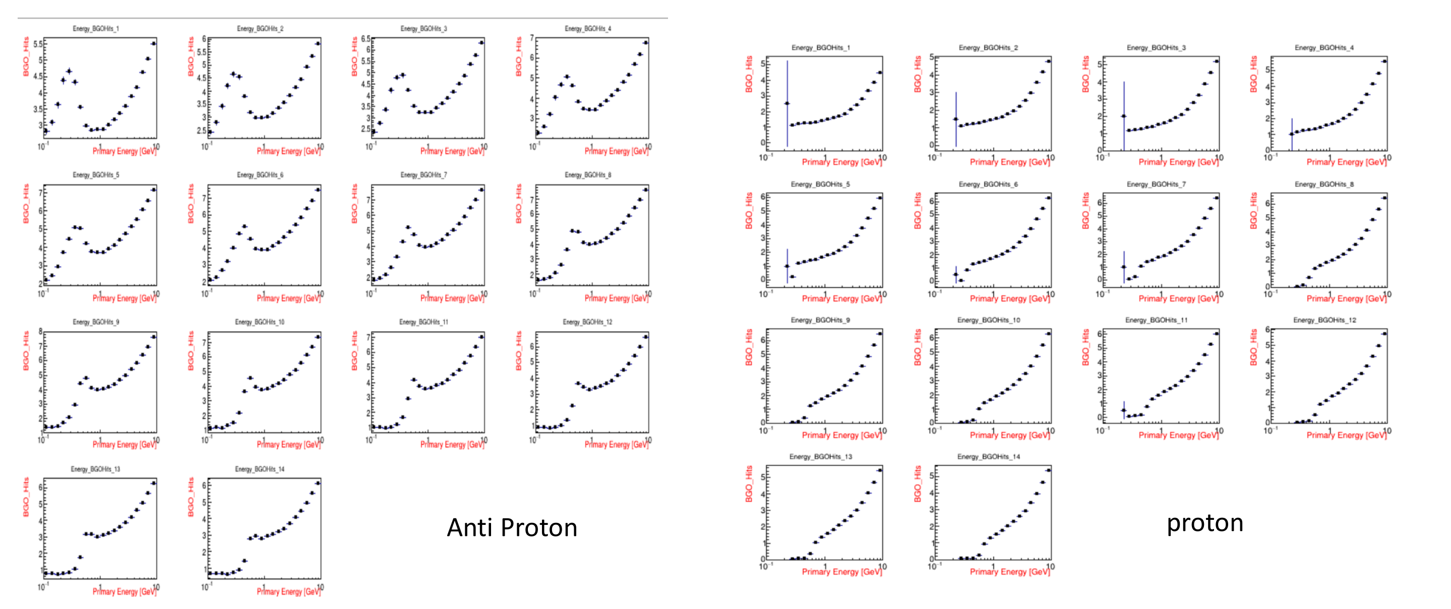
Character Variable : RMS, Eratio, PSD charge

Slide 7
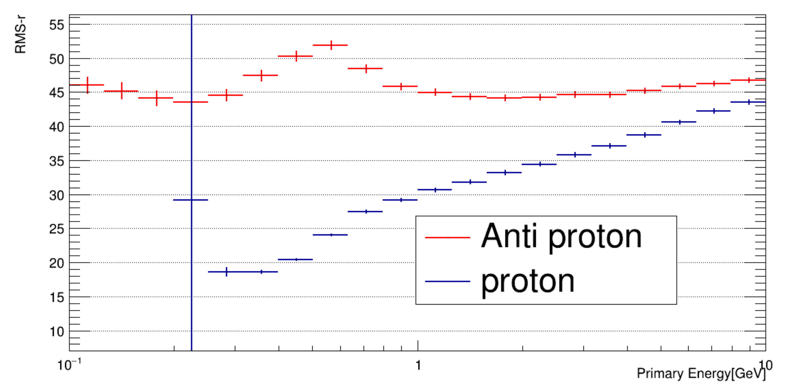
RMS-r

Slide 8
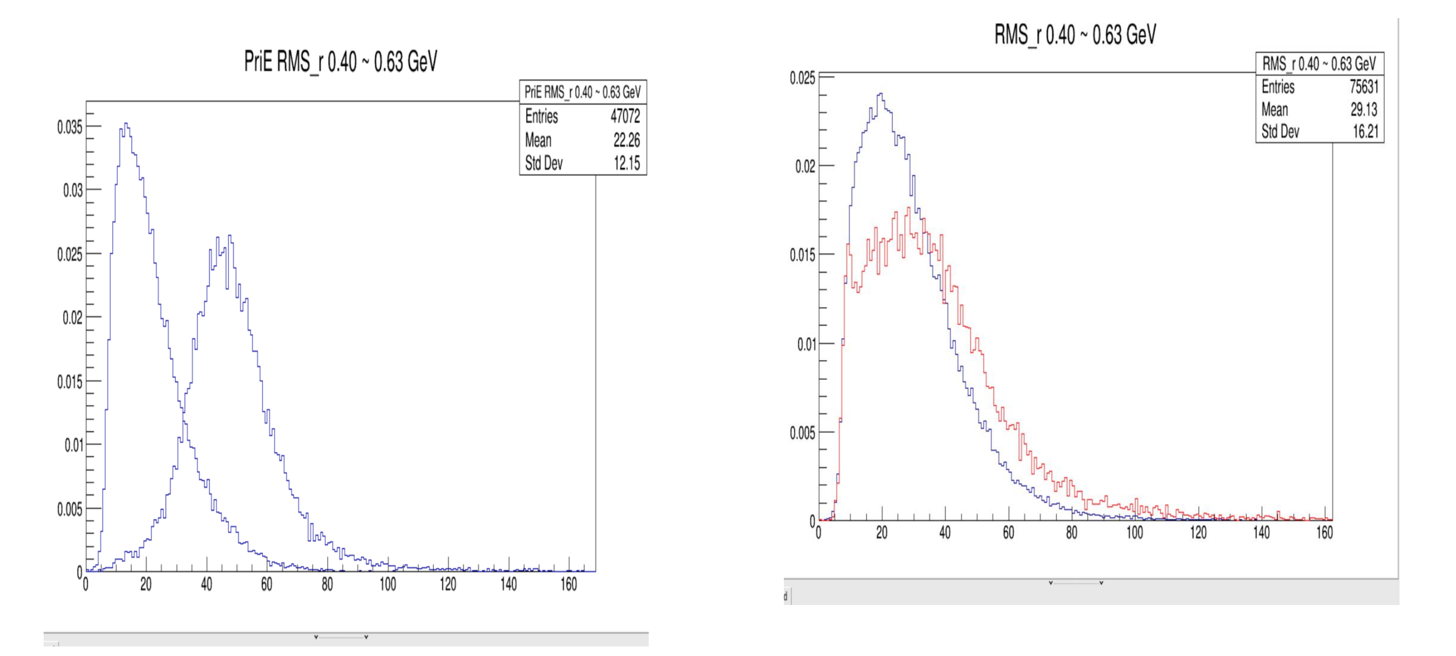
RMS-r
Primary Energy
BGO Energy
Differences that can be observed in primary energy are hardly distinguishable in terms of deposited energy. The signals from annihilation cannot be distinguished from those generated by hadronic showers or ionization (due to the relatively large granularity of the BGO crystals)

Slide 9
Annihilation feature of anti-proton
TMVA variables:
EBGO_Total
EBGO_max
STKQ
PSDQ
EC1（Blue）
EC2（Green）
nEC1
nEC2
EMax/Ebgo
EC1/Ebgo
EC2/Ebgo
EC1/EMax
EC2/EMax
EC1/EC2
Anti-proton
proton
Anti-proton
proton

Slide 10
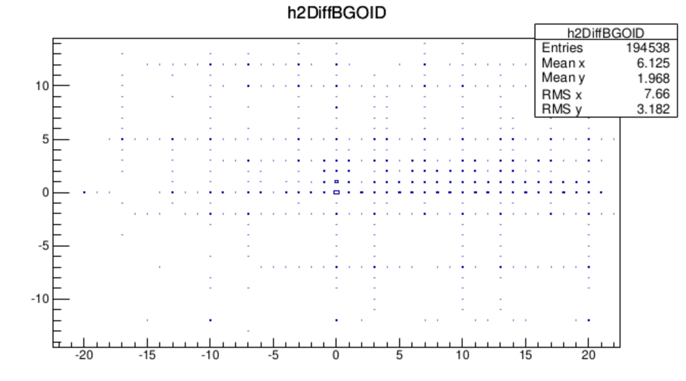
AntiProton MaxEnergy Bar and Stop position
Layer( MaxE - Stop)
Bar( MaxE - Stop )
When constraining Stop_Z within the BGO detector, a statistical analysis reveals that in many cases, there is inconsistency between the MaxE's Bar and Stop_Z's Bar. In the vast majority of cases, MaxE's Bar is located 1-3 layers below StopZ's Bar.

Slide 11
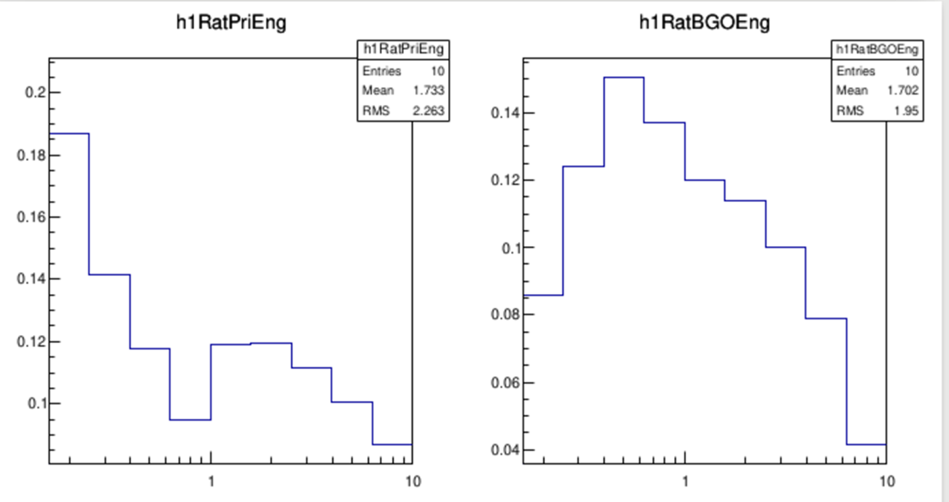
The Probability MaxE Bar equal to Stop Bar
Ratio ( MaxE bar = Stop Bar)
Primary Energy[GeV]
BGO Energy[GeV]
The probability that the StopZ Bar and MaxE Bar at
different energies correspond to the same BGO Bar is very low.

Slide 12
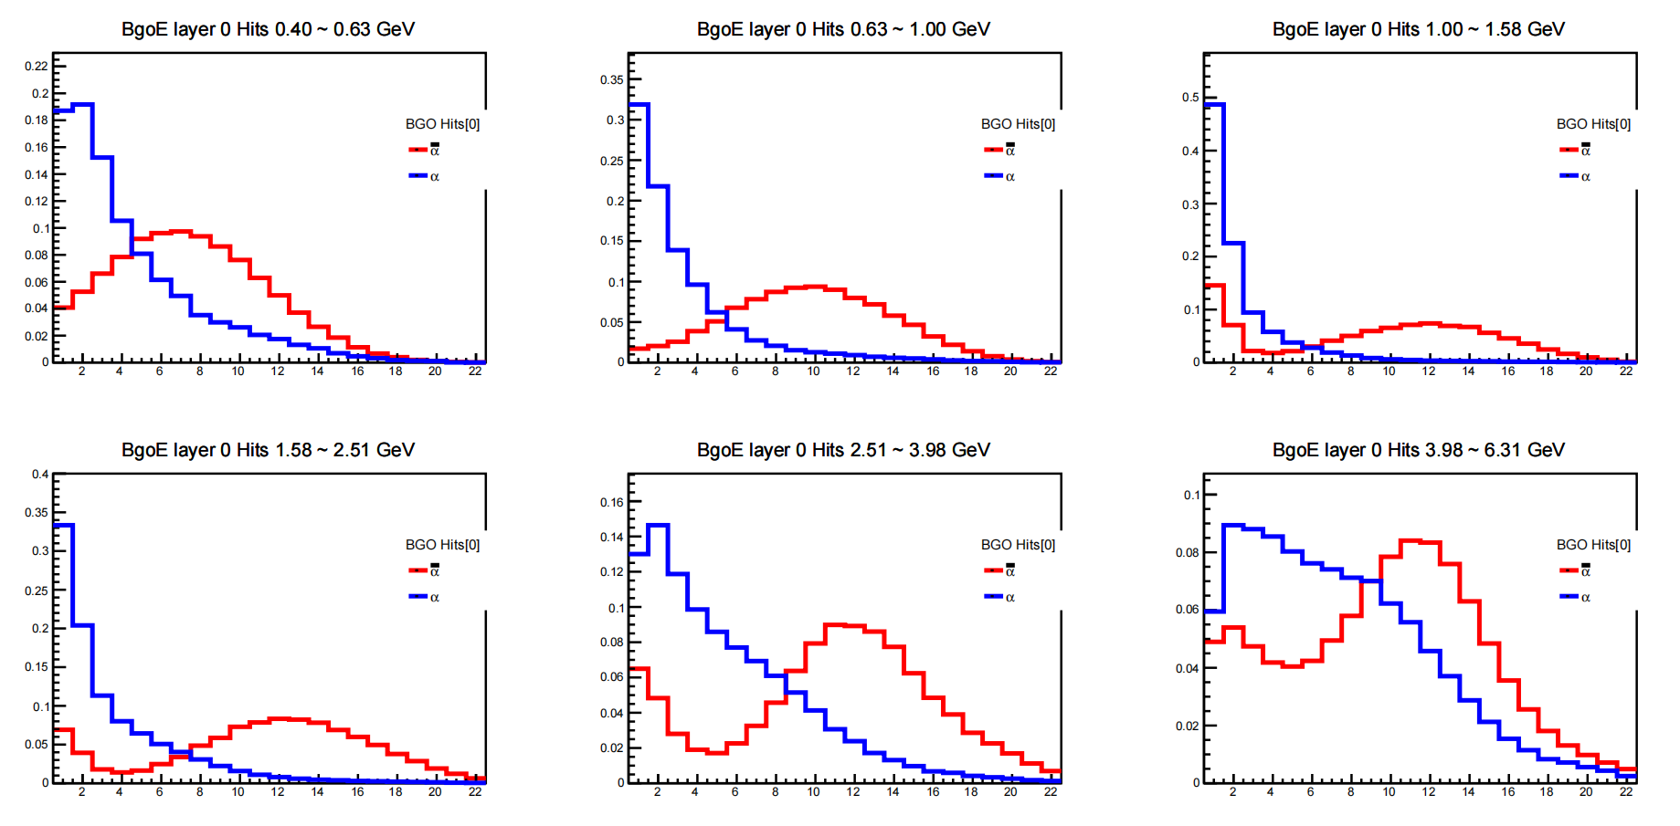
The distinguish between Anti-Helium and Helium
BGO His number in the first layer

Slide 13
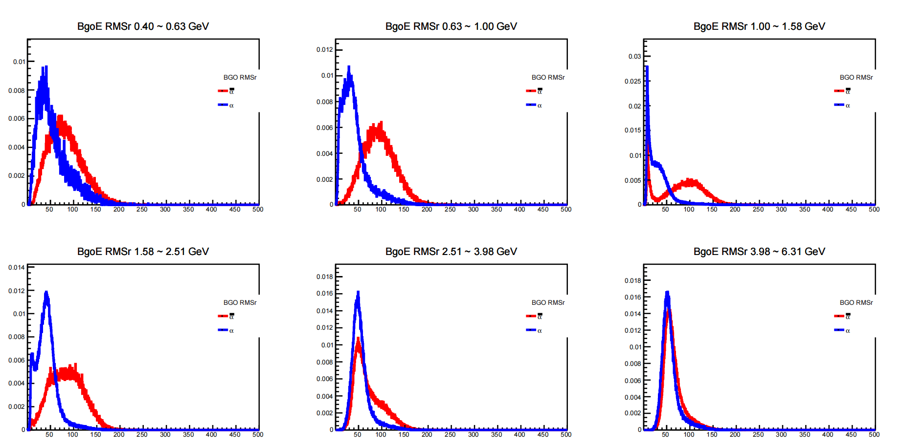
RMS-r between Anti-Helium and Helium
BGO RMS-r

Slide 14
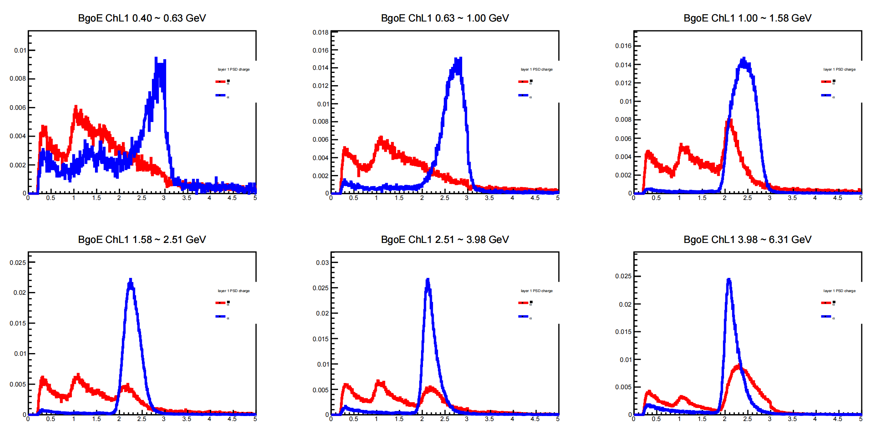
PSDQ1 between Anti-Helium and Helium

Slide 15
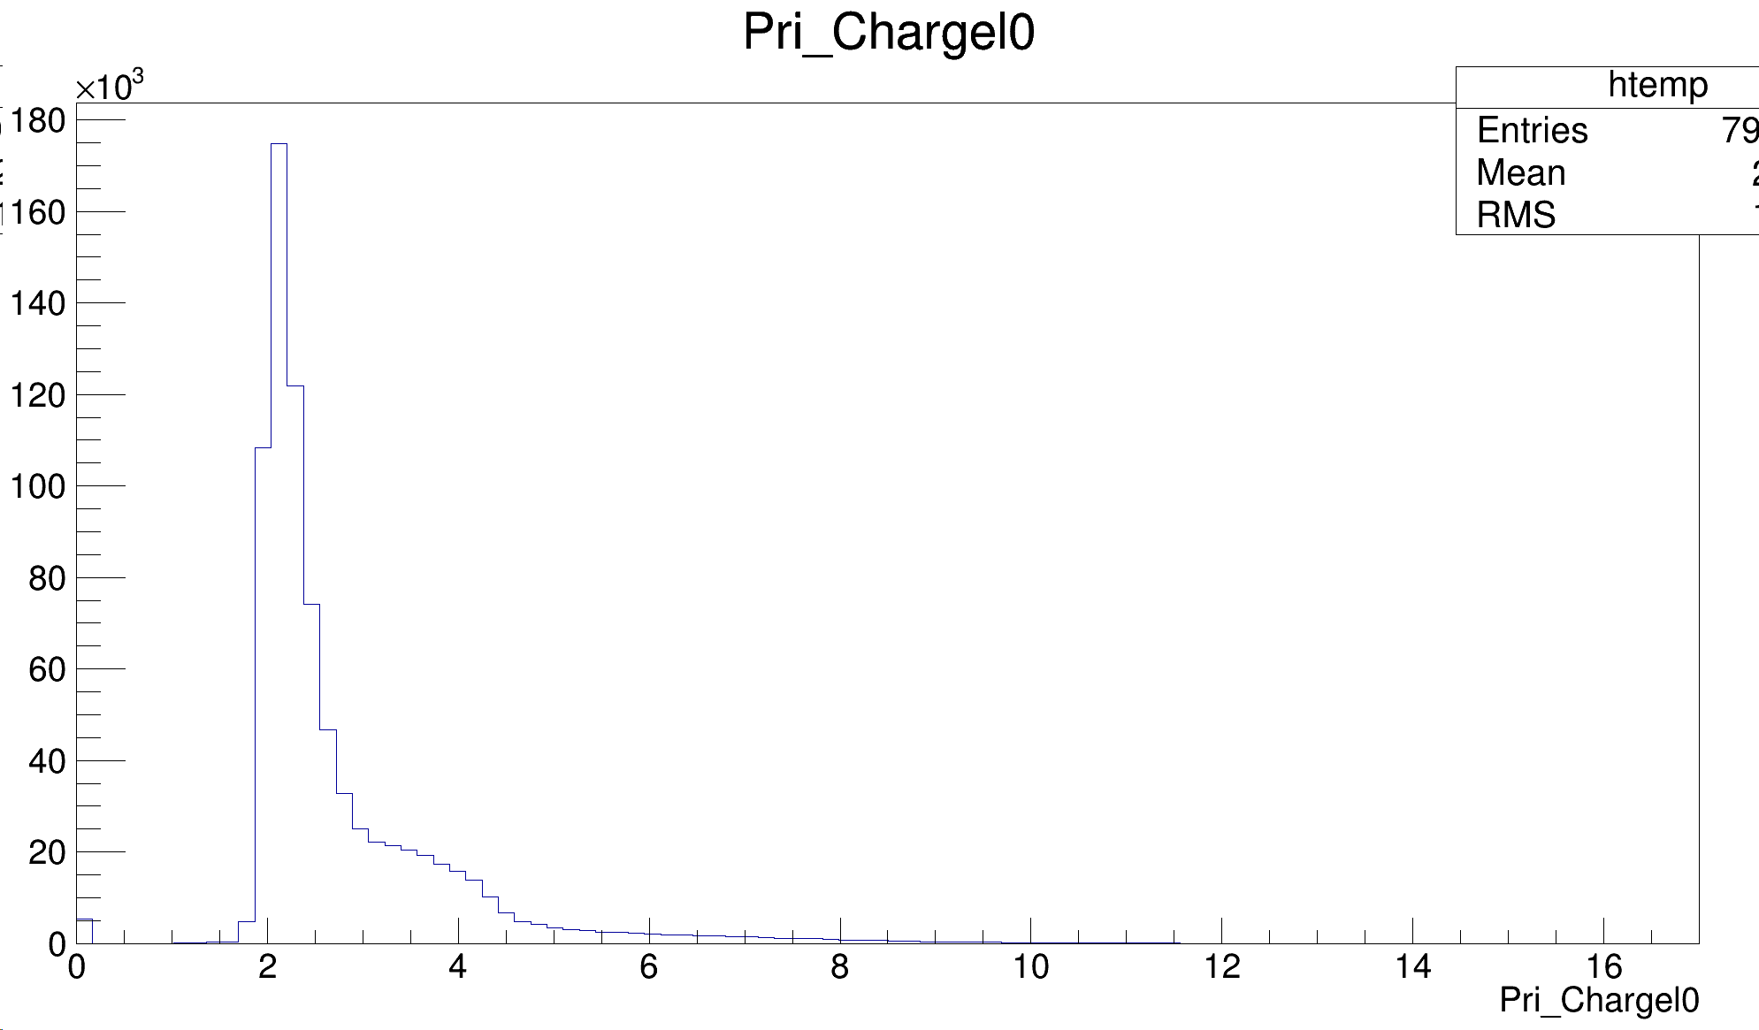
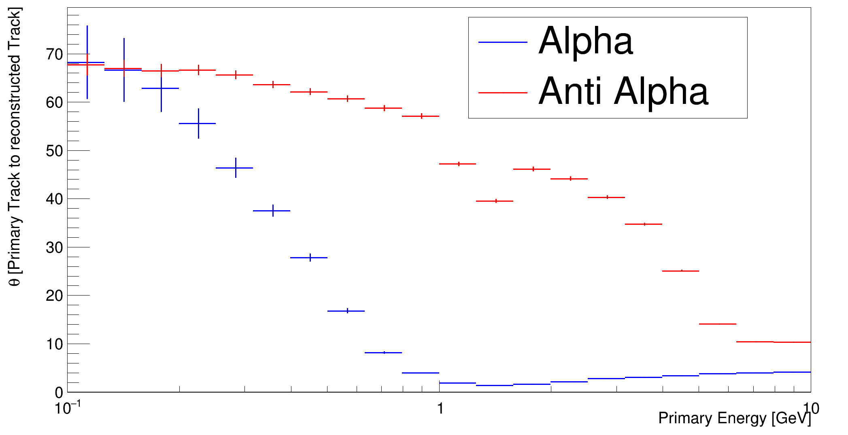
PSDQ1 ( Primary Track for Anti-Helium)
At low energies, particles undergo significant Coulomb scattering within the detector. For positively charged particles, the repulsive Coulomb force decreases, resulting in a smaller overall deflection angle. In the case of negatively charged particles passing near nuclei, the attractive force increases, leading to a larger overall scattering angle.

Slide 16
Summary
In terms of deposited energy, antiprotons and protons exhibit very similar responses inside the detector, but there is still a good discrimination between anti-helium nuclei and helium nuclei.
At low energies, the Coulomb scattering of antimatter is relatively strong, leading to imprecise track reconstruction, and, as a result, the charge determination of antimatter reconstructed tracks is relatively less accurate.
We need to conduct further research on the differential responses of regular particles and antimatter within the detector and propose improved particle identification methods.

