Slide 1
Track Analysis of Anti-Matter
徐志会(Zhi-Hui Xu)
xuzh@impcas.ac.cn
Institute of Modern Physics(IMP), CAS
2023-11-23

Slide 2
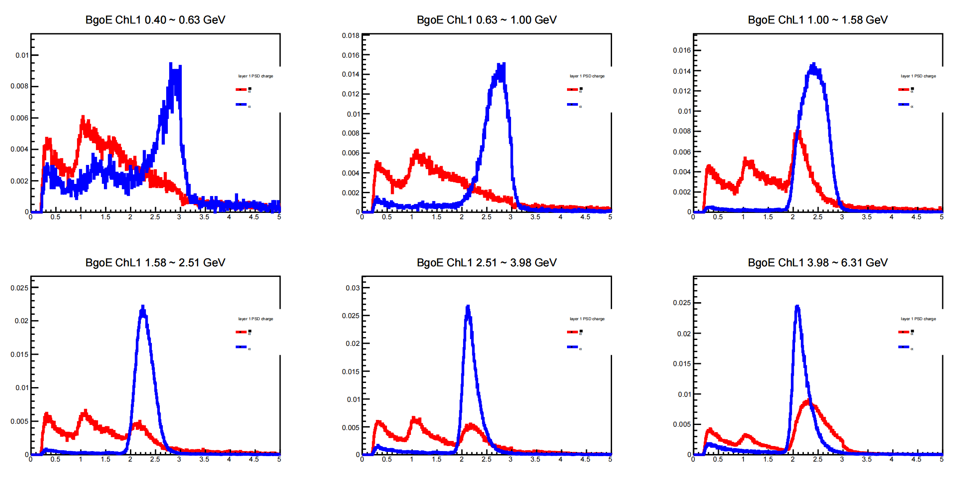
PSDQ1 between Anti-Helium and Helium

Slide 3
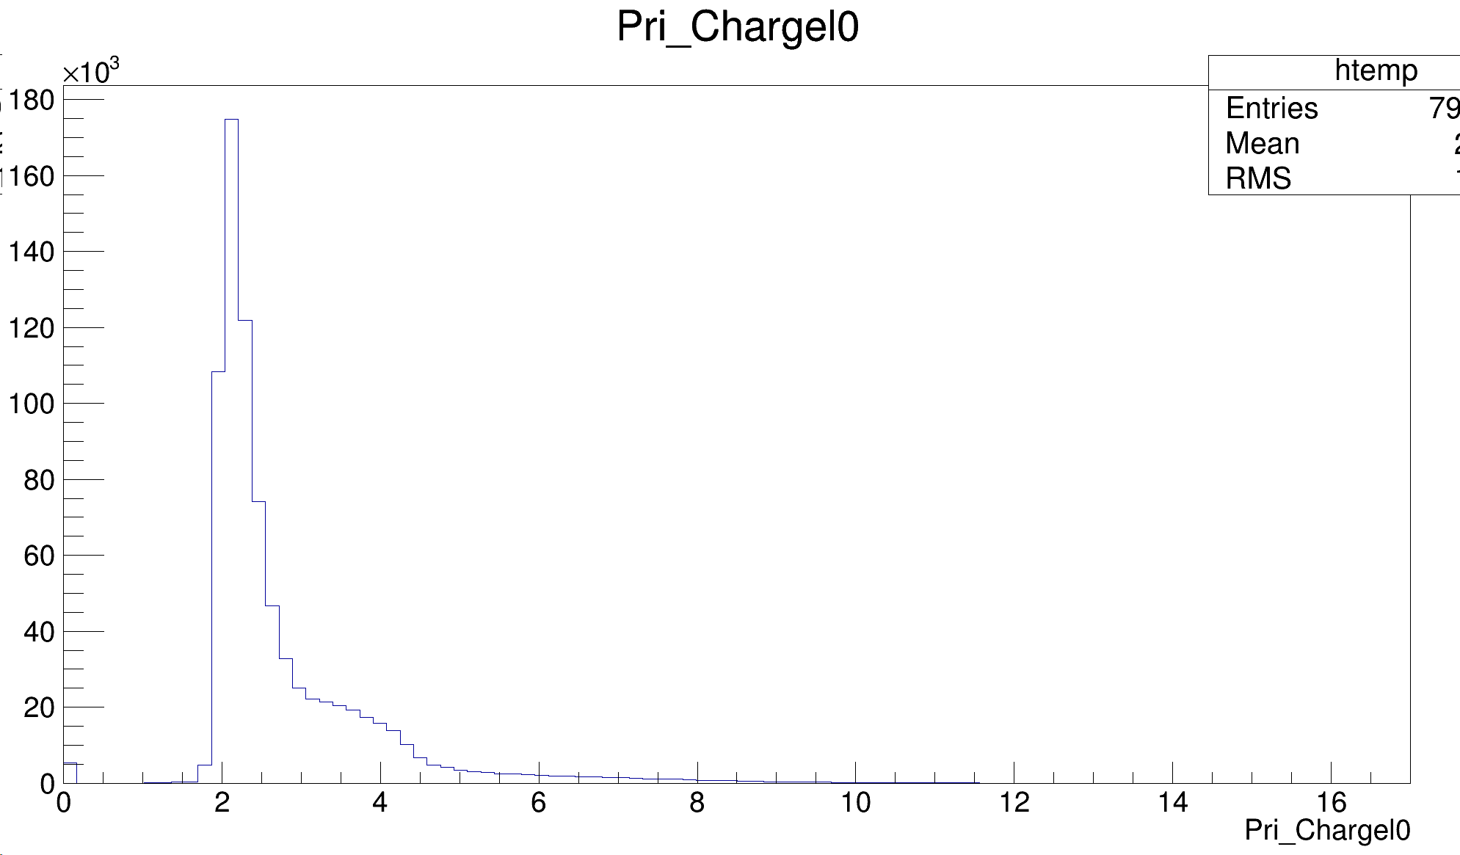
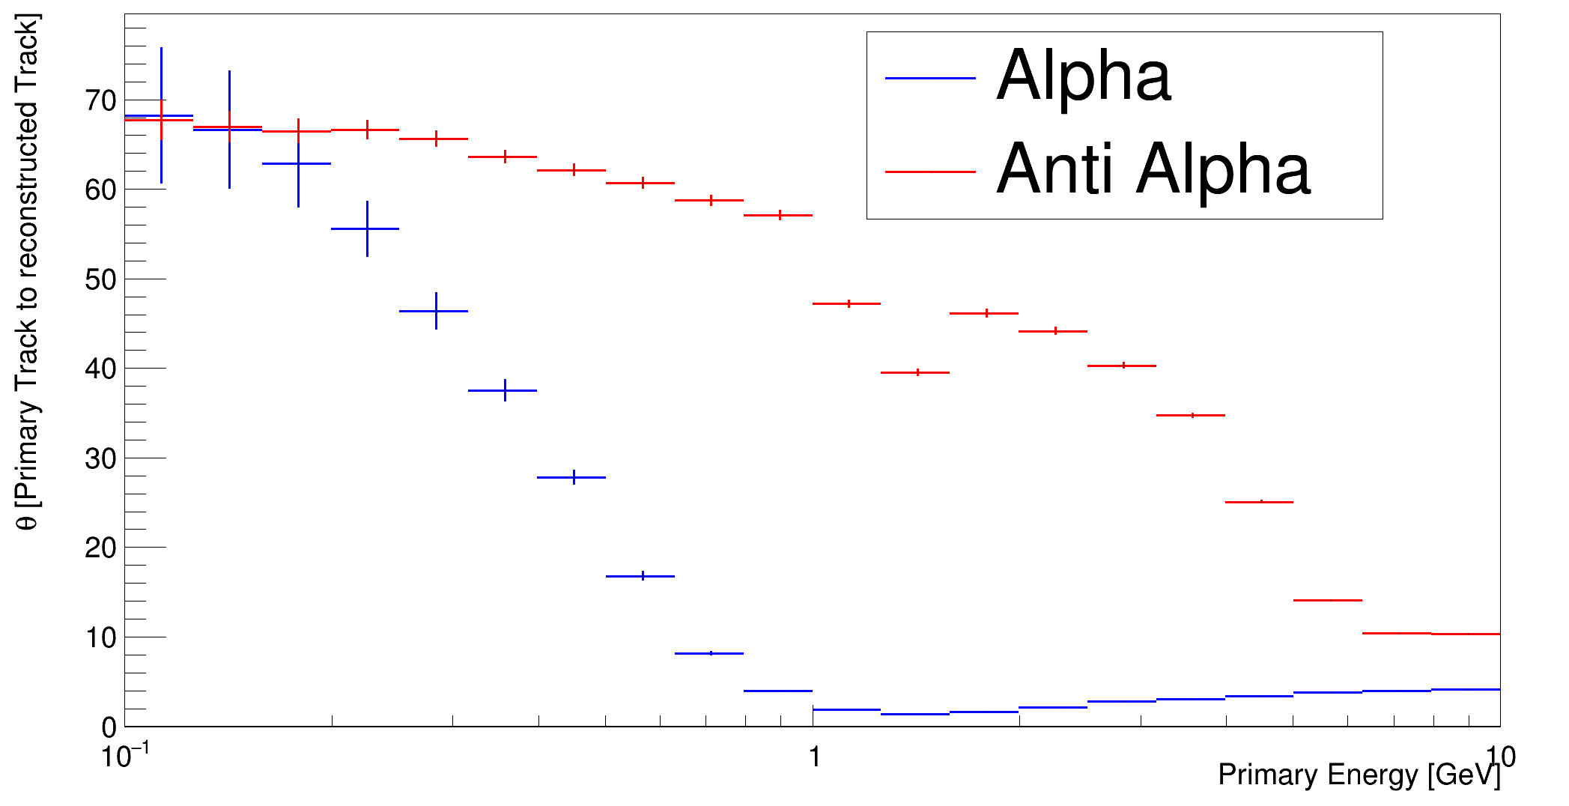
PSDQ1 ( Primary Track for Anti-Helium)
At low energies, particles undergo significant Coulomb scattering within the detector. For positively charged particles, the repulsive Coulomb force decreases, resulting in a smaller overall deflection angle. In the case of negatively charged particles passing near nuclei, the attractive force increases, leading to a larger overall scattering angle.

Slide 4
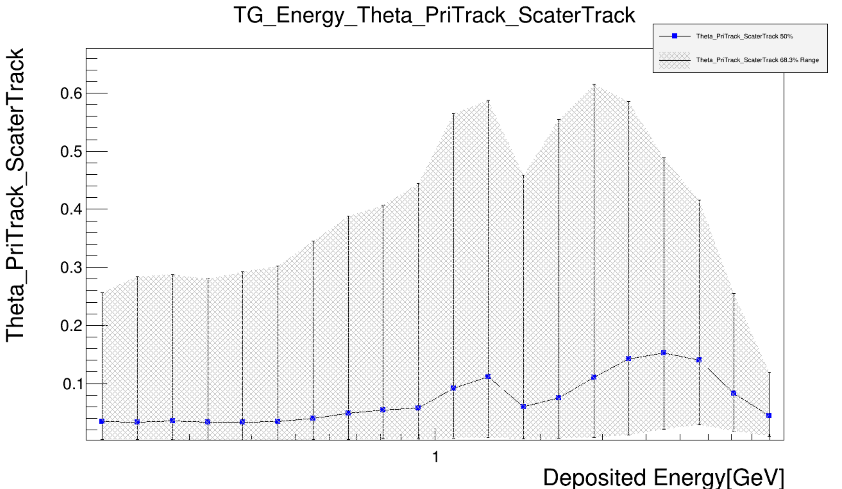
Primary track to Scatter Track

Slide 5
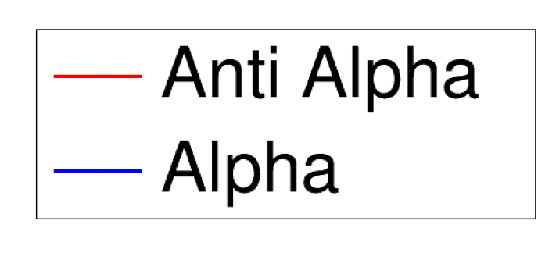
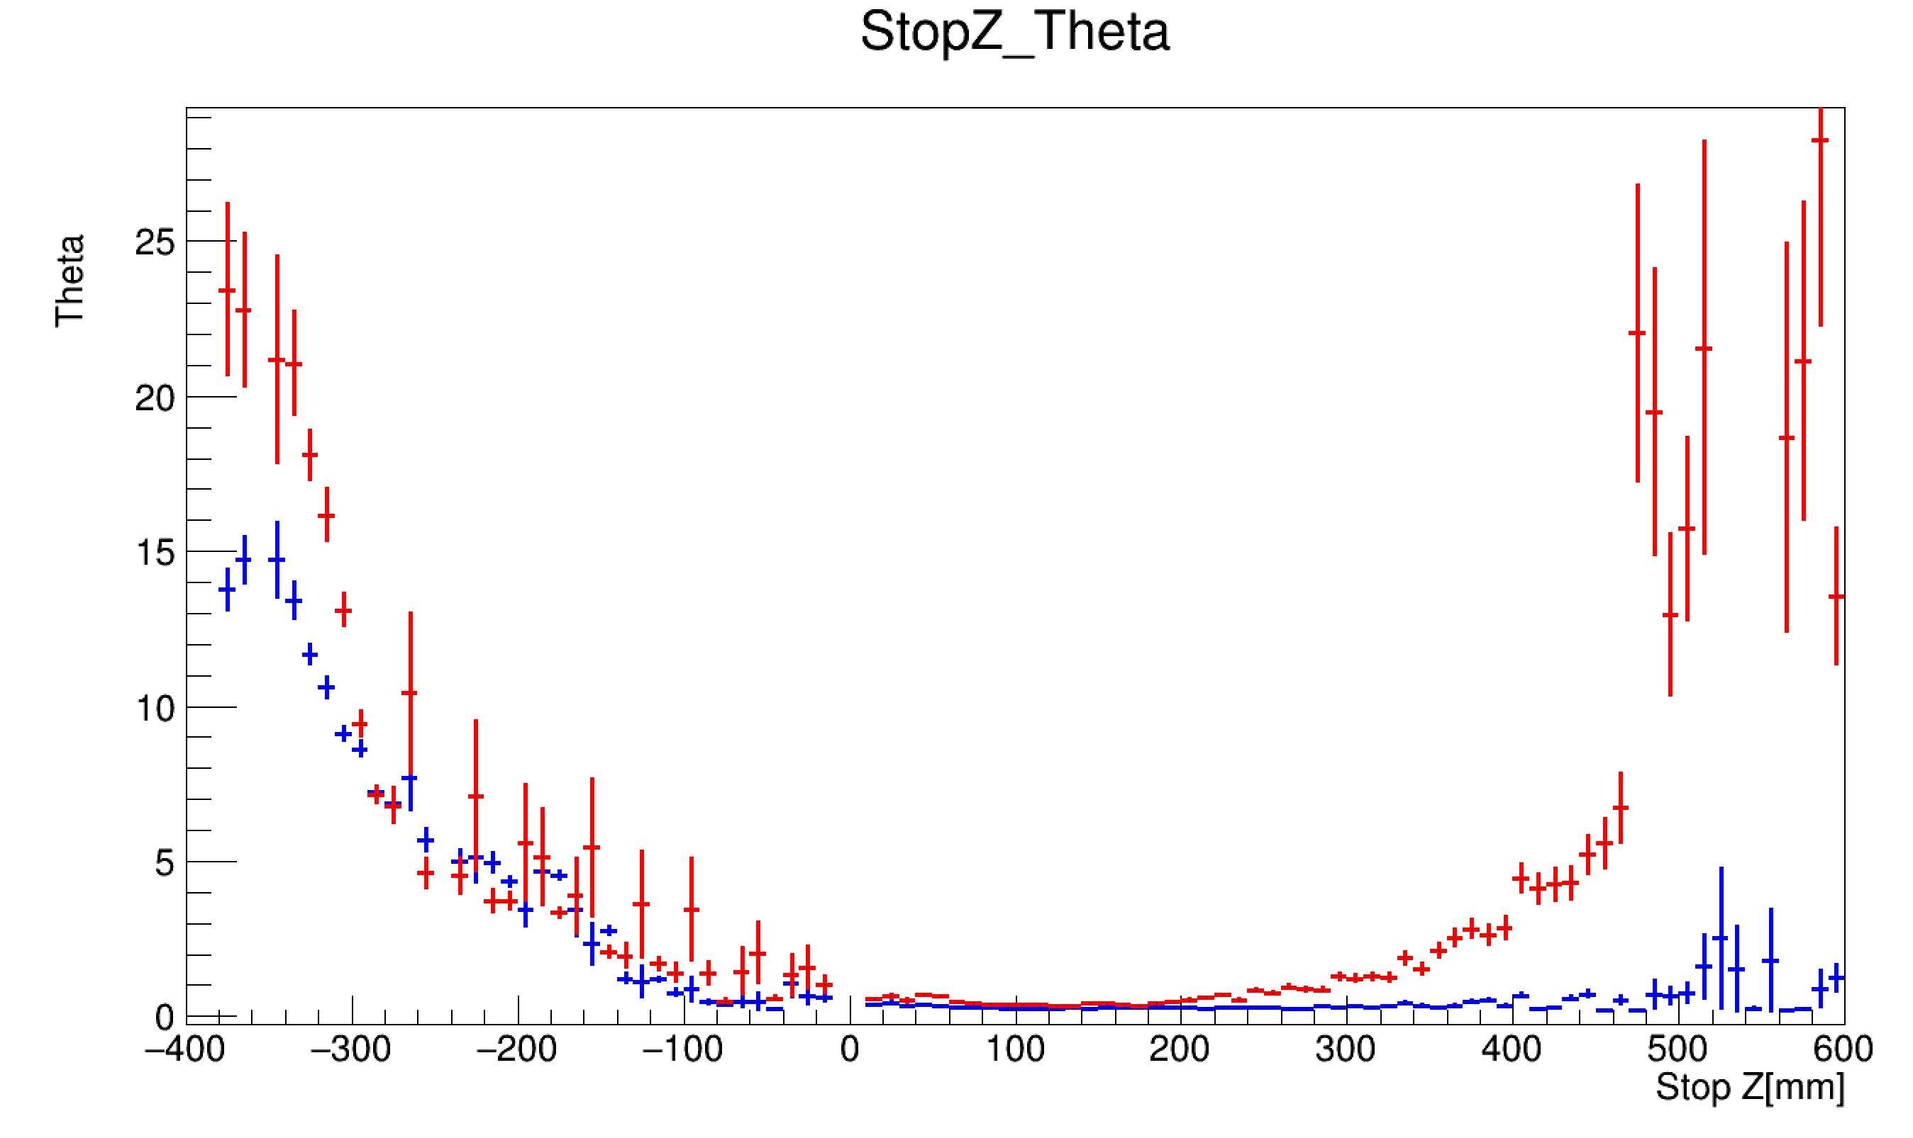
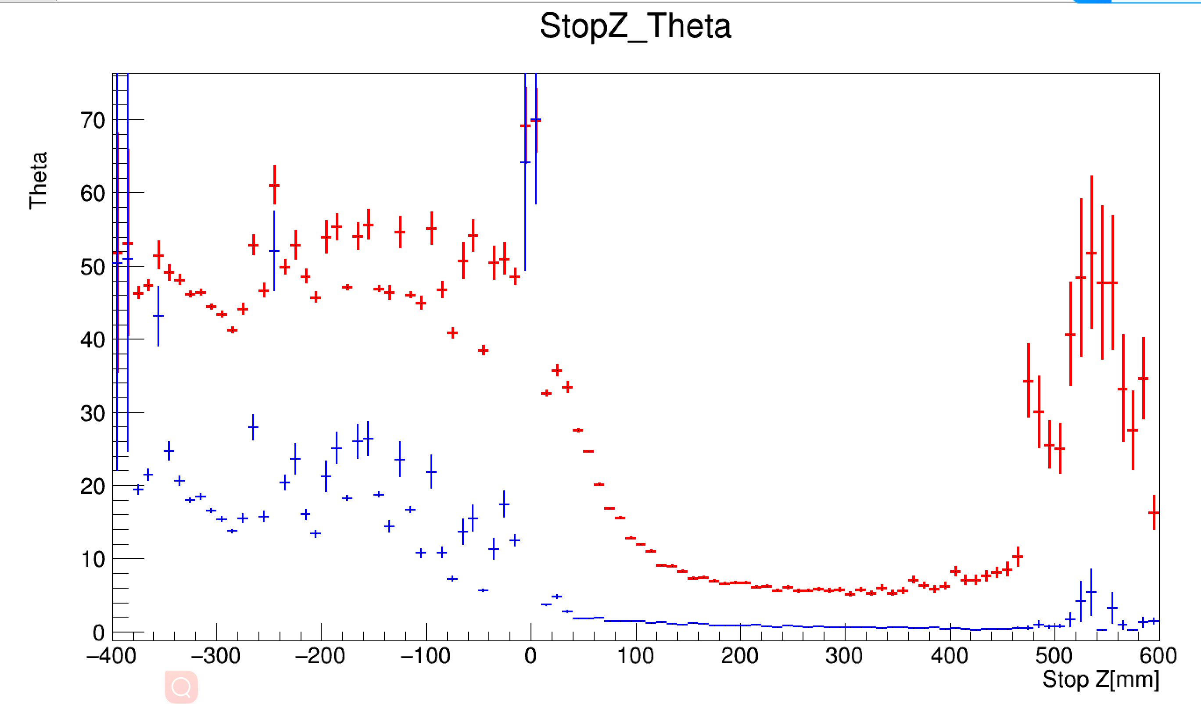
Angle (Reconstructed to Primary ) VS Stop-Z

Slide 6
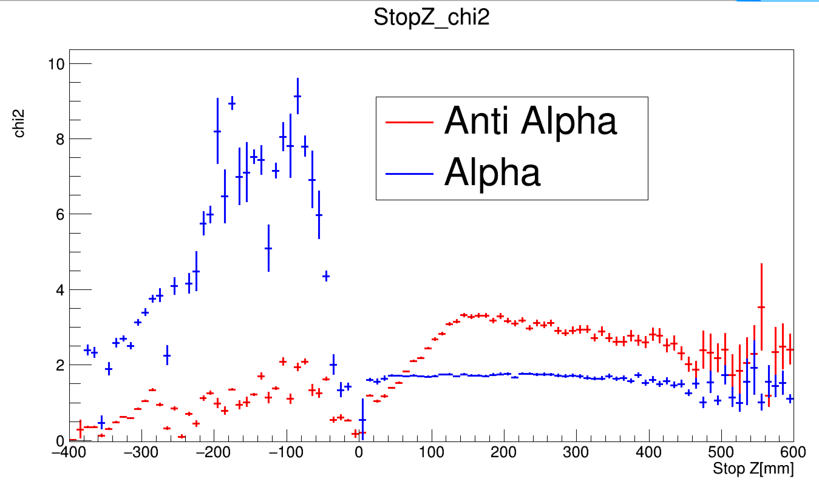
Chi2 VS Stop-Z

Slide 7
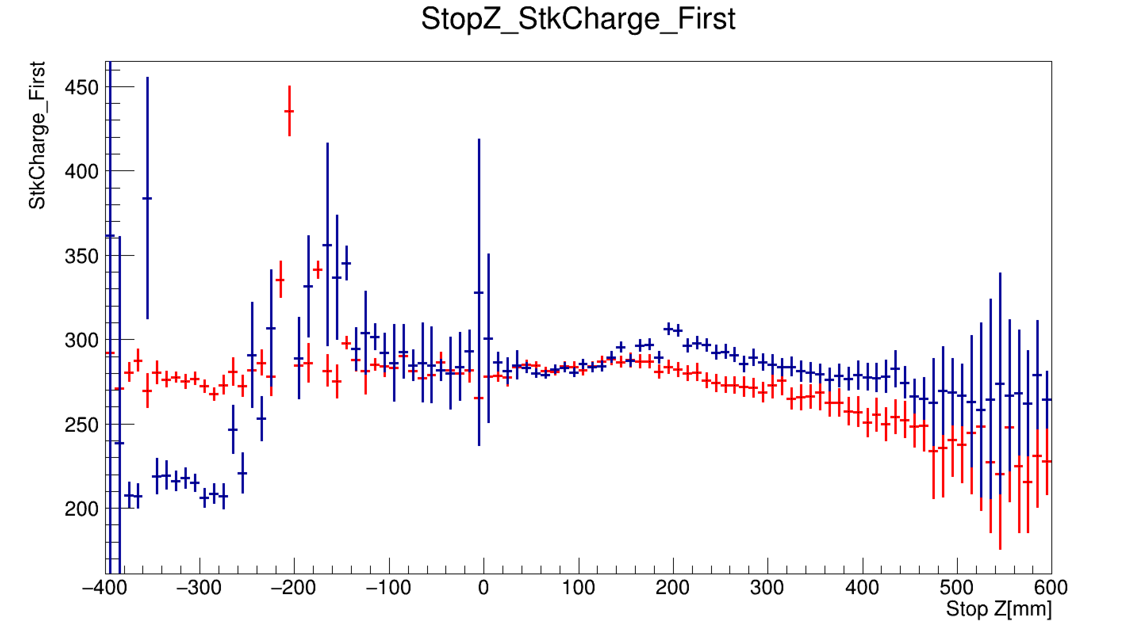
STK charge1 VS Stop-Z

Slide 8
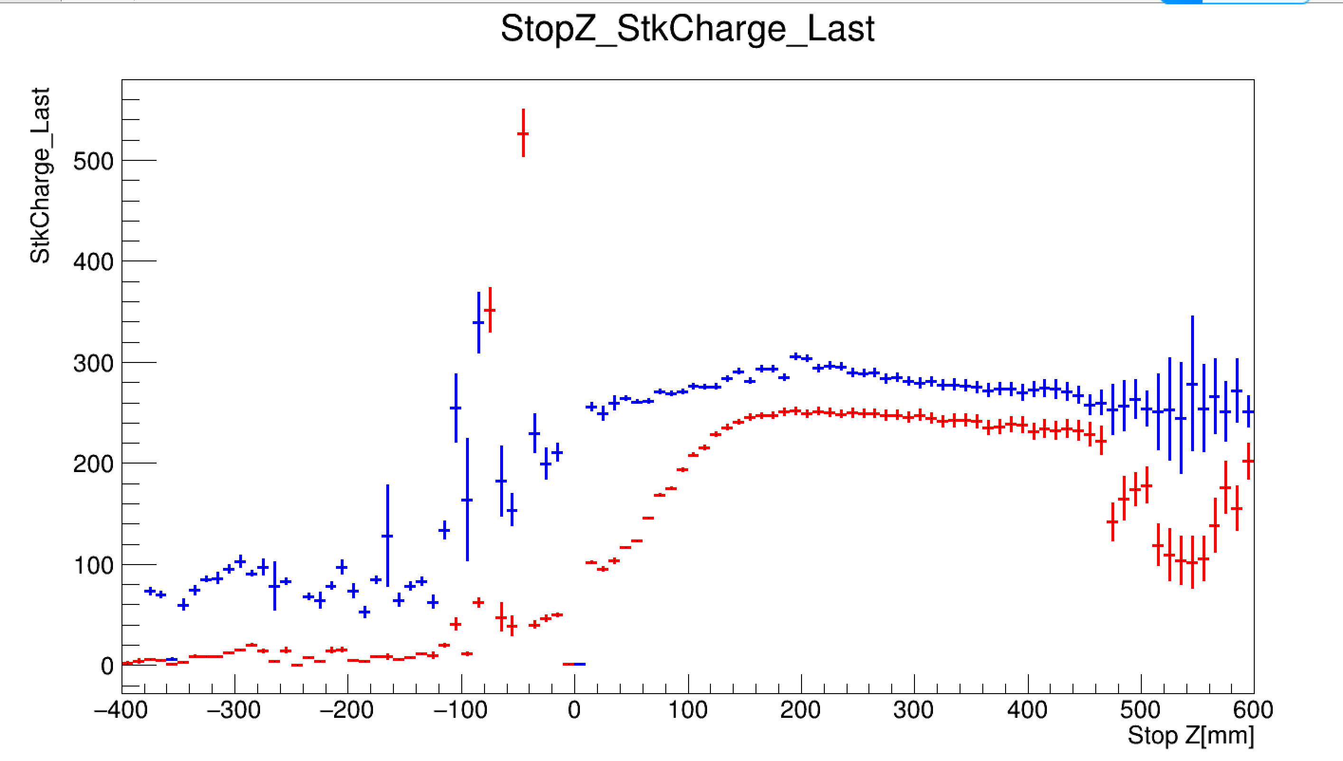
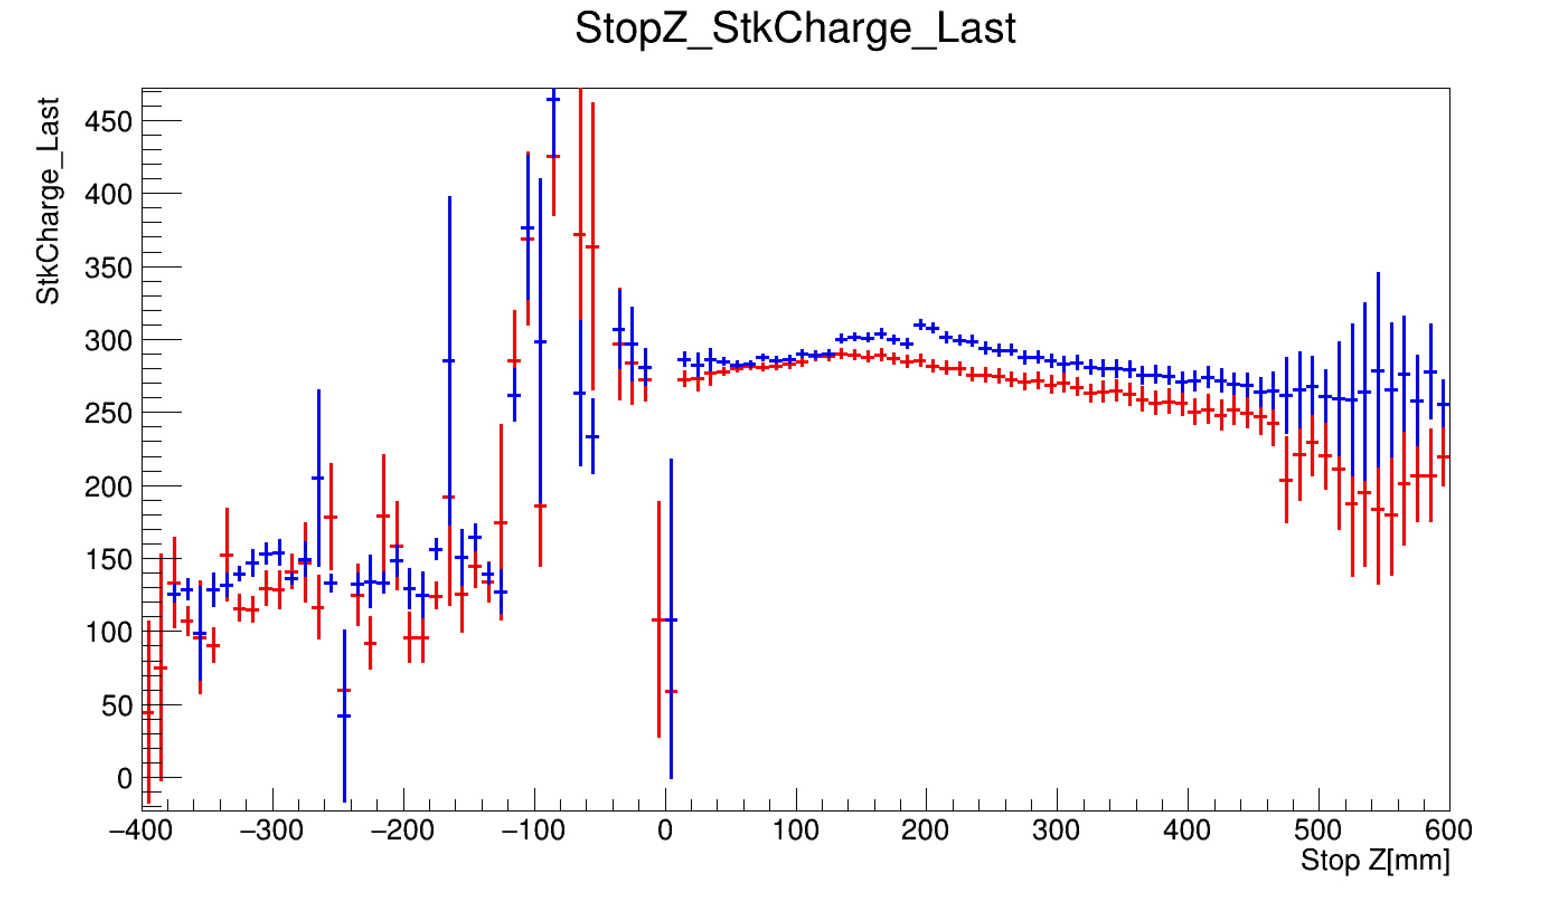
STK charge[-1] VS Stop-Z

Slide 9
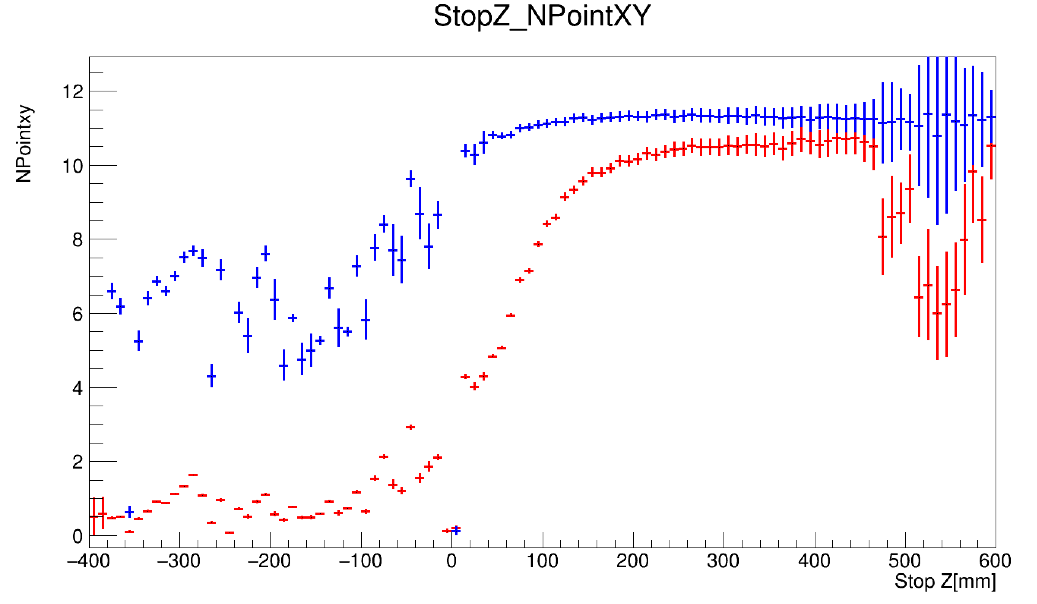
NPoint VS Stop-Z

Slide 10
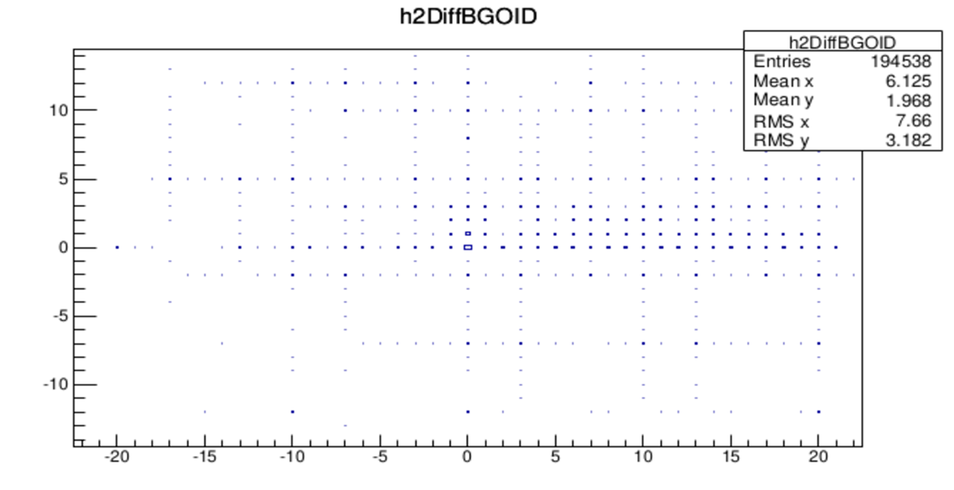
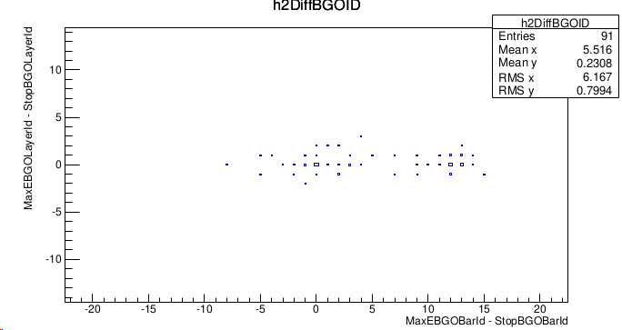

Slide 11
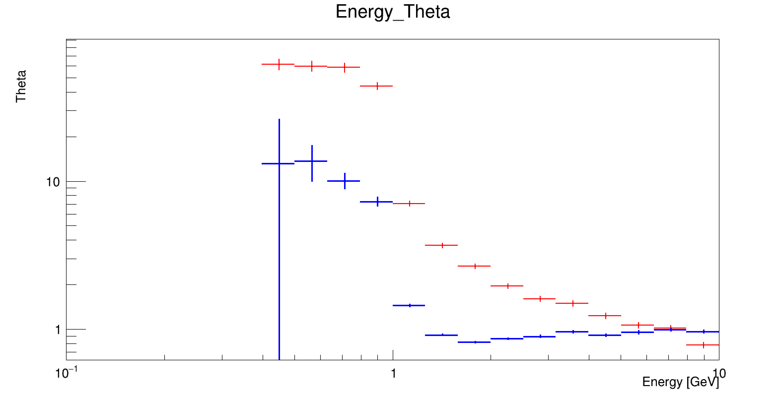
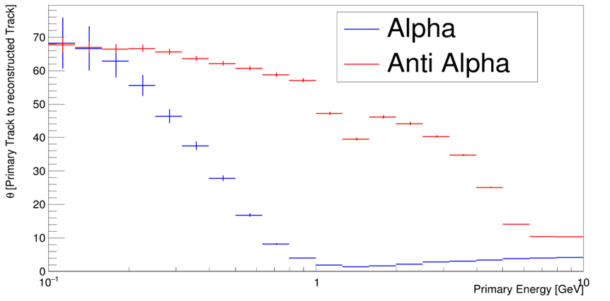
碎裂位置对于分析反氦核至关重要。

Slide 12
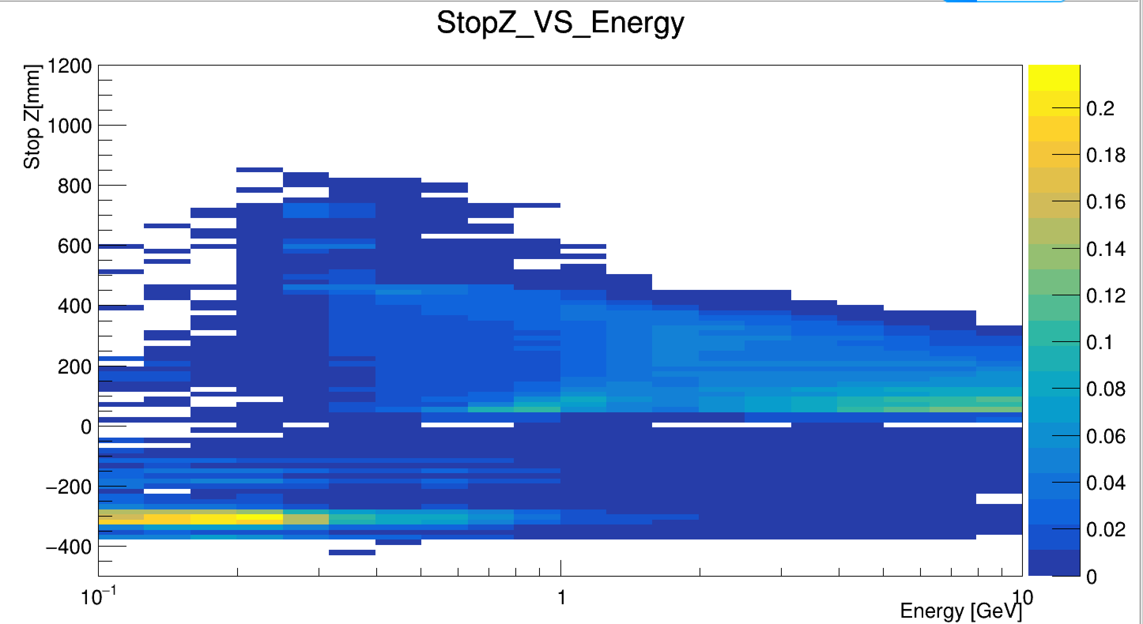
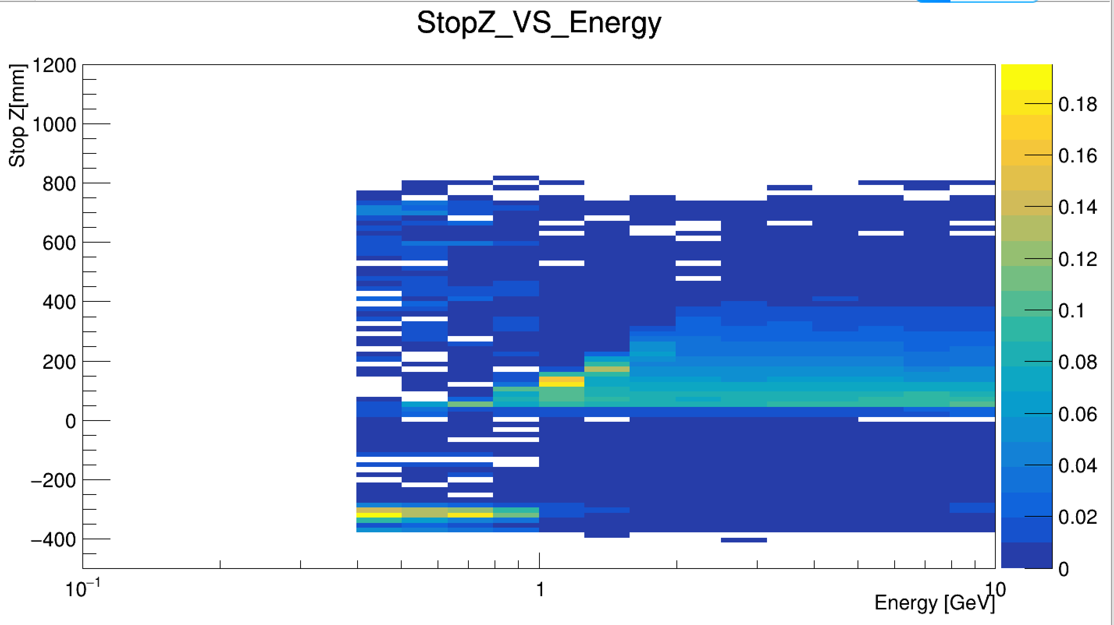
Summary
碎裂位置对于分析反氦核至关重要。

Slide 13
Summary
碎裂位置对于分析反氦核至关重要。

