Slide 1
反物质研究 选择条件更新
徐志会(Zhi-Hui Xu)
xuzh@impcas.ac.cn
Institute of Modern Physics(IMP), CAS
2023-09-17

Slide 2
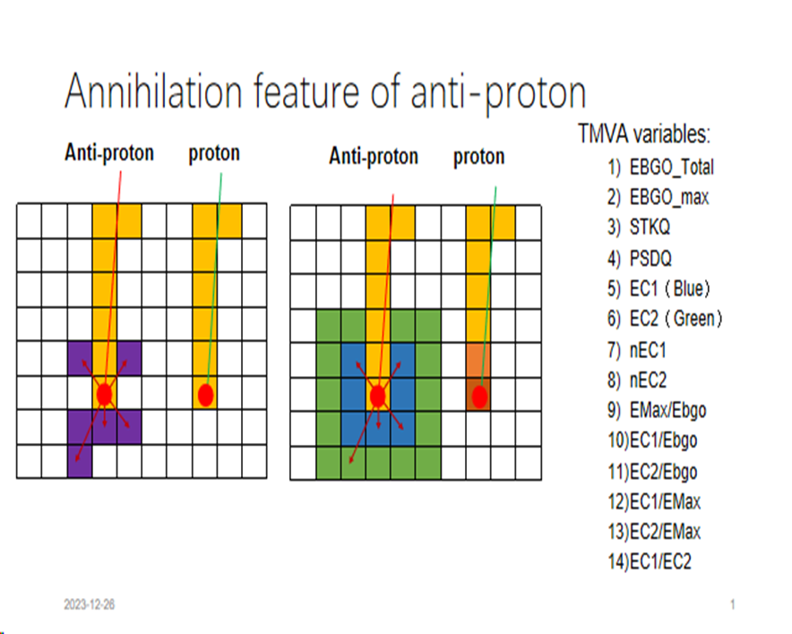
Acceptance

Slide 3
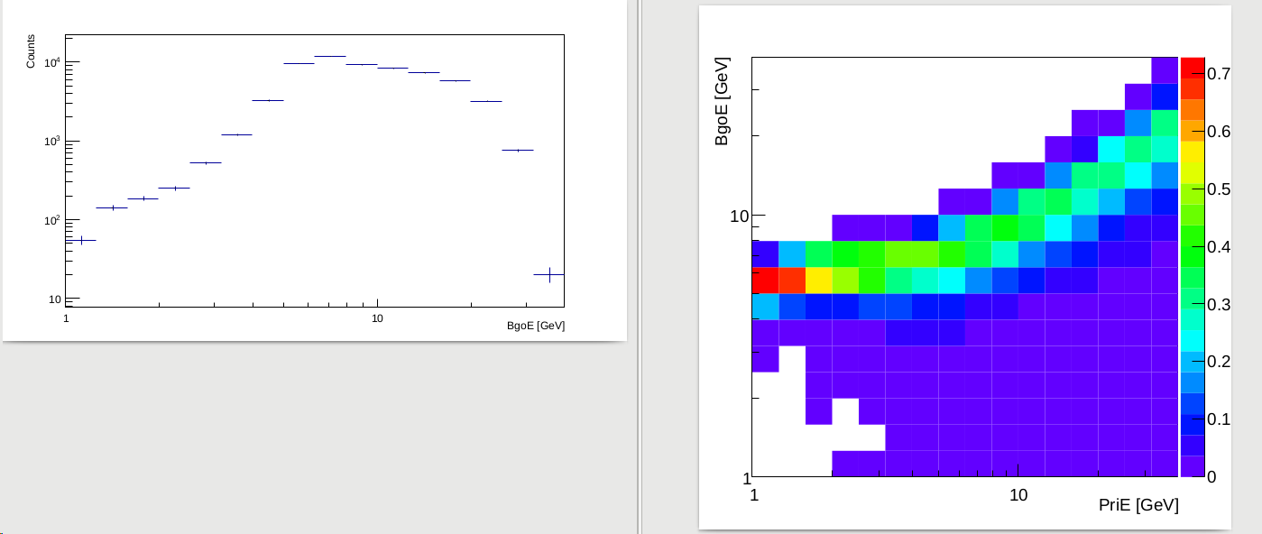
Title

Slide 4
Title

Slide 5
Title

Slide 6
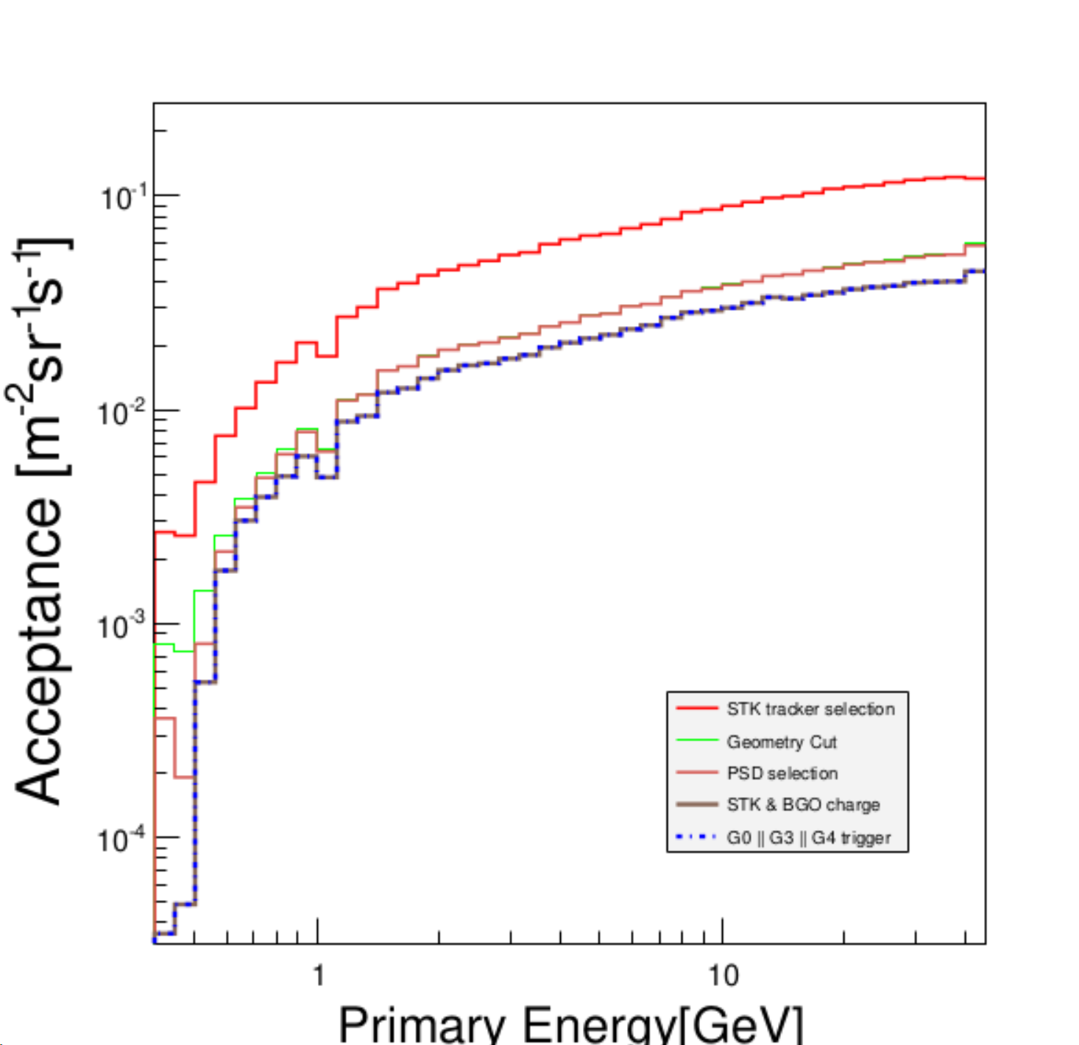
Acceptance

Slide 7
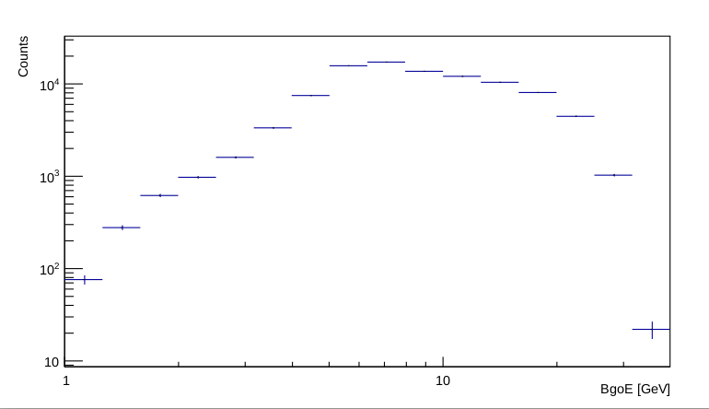
Title

Slide 8
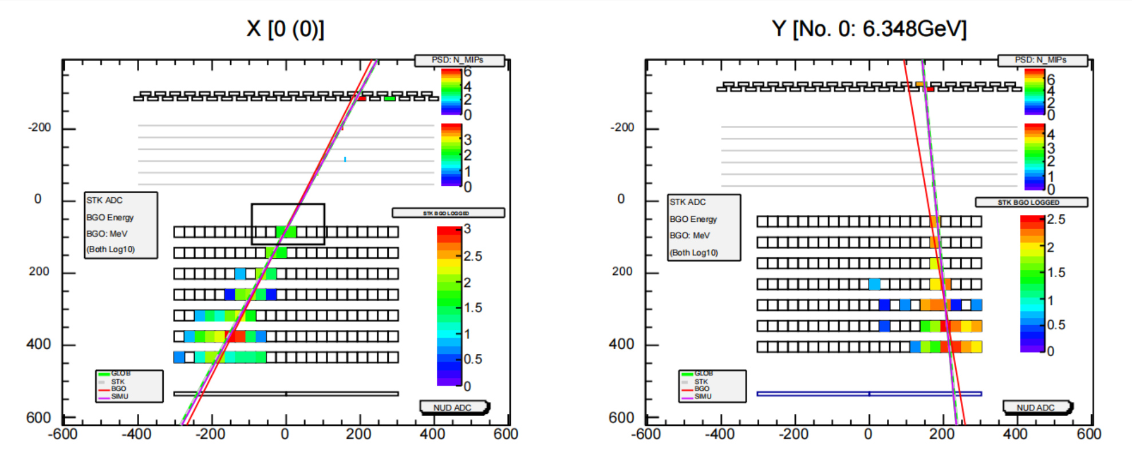
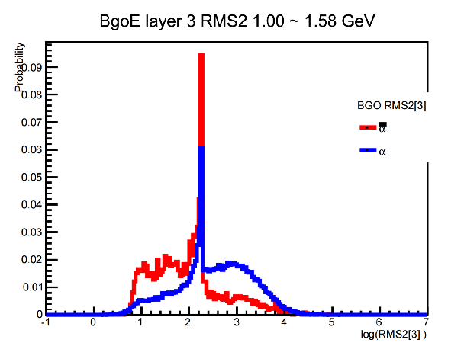
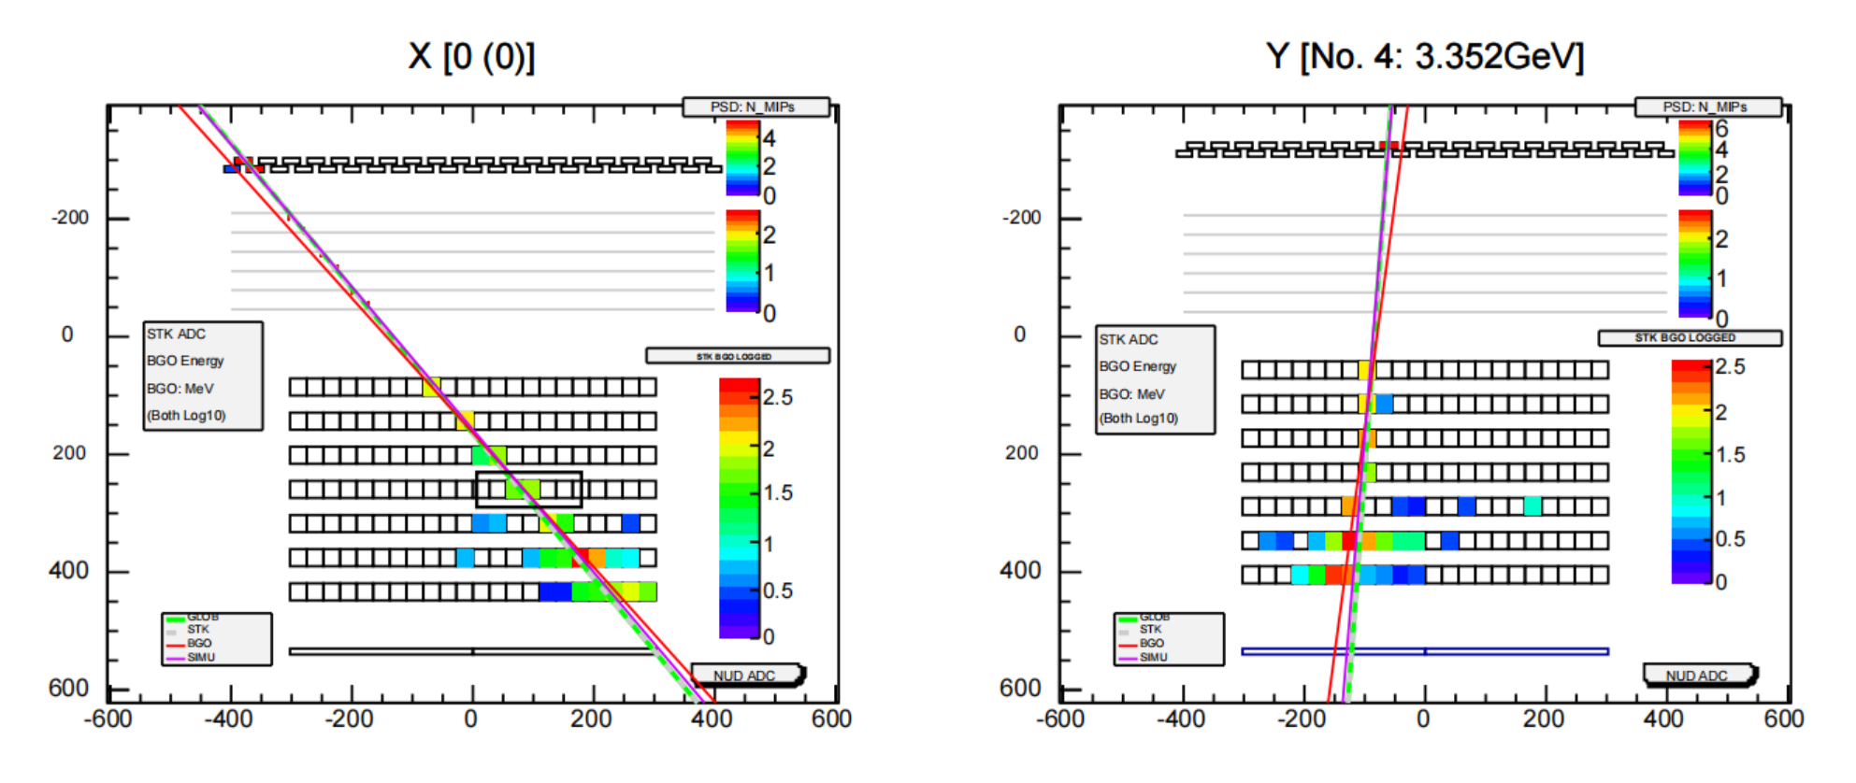
RMS2

