Slide 1
Positron Spectrum
Yu Nie 2024.10.10

Slide 2
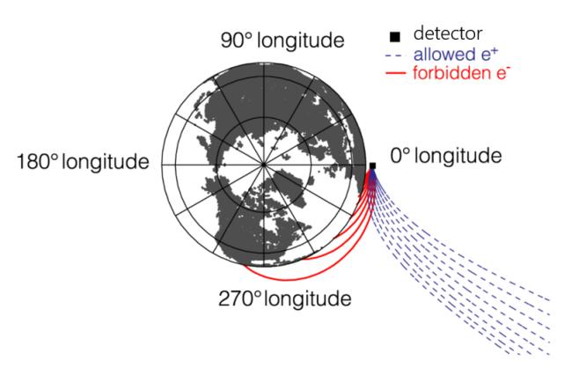
East West effect
There are more negative cosmic ray particles coming from the east than from the west
$$e^{−}$$
$$e^{+}$$

Slide 3
Selection Criteria
High energy trigger
STK track :
hit points >= 3
the track should pass through the first 4 layers of BGO
distance between track and BGO energy center < 25 mm at first 4 layers of BGO
chi2 < 15
Max TQ value : $TQ=\frac{{1+E}_{r}}{ln⁡(D_{sum})}×(1+\frac{N_{tr}−3}{12})$
BGO :
10 GeV < Energy < 30 GeV
Max Energy bar ID != 0 and 21 at first 5 layers of BGO
Number of BGO bar with signal：bin 1, N <= 37; bin 2, N <= 44; bin 3, N <= 46; else, N <= 51
PSD :
0 < Q < 1.8
Track pass through the bar with max deposited energy at both layers
East-West effect cut :
Positron : polar and azimuth of track in positron-only region
Electron : electron-only region
1.0 < L value < 1.14

Slide 4
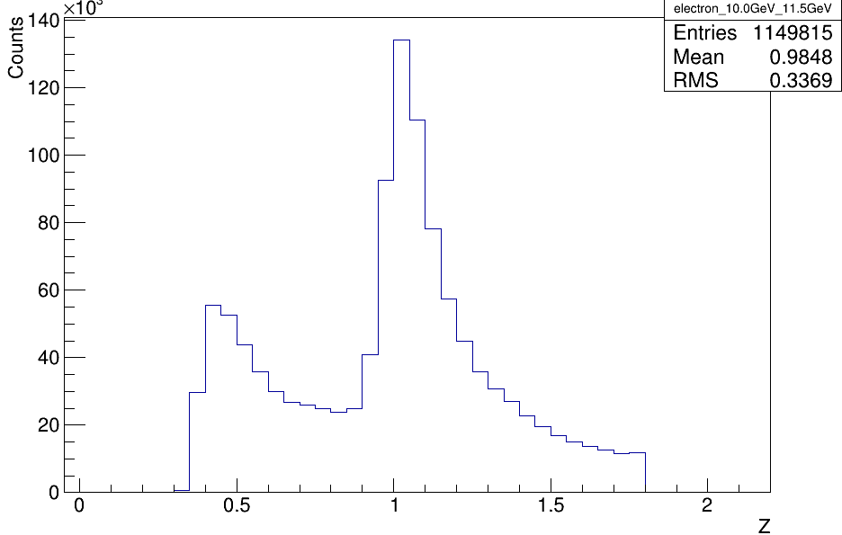
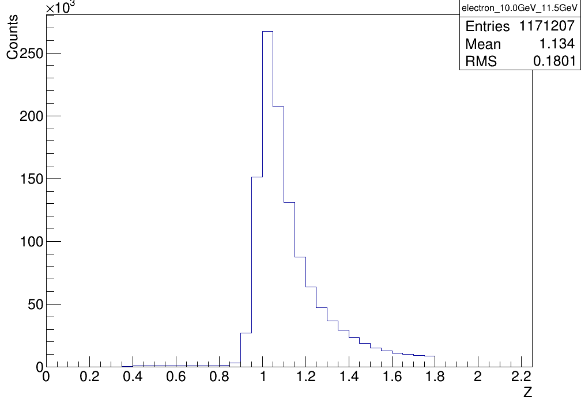
Validity Check: Track
Charge distribution
Global track

Slide 5
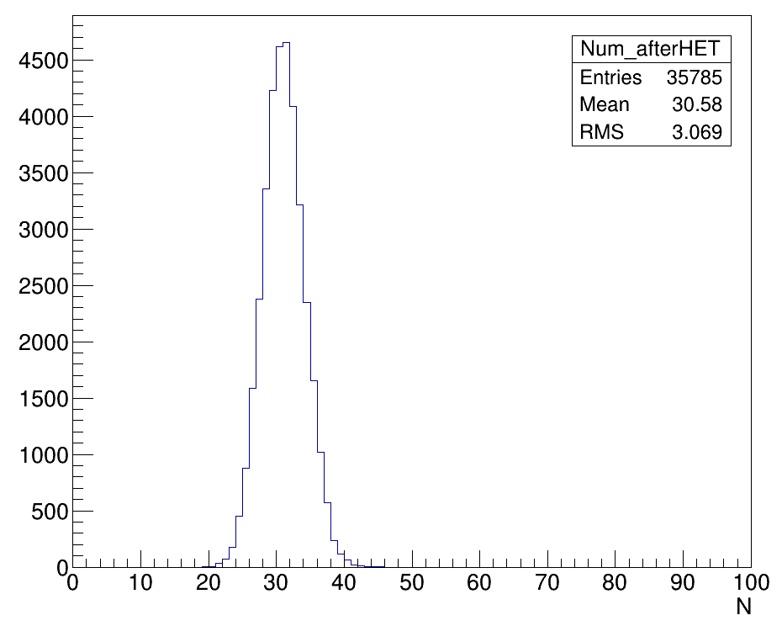
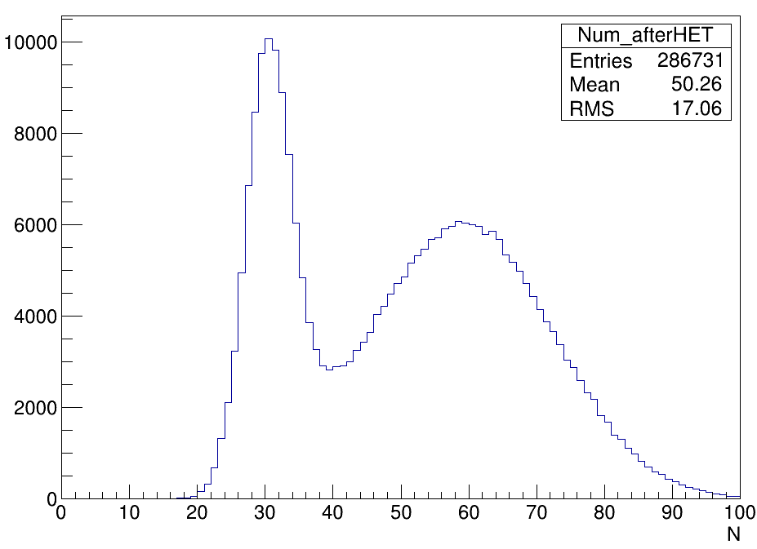
Validity Check: N
Threshold: 20 MeV

Slide 6
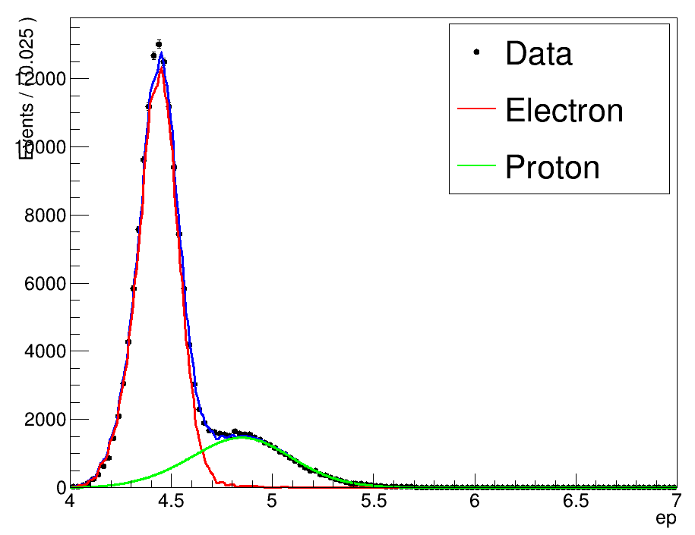
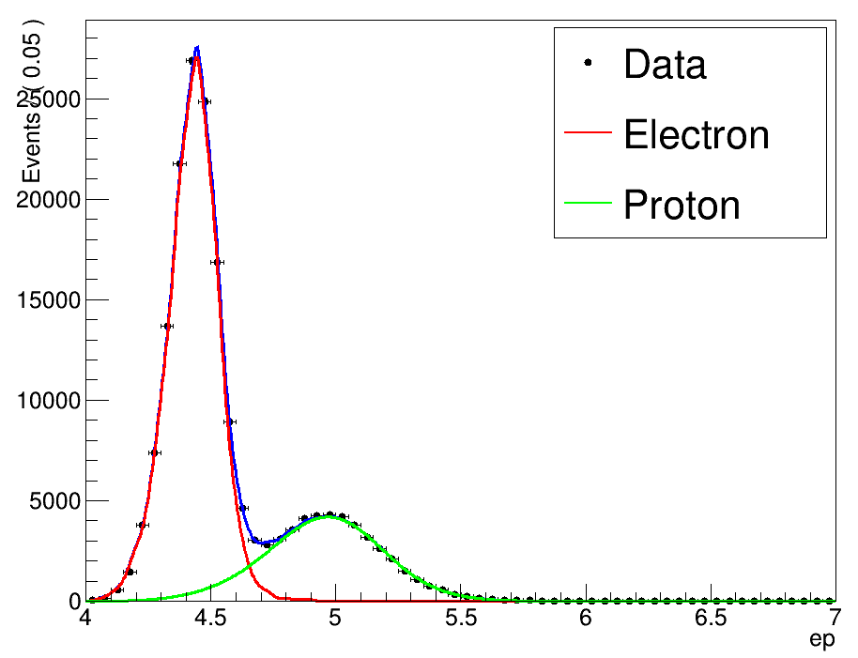
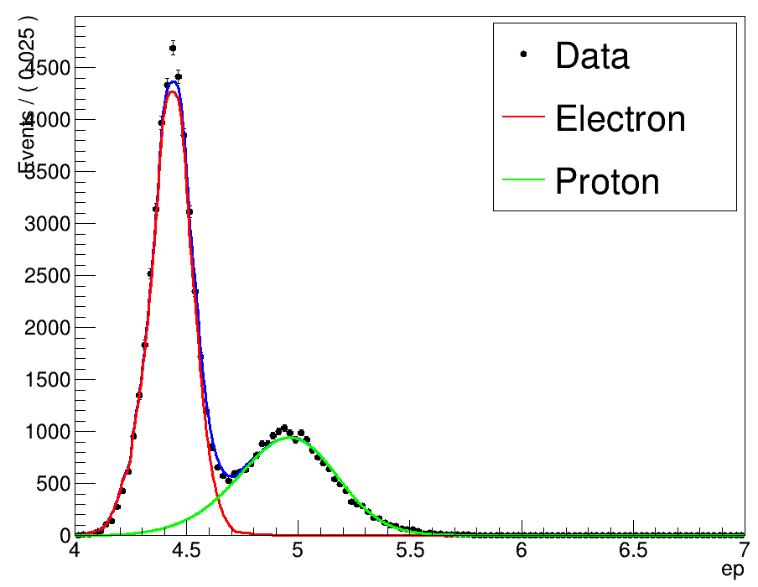
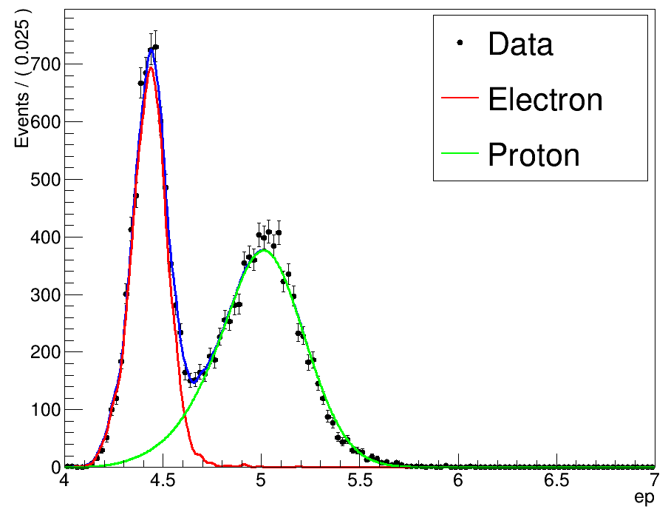
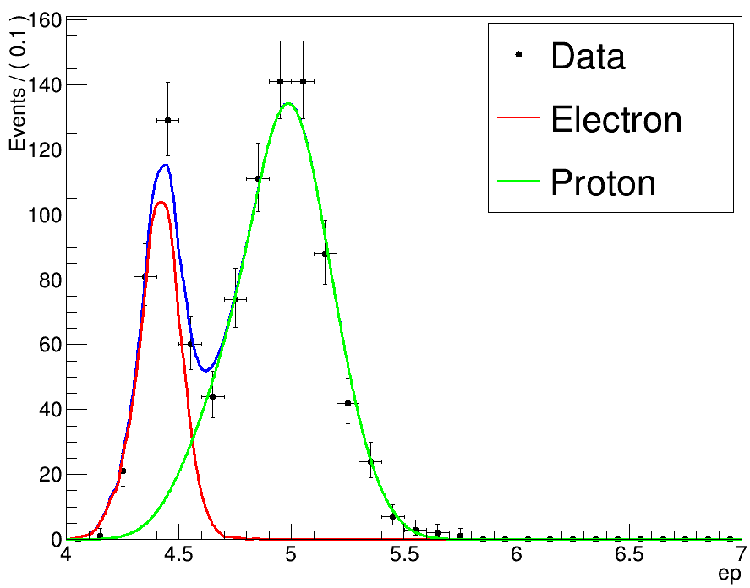
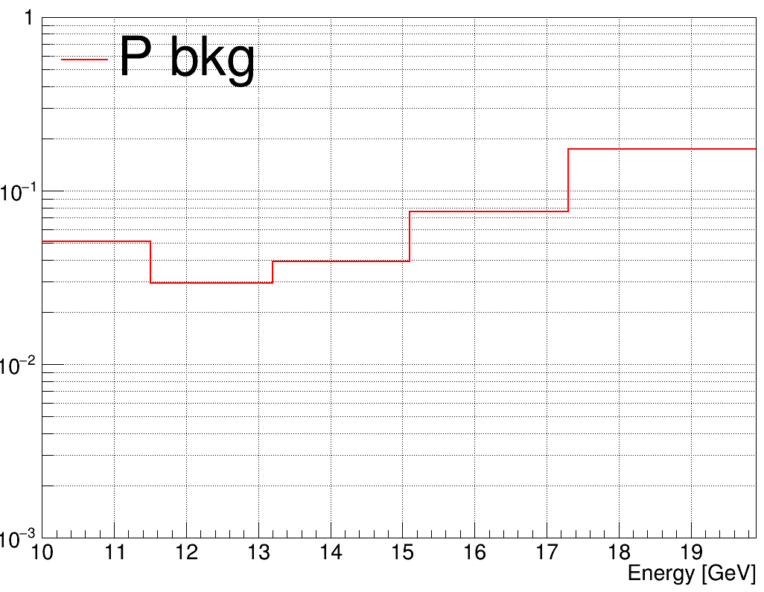
Ep discrimination

Slide 7
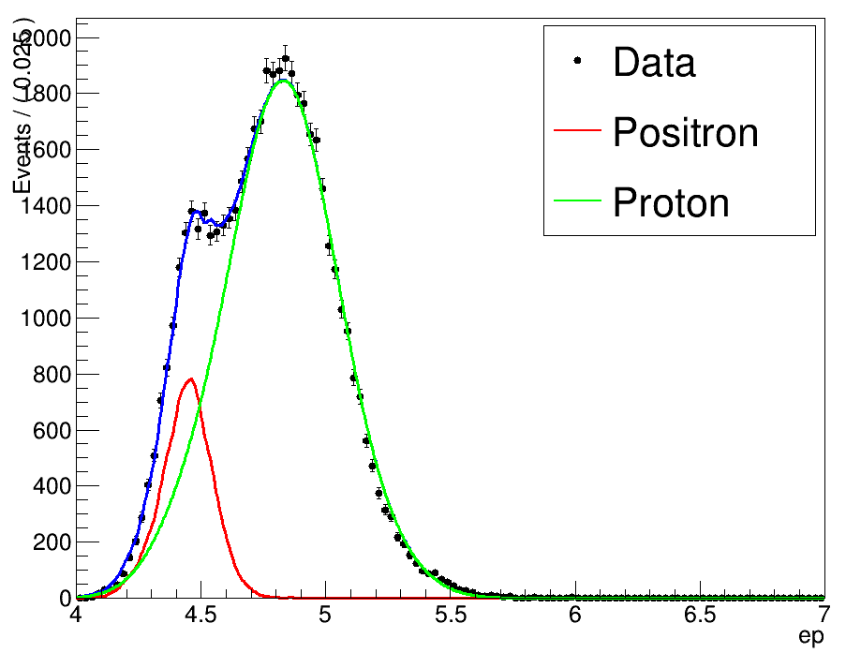
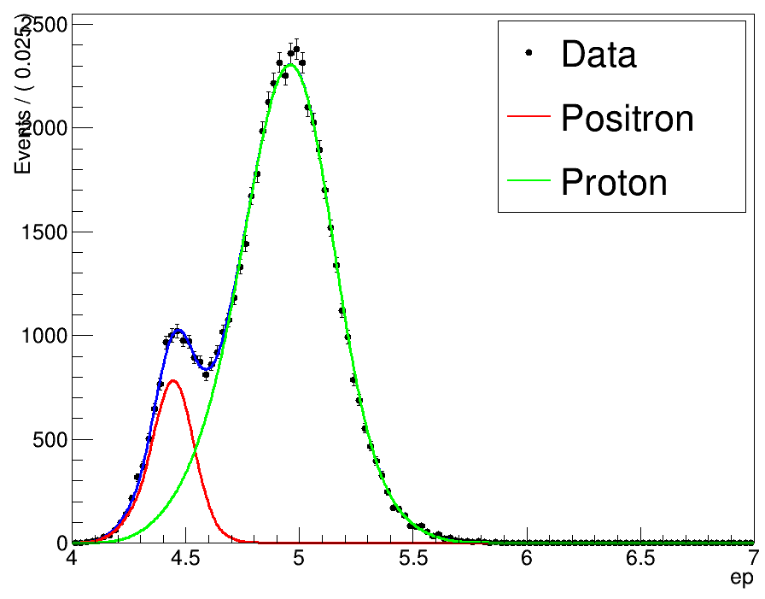
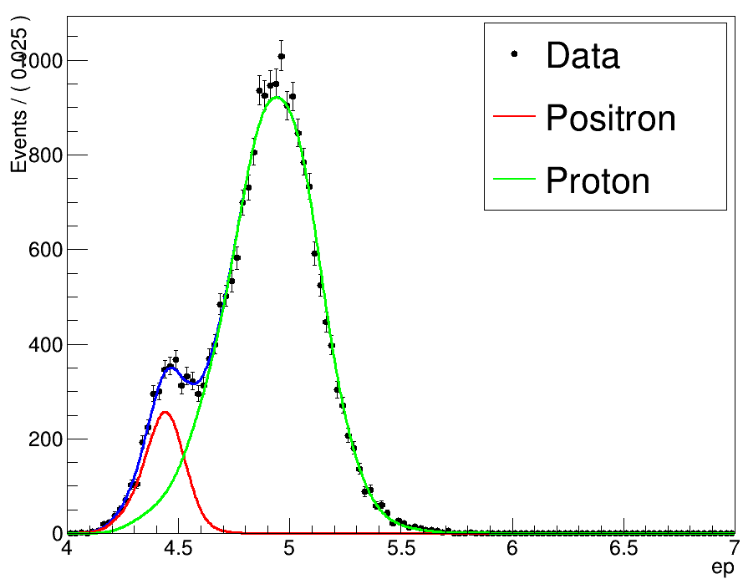
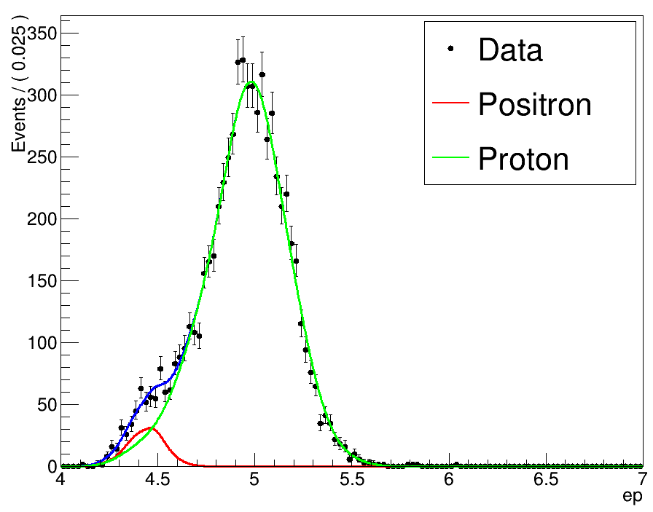
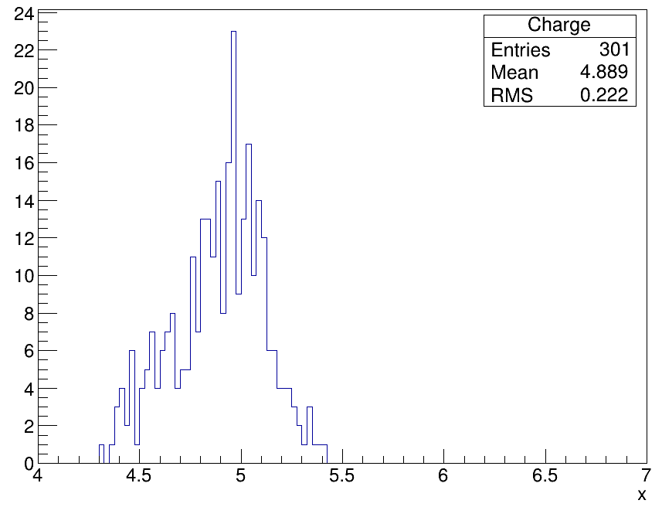
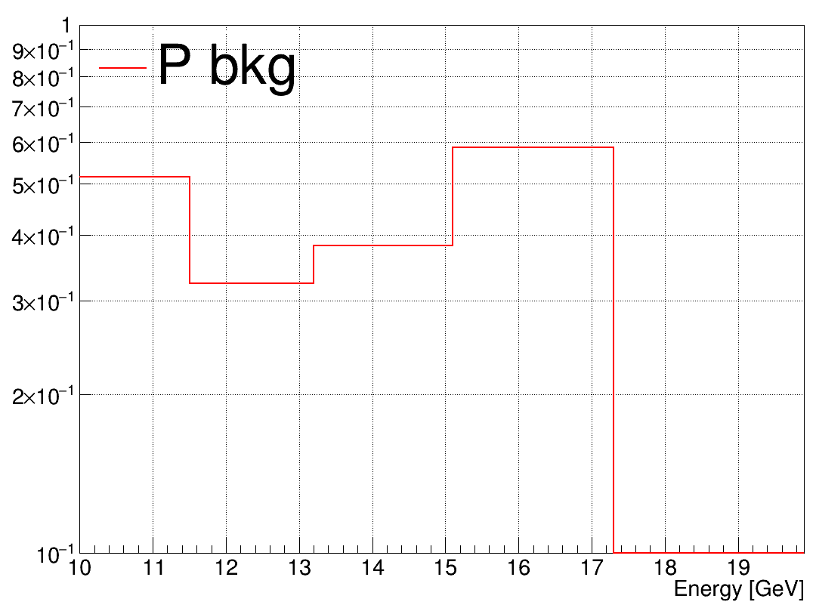
Ep discrimination

Slide 8
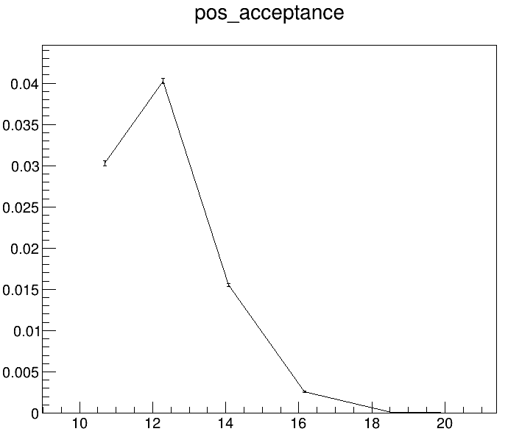
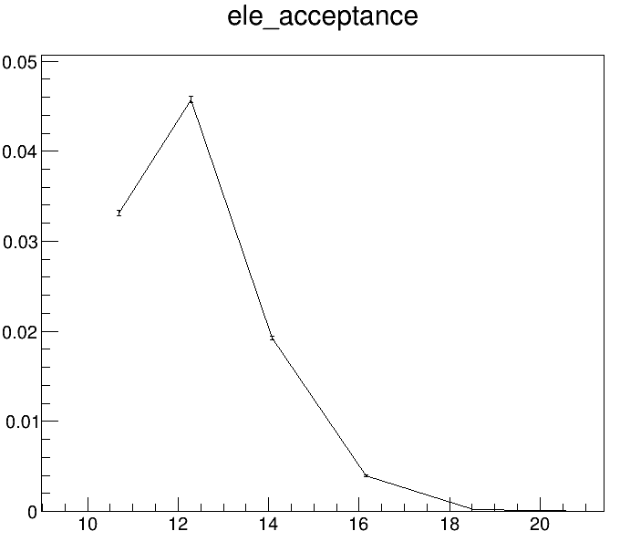
Acceptance

Slide 9
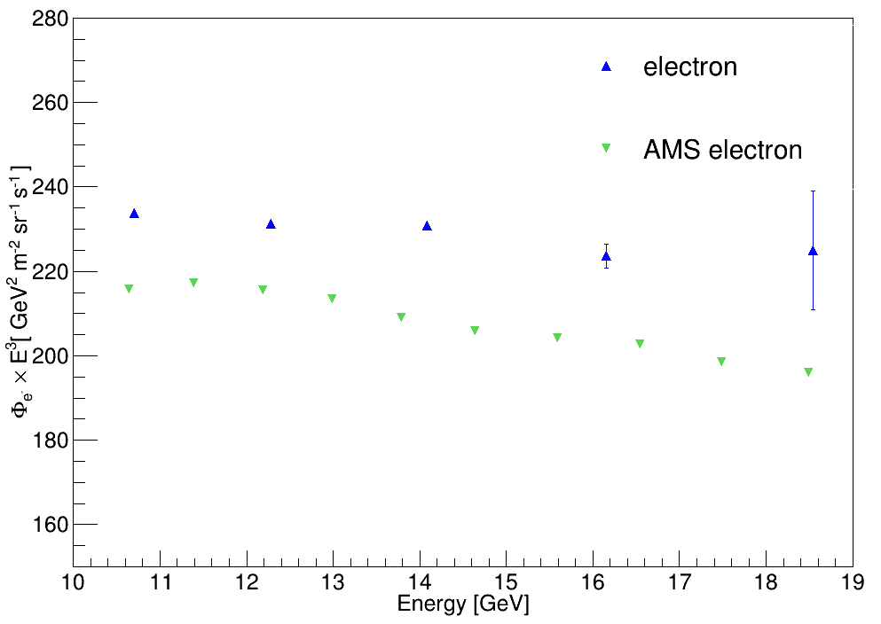
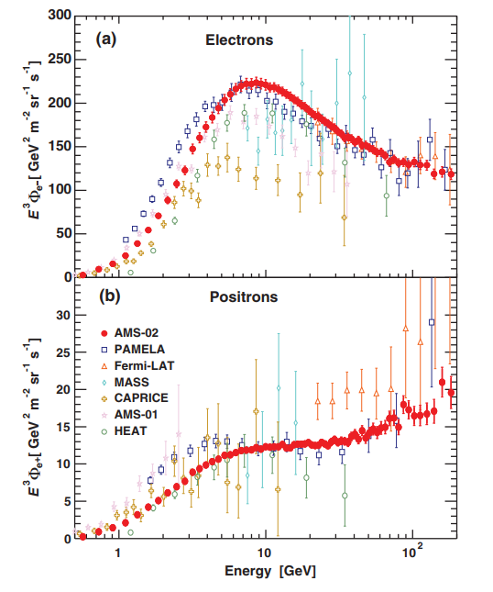
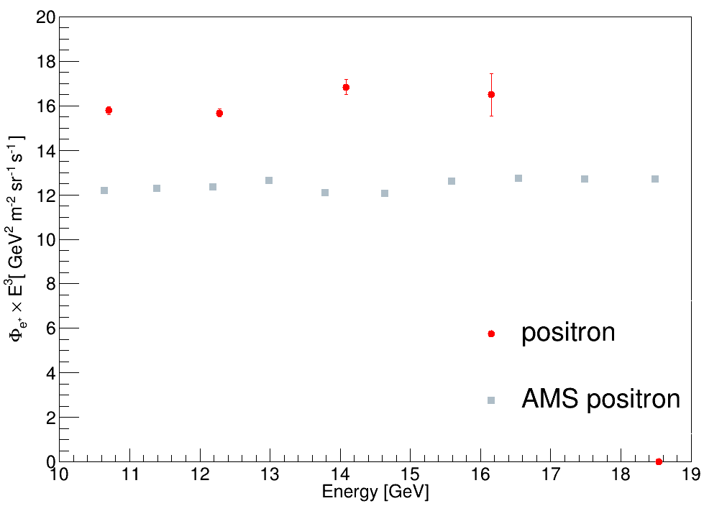
Flux
$$Exposure Time:1.335×{10}^{7} s$$

